Slide 1
LoginLens
Statistical Detection of Unusual Login Activity Using R
Probability and Statistics course project
[Student name] | [Registration number]
[Department] | [Institution]
[Faculty guide] | [Academic year]
Notes:
Introduce yourself and the project in one sentence: a statistical detector of unusual login activity, built in R and Shiny, evaluated on synthetic data. Replace the bracketed placeholders before presenting.

Slide 2
Abstract and motivation
• Whether a login is unusual depends on the user: 3 a.m. is normal for some, suspicious for others
• LoginLens learns each user's own baseline, then scores later events with explainable statistical rules
• Three evidence sources: login-hour rarity, daily-frequency z-score, failed-login bursts
• Evaluated on synthetic data with injected anomalies, using a confusion matrix
• A flag means "statistically unusual" - never "confirmed attack"
LoginLens | synthetic data only | 2
Notes:
Unusual is relative to the person. The detector learns each user's habits from a baseline period, then scores a later evaluation period. All data are synthetic, so results show how the method behaves, not how real systems behave.

Slide 3
Problem statement
• Given: a history of login events (user, time, success or failure)
• Find: new events whose hour, daily count or failure pattern is statistically unusual for that user
• Explain: show the reason each event was flagged
• Measure: how many flags are correct (precision) and how many real anomalies are found (recall)
• Constraint: real login data is private, so use synthetic data with known anomalies
LoginLens | synthetic data only | 3
Notes:
State the problem precisely: identify events that are improbable relative to that user's own past, explain why, and measure correct and incorrect flags.

Slide 4
Aim and objectives
• Aim: a transparent, tested statistical detector with an interactive dashboard
• 1. Generate reproducible synthetic data with user-specific behaviour and injected anomalies
• 2. Estimate per-user baselines from a baseline period only (no leakage)
• 3. Score evaluation events with three rules and three threshold profiles
• 4. Evaluate with TP, FP, TN, FN, precision, recall, specificity, accuracy, F1
• 5. Build the Shiny dashboard and an automated test suite
LoginLens | synthetic data only | 4
Notes:
Walk through the five objectives; each maps to a part of the repository.

Slide 5
Dataset and synthetic data generation
Property | Value
Total events / users | 3179 / 25
Baseline (days 1-30) | 1512 events, no anomalies
Evaluation (days 31-60) | 1667 events
Injected anomalies | 93 (5.6% of evaluation)
Types | unusual hour 30, high frequency 29, failed burst 34
Seed | 42 (reproducible)
• Per-user preferred hour, hour spread, daily rate
• Over-dispersed daily counts (negative binomial)
• 10% benign random-hour logins
• 1% benign failure streaks before a success
• Labels: evaluation only
LoginLens | synthetic data only | 5
Notes:
All numbers on this slide are measured from data/login_events.csv. Emphasise benign noise: ten percent random-hour logins and one percent mistyped-password streaks, so normal behaviour sometimes looks unusual.

Slide 6
Statistical concepts and the z-score
• Daily-frequency z-score for the k-th login of a user-day:
z = min( (k − mean) / max(sd, 1) , 10 )
• mean, sd: user's daily login counts over the baseline days (zero days included)
• max(sd, 1) avoids division by zero; cap 10 keeps scores finite
• Measured example: user U16, mean 1.97, sd 1.54; 10th login of a day gives z = 5.21
• Hour rarity: P(h) = ((K n)h + α) / (N + 24α), circular kernel; flag if P(h) < r/24
• Failed bursts: failures in the last 10 minutes ≥ b
• Caution: counts are skewed integers, so the normal-based z-score is a heuristic
LoginLens | synthetic data only | 6
Notes:
Explain the z-score in words: how many standard deviations above the user's average. Then state the floor and cap. Mention the worked, measured example.

Slide 7
System workflow and architecture
Synthetic generator
R/generate_data.R
login_events.csv
baseline | evaluation
fit_baseline()
baseline rows only
compute_features()
hour, z, burst
Shiny dashboard
app.R (4 tabs)
Flags, scores,
reasons (no labels)
apply_thresholds()
relaxed|balanced|strict
Ground-truth labels
(evaluation only)
evaluate.R
confusion matrix, metrics
LoginLens | synthetic data only | 7
Notes:
Trace the flow left to right. The key point is that ground-truth labels only enter at the evaluation step.

Slide 8
Detector implementation in R
Function | Role
fit_baseline() | Per-user hour probabilities and daily mean/sd from baseline rows only
compute_features() | Uses only event_id, user_id, timestamp, status; hour probability, running z, failure count
apply_thresholds() | Score S = max(ratios); flag if S ≥ 1; reason text
confusion_metrics() | TP, FP, TN, FN and metrics; NA for zero denominators
threshold_profiles() | relaxed r=0.10, z=3.5, b=6; balanced 0.20, 3.0, 4; strict 0.30, 2.5, 3
• Edge cases handled: zero variance, <20 baseline events (pooled profile), missing and empty input, NA metrics
LoginLens | synthetic data only | 8
Notes:
Name the four functions and what each consumes. Note compute_features only selects four columns, so labels cannot leak; a test proves it.

Slide 9
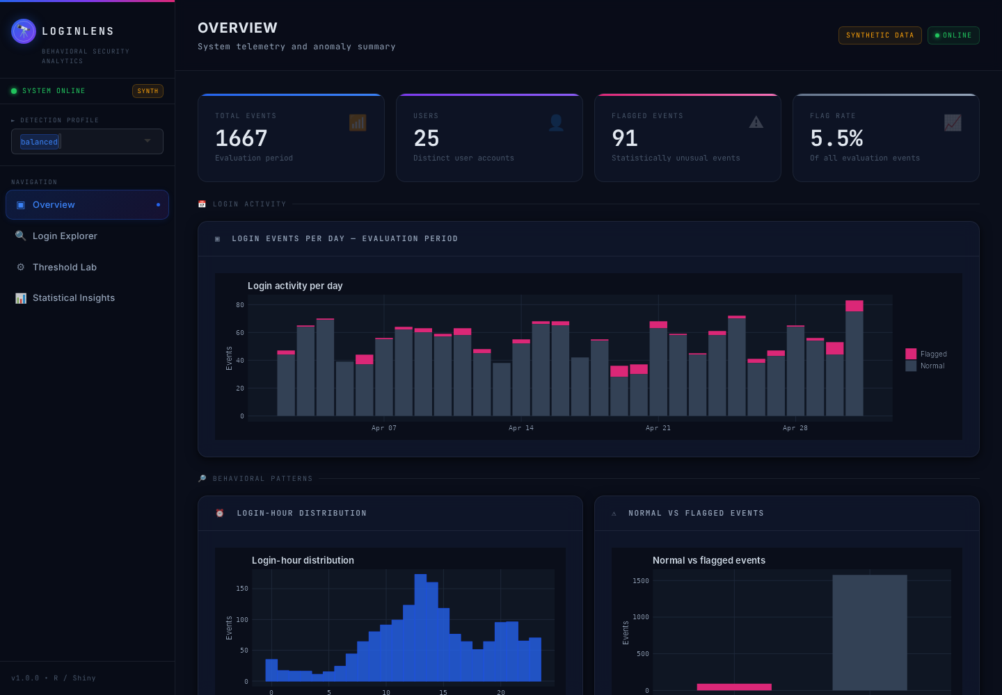
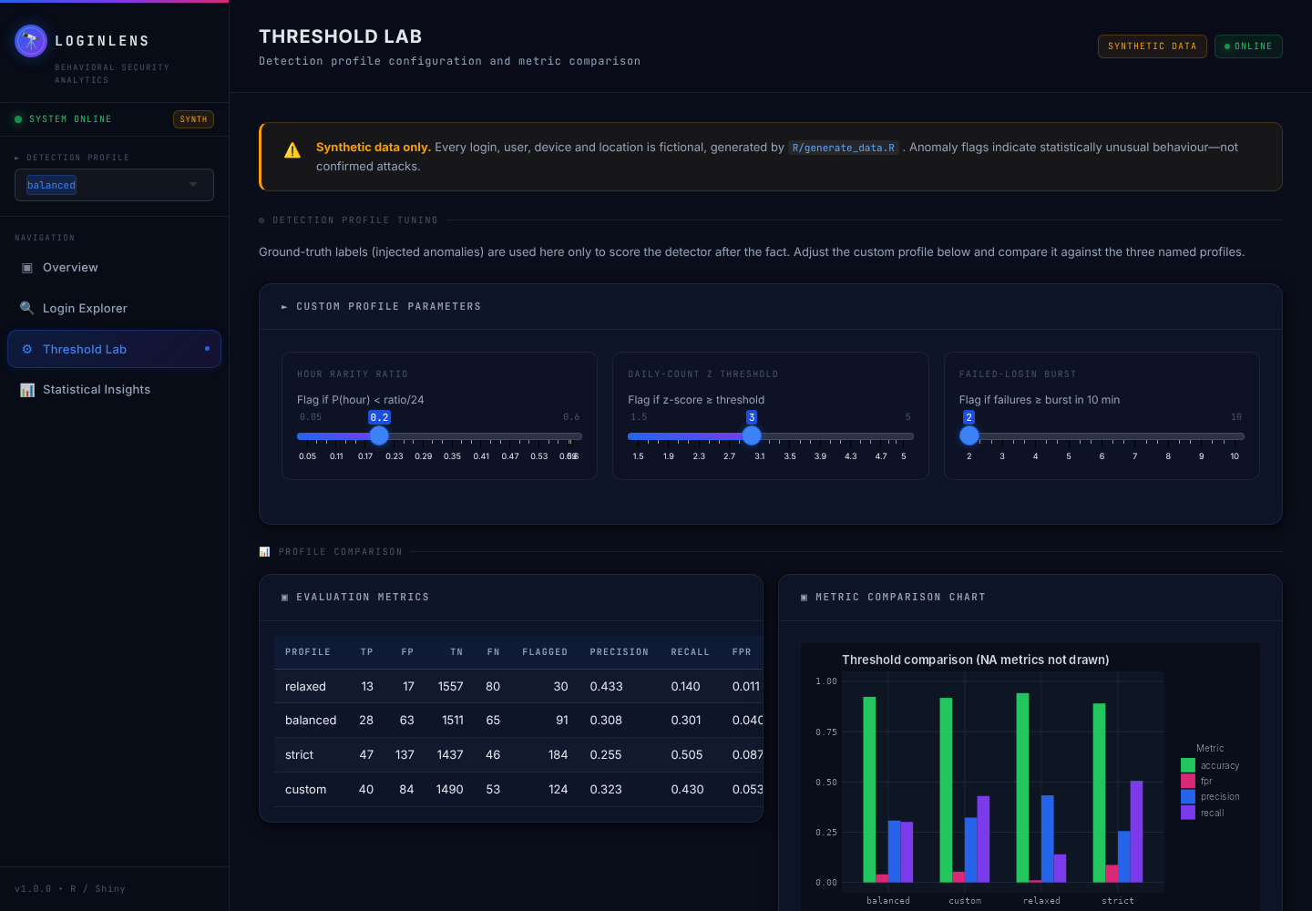
Dashboard interface and main features
• Overview: counts and charts
• Explorer: filters, reasons, CSV export
• Threshold Lab: profiles and custom sliders
• Insights: formulas and limitations
LoginLens | synthetic data only | 9
Notes:
Screenshots are real captures of the running app. Mention the four tabs, the profile selector, filters, CSV export and the Threshold Lab sliders.

Slide 10
Experimental evaluation and metrics
Profile | TP | FP | TN | FN | Precision | Recall | FPR | F1
Relaxed | 13 | 17 | 1557 | 80 | 0.433 | 0.140 | 0.011 | 0.211
Balanced | 28 | 63 | 1511 | 65 | 0.308 | 0.301 | 0.040 | 0.304
Strict | 47 | 137 | 1437 | 46 | 0.255 | 0.505 | 0.087 | 0.339
• Precision = TP/(TP+FP); Recall = TP/(TP+FN); FPR = FP/(FP+TN)
• Specificity = 1 − FPR; F1 = 2PR/(P+R); zero denominator → NA
• Measured on 1,667 evaluation events (93 injected); ground truth used only after detection
• Accuracy 0.890–0.942 is high because ~94% of events are normal
LoginLens | synthetic data only | 10
Notes:
Measured on the seed-42 dataset, evaluation period only. Define each metric once, aloud. Stress that accuracy is dominated by normal events.

Slide 11
Results and interpretation
• Relaxed → strict: recall 0.140 → 0.505, precision 0.433 → 0.255
• Strict flags 184 events to catch 47 of 93; 137 are false alarms
• Same ordering in the mean of 20 other seeds
• Subtle anomalies are often missed (by design)
• Simulated data: not evidence about real systems
LoginLens | synthetic data only | 11
Notes:
The chart is a native PowerPoint chart built from the measured values. Interpretation: the trade-off is clear; absolute performance is modest because the anomalies were deliberately subtle. The 20-seed means show the same ordering.

Slide 12
Limitations and future scope
• Limitations
  – Synthetic data; anomalies injected by the same author
  – Normal z-score on skewed, over-dispersed counts is a heuristic
  – Stable-behaviour and clean-baseline assumptions; no drift handling
  – Three rules combined with OR raise false alarms; device and location unused
• Future scope
  – Poisson / negative-binomial tail probabilities; rolling baselines
  – Device and location novelty; thresholds tuned on validation data
  – ROC / precision-recall curves; tests on anonymised public data
LoginLens | synthetic data only | 12
Notes:
Be upfront: synthetic data, normal approximation for counts, stable-behaviour assumption. Future work is about better count models and real data.

Slide 13
Conclusion
• Explainable statistical rules detect unusual logins relative to each user's own baseline
• Baseline/evaluation separation and label isolation are built in and tested
• Stricter thresholds raised recall and lowered precision on this synthetic data
• Results are simulated; the value of the project is the method and its honest evaluation
• Delivered: R/Shiny app, reproducible data, automated tests, report
LoginLens | synthetic data only | 13
Notes:
Summarise: a tested, explainable detector; clear trade-off; honest limits.

Slide 14
Questions?
Thank you
Notes:
Invite questions. See LoginLens_Viva_Preparation.docx for prepared answers.

