Slide 1
LoginLens
Statistical detection of unusual login activity in R (synthetic data)

Slide 2
Problem and goal
Unusual logins (odd hours, bursts, spikes) are worth reviewing
Goal: transparent statistical rules, not a black box
All data synthetic; a flag means “unusual”, not “attack”

Slide 3
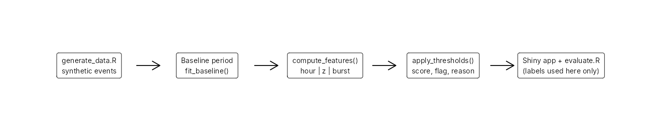
Workflow

Slide 4
Synthetic data
3179 events, 25 users, 60 days (seed 42)
30-day baseline (clean) + 30-day evaluation (93 injected anomalies)
Normal noise: random-hour logins, mistyped-password streaks

Slide 5
Rule 1: login-hour rarity
Smoothed per-user hour probabilities, circular kernel (23:00 ~ 00:00)
Flag if P(hour) < r/24

Slide 6
Rule 2 and 3: frequency and bursts
z = (k - mean)/max(sd, 1), capped at 10
Burst: failures in trailing 10 minutes
Score = max of normalised components; flag if >= 1

Slide 7
Threshold profiles
relaxed (r 0.10, z 3.5, b 6), balanced (0.20, 3.0, 4), strict (0.30, 2.5, 3)

Slide 8
Results
profile | TP | FP | TN | FN | precision | recall | fpr
relaxed | 13 | 17 | 1557 | 80 | 0.433 | 0.140 | 0.011
balanced | 28 | 63 | 1511 | 65 | 0.308 | 0.301 | 0.040
strict | 47 | 137 | 1437 | 46 | 0.255 | 0.505 | 0.087

Slide 9
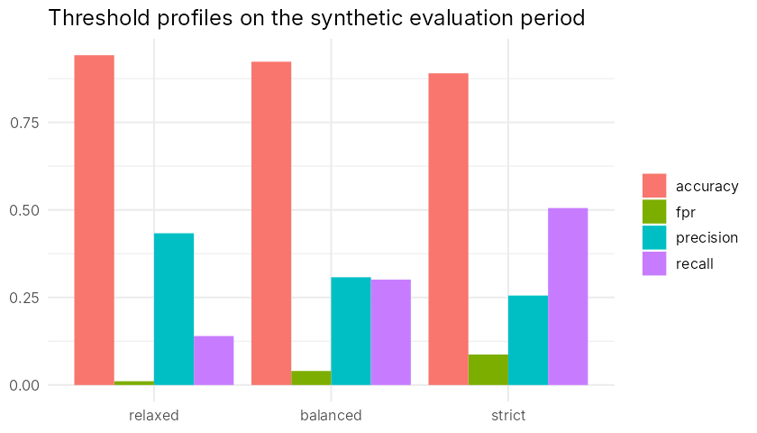
Threshold comparison

Slide 10
Limitations
Simulated data; self-injected anomalies
Normal approximation for counts; stable-habit assumption
Subtle anomalies are missed; results are not real-world evidence

Slide 11
Testing and app
100 automated expectations, all passing
Shiny app: Overview, Login Explorer, Threshold Lab, Insights

