Slide 1
Latency-Optimal Tactile Reflex System
AI-assisted, deterministic FPGA-based tactile controller for robotic gripper actuation
Terasic DE2-115 | Verilog design, verification and AI/ML evaluation

Slide 2
AI advises, FPGA protects
AI/ML path: advisory
FPGA path: authoritative
The rule
Classifies contact, grip condition and force category. Predicts excessive force. Runs on a laptop over a UART link. May be wrong, late or absent.
ADC, fixed-function LUT, Safety Governor, PWM. No CPU and no software loop in the critical reflex path. Bounded, measurable latency.
If a hard limit is violated, the Governor overrides the AI result and enters the safe state. The AI can only lower the command, never raise it.

Slide 3
Research gaps
Research need | How this work responds
Keep ML out of the safety-critical path | Hardware Governor enforces limits; AI can only lower the command
Separate sensing, inference and actuation latency | T_FPGA, T_ML and jitter are reported separately
Reproducible verification of AI-override behaviour | Open Verilog, 175 directed checks, replay with an adversarial AI
Low-cost, open tactile reflex platforms | Commodity parts, open RTL and Python pipeline
Next research step: validation with recorded sensor data across objects.

Slide 4
Novel contributions
Advisory-only AI
Predictive pre-limit
Self-checking AI link
AI can only lower the command; checked with an always-wrong AI.
Fixed-function slope predictor trips ahead of the hard limit, no ML.
Checksum, class check and heartbeat; falls back to FPGA-only.
Instant fail-safe
Separated latency
Low-cost and open
PWM killed on the next clock; latched NC e-stop; 4 to 5 cycle path.
T_FPGA, T_ML and jitter reported apart, never summed.
DE2-115, commodity sensor, laptop AI, open RTL and Python.
Technical description only; not a prior-art or patentability conclusion.

Slide 5
System architecture
FPGA (Cyclone IV E): safety-critical reflex path
Sensor + ADC
Fixed LUT
Safety Governor
PWM
Driver
Actuator
advisory class over UART
Features
Decision tree
Hard limits are checked first; AI advice second.
Laptop (UART link): AI/ML, logging, visualization

Slide 6
How it works
Reflex path (FPGA, authoritative)
1 Sense
2 Condition
3 LUT
4 Govern
5 Drive
FSR voltage read by the SPI ADC
Range and frame checks, no filter
Force code to command, fixed table
Hard limits, predictor, AI cap
PWM, killed on the next clock
104 cycles per frame
1 cycle
1 cycle
1 cycle
1 cycle
AI path (laptop, advisory)
Telemetry
Decision tree
AI packet
Force sent to the laptop about every 1 ms
Class 0 to 3 in about 7 us
Checksum and heartbeat checked; ignored if bad
Example: force passes the limit while the AI says normal grip. The Governor trips and PWM is low 4 clocks (80 ns) after the ADC sample.

Slide 7
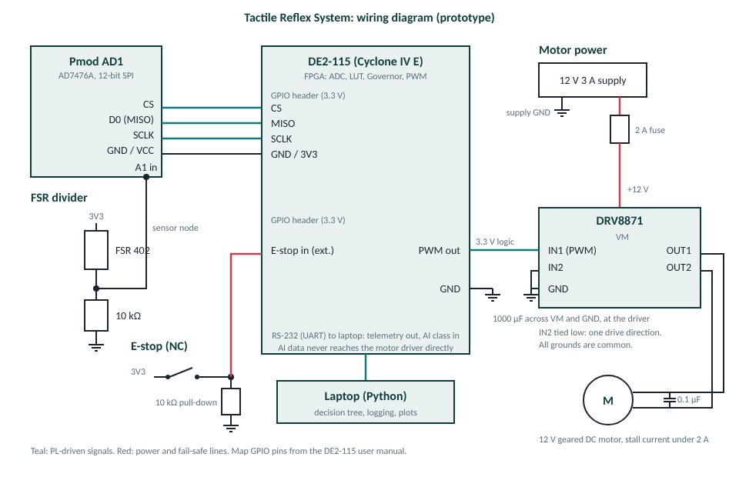
Circuit diagram
Sensing
FSR divider into SPI ADC.
Actuation
PWM to driver, fused supply.
Fail-safe
NC e-stop, common ground.

Slide 8
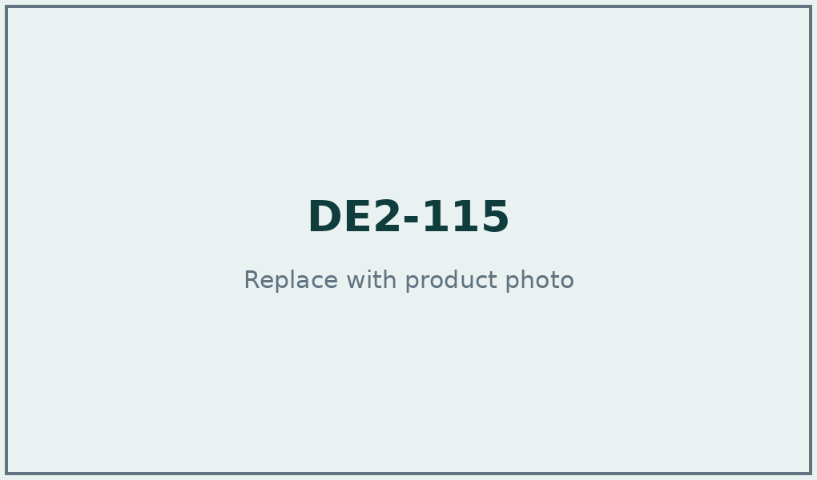

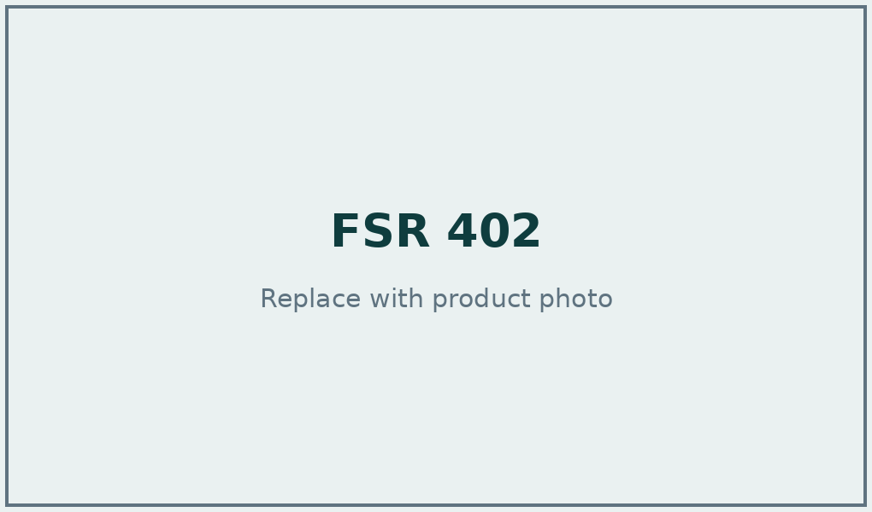
Hardware: control and sensing
DE2-115
Pmod AD1
FSR 402
Cyclone IV E EP4CE115 FPGA
50 MHz clock, RS-232 port
40-pin 3.3 V GPIO header
2 x AD7476A, 12-bit
Up to 1 MSPS, SPI
Wired to the GPIO header
Interlink force-sensing resistor
12.7 mm round active area
Voltage divider with 10 kOhm

Slide 9
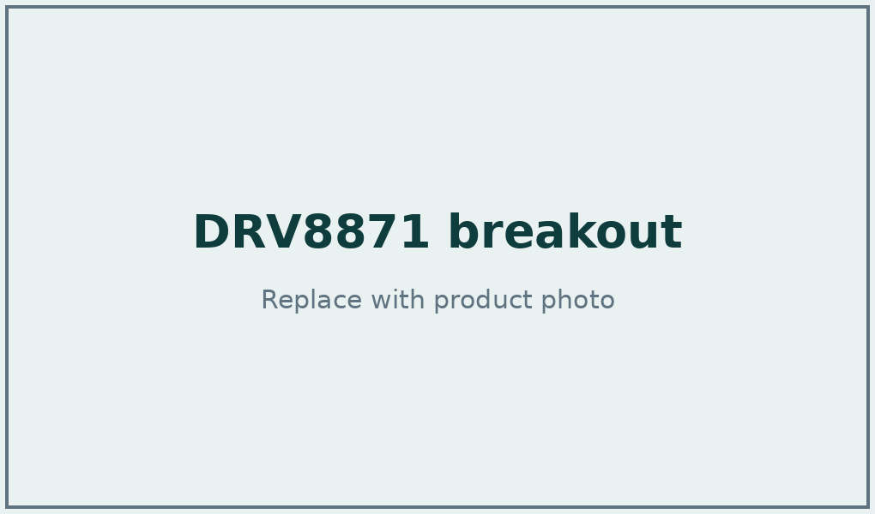


Hardware: actuation and safety
DRV8871 breakout
Geared DC motor
E-stop and supply
Single H-bridge, PWM input
6.5 to 45 V, 3.6 A peak
Current limit, thermal trip
12 V, stall below 2 A
Driven by the DRV8871
Gripper mechanism load
NC mushroom, 22 mm
12 V 3 A supply, 2 A fuse
1000 uF bulk capacitor

Slide 10
Safety Governor rules
1 Maximum force
2 Sensor fault
3 Emergency stop
Force at or above FORCE_MAX trips the safe state, with release hysteresis.
Persistent invalid readings or a silent ADC latch a fault.
Fail-safe input: an open contact or cut wire stops the output.
4 Invalid ADC value
5 Safe output state
6 AI override
Frame errors and railed readings are rejected immediately.
PWM forced low on the next clock, not at the next period.
AI is ignored when invalid or when any hard limit trips.

Slide 11
Verilog modules
Module | Function | Checks passed
adc_interface | SPI frame reader, 12-bit | 17
input_conditioning | Range and frame validity | 9
force_lut | Fixed transfer function | 12
safety_governor | Hard limits and AI override | 22
pwm_generator | 12.2 kHz PWM, instant kill | 8
fault_handler | E-stop and sensor faults | 13
ai_control_interface | AI result and heartbeat check | 9
UART link | AI packets in, telemetry out | 15
tactile_reflex_top | Full path integration | 44
de2_115_top | Board wrapper: keys, LEDs, UART | 18

Slide 12
Verification results
175 / 175
Cases covered
No, light and normal contact
High and excessive force
AI class changes and AI failure
Emergency stop and sensor failure
Reset and LUT boundaries
PWM duty and instant kill
Predictive pre-limit vs model
directed checks pass across 12 testbenches
2 x 1,800
replayed vectors with zero safety violations

Slide 13
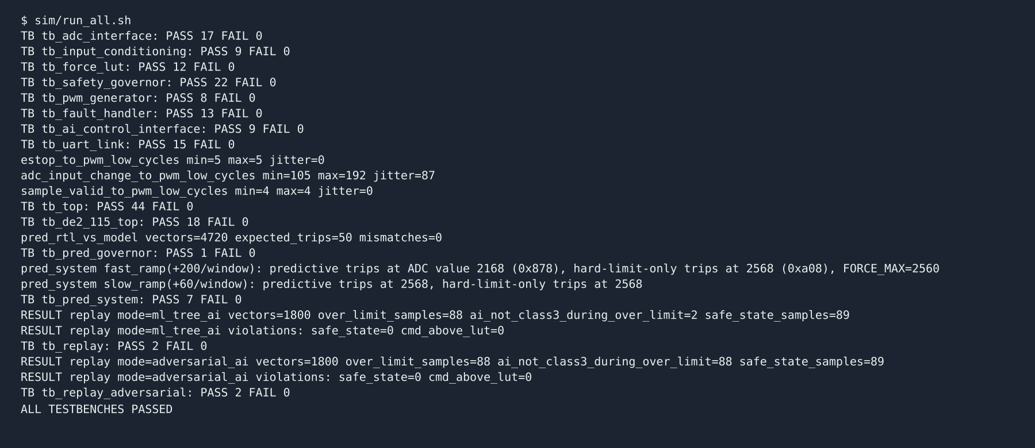
Simulation console output

Slide 14
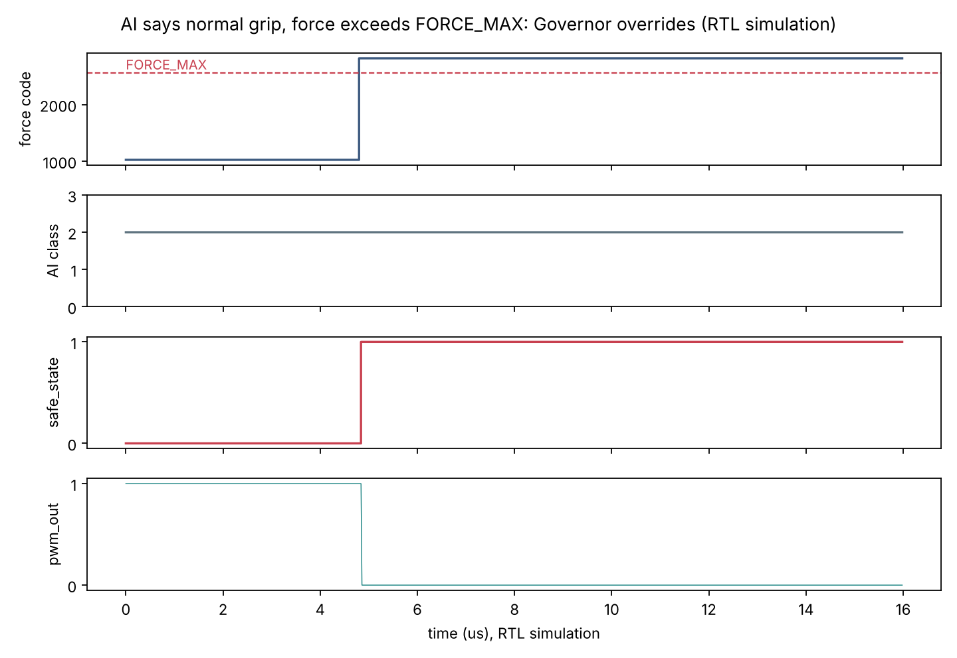
AI overridden by the Governor
AI says class 2
Normal grip, valid, steady.
Force passes FORCE_MAX
Governor trips the safe state.
PWM goes low
AI input ignored.
RTL simulation, 50 MHz clock

Slide 15
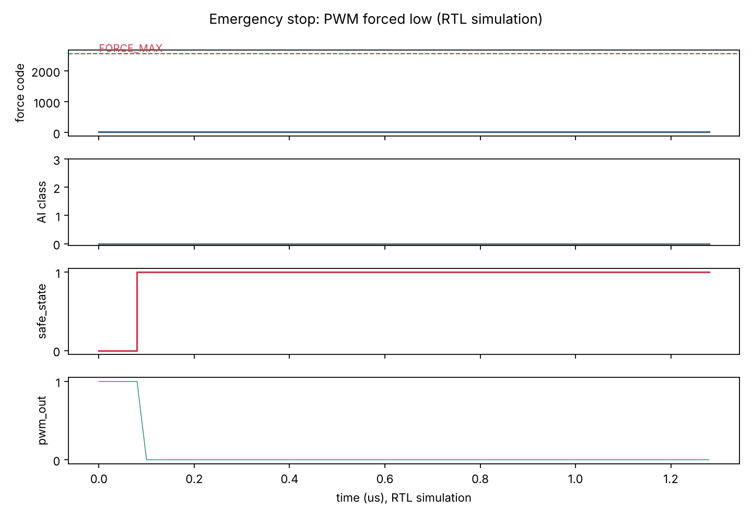
Emergency stop response
E-stop asserted
Input synchronised, then latched.
5 clock cycles
From input edge to PWM low.
Latched
Cleared only by operator.
RTL simulation, 50 MHz clock

Slide 16
FPGA path latency
80 ns
100 ns
ADC sample to PWM low: 4 clock cycles at 50 MHz, jitter 0
E-stop input to PWM low: 5 clock cycles, jitter 0
2.08 us
2.10 - 3.84 us
ADC frame time: 104 cycles at 8.33 MHz SCLK
Input change to PWM low; jitter 1.74 us from ADC frame phase
RTL simulation, 50 MHz clock, behavioural ADC model. T_FPGA is reported separately from T_ML.

Slide 17
Predictive pre-limit
SIMULATED DATA
5.7 ms
6.5%
mean lead before FORCE_MAX on 25 of 25 crossing test episodes
early trips on test episodes that never reach the limit (10 of 155)
0 / 4,720
2168 vs 2568
mismatches between the RTL and the Python reference model
ADC value at trip on a fast ramp: predictive vs hard limit only (RTL)
force + 2 x (rise per 3 ms) >= FORCE_MAX, with a 150-count noise guard. Parameters chosen on training episodes.

Slide 18
Lightweight AI/ML model
SIMULATED DATA
Decision tree: depth 4, 16 leaves (scikit-learn)
Six features: force, previous force, rate of change, moving average, contact duration, last delta
420 training and 180 test episodes, split by episode
Labels come from the scenario that generated each episode
Class | Meaning
0 | No contact
1 | Light contact
2 | Normal grip
3 | Excessive force
Output maps to control states sent to the FPGA.

Slide 19
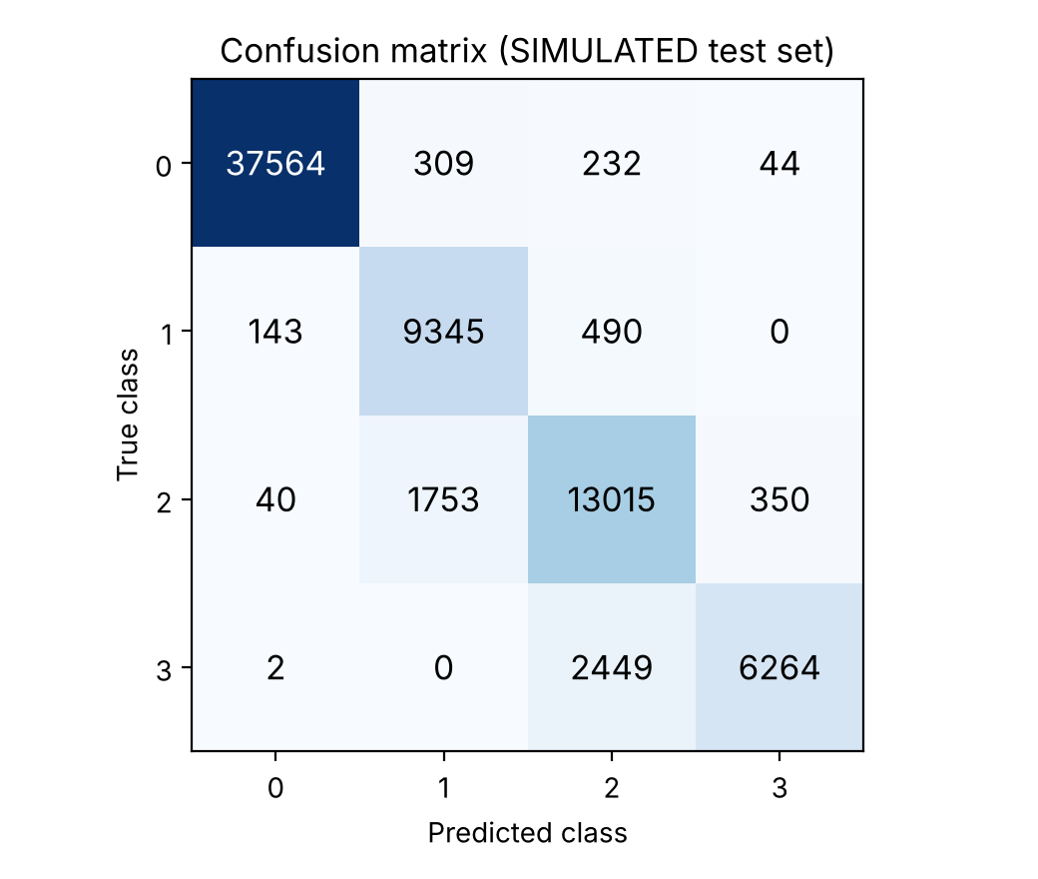
AI/ML evaluation
SIMULATED DATA
Class | Precision | Recall
0 | 0.995 | 0.985
1 | 0.819 | 0.937
2 | 0.804 | 0.859
3 | 0.941 | 0.719
91.9%
85.4%
accuracy
force-only baseline

Slide 20
AI inside the safety envelope
SIMULATED DATA
88 / 88
6.6 us
over-limit samples forced to the safe state while the AI always claimed normal grip
median T_ML per decision (p99 22.9 us), measured on the development host
Separate numbers
T_FPGA and T_ML are never added together. The safety claim rests on the FPGA path alone; the AI path adds higher-level information.

Slide 21
SDG alignment
SDG 9 Industry, Innovation, Infrastructure
SDG 8 Decent Work and Growth
Targets 9.5, 9.b: reproducible FPGA + AI reference design.
Targets 8.2, 8.8: hardware force limits for safer human-robot work.
SDG 3
SDG 12
SDG 2
SDG 4
SDG 10
Assistive and prosthetic grippers
Less damage to fragile goods
Gentle harvesting
Low-cost teaching platform
Affordable assistive devices
An enabling technology; it does not claim to achieve the goals.

Slide 22
National and international uses
National
International
Manufacturing and SME automation
Rehabilitation and assistive devices
Agriculture and food handling
Logistics and warehouses
Education and local R&D
Collaborative robotics (ISO 10218, ISO/TS 15066 as references)
Low-resource assistive devices
Hazardous remote handling
Global teaching and shared benchmarks

Slide 23
Distinctive technical features
1
Tactile sensing with AI/ML-assisted interpretation
2
Fixed-function FPGA tactile-to-actuation transfer
3
Independent hardware Safety Governor
4
No software control loop in the reflex path
5
Deterministic, bounded hardware response
6
AI result checked against hard limits
Technical description only; no legal or patentability conclusion.

Slide 24
Key findings
88 / 88
4 cycles
over-limit samples forced safe, even with an AI that always said normal grip
from ADC sample to PWM low, jitter 0; end-to-end time is set by the ADC frame
91.9% vs 85.4%
6.6 us
tree with dynamic features vs force-only baseline (simulated data)
median AI decision time; class 3 recall is 72%, so the hardware limit stays authoritative

Slide 25
Conclusion
A deterministic FPGA reflex path enforces the hard limits.
The AI path adds contact classification and can only lower the command.
175 directed checks and 3,600 replayed vectors confirm the override behaviour in simulation.

