Slide 1
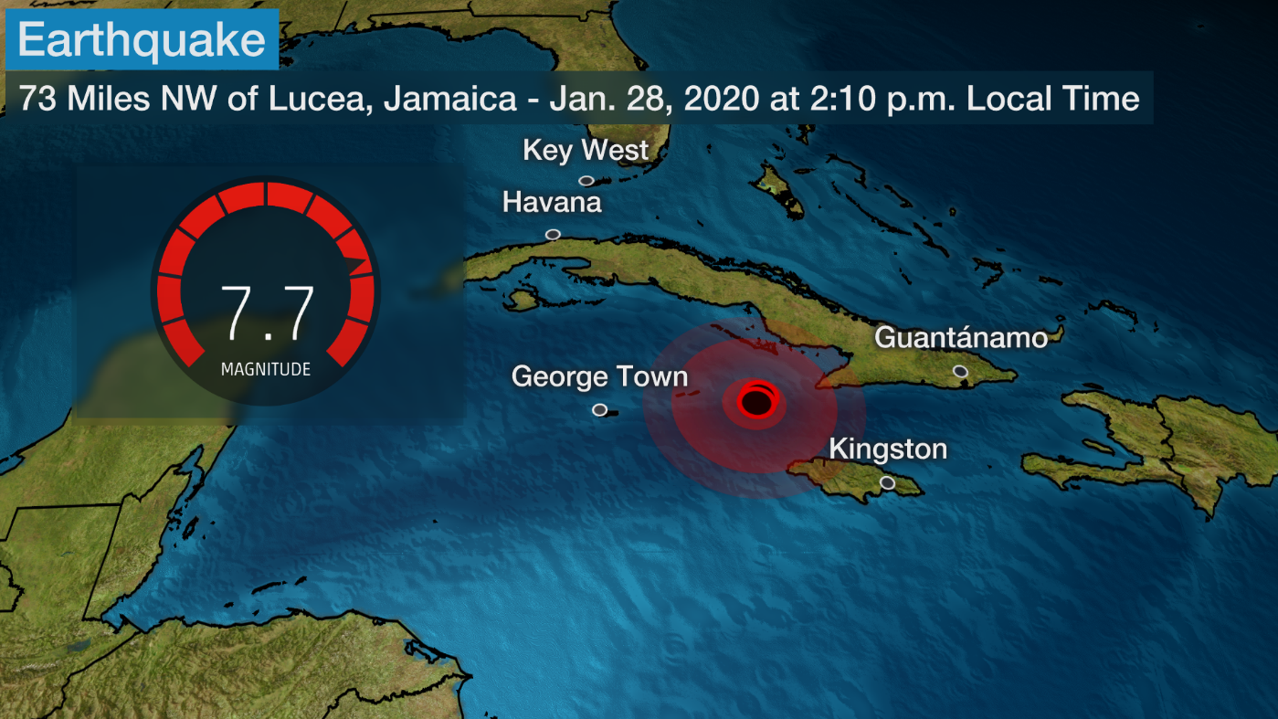
Global Earthquake Visualization
Project Team:
Shruti Jadhav
Sanjive Agarwal
Pierce Henderson
Aslam Momin

Slide 2
Project Purpose:
The goal is to understand the recurrence of earthquakes around the world
Create recognition of the destructive patterns of earthquakes worldwide
Ultimately, this will contribute towards the need to prepare for earthquakes
NOVA-Deadliest Earthquake

Slide 3
Coding Approach
Dataset has worldwide significant earthquake data from 2150 BC to 2019
Over 6000+ data points available
CSV file containing dataset will be converted to geojson file using a library, command line
Geojson file stored in Mongo database to facilitate data slicing and dicing
Data is plotted on a D3 Versor visualization, which consist of a world map with markers that represent earthquakes
Interactivity via layers for studying:
earthquake intensity/magnitude
level of destruction (number of casualties, year/month, and other factors
Chronology of earthquake occurrence
Earthquake frequency for active fault-line plates throughout the world

Slide 4
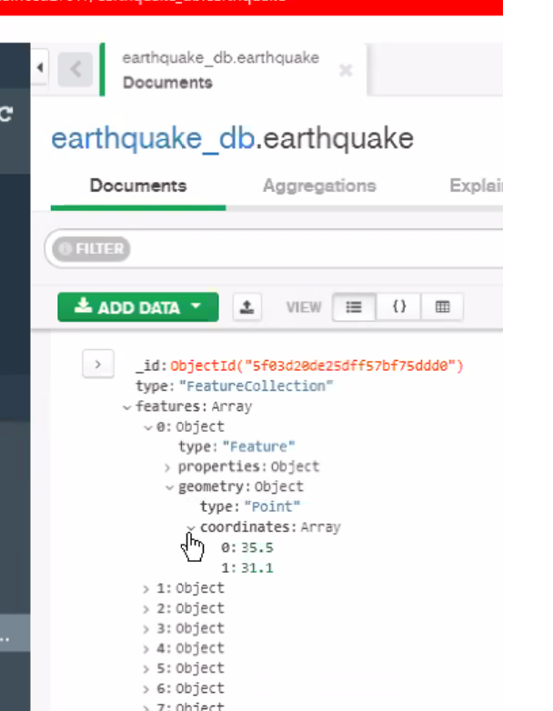
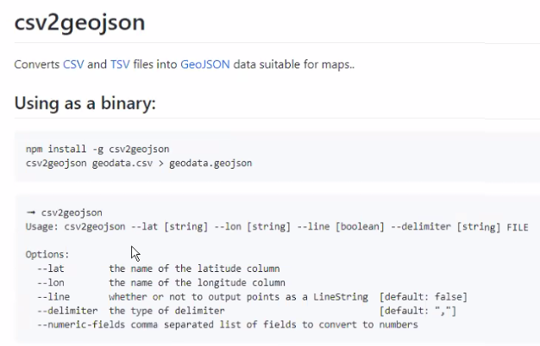
Coding Approach (cont.)
Artifacts:

Slide 5
Data, metadata …
Link to our CSV file - dataset:
https://www.kaggle.com/mohitkr05/global-significant-earthquake-database-from-2150bc
The dataset consists of over 5,700 earthquakes from 2150 BC to 2019.
Each record has information on the
date and time of occurrence
latitude and longitude
focal depth
Magnitude
maximum MMI intensity
It also includes geo-socio-economic data such as:
total number of casualties
Injuries
houses destroyed or damaged
Estimated economic damage estimates
It also includes whether the earthquake was associated with a tsunami or volcanic eruption.

Slide 6
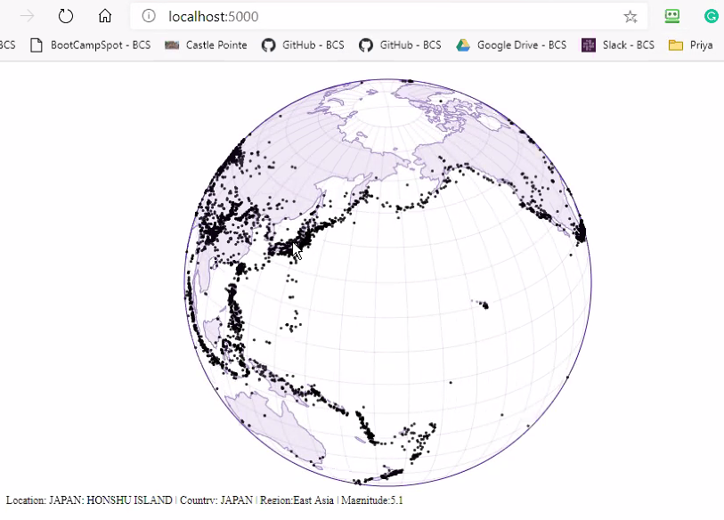
Final Visualization(s)
Our visualization looks like the following design:
The earthquakes will be represented
by markers on the map.
The user will be able to interact with the
visualization by dragging the cursor to
view the other sides of the earth,
and by using a dropdown menu to select different layers.
This is the link to our GitHub repository: https://github.com/sanjive/Earthquake-Vizualization

Slide 7
Project Challenges

Slide 8
Analysis Summary

