Slide 1

Car Sales
by Sanjiv Kumar Pandey

Slide 2
Analyze Car Sales
We have been given car sales data since 1953 till 2016 and asked to analyze its sales.

Slide 3
Data Cleanup
Mileage values have high outlier ranges from 0 to 999.
In actual mileage is between 1 to 35.
Engine volume missing values have been replaced with its median.
Price group has been added to identify the range of cost.
Mileage group has been added to id

Slide 4
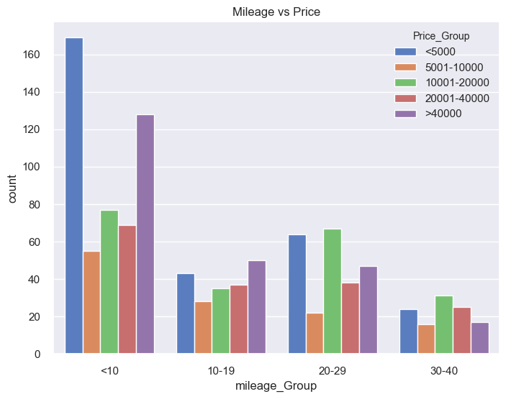
Graphs
Tracked in Google Analytics

Slide 5
Conclusion

