Slide 1
Quality of Life Analysis
Power BI Dashboard Project

Slide 2
Project Overview
Analyze global quality of life indicators including GDP, safety, health expenditure, pollution (AQI), and happiness to understand living standards across countries.

Slide 3
Dataset Description
• 15,001 rows of data
• Country and Year information
• GDP per Capita
• Life Expectancy
• Safety Index
• Happiness Score
• PM2.5 Pollution / AQI

Slide 4
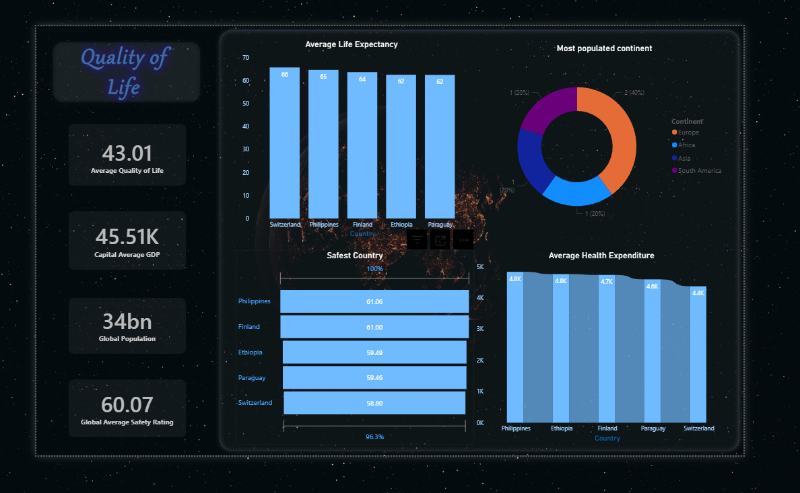
Global Overview Dashboard

Slide 5
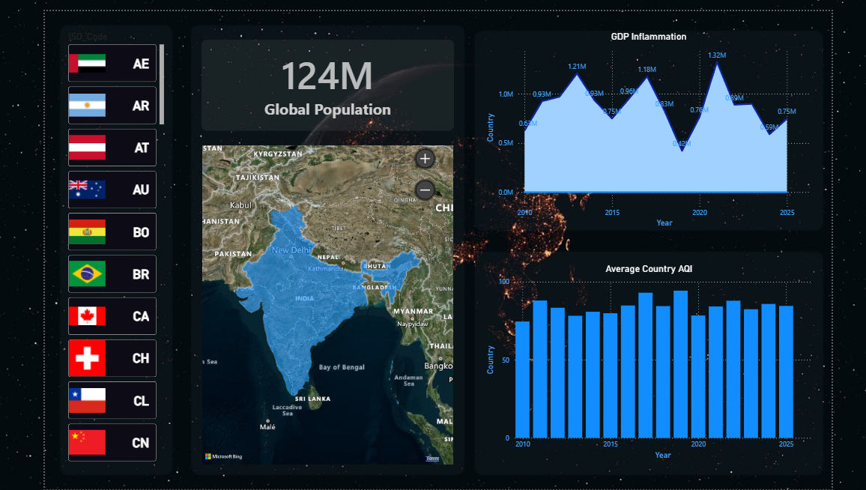
Country Analysis Dashboard

Slide 6
Key Insights
• Countries with higher GDP per capita often show higher life expectancy.
• Pollution levels impact quality of life and health indicators.
• Safety index and happiness score are strong indicators of living standards.
• Interactive filtering allows country-level analysis.

Slide 7
Conclusion
The dashboard provides a comprehensive view of global living conditions.
It helps identify patterns between economic, environmental, and social factors.

