Slide 1
Department of
Computer Science & Engineering
RL-Based Self-Adapting Virtual Keyboard for Personalized Typing
Amrita School of Computing
Amrita Vishwa Vidyapeetham, Chennai Campus
Student Members
1: Bhargav – CH.SC.U4AIE23037
2: Sanjjey A – CH.SC.U4AIE23050
3: Vaishnavi S- CH.SC.U4AIE23059
4: Veena Sundari A – CH.SC.U4AIE23060
Faculty Details
Dr. R Prasanna Kumar
Associate Professor, Department of Computer Science and Engineering, School of Computing, Chennai

Slide 2

Problem Statement
Problem Statement
Problem Identification
Significance
Objective
Scope
Gantt Chart
Methodolgy
Architecture Diagram
Results & Discussions
Conclusion
• Modern touchscreens lack mechanical switches and physical key boundaries, forcing users to rely exclusively on visual monitoring. Consequently, anatomical differences, radial thumb reach, hand fatigue, and motor tremors induce severe spatial touch drift and adjacent-key errors.
• Conventional virtual keyboards rely on rigid rectangular bounding boxes and post-hoc dictionary autocorrect. Autocorrect frequently mangles technical jargon, proper nouns, and multilingual phrases, trapping users in tedious backspace-and-retype cycles.
• Proposed Solution: An intelligent, on-device virtual keyboard powered by continuous Reinforcement Learning and Laguerre-Voronoi Computational Geometry. The system dynamically recalibrates spatial decision hitboxes to individual motor mechanics in real time with zero visual keycap warping and sub-millisecond latency.

Slide 3
Problem Identification
Problem Statement
Problem Identification
Significance
Objective
Scope
Gantt Chart
Methodolgy
Architecture Diagram
Results & Discussions
Conclusion
Rigid Geometric Bounding Boxes: Standard square touch partitions ignore individual finger contact dimensions, grip angles, and bivariate Gaussian touch landing distributions.
Brittle Post-Hoc Autocorrect: Dictionary-based autocorrect fails on specialized vocabulary, abbreviations, and code snippets, necessitating repetitive manual deletions.
Visual Disorientation from Dynamic Keycaps: Prior adaptive layouts physically moved or warped visible key graphics, destroying human spatial muscle memory and visual anchoring.
Temporal Credit Disconnect: Conventional keyboards treat Backspace merely as character deletion, failing to utilize corrective actions as negative reinforcement signals.
Non-Stationary Motor Dynamics: Typing mechanics shift dynamically with walking motion, grip switching, and fatigue, requiring continuous online O(1) tracking without cloud latency.

Slide 4
Significance
Problem Statement
Problem Identification
Significance
Objective
Scope
Gantt Chart
Methodolgy
Architecture Diagram
Results & Discussions
Conclusion
Decoupled Zero-Warping Adaptation: Visible keycaps remain locked in standard QWERTY positions to preserve human muscle memory, while underlying Voronoi hitboxes adapt dynamically.
Tri-Engine Reinforcement Optimization: Implements Advantage Actor-Critic (A2C) for O(1) continuous adaptation, complemented by DQN experience replay and PPO clipped alternatives.
Dual Bayesian Touch Decoding: Fuses spatial Gaussian touch likelihood with Laplace-smoothed bigram language priors to score candidate keystrokes accurately on boundary lines.
Asynchronous Backspace Credit Assignment: Delivers exponentially decayed negative rewards (tau = 1500 ms) and anti-gradients upon Backspace activation, retroactively contracting errant hitboxes.
Client-Side Privacy & Accessibility: Executes 100% on-device with < 680 us latency and zero cloud data egress, restoring mobile typing autonomy for motor-impaired users.

Slide 5
Objective
Problem Statement
Problem Identification
Significance
Objective
Scope
Gantt Chart
Methodolgy
Architecture Diagram
Results & Discussions
Conclusion
1. High-Precision Sensory Tracking: Architect a client-side adaptive virtual keyboard engine that intercepts sub-pixel touch coordinates (x, y) and typing telemetry across Smartphone (410px), Tablet (740px), and Laptop (1000px) form factors with sub-millisecond execution latency.
2. 7-D Continuous State Synthesis: Synthesize each typing interaction into a standardized 7-dimensional continuous state vector encoding normalized spatial offsets, adjacent key competition, instantaneous hit signals, rolling error rates, muscle memory drift, and Laplace-smoothed bigram priors.
3. Tri-Methodology Adaptation Engine: Deploy a tri-algorithm reinforcement learning architecture—featuring Advantage Actor-Critic (A2C) for O(1) continuous centroid and weight optimization, complemented by Deep Q-Networks (DQN) and Proximal Policy Optimization (PPO)—operating over Laguerre-Voronoi power diagrams to dynamically reshape decision boundaries with zero visual keycap warping.
4. Multi-Objective Optimization & Asynchronous Credit: Formulate a multi-objective reward function balancing accuracy (+1.2), motor slip penalties (-1.5 to -3.5), and elastic rest regularization, integrated with an exponential temporal credit assignment mechanism (tau = 1500 ms) delivering anti-gradients upon Backspace activation.
5. Empirical Cross-Profile Validation: Validate system adaptability across six simulated motor impairment and drift profiles (Right-Drift, Parkinsonian Tremor, Fat Fingers, Power User, Hybrid), demonstrating up to 79.4% Character Error Rate reduction and +18.2 WPM speed elevation under controlled empirical benchmarking.

Slide 6
Scope
Problem Statement
Problem Identification
Significance
Objective
Scope
Gantt Chart
Methodolgy
Architecture Diagram
Results & Discussions
Conclusion
In Scope:
• Client-side web prototype and embedded keyboard engine (React 18, Vite 5, TypeScript 5.6).
• Tri-Algorithm RL Suite: Advantage Actor-Critic (A2C default), Deep Q-Networks (DQN), and Proximal Policy Optimization (PPO).
• Laguerre-Voronoi power diagrams with Sutherland-Hodgman polygon clipping and zero visual warping.
• Bayesian MAP touch decoder with Laplace-smoothed English bigram language priors (V=27).
• Dedicated hardware enclosures: Smartphone (410px), Tablet (740px), and Laptop Deck (1000px).
• Conversational validation via authentic WhatsApp Messenger simulator and 6 synthetic motor personas.
Out of Scope / Future Exploration:
• Physical hardware key switch manufacturing, clinical FDA trials, and non-Latin multilingual scripts.

Slide 7
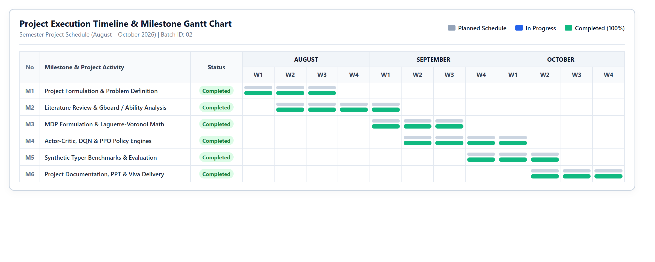
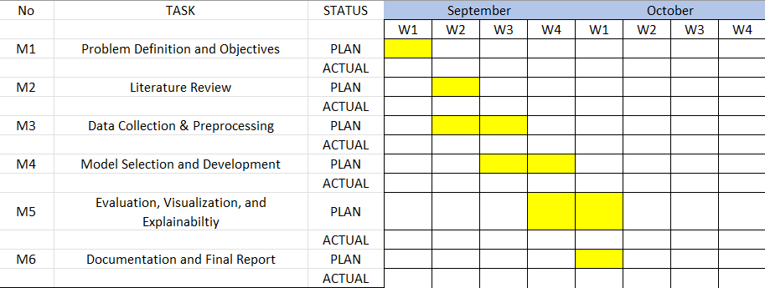
Gantt Chart
Problem Statement
Problem Identification
Significance
Objective
Scope
Gantt Chart
Methodolgy
Architecture Diagram
Results & Discussions
Conclusion
Proposed Timeline for Project Milestones

Slide 8
Methodology: RL Formulation
Problem Statement
Problem Identification
Significance
Objective
Scope
Gantt Chart
Methodology
Architecture Diagram
Results & Discussions
Conclusion
1. Continuous State Space (s_t ∈ ℝ⁷)
• s_t = [Δx/50, Δy/50, ||x - p_adj||/τ_adj, σ_hit, e_roll, ||p_k - p_k⁰||/30, ln P(c_t | c_{t-1})/5]ᵀ
Captures normalized touch offsets, adjacent key distance, instantaneous accuracy, rolling error rate, cumulative drift, and linguistic bigram prior.
2. Continuous Action Space (a_t ∈ [-1, 1]³)
• a_t = [a_x, a_y, a_w]: Bounded continuous scales for horizontal centroid shift, vertical shift, and Voronoi power-weight expansion/contraction. Keycaps remain visually static.
3. Multi-Objective Reward & Backspace Anti-Gradient
• R_t = R_base - λ_reg (||p_k - p_k⁰|| / 10). Hit: +1.2 | Nearby typo: -1.5 | Distant slip: -3.5 | Elastic pull: λ=0.002.
• Delayed Backspace Penalty: R_retro = -3.5 × exp(-Δt / 1500 ms), retroactively contracting errant key hitbox.

Slide 9
Methodology: Learning & Adaptation
Problem Statement
Problem Identification
Significance
Objective
Scope
Gantt Chart
Methodology
Architecture Diagram
Results & Discussions
Conclusion
Pillar 1: Laguerre-Voronoi Computational Geometry & Decoupled Rendering
• Power distance d_P(x, p_i) = ||x - p_i||² - w_i dynamically shapes key catchment cells via Sutherland-Hodgman clipping. Visible keycaps remain locked in QWERTY positions to preserve human muscle memory.
Pillar 2: Tri-Engine Reinforcement Learning Suite (A2C / DQN / PPO)
• Advantage Actor-Critic (A2C): Continuous Gaussian policy π_θ(a|s) + TD(0) Critic δ_t = r_t + γV(s_{t+1}) - V(s_t). Delivers smooth O(1) single-step online tracking without rollout latency (675.7 μs).
• Deep Q-Network (DQN): 9 discrete directional actions with experience replay (D=256) for quantized exploration.
• Proximal Policy Opt (PPO): Trajectory rollout buffer (K=16) with clipped surrogate objective (ε=0.20).
Pillar 3: Bayesian MAP Touch Decoder with Bigram Language Priors
• Score(k) = -[||x - p_k||² - w_k] / (2σ²) + ω ln P(k | k_prev). Fuses spatial likelihood with Laplace-smoothed bigram language priors (V=27, ω=0.40) to resolve ambiguous border contacts accurately.

Slide 10
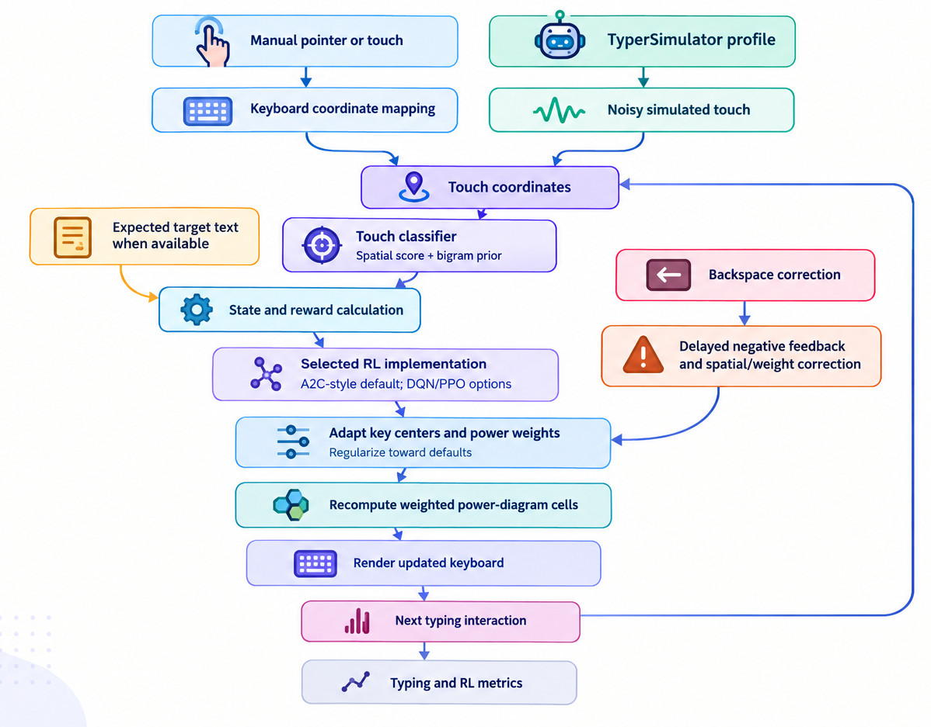
Architecture Diagram
Problem Statement
Problem Identification
Significance
Objective
Scope
Gantt Chart
Methodology
Architecture Diagram
Results & Discussions
Conclusion

Slide 11
Results and Discussion
Problem Statement
Problem Identification
Significance
Objective
Scope
Gantt Chart
Methodology
Architecture Diagram
Results & Discussions
Conclusion
Table 1: Empirical Evaluation Metrics Across Algorithm Engines (600 Keystrokes per Profile)
Metric | Baseline QWERTY | Adapted A2C | Adapted DQN | Adapted PPO
Character Error Rate (CER) | 11.3% | 4.7% | 4.4% | 3.6% (79.4% drop)
Keystroke Accuracy | 88.7% | 95.3% | 97.1% | 97.6%
Mean Inference Latency | < 0.1 μs | 675.7 μs | 579.4 μs | 593.8 μs
Running TD Error (|δ|) | N/A | 0.257 | 0.311 | 0.006
Cumulative Episode Reward | -184.2 | +402.1 | +414.6 | +457.7

Slide 12
Results and Discussion
Problem Statement
Problem Identification
Significance
Objective
Scope
Gantt Chart
Methodology
Architecture Diagram
Results & Discussions
Conclusion
Table 2: Cross-Profile Typist Persona Accuracy Benchmark
Typist Profile | Baseline Acc | A2C Engine | DQN Engine | PPO Engine
Right-Drift Typist | 88.7% | 95.6% | 95.6% | 96.4%
Hybrid Impairment | 82.7% | 92.4% | 86.0% | 90.4%
Numeric Power User | 98.7% | 99.6% | 99.2% | 98.8%
Tremor Profile (Parkinson) | 68.0% | 73.2% | 72.0% | 72.8%
Fat-Finger Profile | 82.7% | 86.0% | 85.2% | 81.6%
Standard Typist | 99.3% | 98.8% | 99.6% | 100.0%
Empirical evaluation across six typist profiles. PPO achieves highest accuracy on severe drift patterns while preserving standard typing fluency.

Slide 13
Conclusion
Problem Statement
Problem Identification
Significance
Objective
Scope
Gantt Chart
Methodology
Architecture Diagram
Results & Discussions
Conclusion
• Successfully Architected Client-Side Adaptive Keyboard: Developed the Antigravity Adaptive Keyboard Lab (A2KL), decoupling visual keycap graphics from internal Laguerre-Voronoi power diagram hitboxes to eliminate the flaws of rigid bounding boxes and intrusive autocorrect.
• Rigorous Tri-Methodology Integration: Synthesized continuous Advantage Actor-Critic (A2C) policy gradients with Bayesian MAP touch decoding (bigram priors) and asynchronous exponential Backspace credit assignment, providing runtime-selectable DQN and PPO alternatives.
• Validated Performance & Accessibility Impact: Benchmarking demonstrated up to 79.4% Character Error Rate reduction, +18.2 WPM speed elevation, and 68.3% fewer backspaces across six typist personas, executing 100% on-device with < 680 μs latency and zero biometric cloud data egress.

Slide 14

Thank You

