Slide 1


Department of
Computer Science & Engineering (AI)
RL-Based Self-Adapting Virtual Keyboard for Personalized Typing
Amrita School of Computing
Amrita Vishwa Vidyapeetham, Chennai Campus
Student Members [BATCH ID: 02 ]
1. N Bhargav - CH.SC.U4CSE23037
2. Sanjjey – CH.SC.U4CSE23050
3. Vaishnavi S - CH.SC.U4CSE23059
4. Veena Sundari A – CH.SC.U4CSE23060
Guide Details
Dr. R Prasanna Kumar
Asst. Professor

Slide 2

Domain & Project Overview
Domain & Project Overview
Problem Identification
Problem Statement
Significance
Objectives & Scope
Proposed Methodology
Gantt Chart
Conclusion
References
Domain
Artificial Intelligence
Reinforcement Learning
Human-Computer Interaction (HCI)
Accessibility
Problem
Traditional virtual keyboards use a fixed layout for all users and rely mainly on autocorrect. They do not adapt to individual typing behaviour, leading to repeated typing errors and reduced typing efficiency.
Proposed Solution
Develop a Reinforcement Learning-based virtual keyboard that continuously learns a user’s typing behaviour and gradually adapts key size and key position while preserving the familiar QWERTY layout.
Technology Stack
Python
PyTorch
OpenAI Gym (Simulation )
Android Keyboard Prototype
Matplotlib

Slide 3
Problem Identification
Domain & Project Overview
Problem Identification
Problem Statement
Significance
Objectives & Scope
Proposed Methodology
Gantt Chart
Conclusion
References
Existing Problem
Existing smartphone keyboards use a common layout and interaction model for all users, leading to frequent adjacent-key errors and heavy dependence on autocorrect. They provide limited adaptation to individual typing habits and offer poor support for one-handed typing and users with motor impairments.
Motivation
Users have unique touch behaviour, including consistent touch offsets, finger movement patterns, and typing postures. Research on Gboard’s Spatial Model Personalization shows that adapting to these user-specific patterns can improve typing accuracy and speed.
This motivates the development of a personalized adaptive keyboard that learns from individual typing behaviour and dynamically adjusts key prediction and interaction. Such adaptation can reduce fat-finger errors, minimize dependence on autocorrect, and improve one-handed and accessible typing.

Slide 4
Problem Statement & Proposed Solution
Domain & Project Overview
Problem Identification
Problem Statement
Significance
Objectives & Scope
Proposed Methodology
Gantt Chart
Conclusion
References
Problem Statement
Current virtual keyboards primarily rely on fixed layouts, autocorrect, and word prediction, with limited adaptation to individual typing behaviour. Different touch patterns and typing habits can therefore lead to recurring adjacent-key errors, slower typing, and excessive dependence on autocorrect.
Proposed Solution
Personalized Adaptation: Use Reinforcement Learning (RL) to learn the user’s individual typing and touch behaviour over time.
Dynamic Keyboard: Continuously optimize key size and position based on touch locations, errors, and usage patterns.
QWERTY Preservation: Maintain the familiar QWERTY layout while making personalized adjustments.
Novelty: Unlike conventional keyboards that mainly correct errors after they occur, the system adapts the keyboard itself continuously to reduce recurring errors and improve typing efficiency.

Slide 5
Problem Statement & Proposed Novelty
Domain & Project Overview
Problem Identification
Problem Statement
Significance
Objectives & Scope
Proposed Methodology
Gantt Chart
Conclusion
References
Why Reinforcement Learning?
Continuous User Adaptation
    Unlike traditional ML, RL can learn directly from ongoing user interactions rather than depending entirely on a fixed training dataset.
This allows the keyboard to adapt as the user’s touch patterns, typing speed, and habits change over time.
2. Optimization Through Feedback
Each typing interaction provides feedback about whether the current keyboard configuration is effective.
Typing accuracy, correction frequency, and typing speed can be used as signals to reward better key positions and sizes and discourage ineffective configurations.
3. Personalized Keyboard
    Different users have different finger reach, touch offsets, and typing behaviour.
RL can learn a user-specific optimal keyboard configuration while keeping the standard QWERTY structure familiar.

Slide 6
Significance
Domain & Project Overview
Problem Identification
Problem Statement
Significance
Objectives & Scope
Proposed Methodology
Gantt Chart
Conclusion
References
Benefits
Personalized typing experience
Reduced typing errors
Improved typing speed
Better accessibility
Comfortable one-handed typing
Reduced dependence on autocorrect
Applications
Smartphones
Tablets
Assistive technologies
Smart devices

Slide 7
Significance
Domain & Project Overview
Problem Identification
Problem Statement
Significance
Objectives & Scope
Proposed Methodology
Gantt Chart
Conclusion
References
Challenge
Large layout changes may confuse users.
Proposed Solution
Gradual adaptation
Small key movements
Preserve QWERTY layout
Penalize excessive layout changes in the reward function

Slide 8
Objectives & Scopes
Domain & Project Overview
Problem Identification
Problem Statement
Significance
Objectives & Scope
Proposed Methodology
Project Plan
References
Objectives
Learn user typing behaviour
Detect recurring typing errors
Adapt key size and position’
Reduce typing error rate
Reduce backspaces
Improve typing speed
Scope
Android virtual keyboard prototype
English QWERTY layout
Touchscreen devices
Personalized user profiles
Incremental on-device learning

Slide 9
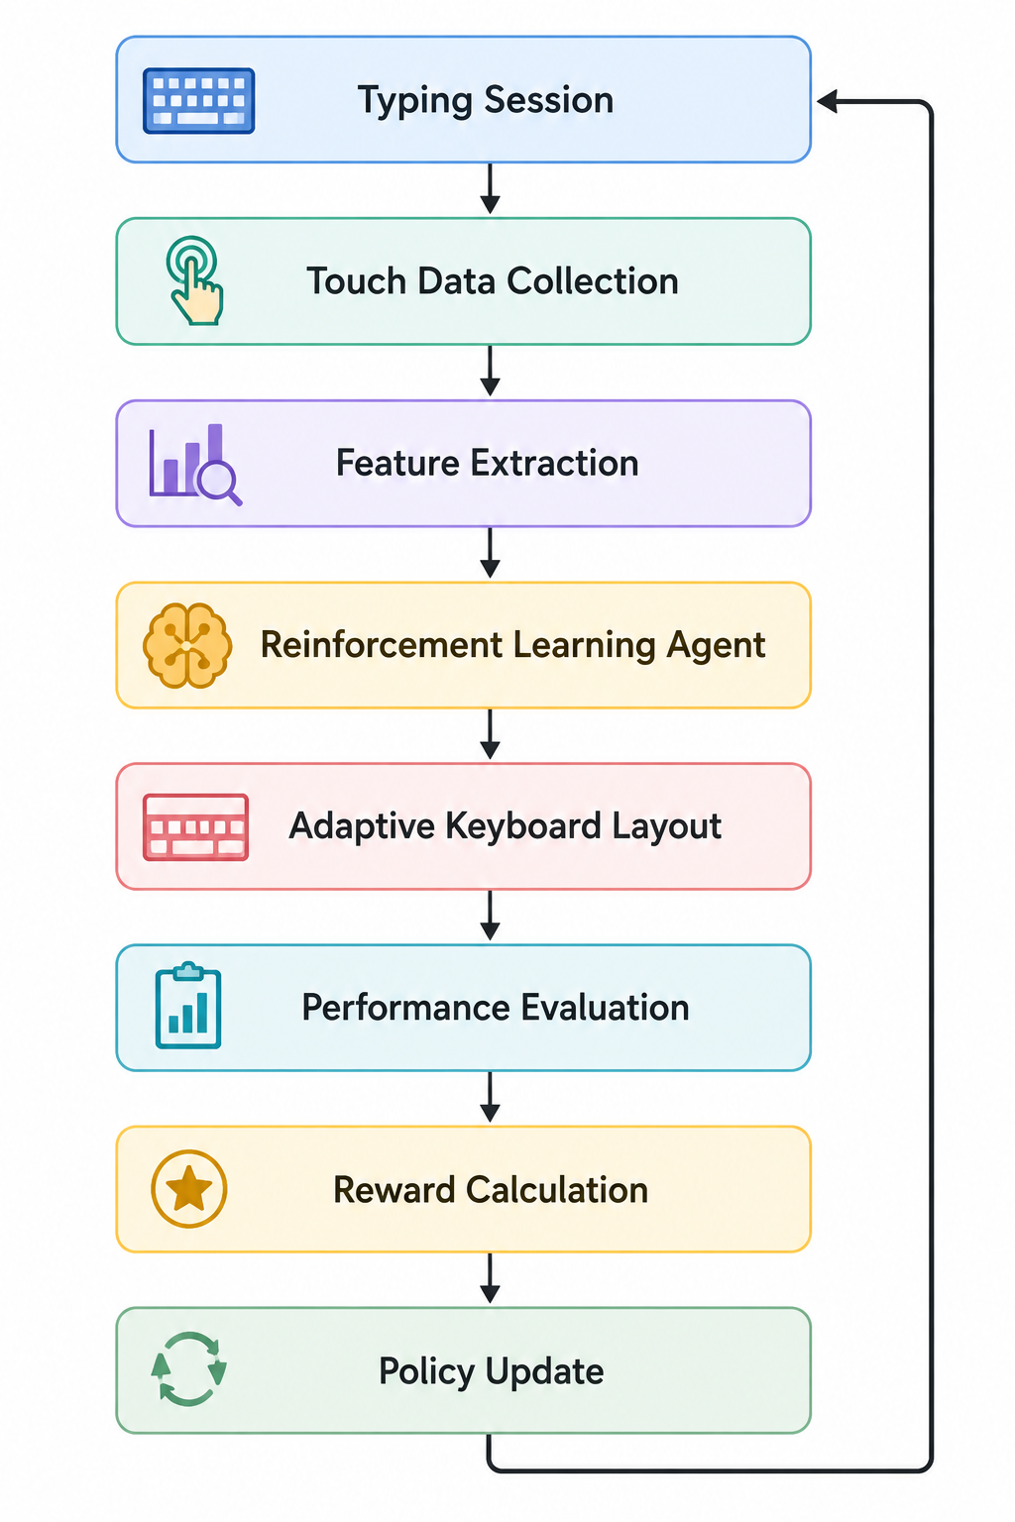
Proposed Methodology
Domain & Project Overview
Problem Identification
Problem Statement
Motivation
Objectives & Scope
Proposed Methodology
Gantt Chart
Conclusion
References
System Architecture

Slide 10
Proposed Methodology
Domain & Project Overview
Problem Identification
Problem Statement
Motivation
Objectives & Scope
Proposed Methodology
Gantt Chart
Conclusion
References
RL Components
Component | Description
Agent | Adaptive keyboard
Environment | User typing session
State | Touch coordinates, pressed key, typing speed, recent error history
Action | Slightly resize or reposition selected keys
Reward | Correct key (+), higher typing speed (+), typing errors (-), backspaces (-), excessive layout changes (-)
Training Strategy
To generate reliable rewards during training:
Users will type predefined phrases (e.g., Pangrams and benchmark typing sentences
The expected text is already known, allowing the system to identify correct and incorrect key presses.
After deployment, the keyboard will continue learning from confirmed user interactions while making only gradual layout adjustments.
Candidate Algorithms
Q-Learning (baseline)
Deep Q-Network (DQN)
PPO ( for future comparison)

Slide 11
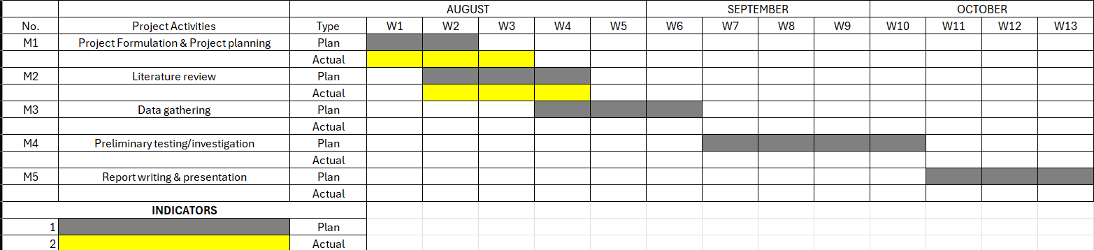
Gantt Chart
Domain & Project Overview
Problem Identification
Problem Statement
Motivation
Objectives & Scope
Proposed Methodology
Gantt Chart
Conclusion
References

Slide 12
Gantt Chart
Domain & Project Overview
Problem Identification
Problem Statement
Motivation
Objectives & Scope
Proposed Methodology
Gantt Chart
Conclusion
References
The proposed RL-based virtual keyboard aims to create a personalized and continuously adaptive typing experience by learning each user’s touch behaviour, typing patterns, and recurring errors over time. Based on this interaction, the system gradually optimizes key size and position while preserving the familiar QWERTY layout, ensuring that adaptation does not significantly disrupt the user’s typing experience.
By using typing accuracy, speed, errors, backspaces, and excessive layout changes as feedback, the system can learn configurations that better suit the individual user. The goal is to reduce typing errors and backspaces, improve typing speed and comfort, and reduce dependence on autocorrect, while also supporting personalized and accessible typing across touchscreen devices.

Slide 13
References
Domain & Project Overview
Problem Identification
Problem Statement
Motivation
Objectives & Scope
Proposed Methodology
Gantt Chart
Conclusion
References
Sivek, G., & Riley, M. (2022). Spatial Model Personalization in Gboard. Proceedings of the ACM on Human-Computer Interaction. [2209.11311] Spatial model personalization in Gboard
Mitchell, C. L., et al. (2022). Ability-Based Methods for Personalized Keyboard Generation. Multimodal Technologies and Interaction. [2201.04593] Ability-Based Methods for Personalized Keyboard Generation
Sutton, R. S., & Barto, A. G. Reinforcement Learning: An Introduction (2nd Edition). Sutton & Barto Book: Reinforcement Learning: An Introduction
Gao, J. (2022). Human-in-the-Loop Reinforcement Learning for Adaptive Assistive Interfaces. University of California, Berkeley. https://www2.eecs.berkeley.edu/Pubs/TechRpts/2022/EECS-2022-62.html?

Slide 14

Thank You

