Slide 1

A Cybersecurity Incident Reporting and Risk Assessment System for Detecting, and Prioritizing Security Threats in an Organization.”
CSA0203-C PROGRAMMING
Presented By:
N. Sanjana(192412478)
Janaki(192412409))
Syed Nazma(192425193)
Guided by:
Dr . K. Saravanan

Slide 2


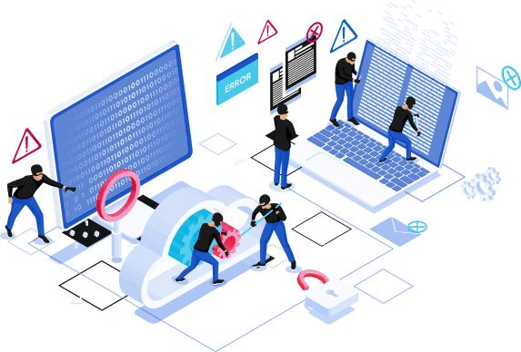
INTRODUCTION
Cybersecurity attacks are increasing rapidly.
Security incidents need to be reported quickly.
Manual reporting can cause delays and errors.
Our system organizes incident reporting and risk assessment.
It helps improve incident response and management.

Slide 3
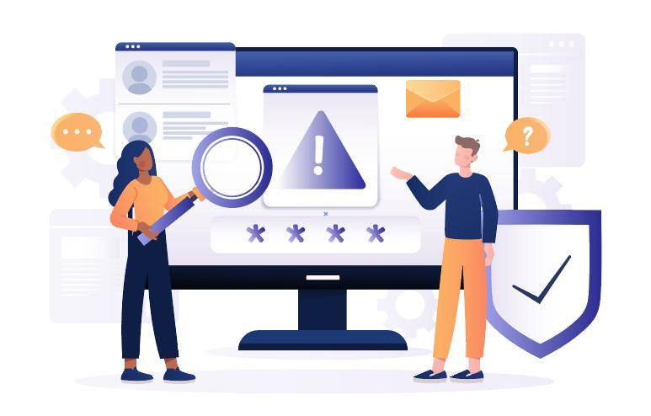
PROBLEM STATEMENT
Existing problems:
Delayed incident reporting
Unorganized incident records
Difficulty in tracking incidents
Manual risk classification
Difficulty handling multiple incidents.

Slide 4

OBJECTIVES
Develop a cybersecurity incident reporting system.
Classify incidents based on severity and risk.
Provide an administrator dashboard.
Track incident status.
Generate reports for analysis.
Improve incident response time.

Slide 5
ABSTRACT
The system helps organizations report and manage cybersecurity incidents.
It detects threats such as phishing, malware, unauthorized access, and data breaches.
Each incident is analyzed based on severity, impact, and likelihood.
The system prioritizes threats as Low, Medium, High, or Critical.
It helps security teams respond quickly, reduce risks, and improve organizational cybersecurity.

Slide 6
EXISTING SYSTEMS
Manual Incident Reporting: Security incidents are often reported through emails, phone calls, or manual forms.
Separate Security Tools: Different tools are used for threat detection, monitoring, and incident management.
Delayed Response: Manual analysis can increase the time required to identify and respond to security threats.
Limited Risk Prioritization: Existing systems may not effectively prioritize incidents based on severity and impact.

Slide 7
PROPOSED SYSTEM
User Authentication
Secure login for users and administrators.
Different access levels based on user role.
Incident Reporting
Users can report security incidents by entering the incident type, description, affected system, likelihood, and impact.
Automatic Risk Assessment
The system calculates the risk score automatically using: Risk Score = Likelihood × Impact
Incidents are classified as Low, Medium, High, or Critical.
Incident Database
All reported incidents are stored in a centralized SQLite database for easy management and tracking.

Slide 8
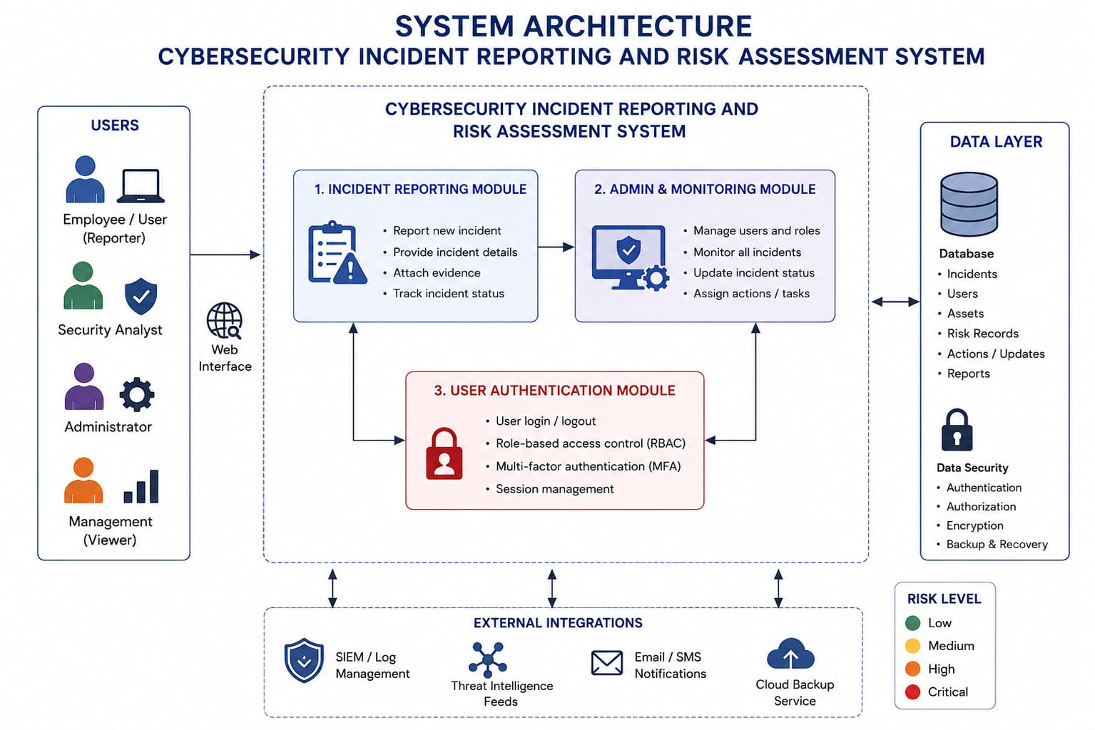
System Architecture

Slide 9
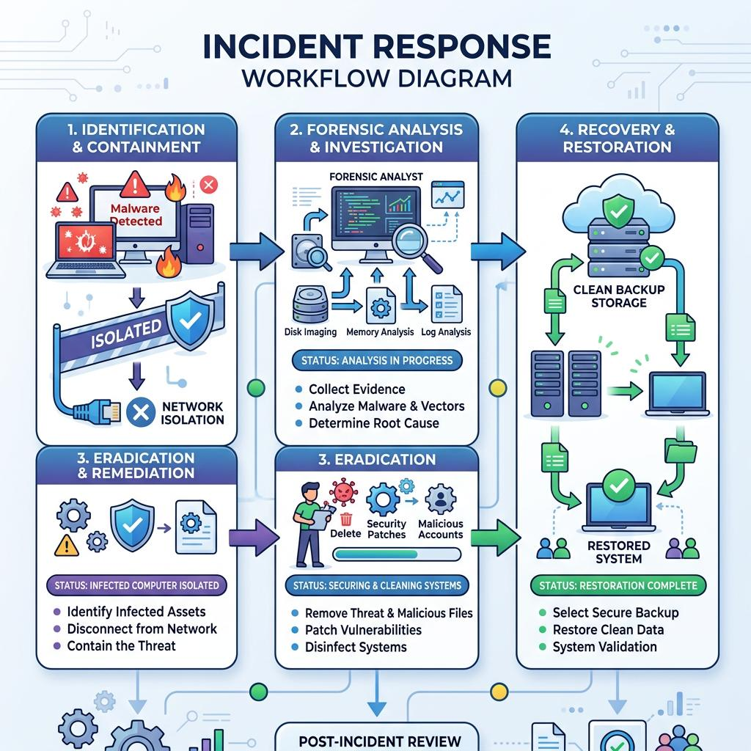
Module 1 :User Authentication Module
User Authentication Module
Identifies and authenticates users.
Allows users to register.
Provides secure login.
Verifies user passwords.
Prevents unauthorized access.
Allows only authorized users to enter the system.
Main Functions:
Registration → Login → Password Verification → System Access

Slide 10
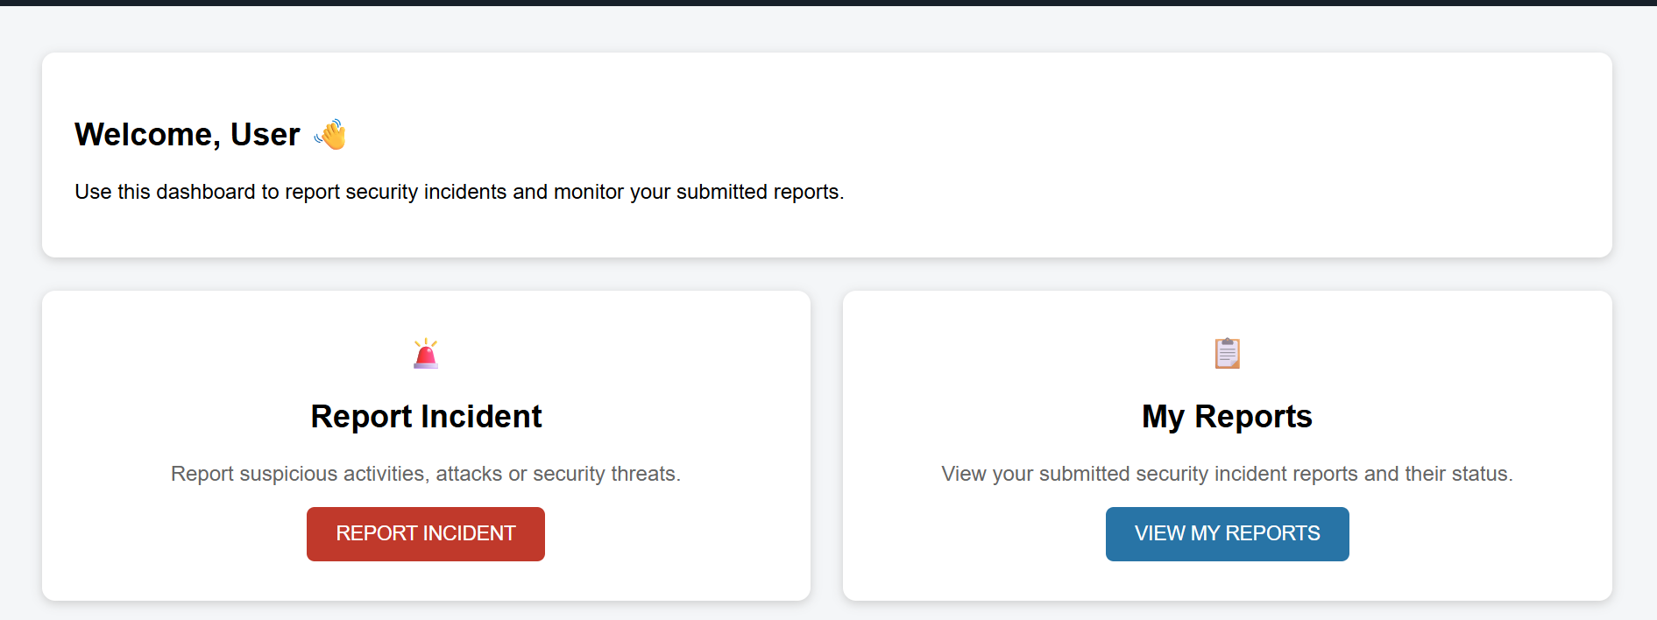
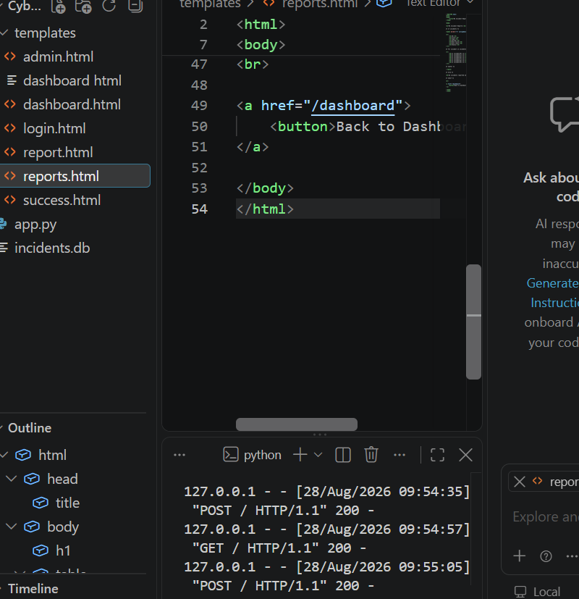
MODULE 1 OUTPUT

Slide 11
Module 2:Incident Reporting
Reports cybersecurity incidents in an organized way
Enters important incident details
Records the reported incident
Uploads supporting evidence
Tracks the status of the reported incident
Helps the administrator investigate and manage the incident
Main Functions
Enter Details → Submit Incident → Upload Evidence → Track Incident

Slide 12
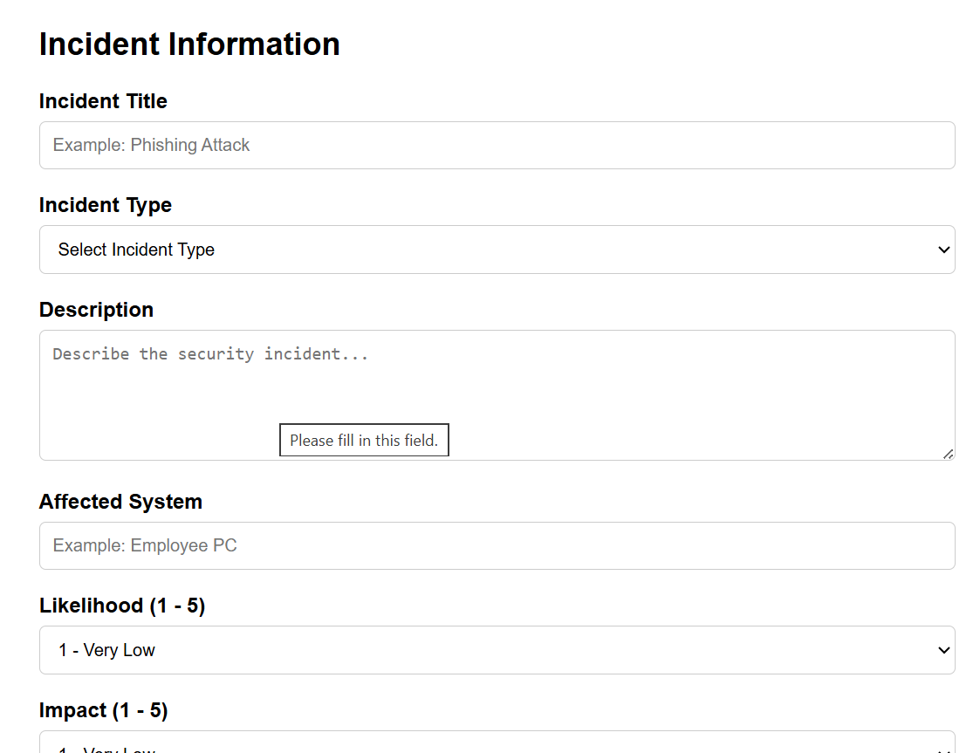
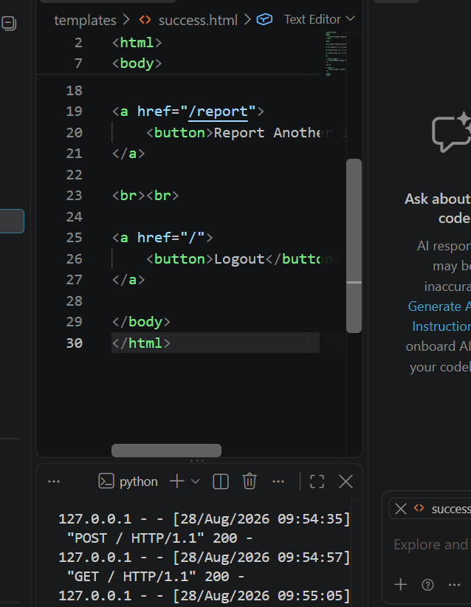
Module 2:Incident Reporting OUTPUT

Slide 13

Module 3 : Admin Dashboard
Provides a central place to manage incidents
Displays all reported incidents
Allows administrators to review incidents
Shows incident risk levels
Updates incident status
Helps manage and resolve incidents
Generates reports for analysis
Main Functions
View Incidents → Review → Update Status → Resolve → Generate Report

Slide 14
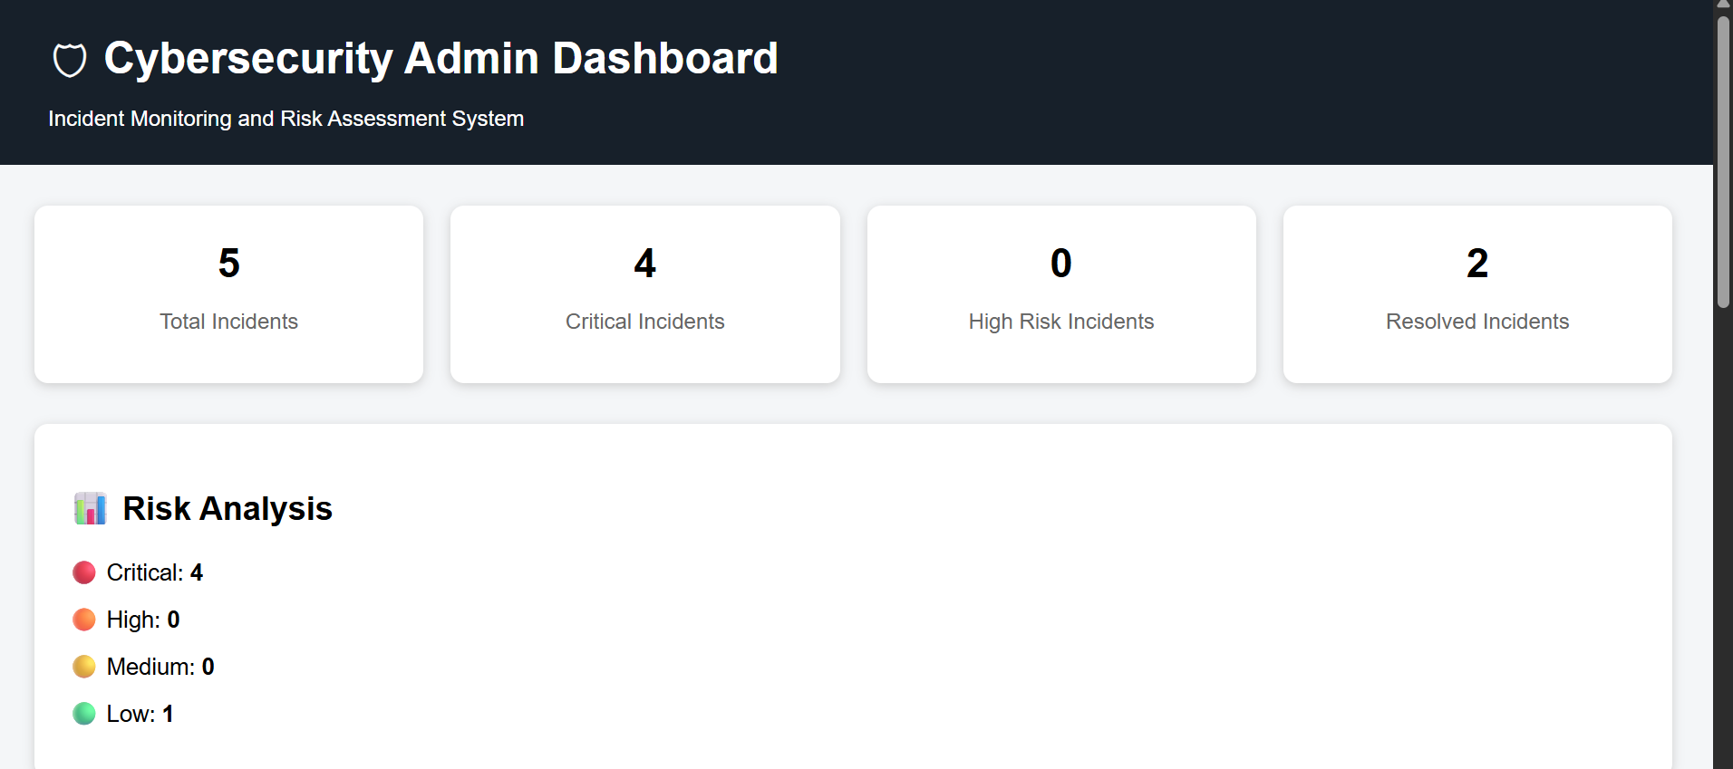
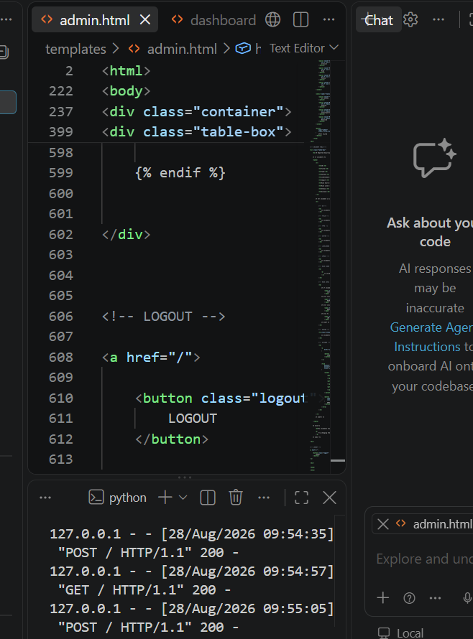
Module 3 : Admin Dashboard Output

Slide 15
FUNCTIONALITIES
User Authentication – Provides secure login for users and administrators.
Incident Reporting – Allows users to report cybersecurity incidents with relevant details.
Risk Assessment – Calculates the risk score based on likelihood and impact.
Risk Classification – Categorizes incidents as Low, Medium, High, or Critical.
Incident Management – Stores and manages reported incidents in a centralized database.
Incident Tracking – Allows users and administrators to monitor incident status.
Admin Dashboard – Provides administrators with an overview of all reported incidents.

Slide 16

Advaced Applications
AI/ML-Based Risk Prediction Predict incident severity and risk automatically.
Real-Time Security Alerts Immediately notify administrators about critical incidents.
Cloud-Based Deployment Enable secure access and centralized incident management.
Advanced Analytics Analyze incident patterns and identify recurring threats.
SIEM Integration Connect the system with security monitoring platforms.

Slide 17
CONCLUSION
the system provides a structured platform for cybersecurity incident reporting.
It helps in identifying and classifying security risks.
Administrators can monitor, track and manage incidents efficiently.
Secure incident information management improves the overall incident response process.
Report generation supports better analysis and decision-making.
The system can be further enhanced using AI/ML and cloud technologies.

Slide 18
References
Halawi Ghoson, N., & Benfriha, K. (2026). A novel dynamic risk assessment tool for evaluating cybersecurity risks in the digital industry. Scientific Reports. DOI: 10.1038/s41598-026-59483-x
Agathangelos-Ioannou, G., & Tsohou, A. (2026). Methodologies for information security risk assessment: Shortcomings for analysing artificial intelligence systems. International Journal of Information Security, 25, 98. DOI: 10.1007/s10207-026-01271-9
Kincl, J., Adam, M. T. P., & Pavleska, T. (2026). Human-AI Integration in Cybersecurity: An Industry-Aligned Perspective on Incident Management. International Journal of Information Security, 25, 103. DOI: 10.1007/s10207-026-01259-5
Paragioudakis, A., Komninos, N., Smyrlis, M., et al. (2026). Risk management for cyber insurance: A survey for data-driven approaches with the use of AI. International Journal of Information Security, 25, 112. DOI: 10.1007/s10207-026-01275-5

Slide 19


