Slide 1
BUSINESS STRATEGY & MONETIZATION MASTERPLAN
Focusr: The Spatial Deep Work OS
Transforming a minimalist digital sanctuary into a sustainable $1.2M+ ARR SaaS enterprise through ethical freemium, ambient sponsorship, and high-margin productivity moats.
52 Free Atmospheres
Freemium Pro & Studio
Ethical Ambient Ads
Multi-Device Cloud Sync
Prepared for Executive Growth & Engineering | Live at: https://focusr-seven.vercel.app

Slide 2
MARKET POSITIONING
Executive Summary: The Digital Burnout Crisis
The Problem: Cognitive Overload
The Focusr Solution & Baseline
Distraction Economy & Friction Heavy Tools
Sensory Flow + Zero Friction
• 78% of knowledge workers report daily mental fatigue from notification overload and fragmented tooling.
• Existing productivity apps are bloated: Complex project management tools demand constant micro-configuration, causing more friction than focus.
• Lack of Spatial Immersion: Most timers are sterile digital stopwatches without emotional warmth, aesthetic satisfaction, or sensory presence.
✓ 52 Curated Spatial Atmospheres: Handcrafted nature sanctuaries, deep space, cyberpunk, and lo-fi aesthetics.
✓ Real-Time Liquid Physics Engine: Dynamic wave height and color calibrated live to focus duration and flow intensity.
✓ Ambient Sound Sanctuary: Synthesized rain, pink noise, celestial frequencies, and binaural beats.
✓ Production Proven: Live on Vercel Edge with instantaneous initial load and zero JS overhead.
FOCUSR • THE SPATIAL DEEP WORK OS
https://focusr-seven.vercel.app

Slide 3
AUDIENCE ARCHITECTURE
Target Personas & Customer Segmentation
The Software Engineer & Builder
The ADHD & Neurodivergent Mind
University & Med Students
Remote Creatives & Writers
42% of Core Users
28% of Core Users
20% of Core Users
10% of Core Users
Needs uninterrupted 90-minute deep work blocks for architecture and debugging. Highly values aesthetic dark mode, hotkeys, and minimal distraction.
Willingness to Pay: High ($39–$89/yr)
Suffers from executive dysfunction and task inertia. Needs visual dopamine triggers (water physics, theme changes, sound layers) to initiate flow.
Willingness to Pay: High ($4.99/mo)
Aesthetic study sessions ("Study With Me" culture). Shares aesthetic setups on TikTok and Discord. Massive organic word-of-mouth driver.
Willingness to Pay: Moderate (Freemium + $2.99 Student)
Solopreneurs, designers, and authors working from home who need emotional compartmentalization and sensory boundaries to start daily writing.
Willingness to Pay: High ($49/yr)
FOCUSR • THE SPATIAL DEEP WORK OS
https://focusr-seven.vercel.app

Slide 4
REVENUE ARCHITECTURE
The 4-Pillar Monetization Framework
1. Consumer Freemium SaaS
2. Zero-Interruption Ambient Ads
3. Teams & Enterprise
4. Physical Ecosystem & Merch
Focusr Pro & Studio
Mindful Brand Partnerships
Focusr Workspaces (B2B)
Desk Companion Goods
60% Projected ARR
15% Projected ARR
20% Projected ARR
5% Projected ARR
• Multi-track custom soundscape mixer
• Cloud sync across laptop, tablet, phone
• AI Deep Work Coach & Burnout Predictor
• Bi-directional Notion / Obsidian sync
• Curated brand atmospheric backdrops
• Post-session 5-minute break reward cards
• Affiliate partnerships for focus gear
• Zero intrusive banner/video popups
• Virtual silent co-working focus rooms
• Team synchronized deep work sprints
• Aggregated burnout & flow analytics
• SSO, central billing & admin control
• Focusr Physical Pomodoro Dial / Lamp
• Aesthetic oversized felt desk mats
• Custom keycap sets & artisan badges
• Limited edition studio apparel
FOCUSR • THE SPATIAL DEEP WORK OS
https://focusr-seven.vercel.app

Slide 5
PRICING & PACKAGING
Product Tier Comparison & Entitlement Matrix
Feature Capability | Free Tier (Zero Cost) | Focusr Pro ($4.99/mo) | Focusr Studio ($89 Lifetime)
Atmosphere Catalog | 52 Free Curated Themes | 52 + 100+ Exclusive 4K Wallpapers | All Wallpapers + Custom Video Upload
Sound Sanctuary | Standard Rain & Lofi Streams | Multi-Track Slider Audio Mixer | Custom Frequency & Binaural Beats
Data & Cross-Device | Local Browser Storage | Encrypted Cloud Sync (3 devices) | Unlimited Devices + Offline PWA
Flow Analytics | 7-Day History & Streaks | 365-Day Deep Work Audit | Exportable CSV / Notion Sync
AI Focus Companion | Standard Daily Target | Predictive Fatigue Warning | Custom AI Routine Assistant
Team & Collaboration | Solo Sessions Only | Join Public Study Rooms | Host Private Co-working Lounges
FOCUSR • THE SPATIAL DEEP WORK OS
https://focusr-seven.vercel.app

Slide 6
REVENUE OPTIMIZATION
Pricing Architecture & Value Anchoring
Monthly Pro
Annual Pro
Studio Lifetime
Billed monthly, cancel anytime
Equivalent to $3.33/mo (Save 33%)
Perpetual Pioneer License
Lowest Barrier
MOST POPULAR (Anchor)
High-Margin Collector
$4.99 / month
$39.99 / year
$89.00 once
Strategic Role:
Anchored lower than a single Starbucks latte. Minimizes friction for students and monthly impulse subscribers.
Volume Target: 15% of Paying Users
Strategic Role:
Primary cash-flow driver. Upfront cash collection funds customer acquisition and audio production costs.
Volume Target: 65% of Paying Users
Strategic Role:
Appeals to indie hacker / software engineer mindset who despise recurring SaaS. High early capital injection.
Volume Target: 20% of Paying Users
FOCUSR • THE SPATIAL DEEP WORK OS
https://focusr-seven.vercel.app

Slide 7
FEATURE ENGINEERING
High-Conversion Premium Features (The Moat)
Multi-Track Dynamic Sound Mixer
Cross-Device Cloud Sync & State
High Emotional Value
Daily Utility Lock-in
Allow users to mix up to 5 concurrent ambient layers: Rain + Fireplace + Vinyl Crackle + Alpha Waves + Coffee Shop Chatter with independent volume faders.
Seamlessly start a focus session on your MacBook, pause on your iPhone while getting coffee, and view cumulative stats on your iPad in real time.
AI Deep Work & Energy Predictor
Obsidian, Notion & Spotify Deep Sync
Unique AI Differentiator
Productivity Ecosystem Moat
Learns user focus curves over 30 days. Alerts user: "Your cognitive flow peaks between 9:30 AM and 11:45 AM. Schedule your most demanding code review now."
Two-way integration: Auto-logs focus sessions directly to daily Notion databases, Obsidian markdown files, and updates active Spotify track statuses.
FOCUSR • THE SPATIAL DEEP WORK OS
https://focusr-seven.vercel.app

Slide 8
ETHICAL MONETIZATION
Zero-Interruption Ambient Advertising Strategy
The Core Philosophy: Focus Is Sacred
Ambient Ad Revenue Streams & CPMs
Why Traditional Popups Are Banned
High-Yield Sponsorship Economics
• Zero Banner Ads, Popups, or Audio Interruptions:
Standard advertising breaks the alpha brainwave state. Any intrusive ad destroys the core value proposition of Focusr.
• Atmospheric Brand Placements:
Brands like Herman Miller, Sony, Keychron, or Calm sponsor curated aesthetic themes (e.g., "The Tokyo Architecture Suite by Sony WH-1000XM5").
• Mindful Break-Time Rewards:
During the 5-minute Pomodoro break, a subtle glass card offers mindful suggestions: "Stretch your posture with 20% off ErgoPro" (100% opt-in).
1. Curated Atmosphere Sponsorship ($45+ CPM)
A premium hardware brand pays a monthly sponsorship fee for featured placement in the Marketplace grid.
2. Curated Audio Stream Sponsoring ($30+ CPM)
"Focusr Lo-Fi Sanctuary brought to you by Calm App". Audio remains uninterrupted, subtle text credits appear in top bar.
3. Affiliate Desk Gear Showcase ($8,000–$15,000/mo)
Users clicking "View Desk Setup" on our aesthetic wallpaper cards are directed to high-ticket affiliate items (keyboards, monitors, chairs).
FOCUSR • THE SPATIAL DEEP WORK OS
https://focusr-seven.vercel.app

Slide 9
B2B EXPANSION
Focusr Workspaces: High-Margin B2B & Teams
Virtual Silent Co-working
University & Med Licensing
Enterprise Deep Work Audits
$6 / user / month
$1,500 / year / lab
$12 / seat / month
Shared Team Presence:
Remote engineering and design teams join synchronised focus rooms. You see team members floating in ambient flow without cameras or mics.
Social Accountability:
Reduces remote isolation and builds deep work culture without Zoom fatigue.
Student Study Hubs:
Universities (MIT, Stanford, Oxford, Cambridge) provide campus-wide access to Focusr for students preparing for finals, MCAT, or bar exams.
Study Groups:
Students create custom study rooms with synchronized Pomodoro intervals.
Aggregated Burnout Analytics:
Gives engineering managers macro insights into organizational flow blocks vs meeting fragmentation.
Strict Zero-Spyware Privacy:
No keystroke logging or screenshot surveillance. Only opt-in aggregate focus minutes.
FOCUSR • THE SPATIAL DEEP WORK OS
https://focusr-seven.vercel.app

Slide 10
FINANCIAL MODELING
3-Year Financial Forecast & Unit Economics
Financial Metric | Year 1 (Bootstrap & Launch) | Year 2 (Ecosystem Scale) | Year 3 (Enterprise & Global)
Monthly Active Users (MAU) | 65,000 | 320,000 | 1,200,000
Free-to-Paid Conversion Rate | 2.8% | 3.4% | 3.8%
Active Paid Subscribers | 1,820 | 10,880 | 45,600
Consumer SaaS Revenue | $72,800 | $435,000 | $1,824,000
Ambient Brand Sponsorships | $18,000 | $96,000 | $360,000
Teams & B2B Licenses | $12,000 | $120,000 | $540,000
Total Annual Gross Revenue | $102,800 | $651,000 | $2,724,000
FOCUSR • THE SPATIAL DEEP WORK OS
https://focusr-seven.vercel.app

Slide 11
CUSTOMER ACQUISITION
Go-to-Market Blueprint & Viral Growth Loops
Product Hunt Launch #1 of the Day
TikTok & IG Reels Aesthetic Loops
Subreddit Community Infiltration
Daily Focus Milestone Cards (Viral Loop)
Launch Sprint Day 1-7
Organic Short-Form Video
r/productivity, r/ADHD, r/digitalnomad
Built-in Social Sharing
• Showcase spatial UI, 52 themes, and liquid physics.
• Offer exclusive "Founding Pioneer Lifetime $49" for first 500 upvoters.
• Target #1 Product of the Day & Product of the Week.
• "Study With Me: Tokyo Cyberpunk 4K" looping videos with serene music.
• Captions highlighting Focusr website link in bio.
• Aesthetic workspace lifestyle clips routinely hit 500k+ views.
• Publish transparent build-in-public case studies: "How I built a distraction-free spatial timer for my ADHD".
• Zero spam, 100% value-driven engagement with free trial perks.
• After completing a 4-hour streak, generate a gorgeous VisionOS glass card.
• One-tap export to Instagram Stories, Twitter/X, and LinkedIn.
• Includes scannable QR code directly back to user room.
FOCUSR • THE SPATIAL DEEP WORK OS
https://focusr-seven.vercel.app

Slide 12
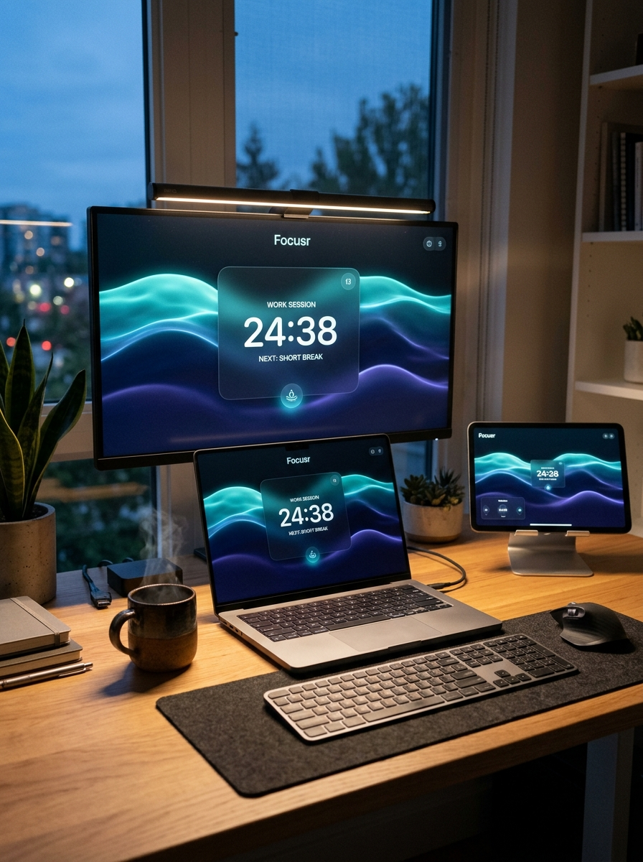
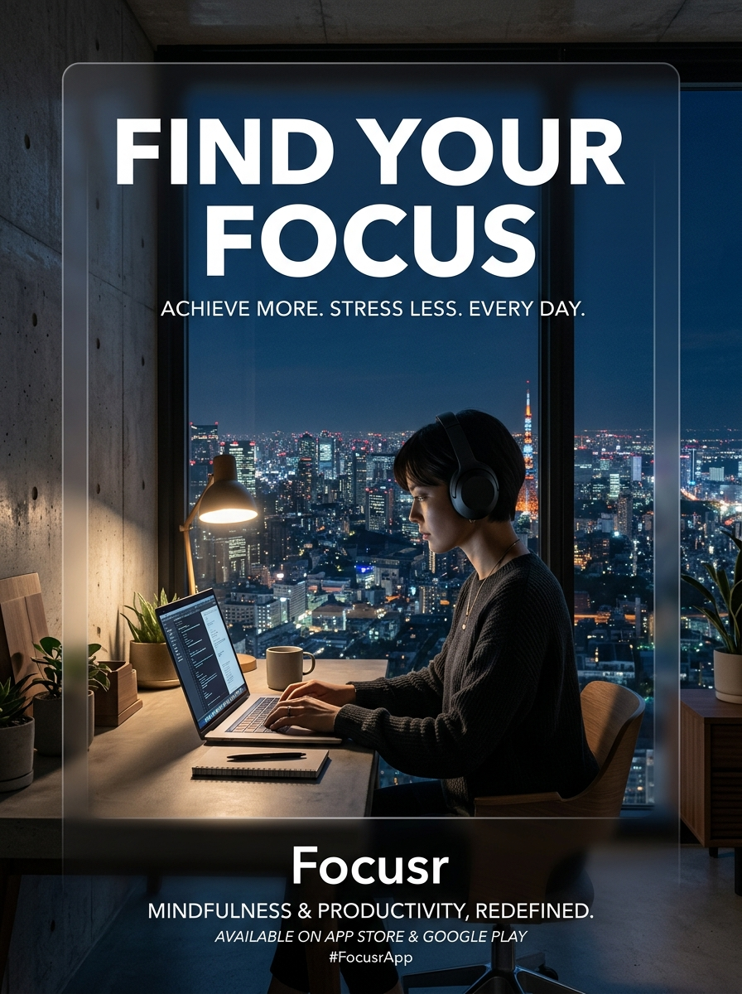
BRAND CREATIVE
Aesthetic Marketing Posters & Campaign Assets
Lifestyle Workspace Campaign
Tokyo Night Street Ad
Omnichannel Distribution
Editorial Studio Photography
Find Your Focus Campaign
Where These Run
• Instagram & Pinterest Ads:
Targeting users interested in minimalism, mechanical keyboards, and architectural design.
• University Campus Posters:
Physical print posters with high-contrast QR code placed outside libraries and computer labs.
• YouTube Desk Setup Sponsorships:
Integrated seamlessly into tech creators desks as their default ambient screen.
FOCUSR • THE SPATIAL DEEP WORK OS
https://focusr-seven.vercel.app

Slide 13
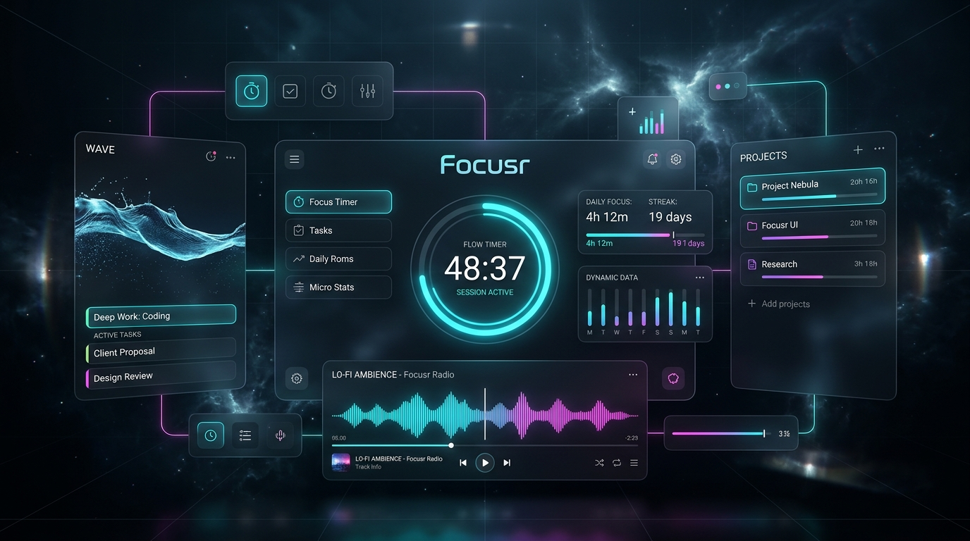
DESIGN ARCHITECTURE
Spatial Operating System UI & Product Interface
Spatial Design Principles
VisionOS Glassmorphism
1. Frosted Glass Depth (Depth Layering)
24px backdrop blurs and subtle 1px border glows recreate physical Apple Vision Pro immersion.
2. Harmonic Liquid Resonator
Fluid water waves ebb and surge based on actual focus completion rate.
3. Ambient Light Orbs
Three multi-layered radial orbs cast gentle cinematic glow across dark backdrops.
4. Zero Latency Execution
Pure CSS hardware acceleration and instant DOM interactions.
FOCUSR • THE SPATIAL DEEP WORK OS
https://focusr-seven.vercel.app

Slide 14
SOFTWARE ARCHITECTURE
Engineering Roadmap & Tech Stack Evolution
Client Experience (Frontend)
HTML5, CSS3 Variables, Web Audio API, Three.js, Canvas Fluid Physics
Ultra-lightweight vanilla execution ensures 60 FPS on any laptop without heavy React bundle overhead.
State, Auth & Database (Backend)
Supabase (PostgreSQL) + Row Level Security + Redis Cache
Encrypted storage for user categories, sound presets, and session logs. Zero sensitive task data logged.
Monetization & Billing Engine
Stripe Billing + LemonSqueezy (Global Merchant of Record)
Automated tax handling in 135+ countries, localized currency display, Apple Pay and Google Pay 1-click checkout.
Desktop & Native Cross-Platform
Tauri (Rust) for Mac/Windows + Capacitor PWA for iOS/Android
Tauri delivers a sub-15MB native desktop app that sips less than 35MB RAM, supporting global shortcut keys.
FOCUSR • THE SPATIAL DEEP WORK OS
https://focusr-seven.vercel.app

Slide 15
TRUST & SECURITY
Privacy-First Architecture & Ethical Compliance
Local-First Data Storage
GDPR & CCPA Compliant
Transparent Open Metrics
Certified Enterprise Trust
Certified Enterprise Trust
Certified Enterprise Trust
• By default, all notes, custom task names, and timer counts remain 100% inside client-side localStorage.
• Focusr servers never inspect, sell, or analyze your private task descriptions.
• One-click data export in JSON format.
• Immediate "Right to be Forgotten" account deletion pipeline.
• Zero cross-site tracking cookies or third-party pixel eavesdropping.
• Aggregate statistics only: users can view overall global community focus minutes.
• No employee surveillance or micromanagement telemetry for team editions.
FOCUSR • THE SPATIAL DEEP WORK OS
https://focusr-seven.vercel.app

Slide 16

LIVE ACCESS
Scan to Experience: Live Production Deployment
Instant Mobile & Web Launch
Experience Focusr Right Now
Scan with any smartphone camera
What You Can Test Live
✓ 52 Curated Wallpapers & Themes:
Open the Marketplace to test live hover previews and instant one-click switching.
✓ Mid-Session Theme Consistency:
Start a session, open the top bar, and switch atmospheres on the fly with synchronized liquid hues.
✓ Focusr Atelier Studio (Tab 1–5):
Custom chromatic accents, ambient sound sanctuary, and daily study targets.
✓ Full Mobile Responsive Experience:
Optimized touch navigation, fluid drawers, and glass styling down to 320px width.
Direct URL: https://focusr-seven.vercel.app
High-density QR code configured with error correction H for instant scan reliability.
FOCUSR • THE SPATIAL DEEP WORK OS
https://focusr-seven.vercel.app

Slide 17
ACTION PLAN
30-60-90 Day Execution Roadmap & Next Steps
Monetization Foundation
Multi-Device & Sound Engine
Teams & Native Desktop App
Phase 1: Days 1–30
Phase 2: Days 31–60
Phase 3: Days 61–90
• Integrate Stripe Billing & Customer Portal
• Implement Pro Tier paywall gate for Cloud Sync & Sound Mixer
• Launch Product Hunt Campaign with "Pioneer Lifetime" deal
• Target: $5,000 Early Bird Revenue
• Ship Multi-Track Ambient Sound Mixer with 12 new sound layers
• Deploy Supabase encrypted cross-device cloud sync
• Launch Campus Ambassador program across 25 university campuses
• Target: 50,000 MAU and $20,000 MRR
• Launch Focusr Virtual Co-working Lounges for remote teams
• Release macOS & Windows native desktop apps via Tauri
• Establish first 3 ambient brand atmosphere partnerships
• Target: $50,000 MRR ($600,000 Run-Rate ARR)
FOCUSR • THE SPATIAL DEEP WORK OS
https://focusr-seven.vercel.app

