Slide 1
High-Frequency Pairs Trading on NSE (NIFTY-50)
Executive Summary
Methods
KPIs & Results

Slide 2
Executive Summary
Goal: Assess if HF pairs trading is profitable on NSE after real frictions
Compare Ranked vs Random pairs and Preferred vs Classical models
Mitigate data-snooping: evaluate full parameter grid
Example portfolio (10 pairs, ₹100k each): solid Sharpe; delay hurts

Slide 3
Key Performance Indicators (KPIs)
Committed Return (ann.)
Invested Return (ann.)
Sharpe Ratio
Number of Trades
Hit Rate
Max Drawdown

Slide 4
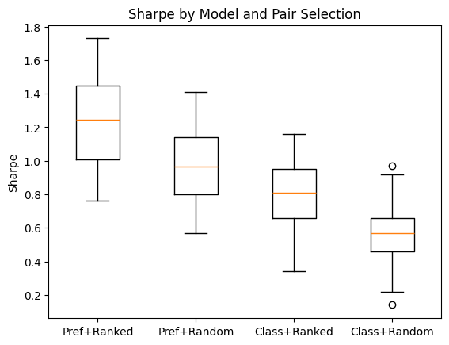
Sharpe by Model & Pair Selection
Ref: see HF_Pairs_Trading_NSE_Analysis.ipynb

Slide 5
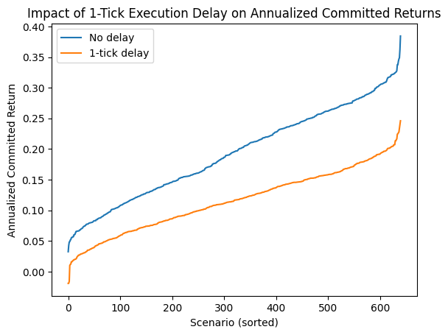
1-Tick Delay vs. No Delay (Committed Return)
Ref: see HF_Pairs_Trading_NSE_Analysis.ipynb

Slide 6
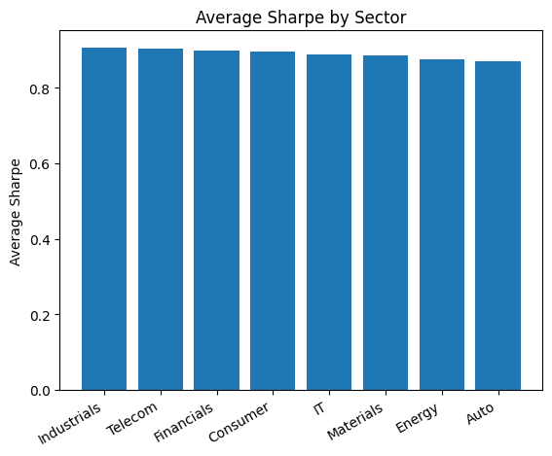
Average Sharpe by Sector
Ref: see HF_Pairs_Trading_NSE_Analysis.ipynb

Slide 7
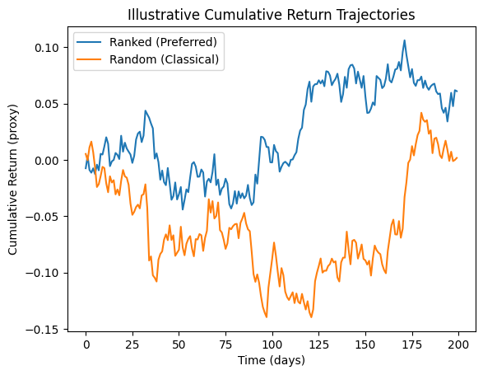
Cumulative Returns (Illustrative only)
Ref: see HF_Pairs_Trading_NSE_Analysis.ipynb

Slide 8
Portfolio Scenarios (Illustrative only)
Scenario | Sharpe | Committed (ann.) | Invested (ann.) | Trades | Hit Rate
Preferred + Ranked (delay 1) | 1.01 | 16.44% | 13.79% | 13980 | 55.60%
Classical + Random (delay 1) | 0.47 | 6.31% | 5.37% | 14307 | 49.70%
Preferred + Ranked (delay 0) | 1.46 | 27.82% | 22.99% | 14278 | 54.90%
Ref: see NSE_PairsTrading_KPIs.xlsx (summary)

