Slide 1
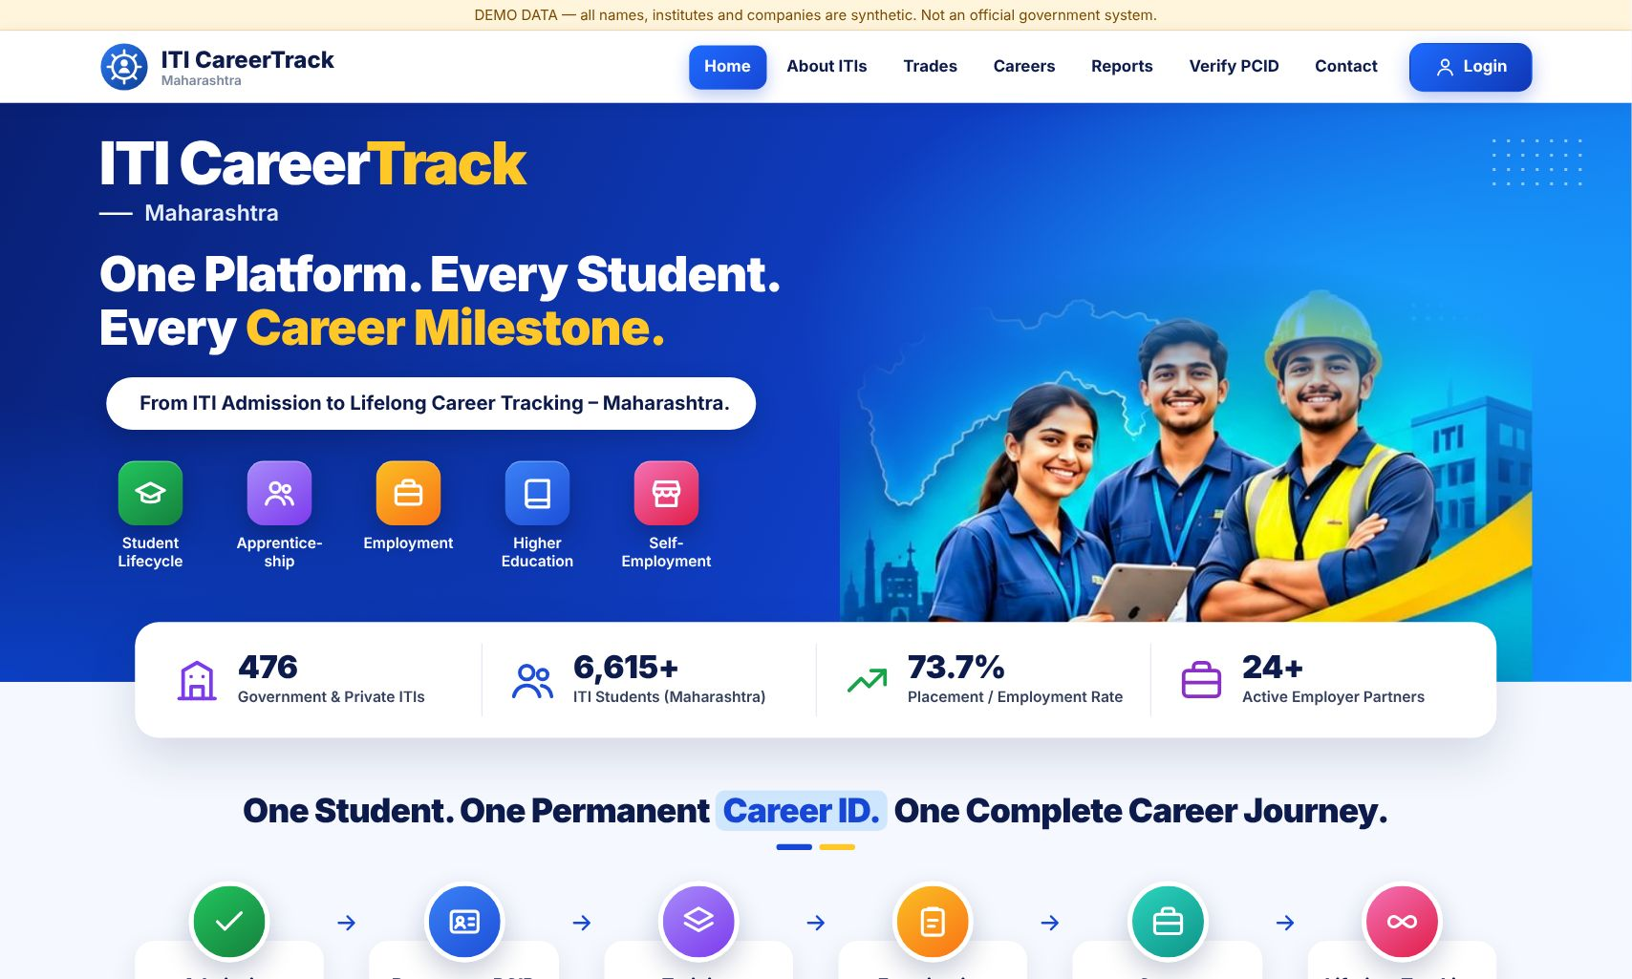
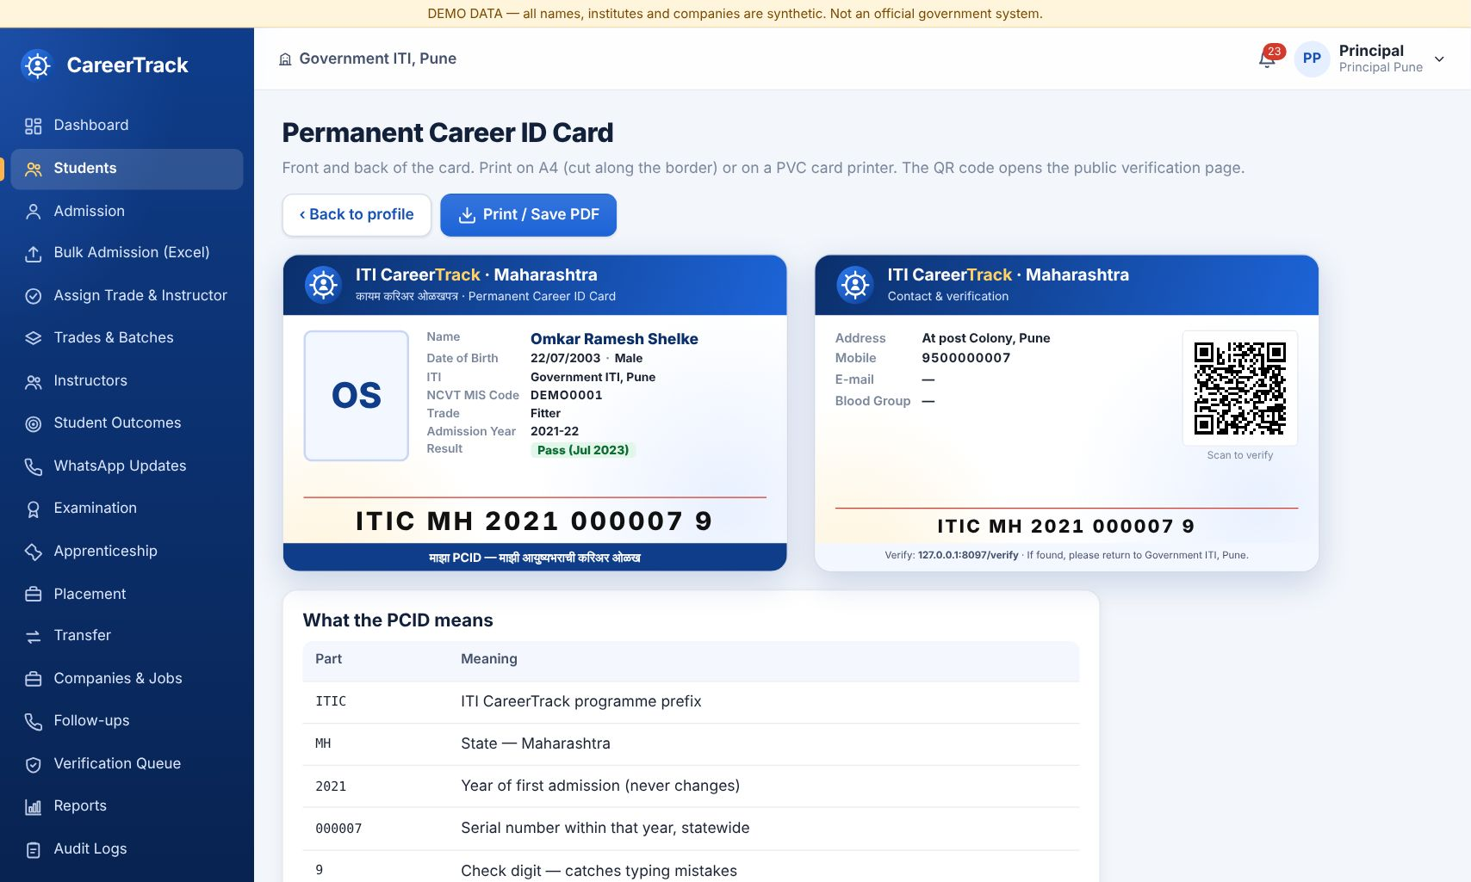
SEVA FIRST INNOVATION CHALLENGE 2026 • EDUCATION AND EMPLOYABILITY
ITI CareerTrack
One Permanent Career ID (PCID) that follows every ITI learner from admission to apprenticeship, job, business and higher studies, filled from official records and WhatsApp even when the student does not update it.
Sub-theme: 5. Apprenticeship, Internship, Placement and Employability Outcome Tracking
Applicant: Sanjay Laxman Rathod (Individual Innovator)
Stage: Working prototype, live with DEMO data
Demo: app.copamcq.com · login DEMO0001 / Demo@1234
For: Approx. 1.52 lakh trainees who appear and 1.37 lakh who pass every year, 430+ Govt ITIs, DVET
Live prototype: home page and PCID card
Notes:
Title slide. Fill every field exactly as entered in the online application form so reviewers can match the deck to the application.

Slide 2
2
The Problem
What real challenge in society, government service or industry are you solving?
What is the problem?
Who is affected, and where?
After the ITI course, nobody can see what a trainee does next. Results, apprenticeships, jobs and studies sit in separate systems, or are not recorded at all. Pass-outs rarely open portals or answer calls.
ITI trainees and pass-outs across Maharashtra, in 430+ Government ITIs and private ITIs in all 36 districts, many in rural areas. Also principals, District Vocational Training Officers (DVTO), Regional Offices and DVET.
~1.37 lakh
ITI pass-outs every year in Maharashtra whose next step is not tracked (approx. 1.52 lakh appear in exams)
Evidence
Current gaps
Why it matters
Approx. 1.52 lakh trainees appear for the final examination and approx. 1.37 lakh pass every year (DVET / NCVT results, approx.). Data is spread across NCVT MIS, the apprenticeship portal (NAPS), EPFO and colleges, with no common ID.
Manual phone surveys and registers that are slow, incomplete and unverified. Students who cannot be traced are counted as "unemployed". No permanent record follows the learner from one job to the next.
Without outcome data, trades, seats and industry links are planned blind, and the trainees still searching for work get no help.
Seva Innovation Challenge 2026 | Slide 2 of 6
Notes:
Reviewers look for a clearly defined, real and significant problem backed by evidence. One strong statistic is better than many weak ones. Cite the source for every number.

Slide 3
3
Our Solution & Innovation
What have you built or designed, how does it work, and what is new about it?
Our solution in brief
What makes it new?
A working web platform (English/Marathi, mobile). Admission, single or bulk from Excel, issues a PCID and an identity-style PCID card with a QR code. Every exam, apprenticeship, job, business and study is then added to the same PCID, with 8 role-based logins.
 | Existing approach | Our approach
Cost | Manual surveys, registers | Less than ₹5 per learner per year (est.)
Speed / time | Months; once a year | Nightly, automatic
Reach / access | Only those who answer calls | Official records + WhatsApp, rural included
Ease of use | Many portals, Excel | One PCID; reply with a number
How it works
1
2
3
Input
›
Process
›
Output
Admission data, official lists (NCVT, NAPS, EPFO, Udyam, DTE), WhatsApp replies, employer entries
Matches every record to the PCID each night (UAN, PCID, Aadhaar hash, mobile + DOB) and updates the status
Lifelong verified career profile; trade-, ITI- and district-wise outcome dashboards for DVET
Key USP
Tracks learners after they leave the ITI without depending on them: official records are matched to one PCID every night, and rural pass-outs update their status in Marathi on WhatsApp by sending one number. Unknown status is shown as "Not updated", never as unemployed.
Seva Innovation Challenge 2026 | Slide 3 of 6
Notes:
Show clearly how the solution addresses the problem on Slide 2. Compare against what exists today — reviewers score originality and relevance here.

Slide 4
4
Feasibility & Implementation
How ready is the solution, and what will it take to implement it on the ground?
Current stage (mark ✔ where you are today)
Idea
Proof of Concept
✔ Working Prototype
Field Pilot
Ready to Deploy
Technology
Estimated cost
Timeline
Partners
Software only, no hardware. PHP 8 + MySQL / MariaDB web app, mobile-responsive, WhatsApp Business API. Runs on shared hosting, a VPS or a state data centre. Tested with 459 automated checks and a load test on 2.7 lakh records.
Prototype already built. Pilot (1 district): about ₹1 lakh (hosting, training, support). State-wide: hosting about ₹2–3 lakh/year plus WhatsApp about ₹55,000/year, i.e. less than ₹5 per learner per year (estimates).
3 months: pilot in one district with real ITI data, training principals and instructors.
6 months: whole region; NCVT and NAPS data sharing; WhatsApp live.
12 months: all 430+ Govt ITIs; EPFO / Udyam links; AI-assisted analytics.
DVET (Skills, Employment, Entrepreneurship & Innovation Dept.) to adopt and pilot; DGT (NCVT MIS, NAPS), EPFO, MSME (Udyam), DTE for data sharing; employers and MSINS.
Seva Innovation Challenge 2026 | Slide 4 of 6
Notes:
Be realistic. A clear, costed plan with an identified adopting department scores better than an ambitious but vague one. Mention any validation already done (tests, user feedback, certifications).

Slide 5
5
Impact & Scalability
What change will your solution create, and how can it grow beyond the first location?
1.52 lakh
70%
1.37 lakh
Beneficiaries reached
Pass-outs with verified status
Jobs or livelihoods
trainees per year, at state-wide roll-out (approx.)
within 12 months (target), compared with no consolidated record today
pass-outs per year linked to jobs and apprenticeships (approx.)
Social impact
Sustainability
Scale-up plan
Reaches rural trainees through Marathi WhatsApp, with no app or login needed. Equal visibility for women trainees and every trade. Verified records help learners prove their experience to employers.
Low running cost (under ₹5 per learner per year, estimate), funded from the DVET / department budget. Built to run on a government server. Daily backups and automatic failover.
Pilot district → region → all 430+ Govt ITIs and private ITIs. The same model fits polytechnics and other states: only the official data links need to be configured.
Seva Innovation Challenge 2026 | Slide 5 of 6
Notes:
Quantify impact wherever possible and state your assumptions. Where relevant, link the solution to an existing Government scheme, mission or the Sustainable Development Goals.

Slide 6
6
Team/Individual & Support Required
Who is behind the idea, and what help do you need from the Challenge?
Photo
Sanjay Laxman Rathod
Support we are seeking
Individual Innovator
Concept, design and development of ITI CareerTrack (end to end)
✔ Mentorship & technical guidance
✔ Pilot with a government department
Already built and tested:
• 8 role logins (State to Student) · Excel bulk admission
• PCID card with QR · automatic linking of official records
• Marathi WhatsApp bot · daily backups and failover
• 459 automated checks passing · load test on 2.7 lakh records
Funding / grant support
Incubation & workspace
✔ Testing, certification or IP support
A DVET pilot in one district with official data access (NCVT, NAPS) would move ITI CareerTrack from prototype to real use for every ITI learner.
Built as a working prototype with synthetic DEMO data; no official logo or real student data used.
Thank you | sanjwebs@gmail.com | app.copamcq.com
Seva Innovation Challenge 2026 | Slide 6 of 6
Notes:
List only active team members. Be specific about the support requested — it helps the organisers match you with the right mentor, department or incubator.

