Slide 1


Slide 2
I
T
N
U
Department of Electronics and Communication Engineering
“Frequency Analysis of ECG Signal”
Sessional Assignment
2EC502- Digital Signal Processing
Presented By : Sanjaykumar Parmar | 18BEC069
Submitted To : Prof. Rutul Patel
Prof. Bhupendra Fataniya
E-mail: 18bec069@nirmauni.ac.in

Slide 3
Presentation Outline
Abstract
Introduction
ECG : Biological View
Electrical Conduction System of Heart
Normal Sinus Rythem
ECG Graph Paper
Abnormalities
ECG : Frequency Analysis
Fast Fourier Transform
Short Time Fourier Transform
Wavelet Transform
ECG : Python Implementation
Peak Detection
Bit per Minutes
Fast Fourier Transform
Short Time Fast Fourier Transform
Continuous Wavelet Transform
Conclusion
Bibliography

Slide 4
Abstract :
The Combination of P-wave, T-wave and QRS-Complex is known as one complete cardiac cycle of Electrocardiogram(ECG) Signal.
Electrocardiograph indicates the Electrical activities of Heart during the Polarization and Depolarization activity.
ECG is plotted on chart(graph) paper and also stored in computer(.dat or .ecg or .hea) for the analyzing purpose in the future.
The cost of ECG test is very much high. And the reason is, It requires automated ECG signal analysis techniques with the help of computerized classification which gives pretty accurate, fast and reliable detection of the disease.
Frequency Analysis & Data analysis are very much useful methods for a Biomedical Engineering research. In this presentation I will be describing the frequency analysis of electrocardiogram(ECG).

Slide 5
Introduction :
ECG is a three letter acronym for Electrocardiography. It has been derived from greek words (electro + cardio + graph) means (electricity + heart + write).
In simple words “Electrocardiography is the graphical representation of Electrical currents of the Heart”.
ECG is composite from 5 waves - P, Q, R, S and T. This signal can be measured by electrodes from the human body in typical engagement. Signals from these electrodes are brought to simple electrical circuits with amplifiers and ADC(Analog to Digital Converter).
The Heart Rate is very much important to check the health status. The frequency measurement is a very useful in medical and sports application. One of possible ways to get the heart rate frequency is to compute it using ECG Signal. And it can be done by many different ways and algorithms.

Slide 6
ECG
Biological View

Slide 7
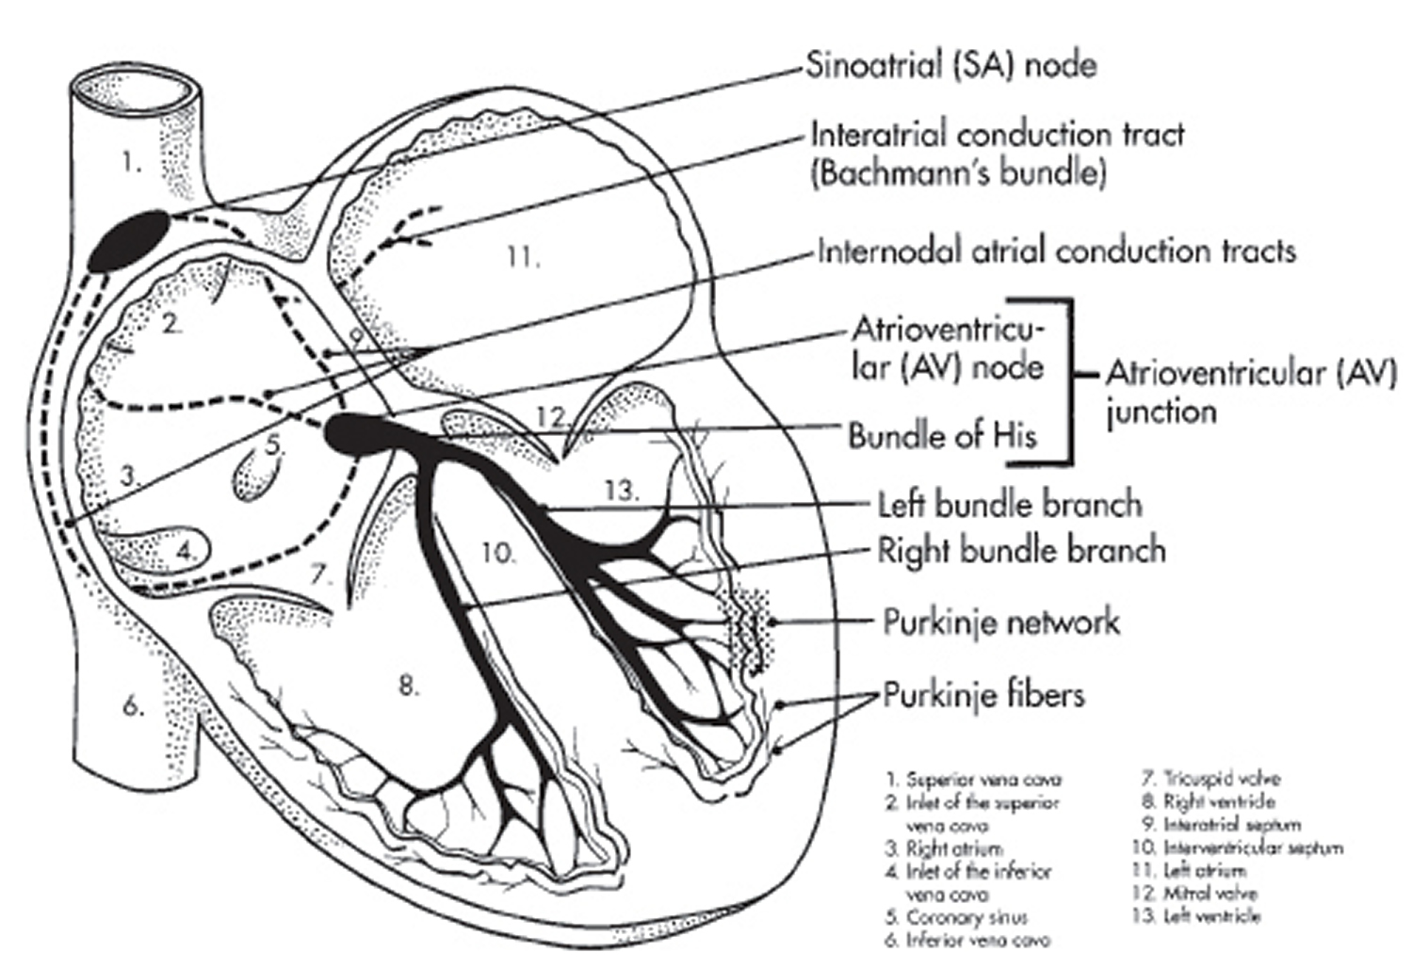
Electrical Conduction System of Heart
Each Cardiac Cycle starts electrically discharging from Right Atrium i.e. Sinotrial (SA) Node.
Depolarization spreads through the atrial muscle fibers.
There is a delay while polarization spreads through another special area in the atrium, the atrioventricular (AV) mode.
Thereafter the electrical discharge travels very rapidly, down specialized conduction tissue : First a single pathway, the ‘bundle of his’ which then divides in the septum between the septum between the vetricles into the right and left bundle branches.
Within the ventricular mass, conduction spreads somewhat moreslowly, through the specialized tissue called ‘Purkinje Fibres’.

Slide 8
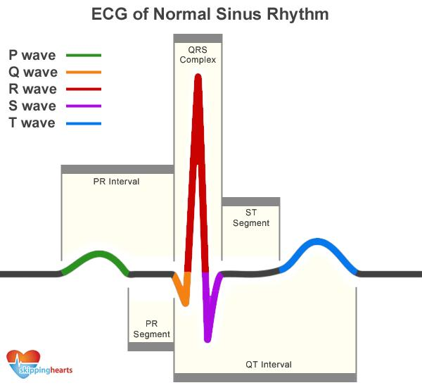
Normal Sinus Rythem

Slide 9
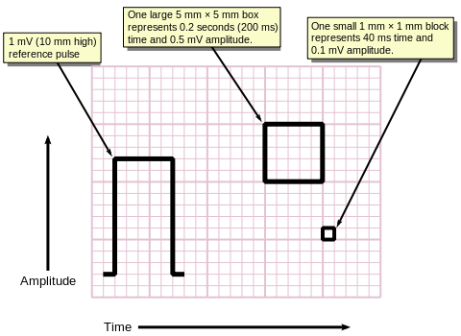
ECG Graph Paper

Slide 10
Abnormalities
Abnormality | Characteristics
Bradycardia | R-R Interval > 1s
Tachycardia | R - R Interval < 0.6s
Hypercalcaemia | QRS Interval < 0.1s
Dextrocardia | Inverted P-wave
Hyperkalemia | Tall T-wave and absence of P-wave
Sudden Cardia Death | Irregular ECG
Sinoatrial Block | Complete drop out of cardiac cycle
Miocardial Ischemia | Inverted T-wave

Slide 11
ECG
Frequency Analysis

Slide 12
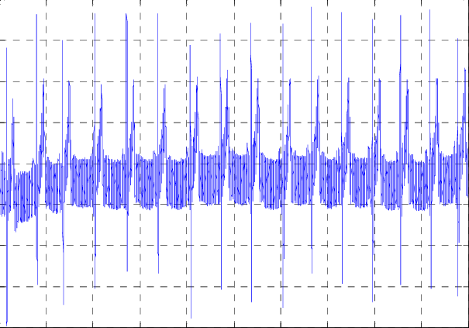
Frequency Analysis of ECG Signal
Digital Signal Processing and Heart Rate calculation of the ECG signal can be acquired by measurement card with sampling frequency fs = 500 Hz. And this sampled signal was used as input signal for the digital filters and the heart rate detection algorithms designing and testing.

Slide 13
Fast Fourier Transform
In earlier days Time Domain Method was used for the ECG Signal Analysis. But it was not sufficient to study all the characteristics of ECG Signal. So, the new method named FFT is been introduced. Fourier Transform is well known for transformation of Time Domain Signal to Frequency Domain to obtain the frequency coefficients. It is much faster and more capable algorithm to work out the DFT and obtains the same effect. FFT is defined by the formula :
Where k is an integer ranging from 0 to N-1
ECG signals can be compressed by using variety of techniques. One of the most important techniques is FFT. The process is consisting of :
Obtaining an ECG sample or input signal.
Compressing the input signal by removing the low frequency components.
Recovery of the original signal by using inverse FFT
But the FFT fails to provide the information regarding the accurate location of frequency components in time.

Slide 14
Short Time Fourier Transform
STFT is consisting of both Time and Frequency information. The Spectrogram based on STFT is a very simple and fast technique in comparison to other time–frequency analysis. It is an easy approach of slicing the waveform of our interest into a large number of short-segments. Then it analyzes each segment using standard Fourier transform.
In this method, A window function is applied to a segment of data, efficiently isolating that segment from the overall waveform, and then Fourier transform is applied to that segment.
For a signal x(t), the definition of STFT can be given as :
Where, w(t) is the window with Duration = T and Centered at time location t.
STFT = Fourier Transform of windowed Signal x(t)w(t-ԏ)
Limitation : Its time frequency precision is not optimal.
So, To overcome this drawback we will be looking for more suitable technique. i.e. Wavelet Transform.

Slide 15
Wavelet Transform
For variety of Applications, there are various Wavelets available which includes :
Biorthogonal, Haar, Coiflet, Symlet, Daubechies Wavelets, etc.
Some features which make them useful are:
Wavelets are localized in both time and frequency.
For analyzing non-stationary signals such as ECG which have frequent level variations and uneven features.
Wavelet separates a signal into Multi Resolution components.
The Wavelet Transform is a linear process that decomposes the signal into a number of scales associated with frequency components and analyzes each scale with a certain resolution. One of the major advantages of Wavelet technique is that many different Wavelet functions are available and that allows user selecting the best function for analyzing the signal, whereas in the case of Fourier analysis it is restricted to one feature morphology that is the sinusoidal.
Wavelet transforms can be classified into two categories :
Continuous Wavelet Transforms (CWT)
Discrete Wavelet Transforms (DWT)

Slide 16
Wavelet Transform Cont.
Continuous Wavelet Transform : It is the method for Time-Frequency Analysis. It differ from the conventional method STFT in the only case that “It allows high localization in time of high frequency signal features”.
The CWT of a signal x(t) is defined as :
Where,
h(t) is mother wavelet
a is scaling parameter in y-axis
b is the shift parameter in x-axis
Discrete Wavelet Transform
The DWT is defined as :
Where Ψ(t) is a time function with finite energy and fast decay called the mother of wavelet.

Slide 17
ECG
Python Implementation

Slide 18
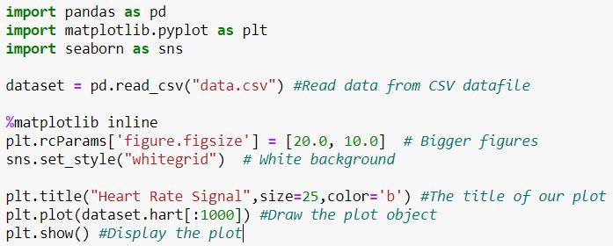
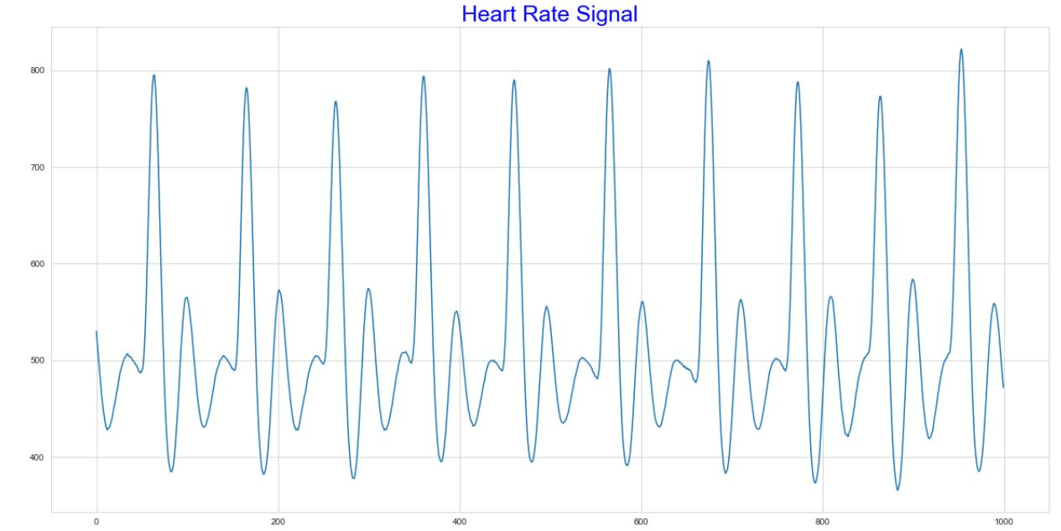
Plot ECG Signal

Slide 19
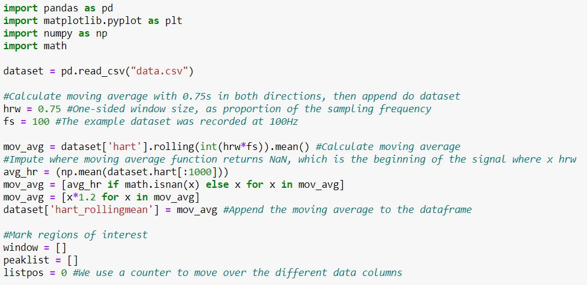
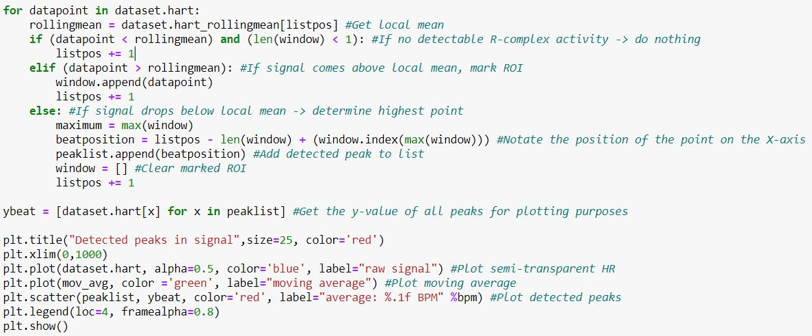
Peak Detection

Slide 20
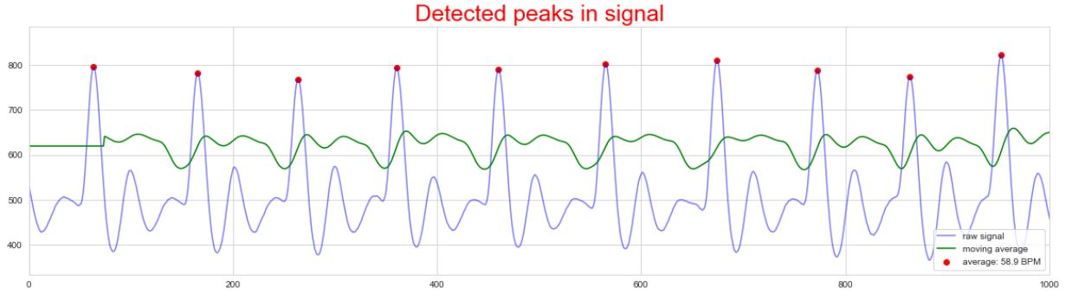
Peak Detection Cont.

Slide 21
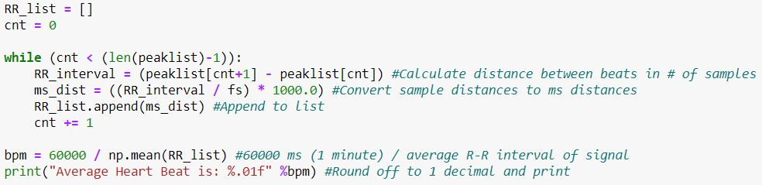
Average Beat per Minute (BPM)
Result : Average Heart Beat is: 58.9

Slide 22
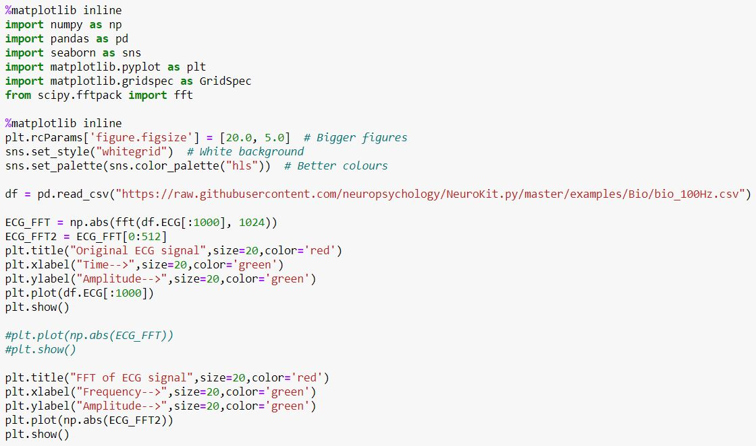
Fast Fourier Transform

Slide 23
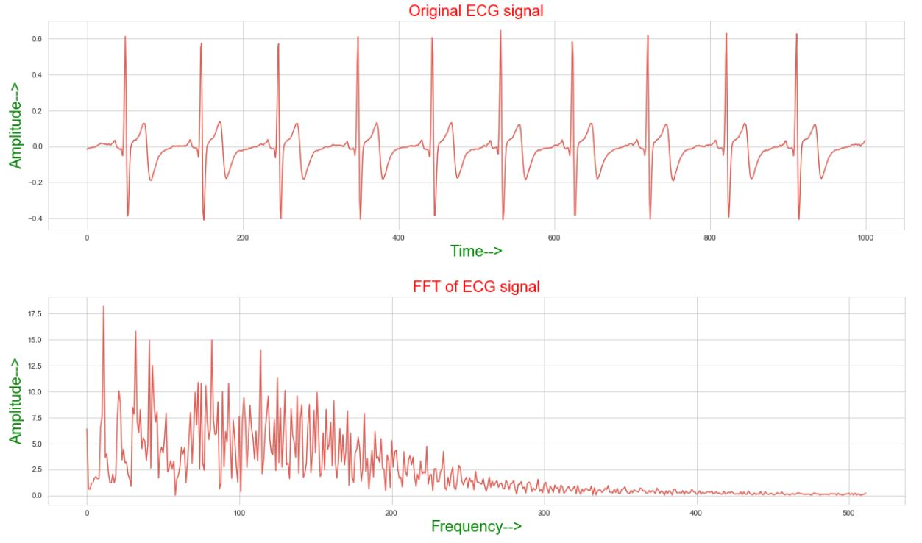
Fast Fourier Transform Cont.

Slide 24
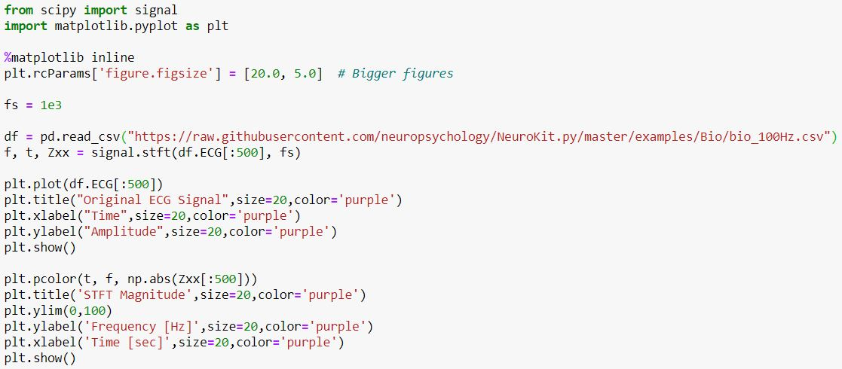
Short Time Fourier Transform

Slide 25
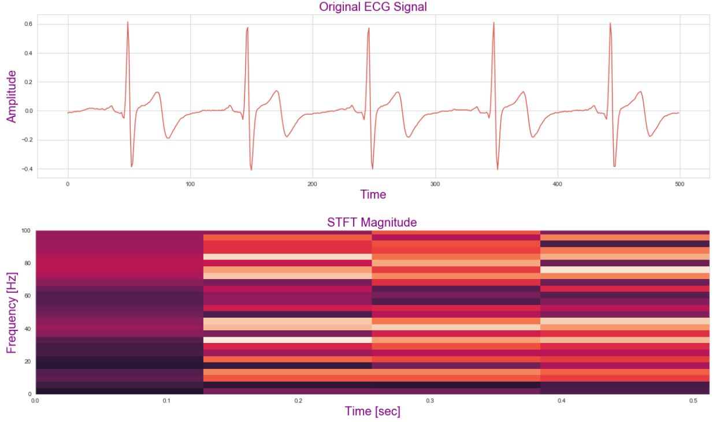
Fast Fourier Transform

Slide 26
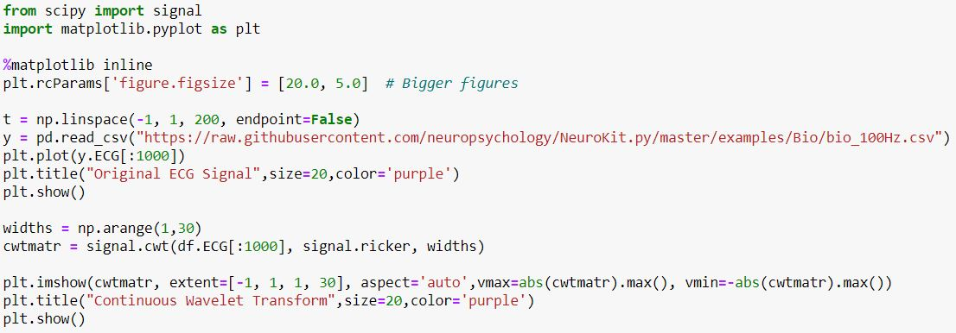
Continuous Wavelet Transform

Slide 27
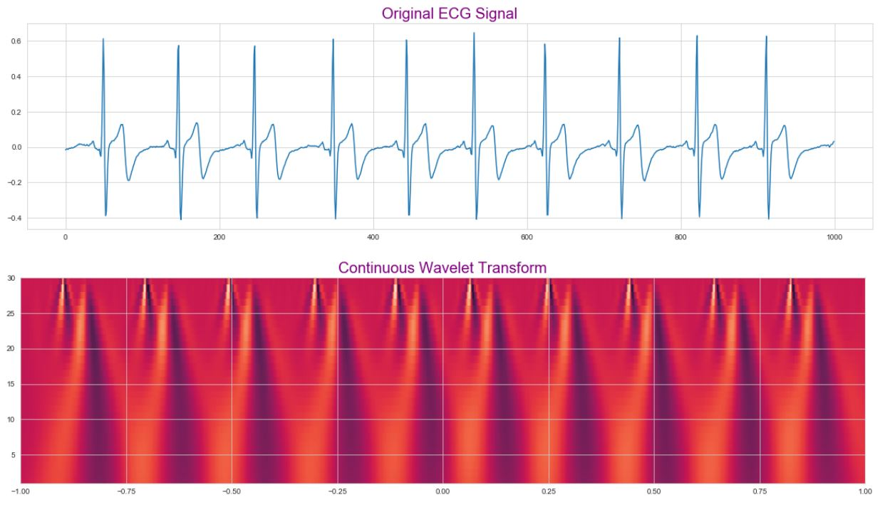
Continuous Wavelet Transform Cont.

Slide 28
Conclusion
This presentation gives a review on various techniques used to detect abnormalities in ECG signal. Wavelet Transform is the flexible tool which can be used for ECG signal analysis.

Slide 29

Bibliography
Concept
Electrocardiogram Signal Analysis - An Overview by Rajni and Indebir Kaur
Tutorials & Examples
Github : Neurophysiology
Facts and Statements
PPT - Electrocardiography by Dr. Anwar Hasan Siddiqui, Dept. Of Physiology at JNMC

Slide 30
Thank You

