Slide 1


Crash AI Detection System
An advanced real-time AI solution for crash detection.
by Sanju

Slide 2
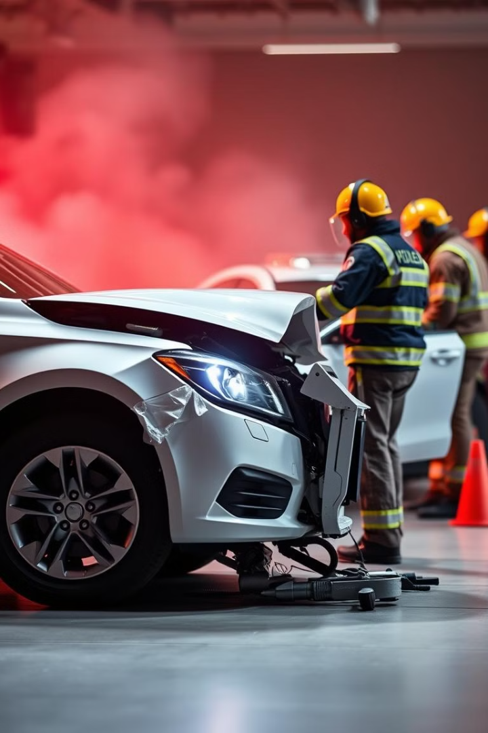
Project Overview
Cutting-edge AI
Enhanced Accuracy
Crash detection system.
Responsiveness and reliability.
Multi-platform Compatibility
Real-time Detection
Emergency response.
PC & Mobile.

Slide 3
System Design Details
IDE
Languages
Backend
Frontend
PyCharm, Android Studio.
Python, Dart, Java.
Firebase, FCM.
Tkinter, Flutter.

Slide 4

AI Frameworks & Libraries
YOLOv8
Torch & Torchvision
Object detection model.
Training and deployment.
OpenCV-python-headless
Dataset
8,600+ labeled images and videos.
Image and video processing.

Slide 5
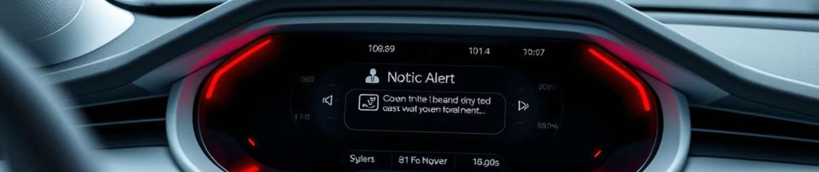




Key Features
Real-time Detection
Automated Notifications
Cross-platform Integration
Image & Video Processing
Processes video feeds.
Alerts to responders.
PC and mobile sync.
Handles high-resolution streams.

Slide 6
System Advantages
Efficiency
Scalability
Real-time operation.
Supports expanding datasets.
Accuracy
Cost-Effective
Reduces false positives.
Cloud-based infrastructure.
Data Security
User-Friendly
Robust Firebase protocols.
Intuitive design.

Slide 7
Technologies & Tools
IDE
Frameworks
Backend
Image & Video Processing
PyCharm, Android Studio.
Flutter, PyTorch.
Firebase.
OpenCV-python-headless.

Slide 8
Workflow Diagram
Data Collection
1
Images and videos labeled.
2
Model Training
YOLOv8 trained using PyTorch.
Video Stream Input
3
Live feeds processed using OpenCV.
4
Real-time Detection
AI model identifies crash events.
Notification Trigger
5
Firebase sends alerts.
6
Result Display
Outputs shown on PC and mobile.

Slide 9
Implementation Details
Development
1
Setting up IDEs, training models, backend integration.
Testing
2
Extensive testing with diverse scenarios.
Deployment
3
Deployment on PC and mobile platforms.

Slide 10

Conclusion
Revolutionizing Crash Detection
Enhanced Responsiveness
AI-driven solutions.
Multi-platform usability.
Scalable System
Improving Emergency Response
Ready for future advancements.
Saving lives.

