Slide 1
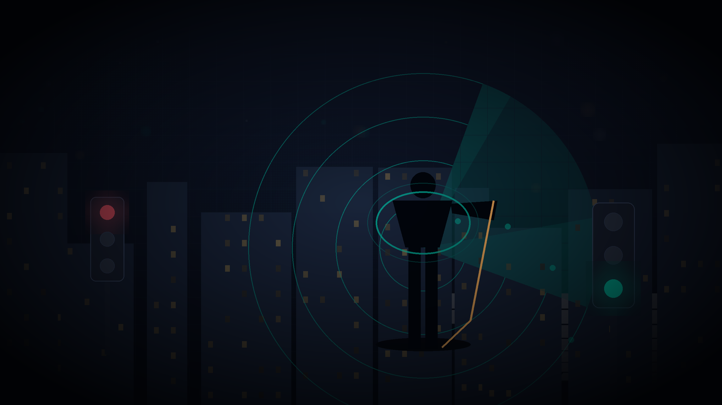

S
SENTINEL v0.1.0
LIVE / OFFLINE / PWA
THE HAPTIC CO-PILOT FOR PEOPLE WHO CANNOT SEE
SENTINEL
Most assistive tech narrates what you point at. Sentinel watches the world for you - every car, crowd, kerb and crosswalk - and only speaks when it matters.
2.2B
4
100%
people with vision impairment
pillars - one brain
on-device AI

Slide 2

THE PROBLEM IS THE SCALE
2.2 billion people walk a world
that was built for eyes.
Every commute is a sequence of gambles - crossing, catching, finding, turning. Sound and memory are doing all the seeing.
2.2B
36M
6s
PEOPLE
HAVE NO SIGHT
OF ATTENTION
live with a vision impairment worldwide (WHO).
at all. The world they share is not designed for them.
is all narration yields before the ear tunes it out.
The real scarcity is not sight. It is attention.
SENTINEL / silence-first, because attention is the scarce resource
02

Slide 3
THE PROBLEM - EXISTING TOOLS FAIL
Their guide AI talks. Noise, not safety.
We analyzed Envision, Seeing AI, Google Lookout, Be My Eyes, Aira, WeWALK, NaviBelt, ASHIRASE, Soundscape and 15 more products + the 2024-25 haptic-navigation literature.
1
REACTIVE NARRATION
2
NOTIFICATION FATIGUE
They only describe what you point at them. If you cannot think to ask, you never find out. The 2.2B who need help most get the least of it.
"Arriving at... arriving at..." Constant narration trains the ear to ignore the voice - exactly when it matters most. Users mute the tool that exists to help them see.
THE RESULT: attention, not information, is the scarce resource - and everyone is wasting it.
SENTINEL / silence-first, because attention is the scarce resource
03

Slide 4
THE GAP - A 2X2 NO ONE OCCUPIES
Nobody occupies this square.
Every competitor is stuck somewhere in the grey. Sentinel is alone in the bright one.
REACTIVE
PROACTIVE
Seeing AI
Be My Eyes / Aira
narrates everything you point at it.
a human on the other end of your camera.
WeWALK / NaviBelt
SENTINEL
haptic hardware, but single-purpose and blindness-only sensors.
proactive ambient sensing + haptic-first + on-device + silence-first salience.
NARRATION-FIRST
HAPTIC-FIRST
ONE product. FOUR capabilities. THAT is the entire gap.
SENTINEL / silence-first, because attention is the scarce resource
04

Slide 5
THE CORE INSIGHT
Silence is not the absence of help.
It is the product working.
We inverted the assistive-tech model: instead of narrate-everything, Sentinel scores every event by imminence x actionability x non-redundancy - and surfaces the ONE thing that matters, only when it matters. Everything else is logged, never spoken.
WATCH
>
SCORE
>
DECIDE
>
ACT
>
SILENCE
Every down-voted alert is stored in the Silence Log - visible proof Sentinel is watching, choosing, and deliberately staying quiet.
THE HEADLINE COMPETITORS CANNOT PRINT: attention saved.
SENTINEL / silence-first, because attention is the scarce resource
05

Slide 6
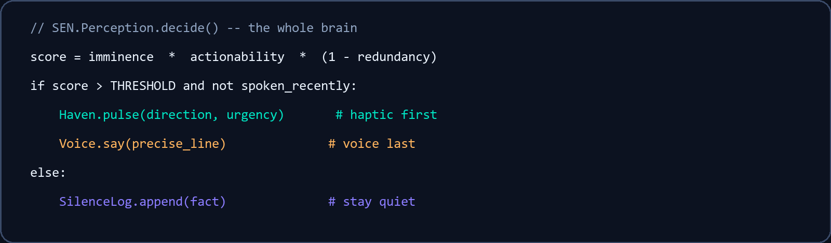
HOW IT WORKS - THE SALIENCE BRAIN
A salience brain, not a vision app.
PERCEPTION
1
the whole brain, in 7 lines
Webcam YOLOv8-nano + MiDaS depth, or a simulated city - cars, crowds, approach velocity, kerbs. On-device.
SALIENCE
2
Perception.decide() scores imminence, actionability and redundancy on every event.
DECISION
3
Surfaces the single most important item - only when it matters. Rejects go to the Silence Log.
HAPTIC FIRST
4
Direction + urgency pulses on the wearable belt. No listening tax, no ear fatigue.
VOICE LAST
5
One precise earned line - "Turn right - the cafe, 32 meters." Then silence.
SENTINEL / silence-first, because attention is the scarce resource
06

Slide 7
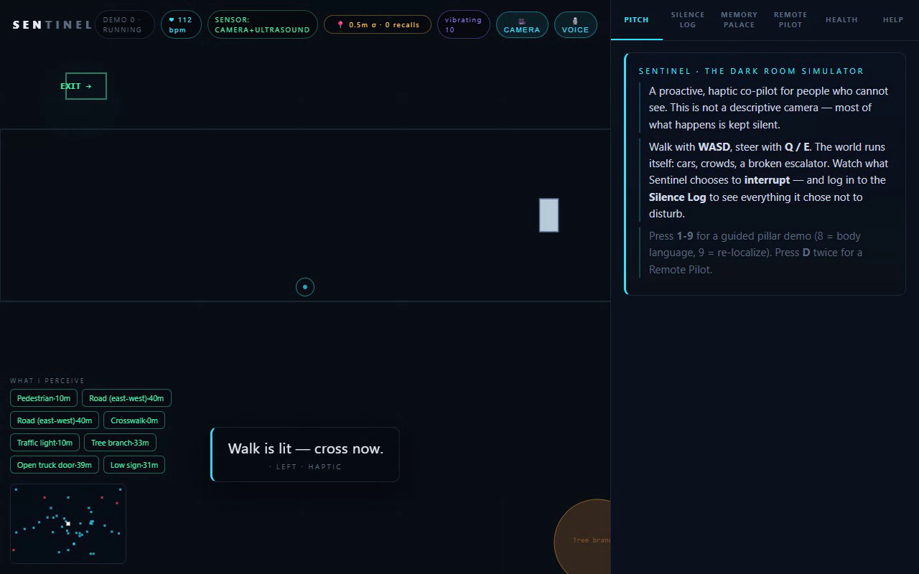
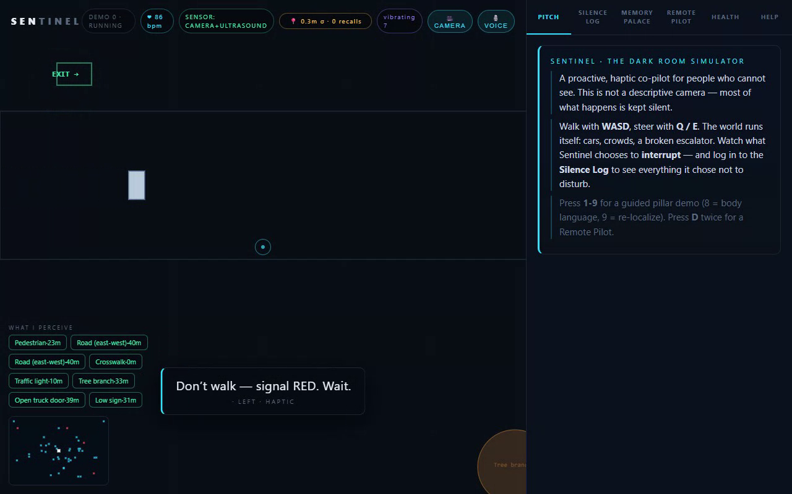
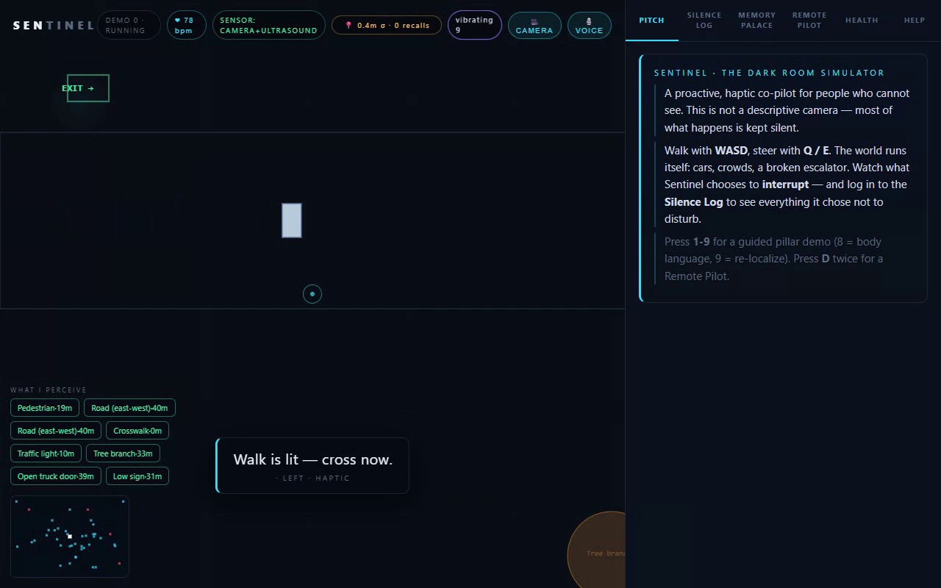
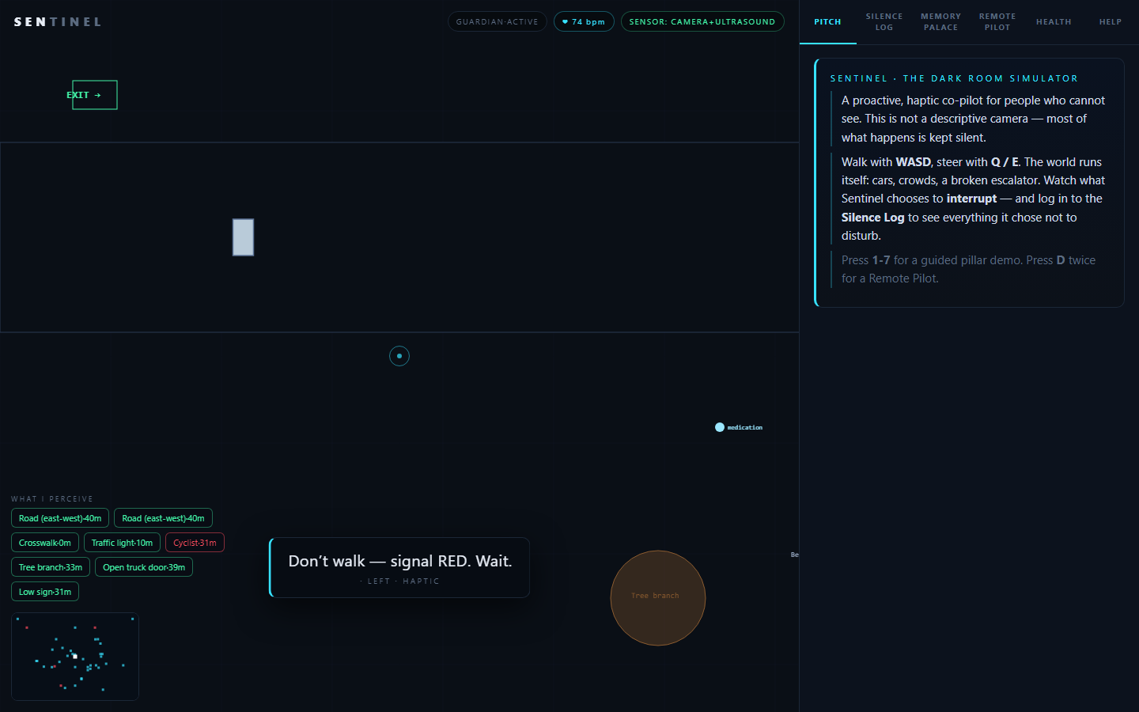
press 0 = AUTO TOUR
LIVE DEMO - DEPLOYED, RUNNING
This is running right now.
Not a mockup. An installable PWA that works fully offline - camera, YOLO, depth, haptics, voice.
AUTO TOUR
GUIDED NAV
Sentinel walks ITSELF through the plaza - crosswalk, exit, keys, cafe, loop-close.
Nearest landmark, spoken side + distance nudges ("Turn right - the cafe, 32m").
VOICE + MEMORY
THE FULL APP
Say "where are my keys" - routed to the Memory Palace, answered.
Dark HUD, Silence Log, pillar tabs, haptic belt ring, in-browser radar.
DEPLOYED
OFFLINE-FIRST
INSTALLABLE
0 DEPENDENCIES
ON-DEVICE AI
SENTINEL / silence-first, because attention is the scarce resource
07

Slide 8
THE FOUR PILLARS
One brain. Four domains.
A single salience engine serving every part of a daily life.
GUARDIAN
MEMORY
1
2
SAFETY / NAVIGATION
COGNITION / MEMORY
Traffic alerts, obstacle avoidance, path finding. The watch that never blinks.
Memory Palace - "did I leave my keys?" - plus beacon-free visual SLAM.
SOCIAL
HEALTH
3
4
COMMUNICATION
BODY / ECOSYSTEM
Remote pilot: a trusted contact sees through your eyes, in real time.
Heart rate (rPPG) + medication reminders. Health that hides in the background.
SENTINEL / silence-first, because attention is the scarce resource
08

Slide 9
THE STACK - PRIVACY BY PHYSICS
Everything on-device. Zero cloud.
A server is a liability, not a feature. Vanilla JS ES-modules + WebAssembly.
YOLOv8-nano
MiDaS v3.0
real-time detection in the browser via onnxruntime-web (WASM)
monocular depth to real meters, fused with YOLO boxes
Visual SLAM-lite
Kinesthesis
dead reckoning + loop closure - position belief with sigma
posture + approach intent from physics only - never faces
Haven haptics
Voice + Guide
NaviBelt direction + urgency: vibrate, spatial audio, motor plug
one-shot Web Speech input; turn-by-turn nudges with haptics
Fusion
PWA + Capacitor
GPS / compass / accelerometer merged with SLAM
offline service worker, manifest, installable, native shell
PRIVACY BY PHYSICS: scenes, keys and health data never leave the phone. The camera is the only sensor.
SENTINEL / silence-first, because attention is the scarce resource
09

Slide 10
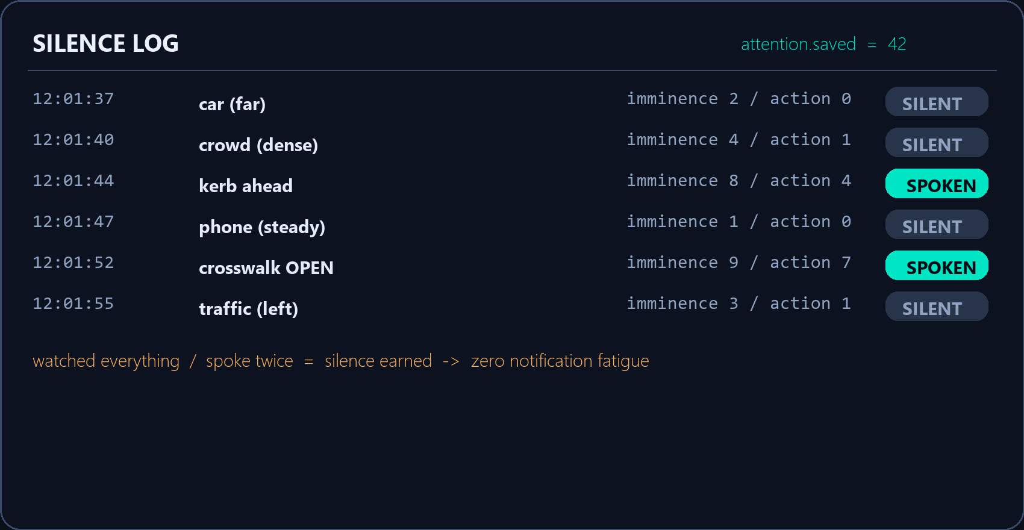
THE PROOF THAT BREAKS THE MARKET
We prove it works by showing the silence.
The Silence Log is the competitor-impossible feature: knowing when NOT to speak.
THE METRIC EVERYONE IGNORES
ATTENTION SAVED
Every good no-speech is a prevented interruption. Sentinel converts the world into decisions, and only the right one becomes sound.
"car (far)" -> silent.
"crosswalk OPEN" -> ONE earned line.
then silence again.
SENTINEL / silence-first, because attention is the scarce resource
10

Slide 11
ROADMAP
Prototype proven. Field is the last mile.
The salience-first difference already works in the browser today.
NOW
NEXT
THEN
Hardware spine
Field study
Pilot
Swap the in-browser haptic stand-in for a LiDAR phone + a real wearable at Haven.pulse().
20 blind users, 4 weeks, real streets. Measure attention-saved vs. narrator apps.
Remote-pilot network + pharmacy translation (EN-Hindi) already prototyped.
The differentiator - salience before speech - is shipped. The field is the last mile.
SENTINEL / silence-first, because attention is the scarce resource
11

Slide 12
WHY SENTINEL WINS
Judge the gap, not the polish.
We stand on a working, deployed, offline-first prototype - and real recordings against the real app.
1
Silence-first salience filter
the brain competitors do not have - known-when-NOT-to-speak.
2
On-device everything
privacy by physics - scenes, keys, health never upload.
3
Deployed + demonstrable
PWA live, 3 demo recordings, narrated walkthrough, 23/23 smoke tests green.
Take 40 seconds: sanju-zxt.github.io/sentinel-prototype
SENTINEL / silence-first, because attention is the scarce resource
12

Slide 13
CLOSE
"The best accessibility feature is one you never notice working.
Thank you.
Sentinel - silence-first, because attention is the scarce resource.
sanju-zxt.github.io/sentinel-prototype

