Slide 1
Bank Customer Churn Prediction and Risk Analytics
Finding who will leave, why, and whom to call first
D.R.Sanjanaa · 2026165031
Churned (21.2%)
Stayed
1 dot = about 1,650 customers
Notes:
Introduce the project: we predict which bank customers will leave, explain why, and rank who the retention team should call first. The dots show the core issue: about 1 in 5 of the 165,034 customers leave.

Slide 2



Why banks worry about churn
A quiet loss
165,034 customers in our dataset
Customers rarely complain. By the time the account closes, the chance to act has passed.
Nobody can call everyone
21.2%
A retention team needs to know who to contact, and early.
churned
Accuracy hides the problem
Predicting “stays” for everyone is about 79% right and finds nobody.
Stayed 130,113
Churned 34,921
Notes:
Customer churn means a customer closing an account or stopping use of the bank. Banks cannot manually watch every customer, and churners are a minority, so plain accuracy is misleading. Dataset: 165,034 customers, 34,921 churned (21.16%).

Slide 3



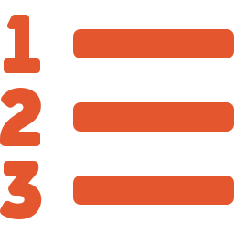
Four things that make it hard
Few churners
Weak single signals
Only 21.2% left, so a model can look accurate and still miss most of them.
No single column is strongly tied to churn (top correlation 0.34). Risk hides in combinations.
Scores need reasons
A score is not an action
A retention manager will not act on a number nobody can explain.
With 165,034 scores, where does the team start?
Base paper recall: 0.56. 44 of every 100 customers who left were never flagged.
Notes:
The problem is not just predicting churn. Class imbalance, weak single signals, the need for explanations and the need for prioritisation are what make this hard. A model that says everyone stays is about 79% accurate and catches zero churners.

Slide 4
What we set out to do
1
2
3
Reproduce the XGBoost baseline of the base paper
Find which customer groups churn the most
Compare SMOTE with class weighting
4
5
6
Choose the decision threshold on training data only
Explain every score with SHAP and risk tiers
Build a web app that scores one customer or a whole file
Notes:
Six measurable objectives. Each one maps to an output later in the deck: EDA charts, risk profiles, the model comparison, SHAP plots and the dashboard.

Slide 5
What others did, and the gap we found
Related work
Gaps we address
Study | Method | Reported
Bhuria & Aluvala (2025), our base paper | XGBoost | Churn recall 0.56
Hon et al. (2023) | Six classifiers, XGBoost best | F1 57.0%
Andespa et al. (2025) | Random forest and XGBoost + SMOTE | F1 0.873 (richer data)
Recall of only 0.56
Tuned model, recall 0.701
►
SMOTE assumed to help
Tested against class weights
►
Cut-off may peek at test data
Chosen on training data only
►
Scores stop at a table
Tiers, reasons and an app
►
Notes:
The base paper reports churn recall 0.56 and gives little beyond one overall score. We compare SMOTE with class weighting, choose the threshold on training data only, and go beyond prediction with tiers, SHAP reasons and an app.

Slide 6
The data:
Numeric and yes/no inputs (8)
165,034
21.16%
CreditScore
Age
Tenure
23k customers, 14 columns
churned (34,921 left)
Balance
NumOfProducts
HasCrCard
IsActiveMember
EstimatedSalary
3
0
One-hot encoded (2)
countries: France, Germany, Spain
missing values or duplicate rows
Geography
Gender
Target
Dropped identifiers (3)
Exited = 1 if the customer left
id
CustomerId
Surname
Training uses 132,027 customers; the untouched test set has 33,007 (80/20 stratified split).
Notes:
Dataset: bank_churn_large_labelled.csv. Identifiers (id, CustomerId, Surname) were dropped because they carry no predictive meaning. For analysis we also built age groups, product groups (1, 2, 3-4), activity and a zero-balance flag. Note: CustomerId repeats (23,221 unique values across 165,034 rows), so rows are records, not necessarily unique people.

Slide 7
How the system fits together
ANALYSIS PATH
Exploratory analysis
Risk profiling
churn rates and tests
groups ranked with 95% ranges
Raw dataset
Data preparation
Risk tiers and flag
165,034 customers, 14 columns
drop IDs, build groups, 80/20 split
Low, Medium, High; flag at 0.63
Model training
Explainability
class weights, tuning, threshold
SHAP reasons per score
MODEL PATH
Everything is fitted on training data only. The test set is used once, for reporting.
Notes:
Walk the diagram left to right. The cleaned data splits into an analysis path (EDA, risk profiling) and a model path (training, SHAP). Both end in risk tiers and the web application.

Slide 8






Tools and libraries we used
Data and statistics
Modelling
Explainability
pandas
NumPy
scikit-learn
XGBoost
SHAP
SciPy
imbalanced-learn
Cleaning, groups, chi-square tests
Pipeline, tuning, SMOTE
A reason for every score
Visualisation
Web application
Environment
Matplotlib
Seaborn
Dash
plotly
Python 3
Jupyter Notebook
Plotly
EDA charts and dashboard plots
Scoring page and saved model
All experiments in one notebook
Notes:
pandas/NumPy for data, SciPy for chi-square and Mann-Whitney tests, scikit-learn pipelines, XGBoost, imbalanced-learn for SMOTE, SHAP for explanations, Matplotlib/Seaborn/Plotly for charts, Dash for the application and joblib to save the trained model.

Slide 9
Exploratory analysis: what we examined
Base-paper style EDA
Our additions beyond the base paper
Churn distribution
Retained vs churned, class imbalance
Heatmaps
Age × activity; country × age × products
Geography, gender, activity
France, Germany, Spain; female vs male; active vs inactive
Geographic view
Country churn map and customer mix
Products and age
Churn by product count, KDE and age groups
Multi-factor profiling
High-risk combinations, lift and 95% intervals
Numerical features
Box plots: credit score, balance, tenure; age KDE
Statistical testing
Chi-square, Mann–Whitney U, effect sizes
Credit card and balance
Card ownership; zero vs non-zero balance
Why this matters
Correlation matrix
All features against Exited
No single column explains churn. The extra analysis finds the combinations that do, and tests that they are real.
Hypotheses tested: Germany, older age and inactivity raise churn; 2 products is safest; card, tenure and salary matter little.
Notes:
Section 6 of the notebook reproduces the base-paper style EDA (distribution, single factors, correlation). Sections 7, 8 and 15 go beyond it: heatmaps, map, multi-factor risk profiles with confidence intervals, and significance tests with effect sizes.

Slide 10
Churn distribution: about 1 in 5 customers leaves
Churned vs retained customers
130,113
34,921
retained customers (78.8%)
churned customers (21.2%)
What the imbalance means
Plain accuracy is misleading: “everyone stays” is already 79% right.
We judge models on churn-class recall, with precision, F1 and ROC-AUC alongside.
Imbalance is handled in training (class weights vs SMOTE) and by choosing the decision threshold.
n = 165,034
Notes:
Class balance. 130,113 retained vs 34,921 churned (21.16%). A model that predicts everyone stays would score about 79% accuracy and catch no churners, which is why recall on the churn class is our main metric.

Slide 11
What single factors tell us: country, gender, activity
Churn rate by country
Churn rate by gender
Churn rate by activity
Germany churns at more than twice the rate of France or Spain.
Women churn at 28.0%, men at 15.9%.
Inactive members churn more than twice as often.
Overall churn is 21.2%. Each of these gaps is statistically significant, but country and activity matter more than gender.
Notes:
Churn rate = churned customers divided by customers in each group. Overall churn is 21.2%. Germany 37.9% (n=34,606) vs France 16.5% (n=94,215) and Spain 17.2% (n=36,213). Female 28.0% (n=71,884) vs male 15.9% (n=93,150). Inactive 29.7% (n=82,885) vs active 12.5% (n=82,149). These describe patterns in past data, not proven causes.

Slide 12
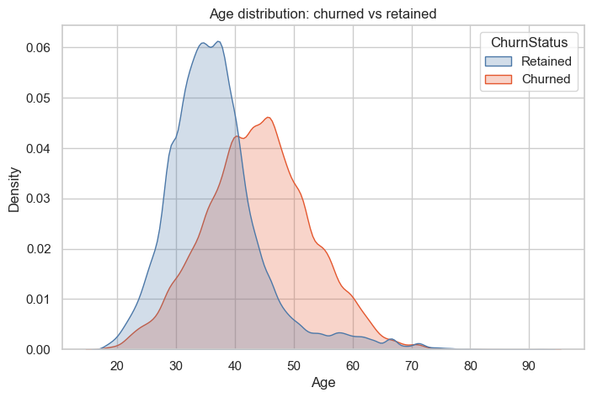
Products held and age: the two strongest signals
Churn rate by products held
Churn rate by age group
Age distribution (KDE)
Two products is the safe spot. Three or four almost always leave (n = 3,369).
Churn climbs with age and peaks at 50–59 (60.9%).
Churners are concentrated between 40 and 60; retained customers sit in their 30s.
Age and number of products are the two largest effects in the data.
Notes:
Products: 1 = 34.7% (n=77,374), 2 = 6.0% (n=84,291), 3 = 88.3% (n=2,894), 4 = 87.6% (n=475). Age groups: 18-29 8.4%, 30-39 10.8%, 40-49 34.8%, 50-59 60.9%, 60+ 34.9%. The KDE shows churned customers are concentrated at ages 40 to 60. The 3 and 4 product groups are small (about 2% of customers), so segment size matters.

Slide 13
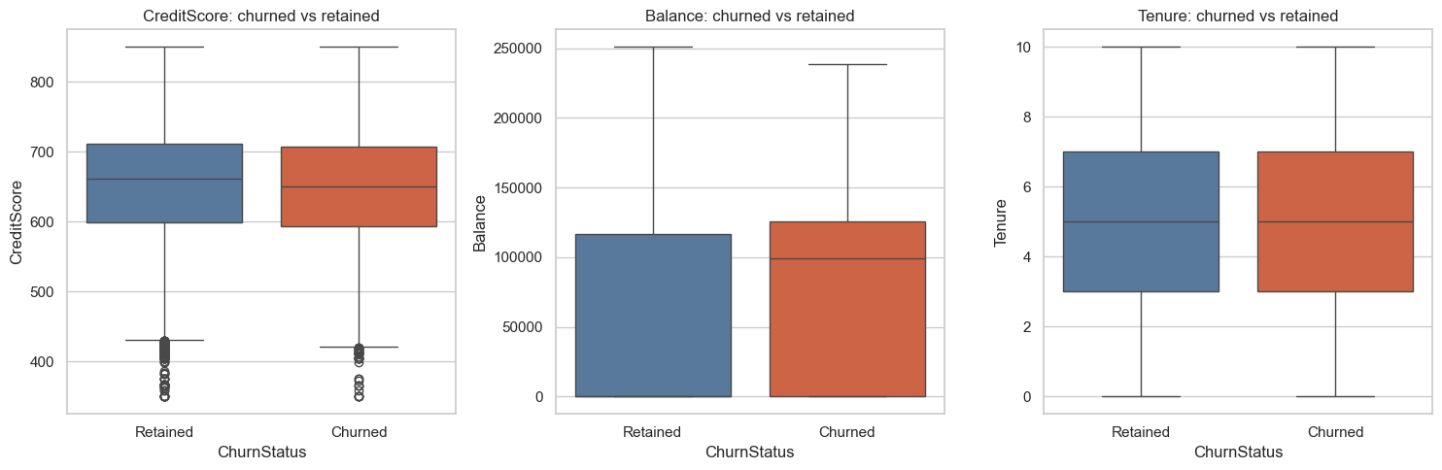
Numerical features: age and balance separate churners
Credit score, balance and tenure: churned vs retained
44.0 vs 36.6
mean age: churned vs retained
98,956 vs 0
median balance: churned vs retained
652 vs 658
mean credit score: churned vs retained
Credit score and tenure boxes almost overlap: they tell us little. Balance differs: half of retained customers hold zero balance, while the typical churner holds about 99,000.
4.9 vs 5.0
mean tenure (years)
Age is shown as a KDE on the previous slide; the box-plot trio covers the other numeric inputs.
Notes:
Box plots compare churned and retained customers. Age: mean 44.0 vs 36.6. Balance: median 98,956 for churned vs 0 for retained (more than half of retained customers have zero balance). Credit score: mean 652 vs 658. Tenure: mean 4.9 vs 5.0. Estimated salary: 114,403 vs 112,084.

Slide 14
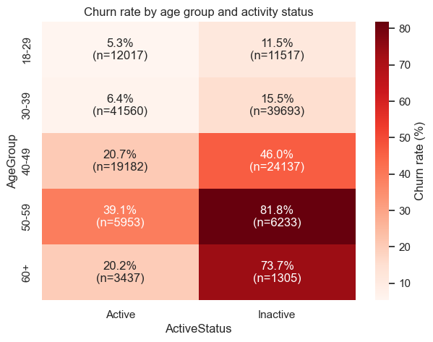
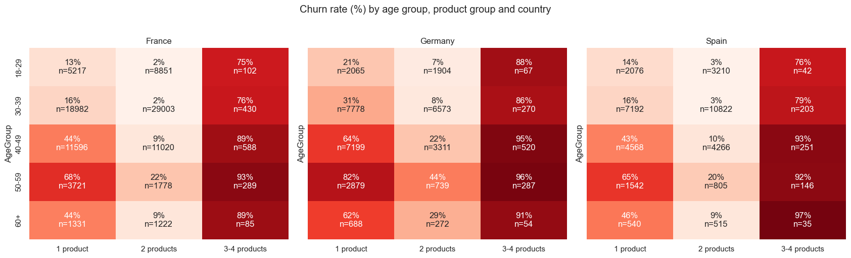
Heatmaps: combining factors finds the hot spots
Age group × activity status
Country × age group × number of products
81.8%
82%
2%
inactive, aged 50–59 (n = 6,233)
Germany, aged 50–59, 1 product
France, under 40, 2 products: the safest
Colour shows churn %, darker is higher. n is the group size.
Notes:
Left: churn rate by age group and activity (n per cell shown). Inactive customers aged 50-59 churn at 81.8% (n=6,233); inactive 60+ at 73.7%. Right: churn by age, product group and country. Germany with 1 product aged 50-59 is 82%; France and Spain 18-39 with 2 products churn at only 2-3%. Cells with few customers (3-4 products) are small, so read them with care.

Slide 15
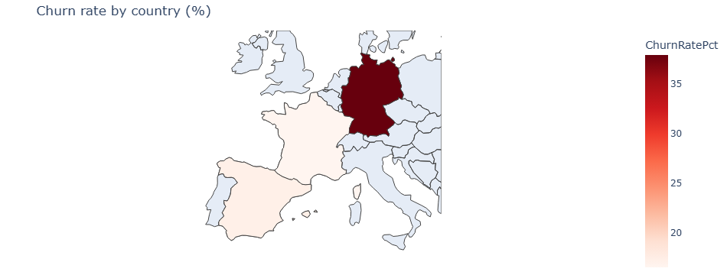
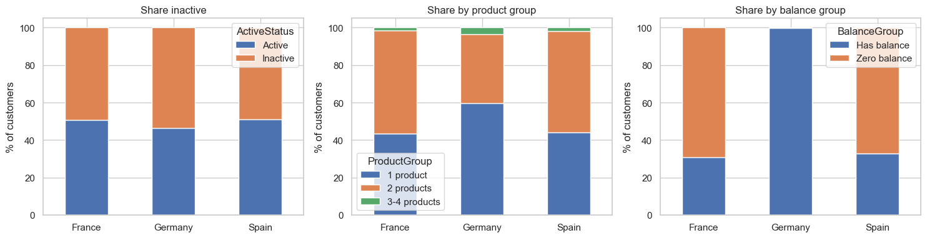
Geographic view: Germany stands out
Churn rate by country (%)
France
16.5%
94,215 customers
churn rate
Germany
37.9%
34,606 customers
churn rate
Customer mix by country: activity, products, balance
Spain
17.2%
36,213 customers
churn rate
Germany: average balance 121,236 vs about 38,000 to 40,000 in France and Spain.
Notes:
Country-level churn map (Plotly choropleth) and customer composition. France 16.5% (94,215 customers), Germany 37.9% (34,606; average balance 121,236), Spain 17.2% (36,213). Germany differs in mix: nearly all customers have a balance and a larger share hold only one product.

Slide 16
Multi-factor profiling: ranking risky groups fairly
Top profiles (at least 100 customers, ranked by lower 95% bound)
Checked on unseen data
Profile | Customers | Churn rate | Lift | 95% CI low
Germany, 40–49, inactive, 3–4 products | 388 | 96.4% | 4.56x | 94.0%
Germany, 50–59, inactive, 3–4 products | 202 | 96.5% | 4.56x | 93.0%
France, 50–59, inactive, 3–4 products | 178 | 96.6% | 4.57x | 92.8%
Germany, 50–59, inactive, 1 product | 1,791 | 92.2% | 4.36x | 90.9%
Spain, 40–49, inactive, 3–4 products | 177 | 94.9% | 4.49x | 90.6%
France, 40–49, inactive, 3–4 products | 424 | 92.9% | 4.39x | 90.1%
Germany, 50–59, inactive, 1 product
92.3% → 92.1%
train → unseen 30% test split. The pattern is not a chance finding.
Safest group
1.4%
France, 30–39, active, 2 products (n = 15,148)
Lift = group churn rate divided by the overall rate (21.2%). A lift of 4.4x means 4.4 times as likely to leave.
Top profiles are almost all inactive, aged 40+, and hold 1 or 3–4 products. No single column shows this.
Notes:
Dimensions: Geography x AgeGroup x ActiveStatus x ProductGroup. 71 profiles have at least 100 customers. Metrics: churn rate, lift (segment churn / overall churn), 95% Wilson confidence interval. Ranking by the lower bound of the interval so large reliable groups rank above small noisy ones. Validation: profiles found on a 70% split keep their churn rate on the unseen 30%.

Slide 17
Are the patterns statistically real? Effect sizes
Effect size by feature (larger = stronger link with churn)
How we tested
Chi-square for categories, Mann–Whitney U for numbers, each with an effect size.
What we found
All p-values are below 0.05 because the sample is huge.
Large effect: age and number of products.
Medium to small: country, activity, balance, gender.
Negligible: credit score, salary, tenure, credit card.
Orange: large, amber: small to medium, grey: negligible. A tiny p-value alone does not mean a big effect.
Notes:
Chi-square tests (effect size Cramer's V) for categorical features and Mann-Whitney U tests (rank-biserial effect size) for numeric features. With 165,034 rows every p-value is below 0.05, so the effect size is what tells us how much a feature matters. Rough guide: about 0.1 small, 0.3 medium, 0.5 large.

Slide 18
Which model, and why XGBoost
Baseline models at threshold 0.5 (test set)
Best on every metric
Model | Accuracy | Precision | Recall | F1 | ROC-AUC
Logistic regression | 0.833 | 0.694 | 0.381 | 0.492 | 0.814
Random forest | 0.859 | 0.724 | 0.542 | 0.620 | 0.875
XGBoost (chosen) | 0.864 | 0.735 | 0.560 | 0.636 | 0.887
Highest accuracy, precision, recall, F1 and ROC-AUC of the three.
Learns combinations
EDA showed risk sits in age × activity × products; trees capture these.
Our replication matches the paper
Baseline XGBoost churn recall = 0.560, the same as the base paper's 0.56. This is the starting point we improve on.
Built for the next steps
Supports class weights and exact SHAP explanations.
Accuracy looks fine for every model (0.83 to 0.86) while churn recall ranges from 0.38 to 0.56: accuracy alone would mislead.
Notes:
We compared three baselines at the default 0.5 threshold on the same untouched 20% test set (33,007 customers). XGBoost was best on every metric. Our replication reaches recall 0.560, matching the base paper's reported 0.56, so the baseline is faithfully reproduced. Logistic regression has decent accuracy but misses 62% of churners.

Slide 19
How the model was built
1
2
3
4
5
Split
Balance
Tune
Threshold
Test once
80/20 stratified, seed 42: 132,027 train, 33,007 test
Class weight 3.73 on churners, vs SMOTE inside each CV fold
Randomized search, 30 trials, 5-fold CV, scored on PR-AUC
Highest precision with recall ≥ 0.70 on out-of-fold scores: 0.63
Test set touched only for the final report
Inside the pipeline (identical for training and for every new customer)
New customer record
One-hot encode country and gender
XGBoost with class weight
Churn score, 0 to 1
Score ≥ 0.63 sets the flag
►
►
►
►
Weight 3.73 = about 104,000 retained / 28,000 churned customers in the training set.
Notes:
SMOTE was applied only inside training folds, never to the test data. The threshold of 0.63 is our selected cut-off, not a default; it was chosen from out-of-fold training predictions as the highest precision that keeps recall at 0.70 or more. Class weight 3.73 = retained / churned in the training set.

Slide 20
SMOTE vs class weighting: why weighting won
SMOTE: add synthetic churners
Class weighting: make misses cost more
Creates new churner rows between real ones, inside each training fold. The model still treats each error the same, so it stays cautious.
No new rows. Each missed churner counts 3.73 times in the loss, so the model learns to catch more of them.
Recall 0.563 (tuned 0.561)
Recall 0.775 (tuned 0.792)
Churn recall (test set, threshold 0.5)
Tuned PR-AUC was a tie
0.7304 vs 0.7307
Recall decided it: 0.792 with class weights vs 0.561 with SMOTE. We kept class weighting.
Notes:
SMOTE creates synthetic churners by interpolating between real churners, applied inside each training fold only. Class weighting adds no rows; it makes each missed churner count 3.73 times in the loss. After tuning, PR-AUC was a near tie (0.7304 SMOTE vs 0.7307 weight), but recall was 0.561 vs 0.792, so class weighting is the clear choice. A likely reason is that churners overlap heavily with loyal customers, so synthetic churners add little new information.

Slide 21
Model improvement: recall 0.56 to 0.70
Churn recall by model (test set)
Baseline vs final (test set)
Metric | Baseline | Final
Accuracy | 0.864 | 0.851
Precision | 0.735 | 0.633
Recall | 0.560 | 0.701
F1-score | 0.636 | 0.665
ROC-AUC | 0.887 | 0.890
+14.1 pts
+1,431
recall vs base paper and baseline
extra false alarms: the price paid
Base paper recall: 0.56
Grey: other · Blue: baseline · Amber: SMOTE · Orange: class weight · Navy: final
Cross-validated recall: 0.705 ± 0.006 (final) vs 0.560 ± 0.012 (baseline). Accuracy dips slightly; we trade it for catching more churners.
Notes:
Churn recall by model on the test set. Base paper 0.56; our baseline XGBoost 0.560; final (class weight, tuned, threshold 0.63) 0.701: a gain of 14.1 percentage points. Cross-validated recall is 0.705 +/- 0.006 for the final model vs 0.560 +/- 0.012 for the baseline, so the gain is real. The trade-off: precision falls from 0.735 to 0.633 and accuracy from 0.864 to 0.851.

Slide 22
Final model: 4,895 of 6,984 churners caught
Predicted: stayed
Predicted: churned
Baseline vs final
23,184
2,839
Missed churners
3,071
→
2,089
Actually stayed
26,023
True negatives
False alarms
loyal, left alone
loyal, but flagged
False alarms
1,408
→
2,839
2,089
4,895
Recall
0.560
→
0.701
Actually churned
6,984
Missed churners
True positives
Precision
0.735
→
0.633
left, never flagged
left, and flagged
Test set, 33,007 customers, cut-off 0.63
The price: 1,431 more false alarms to catch 982 more churners. Worth it if an offer costs far less than a lost customer.
Notes:
Test set of 33,007 customers, cut-off 0.63. TP: churner correctly flagged. TN: loyal customer left alone. FP: loyal customer flagged. FN: churner missed. The final model finds 4,895 of 6,984 churners and misses 2,089, down from 3,071 for the baseline.

Slide 23
Choosing the cut-off is a business call
Precision and recall at three cut-offs
Catch the most churners
0.48
10,545 flagged
Chosen: most precise with recall ≥ 0.70, also best F1
0.63
7,734 flagged
Few false alarms (precision ≥ 70%)
0.73
6,036 flagged
If the team calls from the top of the ranked list
How 0.63 was selected: on out-of-fold training scores, the highest precision that still keeps recall at 0.70 or more. The test set was never used.
Contact list | Precision | Churners caught
Riskiest 5% | 91.8% | 21.7%
Riskiest 10% | 84.1% | 39.8%
Riskiest 20% | 68.1% | 64.4%
Notes:
Thresholds are chosen on training out-of-fold scores; the test set is only used to report. 0.48 catches at least 80% of churners; 0.63 is the highest precision with recall >= 0.70 (it also has the best F1); 0.73 gives precision >= 70%. If the team calls from the top of the ranked list, precision is much higher on a short list. An assumed cost model (offer 500, loss 5,000) would favour a lower cut-off of 0.29.

Slide 24
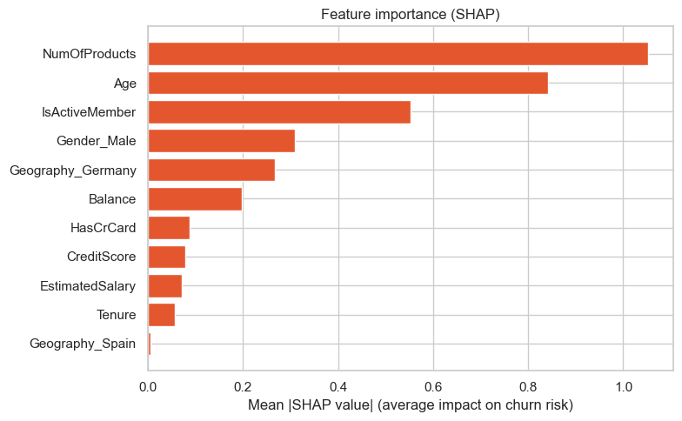
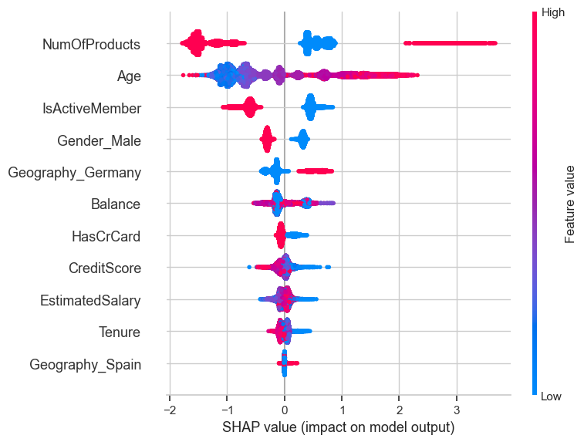
What the model leans on (SHAP)
Average push each input gives a score
Each dot is a customer; red means a high value
Products 1.05
Age 0.84
Active member 0.55
SHAP shows what the model leans on, not proof of what causes churn.
How it helps: every score comes with reasons. The riskiest customers combine 3 products, age 51–54, inactive and Germany.
Notes:
Mean absolute SHAP values: number of products 1.05, age 0.84, active member 0.55, gender 0.31, Germany 0.27, balance 0.20. Credit card, credit score, salary, tenure and Spain contribute very little. The three highest-risk customers all combine 3 products, age 51 to 54, inactive membership and Germany. This agrees with the EDA and risk profiles. SHAP explains the model, not real-world cause and effect.

Slide 25

The application, end to end
Input
Validation
Saved model
Output
Dashboard
One-customer form or CSV upload
►
Bad rows rejected with a reason
►
Pipeline and 0.63 cut-off, via joblib
►
Score, tier, flag, SHAP reasons
►
Filters, heatmap, ranked profiles
Test cases we ran
France, female, 42, inactive, 1 product
Country not in training data (Italy)
Age below 18
Score 1,000,000 customers
Score 0.69, High tier, flagged
Rejected, with the reason shown
Rejected: age is below 18
Finished in about 1.4 seconds
The saved model reproduces the test result: recall 0.701, precision 0.633, ROC-AUC 0.890 (33,007 held-out customers, none rejected).
Notes:
The application is a single Dash page. Every input is validated before it reaches the model. For one customer it shows the score, tier, flag, the factors that raised or lowered the score and the churn rate among similar past customers. Suggested actions are simple rules and are untested on real customers.

Slide 26
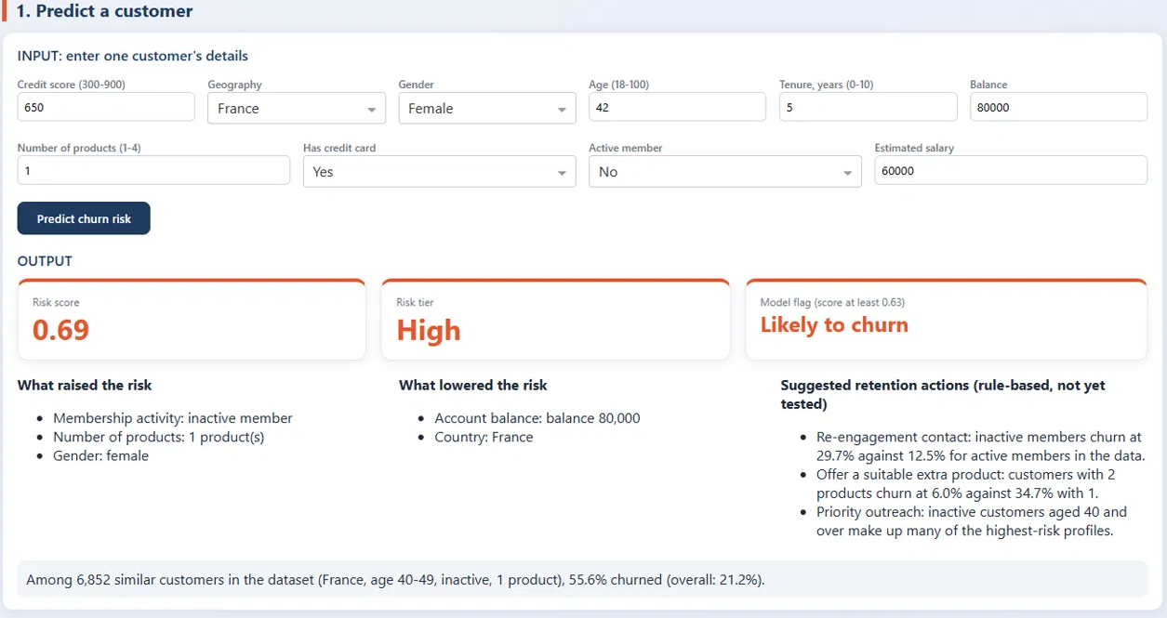
The app in action: predict one customer
Score 0.69
High tier, flagged at the 0.63 cut-off
Reasons shown
Inactive, 1 product, female raised risk; balance and country lowered it
Context
6,852 similar customers: 55.6% churned vs 21.2% overall
A second input path scores a whole CSV, and a template can be downloaded.
Notes:
Screenshot of the Dash application. Input: credit score 650, France, female, age 42, tenure 5, balance 80,000, 1 product, has credit card, inactive, salary 60,000. Output: risk score 0.69, High tier, flagged likely to churn (cut-off 0.63). Reasons that raised risk: inactive member, 1 product, female. Among 6,852 similar customers, 55.6% churned (overall 21.2%). The retention actions are rule-based and untested.

Slide 27
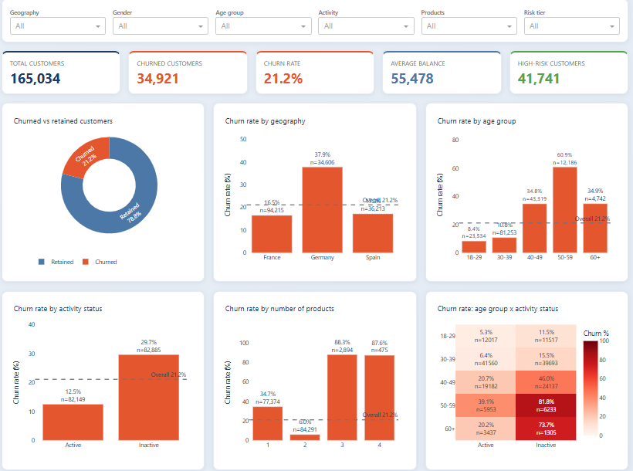
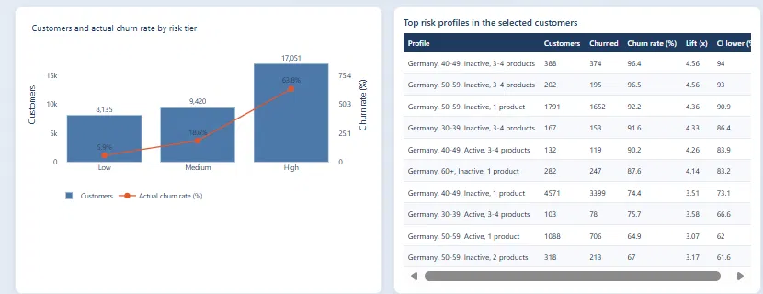
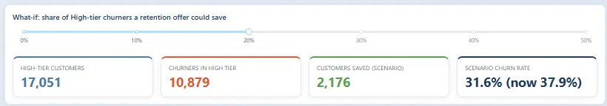
The app in action: dashboard and what-if
Germany filter shown on the right: 17,051 High-tier customers, scenario churn 37.9% → 31.6% at 20% saved (assumed).
Filters: geography, gender, age group, activity, products and risk tier.
Notes:
Left: the dashboard over all 165,034 customers (KPIs, churn by country, age, activity, products and the age by activity heatmap). Right: with Germany selected, the ranked risk profiles and a what-if slider. At 20% of High-tier churners saved, the scenario churn rate falls from 37.9% to 31.6% (2,176 customers saved). The saved figure is an assumed scenario, not a measured result.

Slide 28


Limits and what comes next
Limits
Next steps
One bank, one file, no outside check. Origin undocumented and CustomerId repeats (23,221 unique in 165,034 rows)
Validate on data from other banks
The score ranks risk. It is not a probability
Add transaction and service data
Recall is only 25% for ages 18–29 and 40% for 30–39
Test whether offers really keep customers
Suggested actions are untested on real customers
Monitor the model after deployment
Notes:
Be upfront about the limits. The data is a single file whose origin is undocumented; CustomerId repeats (23,221 unique across 165,034 rows), so the same person may appear more than once. The model flags German customers, women and middle-aged customers more often and misses most young churners (recall 24.5% at ages 18-29, 39.5% at 30-39, 23.9% for 2-product customers), so a person should review flagged customers before any offer goes out.

Slide 29
What we achieved
Churn recall
ROC-AUC
High-risk tier
0.56 → 0.70
0.887 → 0.890
25%
Base paper and our baseline: 0.56. Final: 0.701
Ranks customers as well or better, not just flags more
of customers hold about 73% of all churners
Class weighting, tuning and a cut-off chosen on training data did the work. SHAP explains each score, and the app turns scores into a ranked call list. We also added EDA beyond the base paper: heatmaps, a country map, risk profiles with confidence intervals and significance tests.
Notes:
Close with the three headline results and the contribution: not just a prediction, but an explained, ranked, usable tool. Results come from one dataset and have not been tested elsewhere. Accuracy dipped slightly (0.864 to 0.851): this is the deliberate trade for catching more churners.

