Slide 1
Nipah Virus Phosphoprotein Evolutionary Selection Analysis

Slide 2
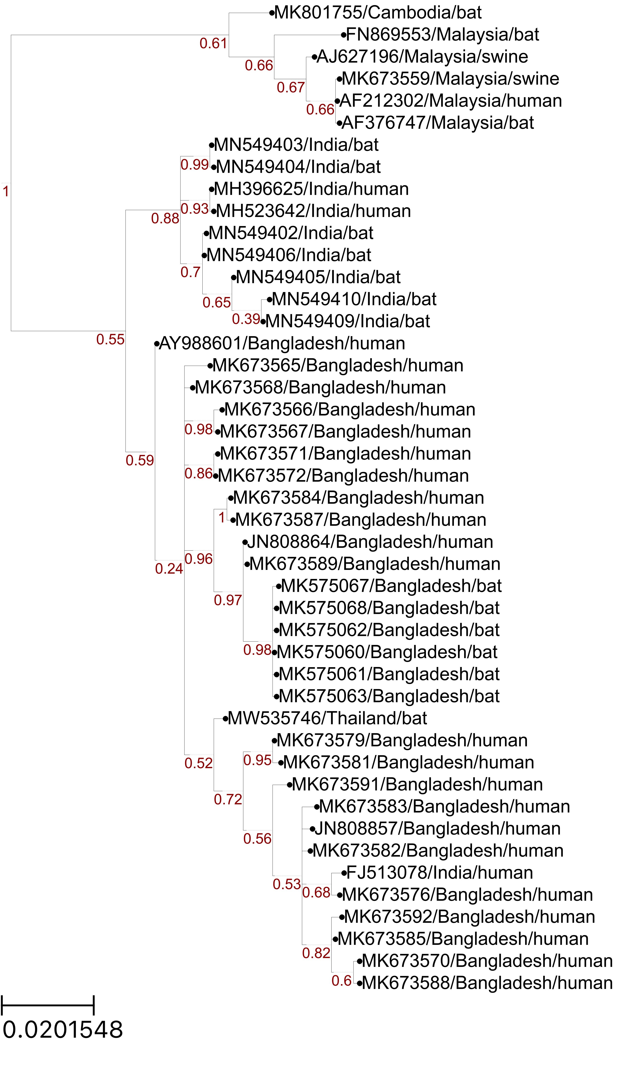
MEME and FEL: Codons under Positive Selection
Malaysia
Sites:
58
64
228
377
380
408
421
437
438
India
Bangladesh
Notes:
FEL also identified site 380
Not sure how to use the Empirical Bayes Factor to help with analyses. Provides a confidence measure of whether diversification occurred in a given branch? The paper seems to mention EBF values > 1, but the table outputs proportions between 0 and 1.

Slide 3
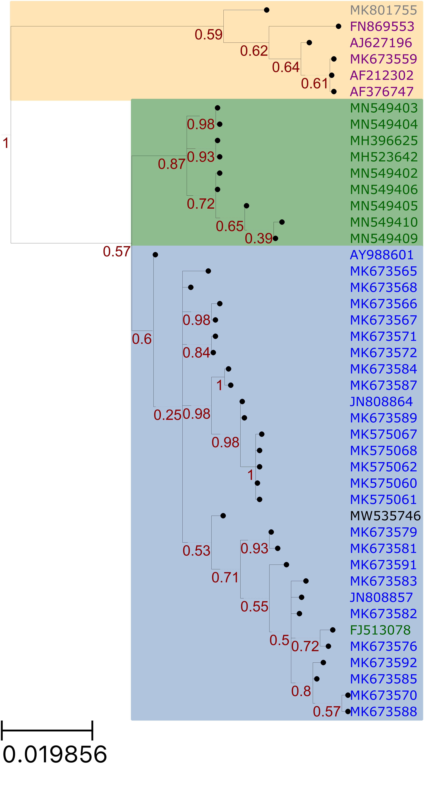
aBSREL branch with diversifying selection
Malaysia
India
Bangladesh

