Slide 1
Nipah Virus Evolutionary Selection Analysis Updates

Slide 2
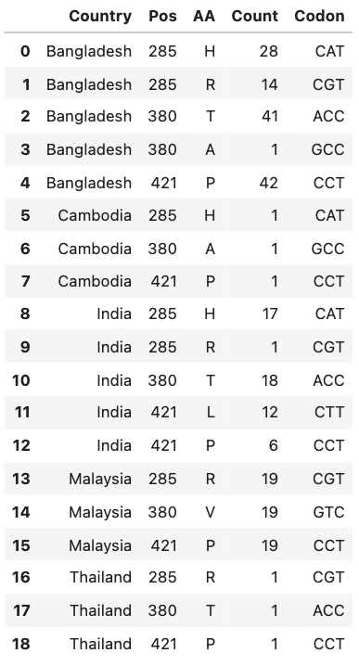
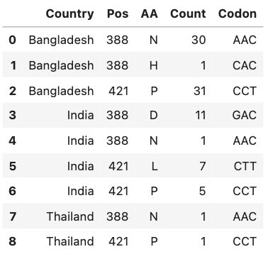
Sites under positive selection in the NiV Phosphoprotein, FUBAR
All sequences: 285, 380, 421
Bangladesh clade only: 388, 421
Notes:
FUBAR maybe better at detecting very weak positive selection.

Slide 3
Zero Branch Support Values in Phosphoprotein Tree
No ambiguous (N) nucleotides in the 4 isolates with 0 branch support.
2 bat, 1 human, 1 swine. 2 Malaysia, 2 Bangladesh. No obvious trends
Run BEAST to generate trees to compare? (Already tried PhyML to get ML trees)

Slide 4
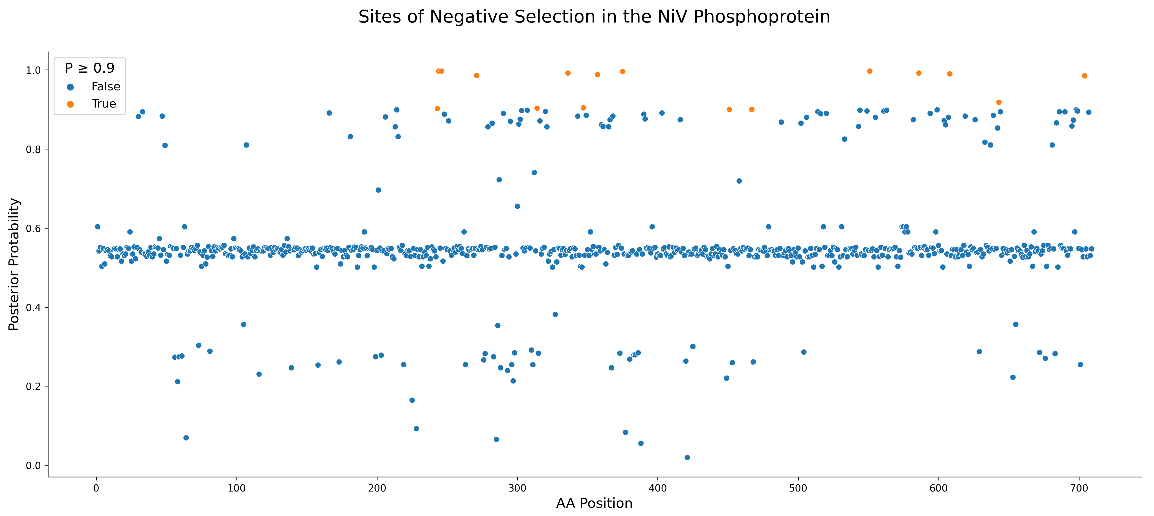
Notes:
Bangladesh, India, and Thailand only

Slide 5
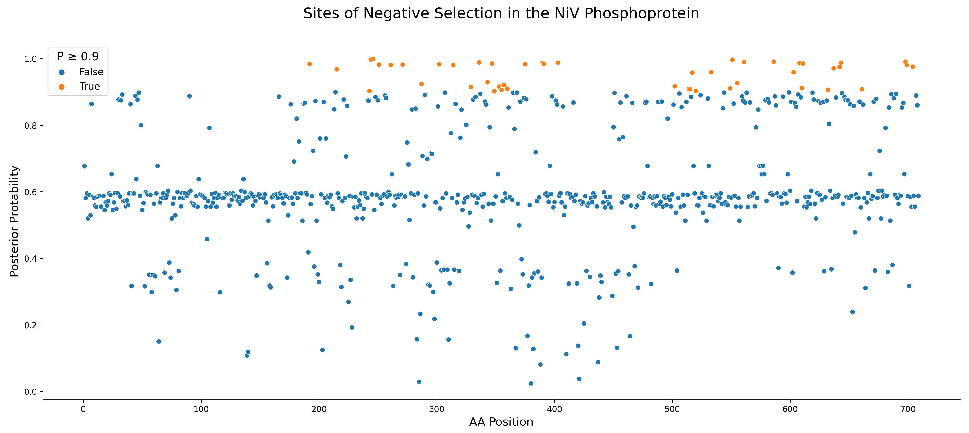
Notes:
Exact sites: 192-403, 502-704
All sequences

Slide 6
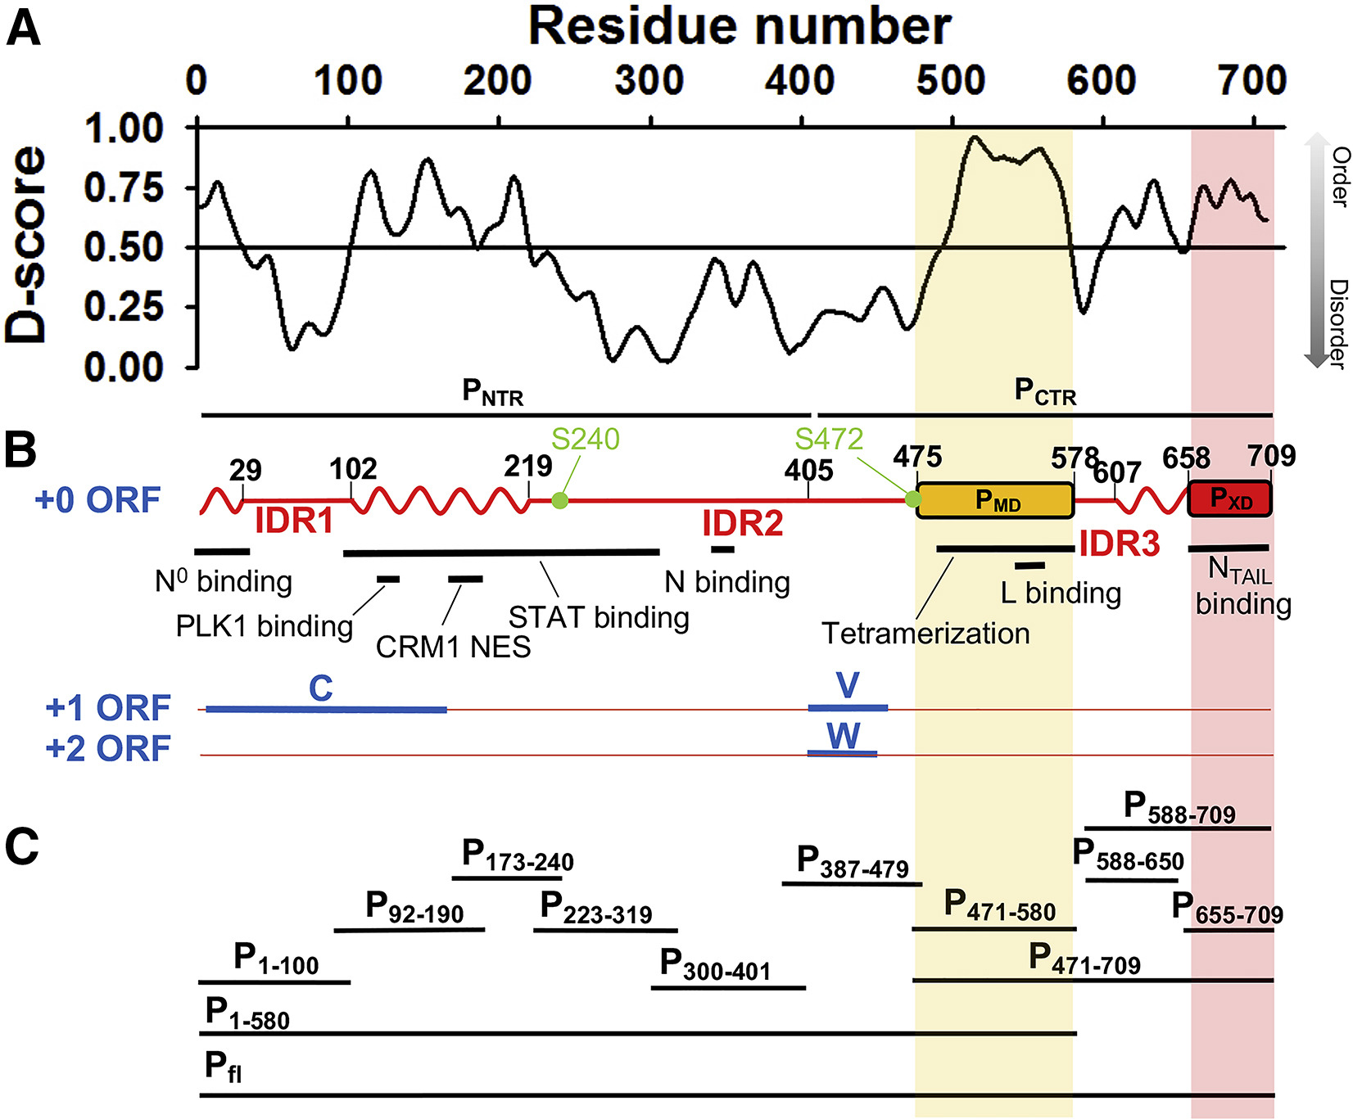
Jensen et al., Biophysical Journal, 2020
Notes:
Exact sites: 192-403, 502-704
Intrinsically disordered proteins may allow more mutations (diversifying selection) because structure isn't very constrained. BUT intrinsically disordered viral proteins also tend to bind a lot of other proteins. It's like both things at once -- constrained for binding, but unconstrained structurally.
Look at short proteins in evolutionary selection. If you have small proteins and small datasets, can you find anything? Look at some papers.

