Slide 1
Nipah Virus Evolutionary Selection Analysis Updates

Slide 2
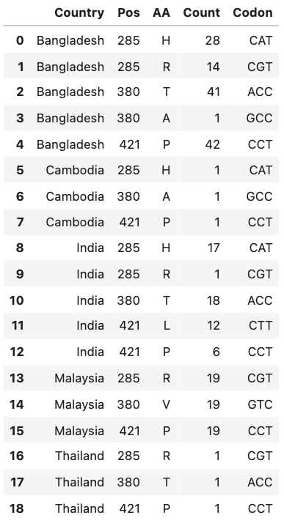
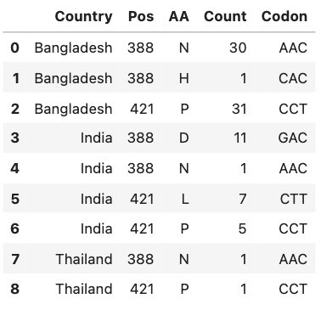
Sites under positive selection in the NiV Phosphoprotein, FUBAR
All sequences: 285, 380, 421
Bangladesh clade only: 388, 421
Notes:
FUBAR maybe better at detecting very weak positive selection.
Look at codon table to see how many nucleotides needed to change for the amino acid change to happen.
Look for correlations between the different sites and the different clades of NiV. Are they enriched in particular groups.

