Slide 1
Nipah Virus Evolutionary Selection Analysis Updates

Slide 2
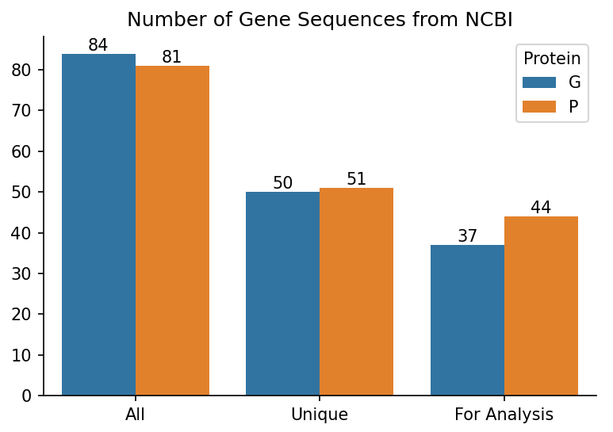
Rebuilding Trees
Removed all sequences containing ambiguous nucleotides because the dataset is not robust.
Used iqtree to select best codon substitution model.
Branch support values = non-parametric bootstrap with 1000 replicates.
Notes:
Make a side by side bar chart of the number of isolates originally, after deduplication, and then after ambiguous nucleotide removal.

Slide 3
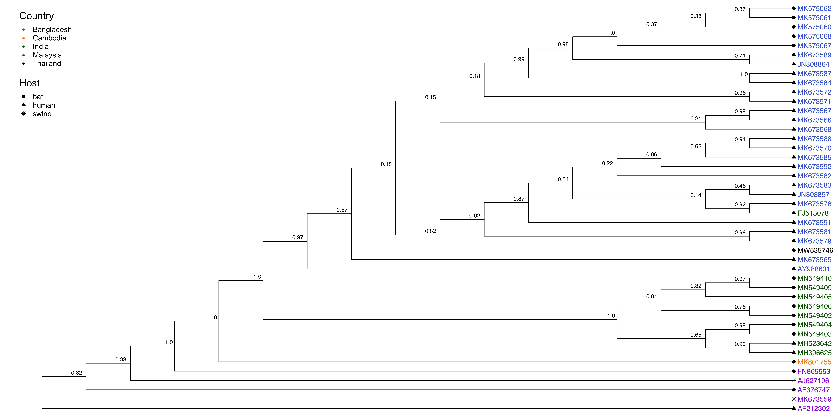
Phosphoprotein Tree, 44 Isolates

Slide 4
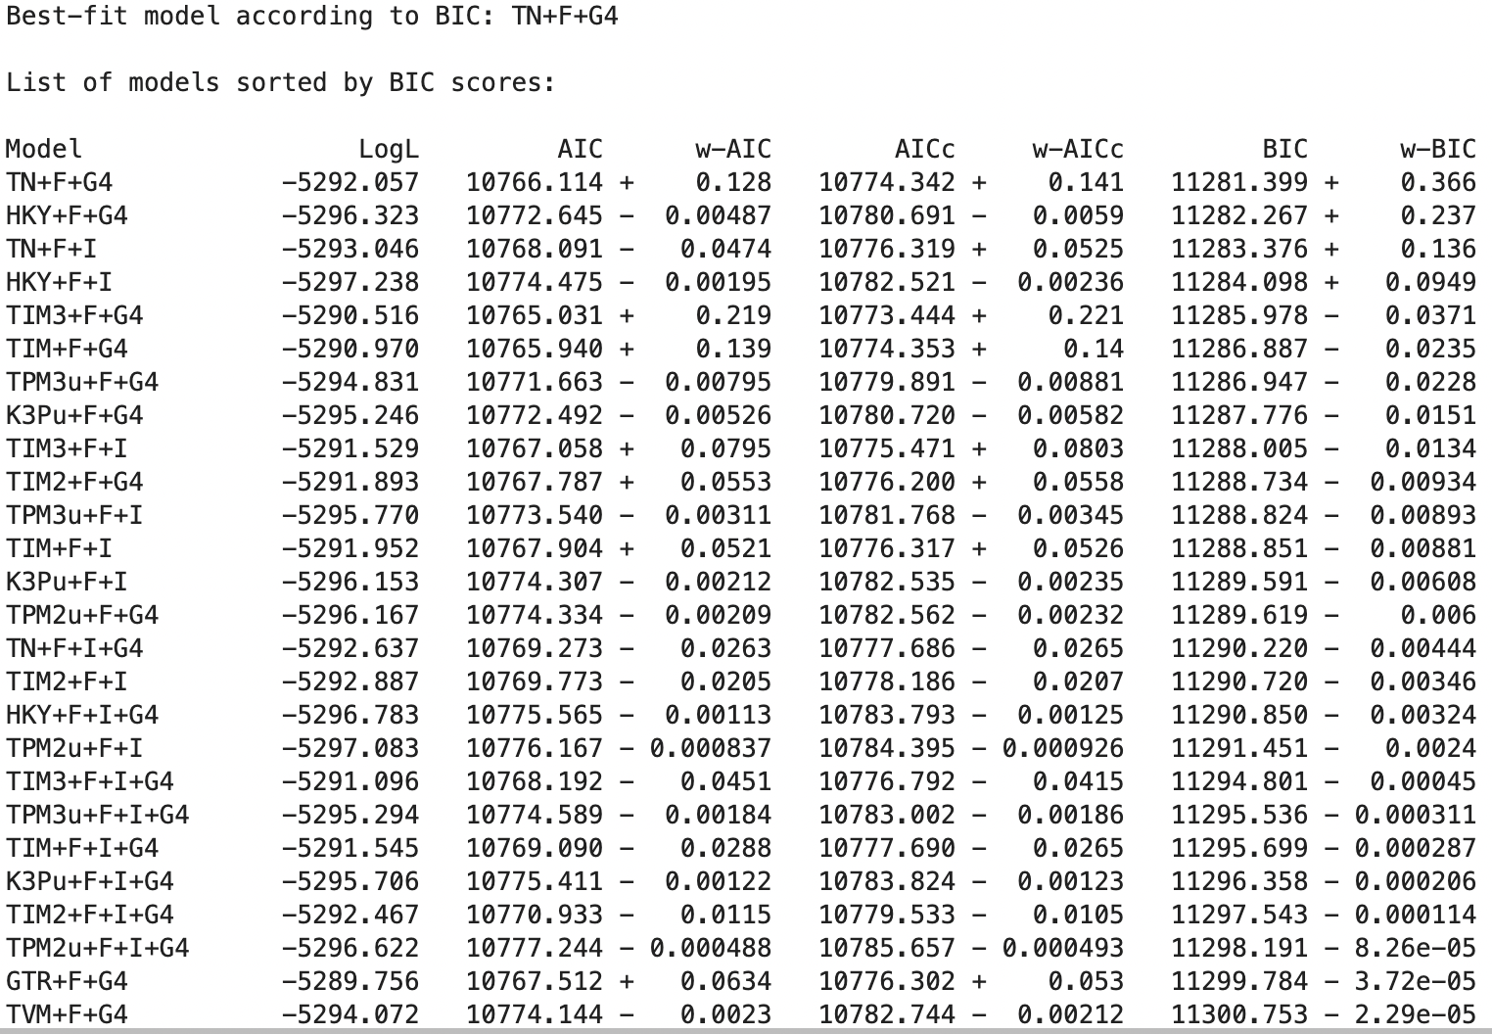
Phosphoprotein Tree, 44 Isolates

Slide 5
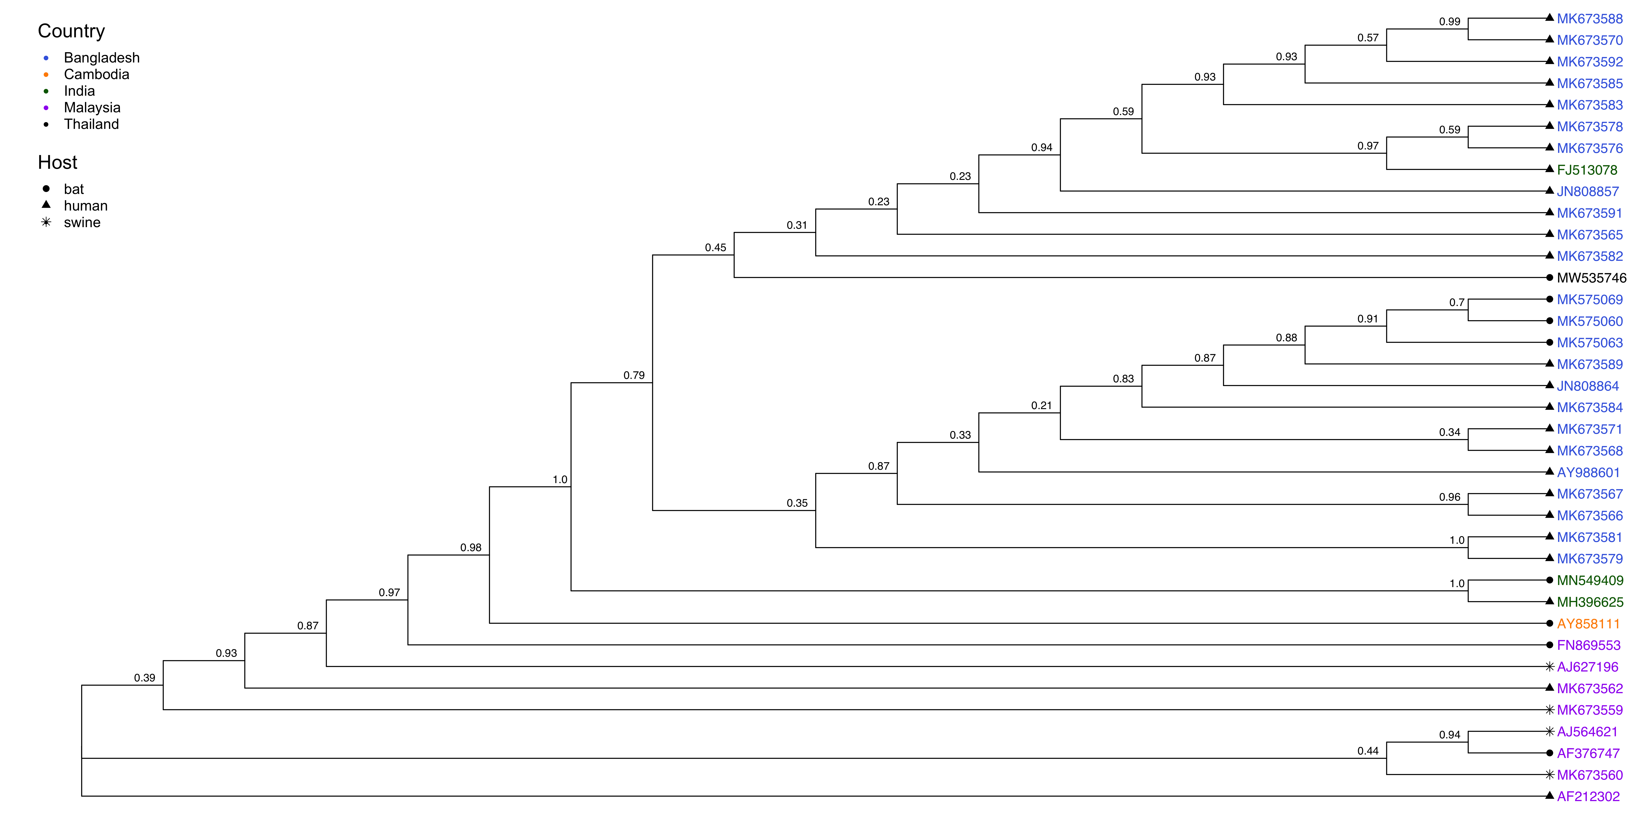
Glycoprotein Tree, 37 Isolates

Slide 6
Glycoprotein Tree, 37 Isolates

Slide 7
Questions
When can synonymous rates be 0? This is an option in Hyphy. Currently, I've been telling it to force dS > 0 so that dN/dS rates can be computed.
Good to use iqtree trees for evolutionary selection analyses?
Would it be good to look at site differences across B and M clades? Could see which sites are most diverse in each clade to come up with hypotheses for functional differences.

Slide 8
Sites under positive selection in the NiV Phosphoprotein, FUBAR
Notes:
FUBAR maybe better at detecting very weak positive selection.

Slide 9
Notes:
Bangladesh, India, and Thailand only

Slide 10
Notes:
Exact sites: 192-403, 502-704
All sequences

Slide 11
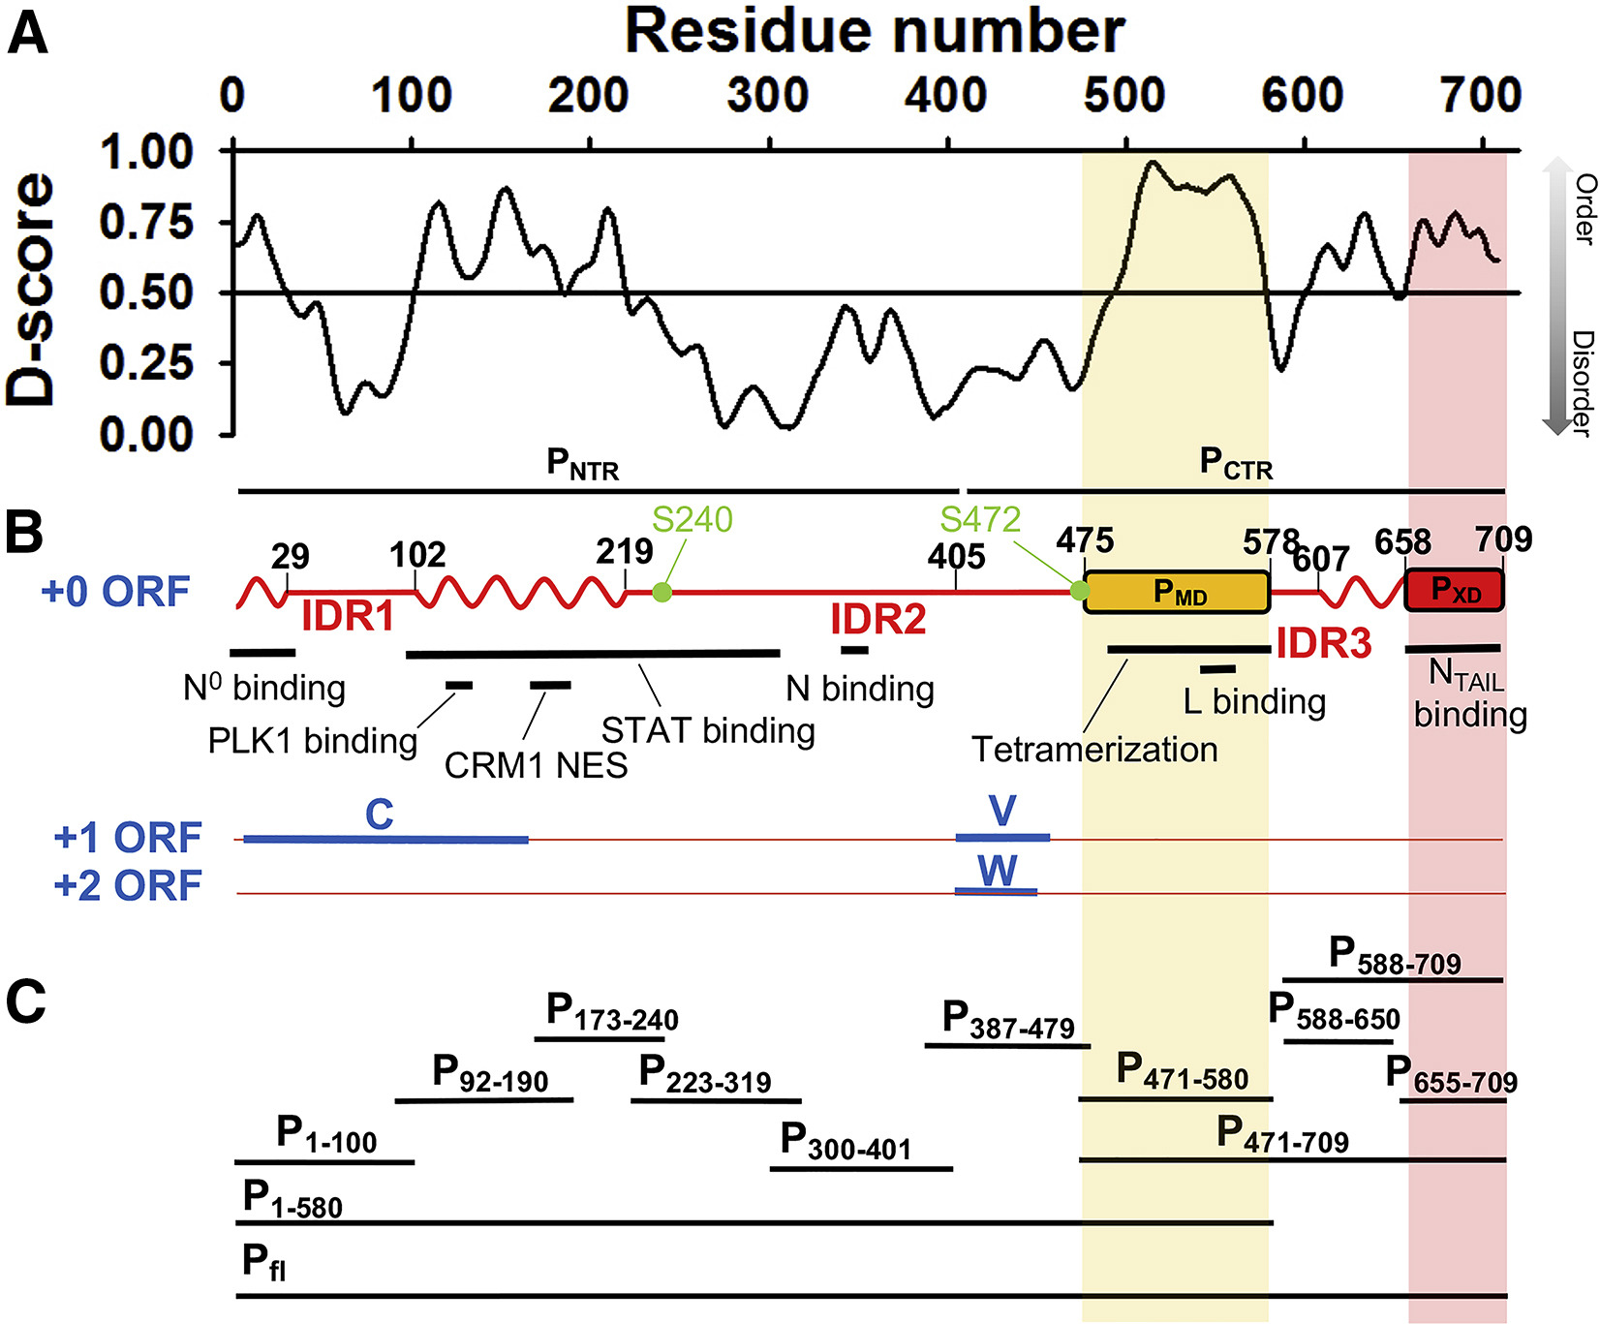
Jensen et al., Biophysical Journal, 2020
Notes:
Exact sites: 192-403, 502-704
Intrinsically disordered proteins may allow more mutations (diversifying selection) because structure isn't very constrained. BUT intrinsically disordered viral proteins also tend to bind a lot of other proteins. It's like both things at once -- constrained for binding, but unconstrained structurally.
Look at short proteins in evolutionary selection. If you have small proteins and small datasets, can you find anything? Look at some papers.

