Slide 1
Nipah Virus Phosphoprotein Tree Building Updates

Slide 2
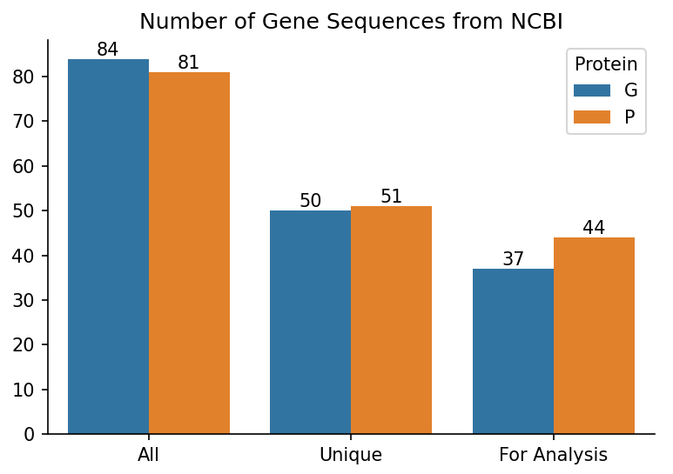
Rebuilding Trees
Removed all sequences containing ambiguous nucleotides because the dataset is not robust.
Used iqtree to select best codon substitution model.
Branch support values = non-parametric bootstrap with 1000 replicates.
1 Hendra virus sequence as an outgroup
Notes:
Make a side by side bar chart of the number of isolates originally, after deduplication, and then after ambiguous nucleotide removal.

Slide 3
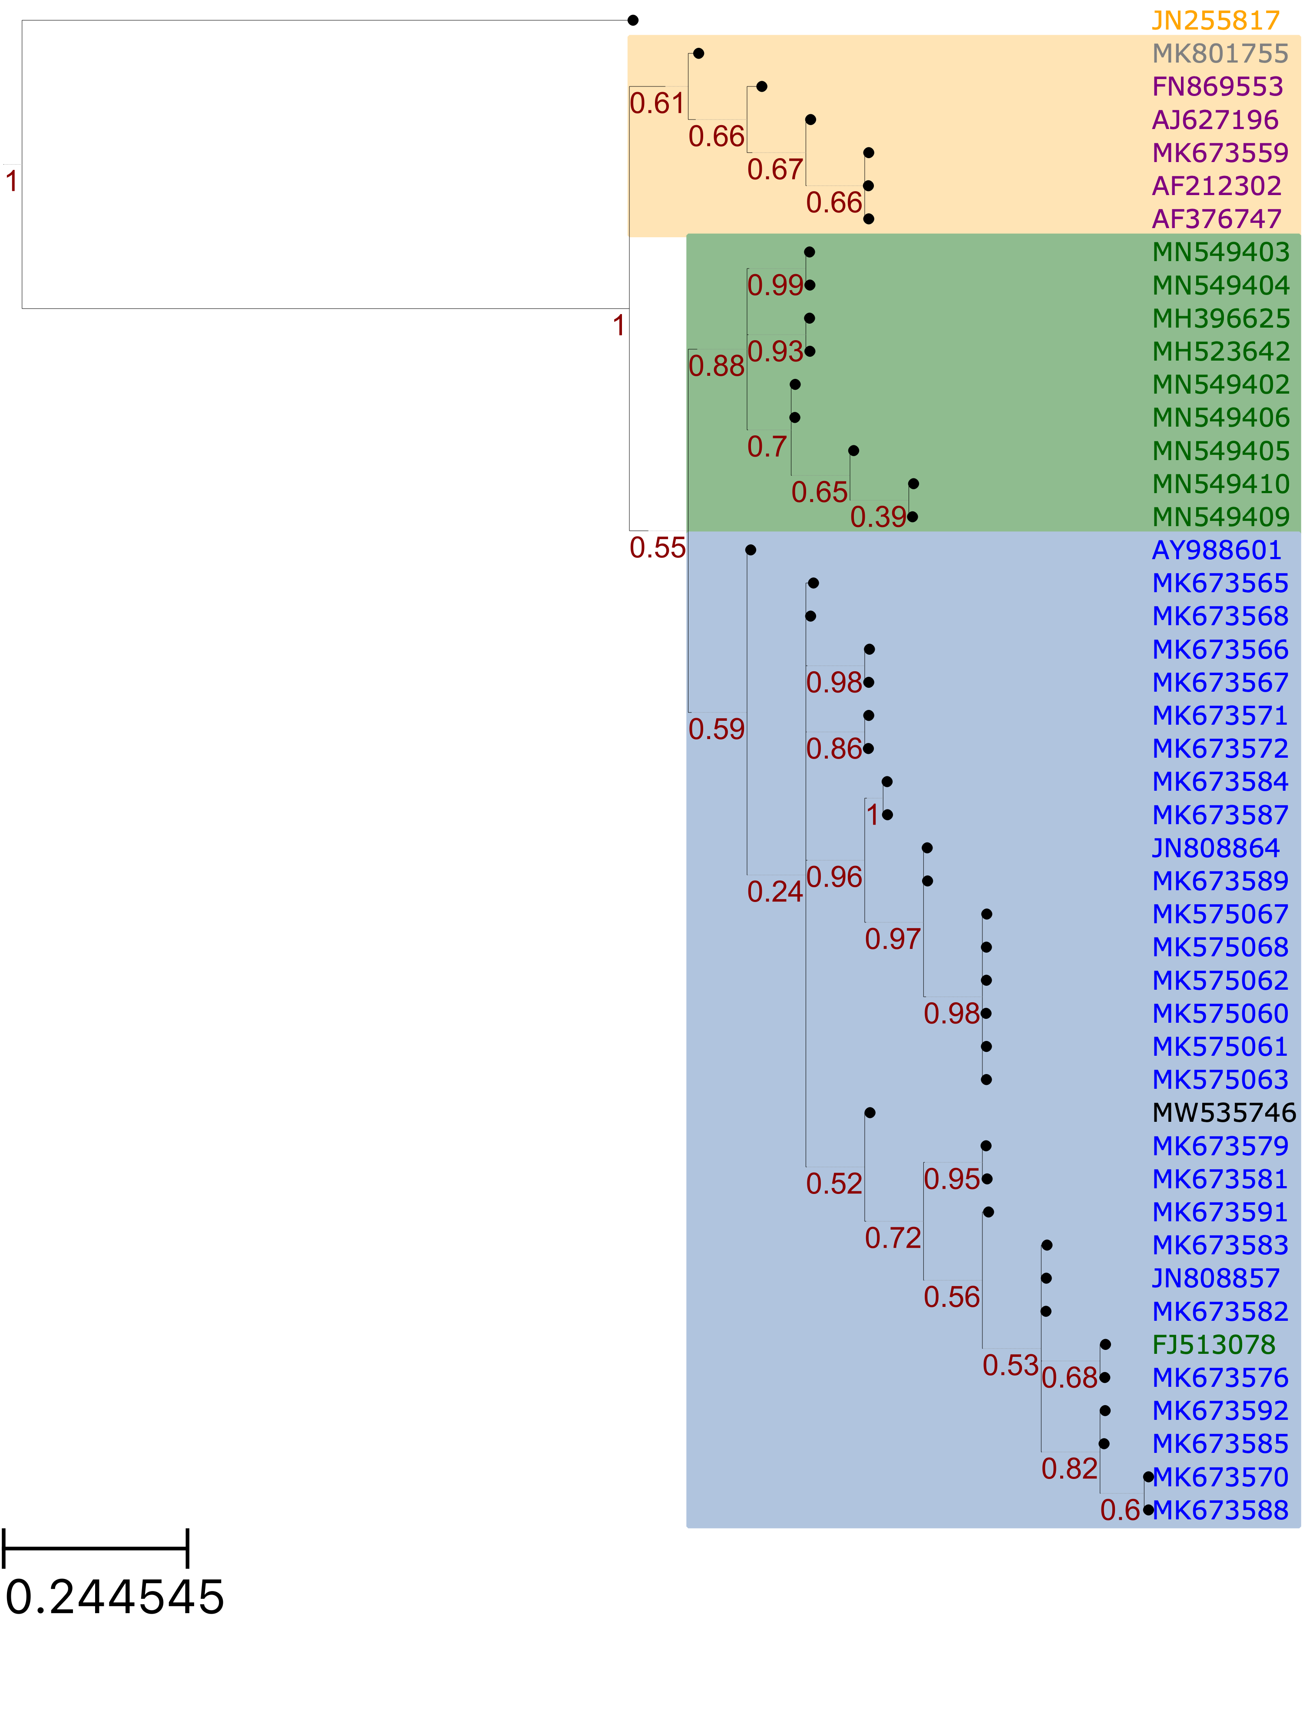
All Unique Phosphoprotein Sequences
HeV
Cambodia
India
Bangladesh
Thailand
India

Slide 4
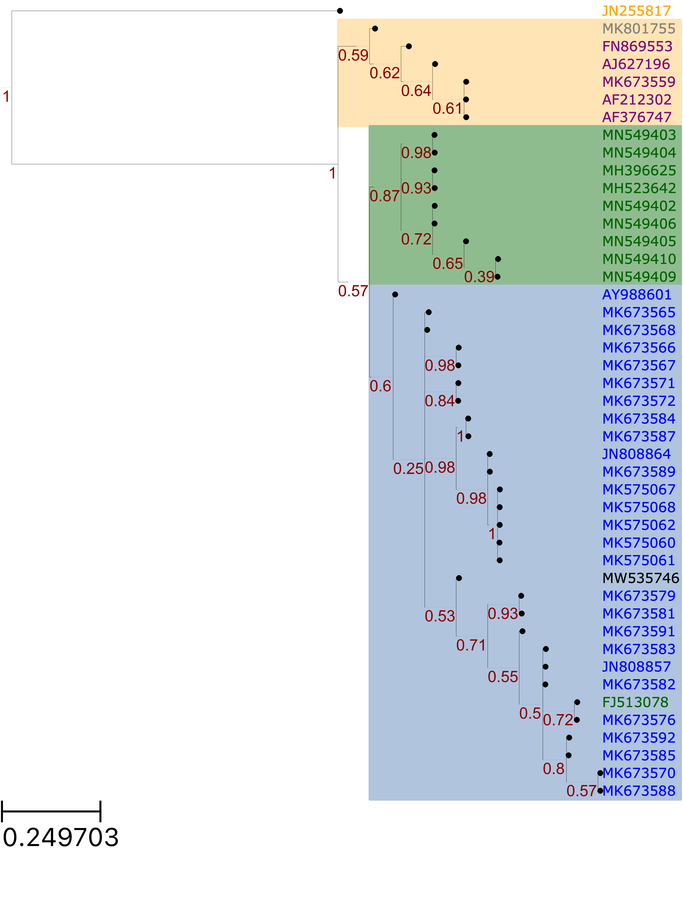
Phosphoprotein Sequences Minus 1 with Premature Stop Codon
HeV
Cambodia
India
Bangladesh
Thailand
India

Slide 5
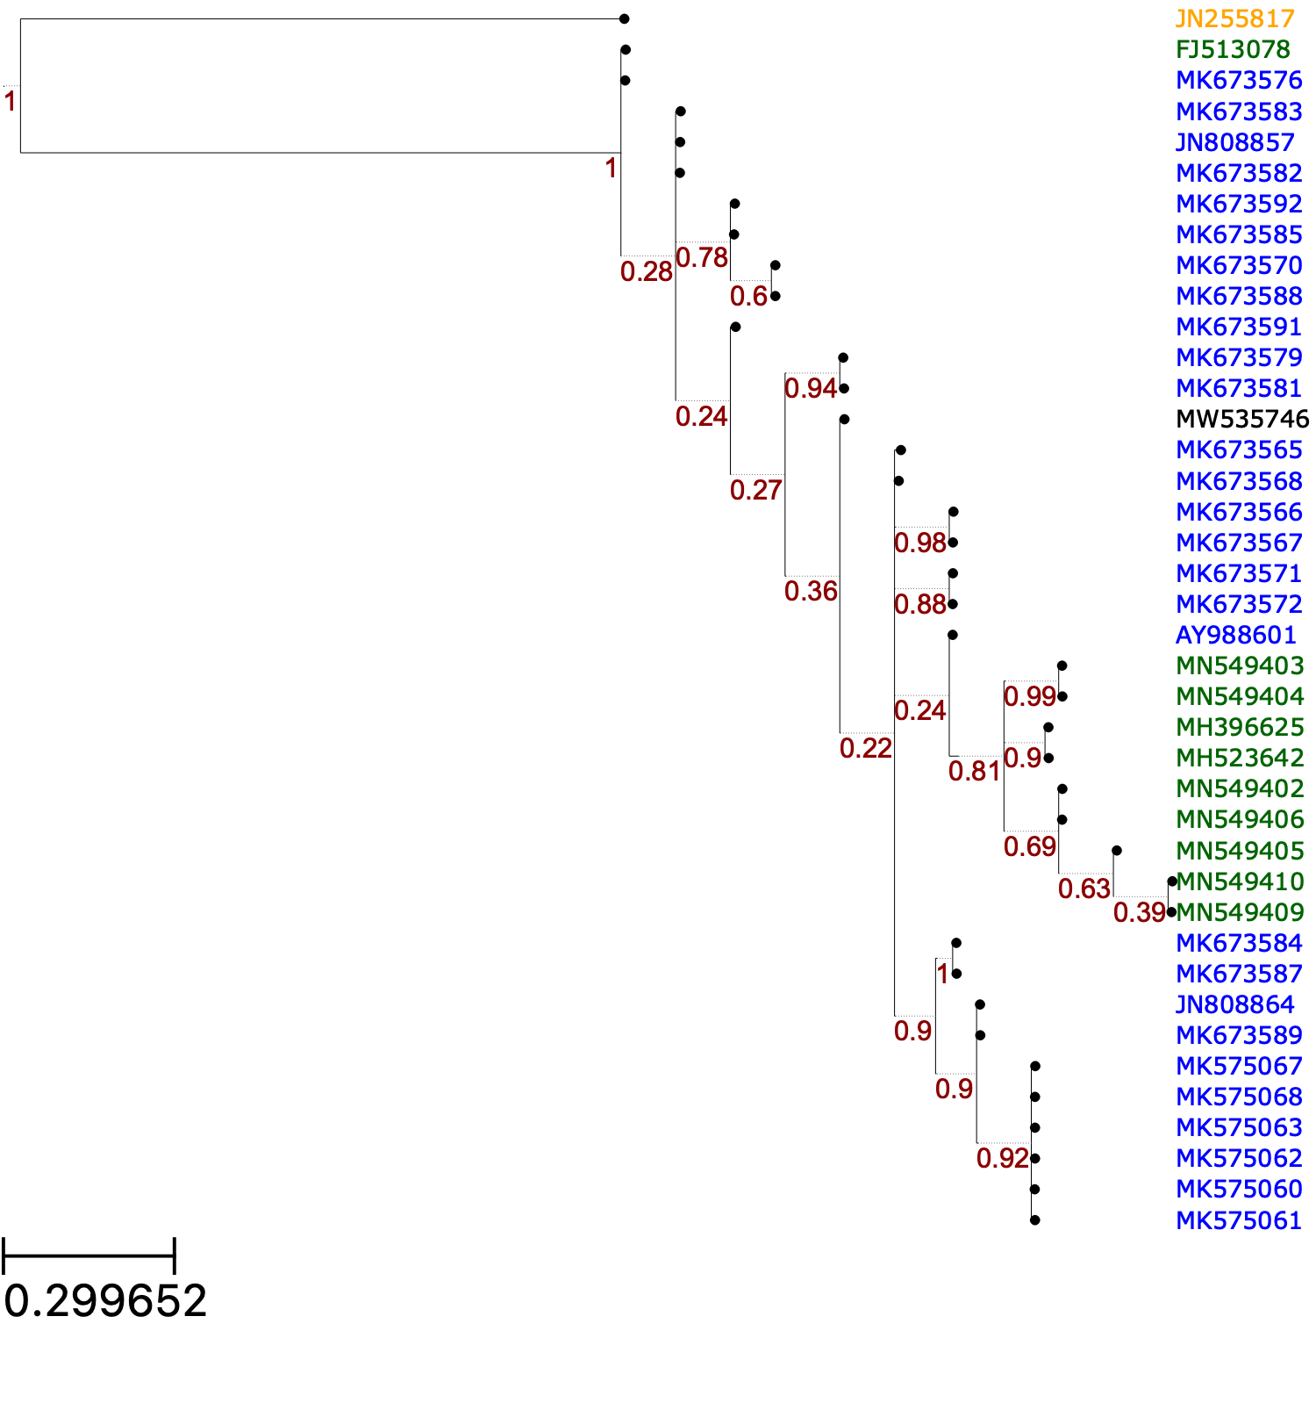
Bangladesh Clade
B-2
B-1
India
Notes:
Whitmer et al = MK67…..

Slide 6
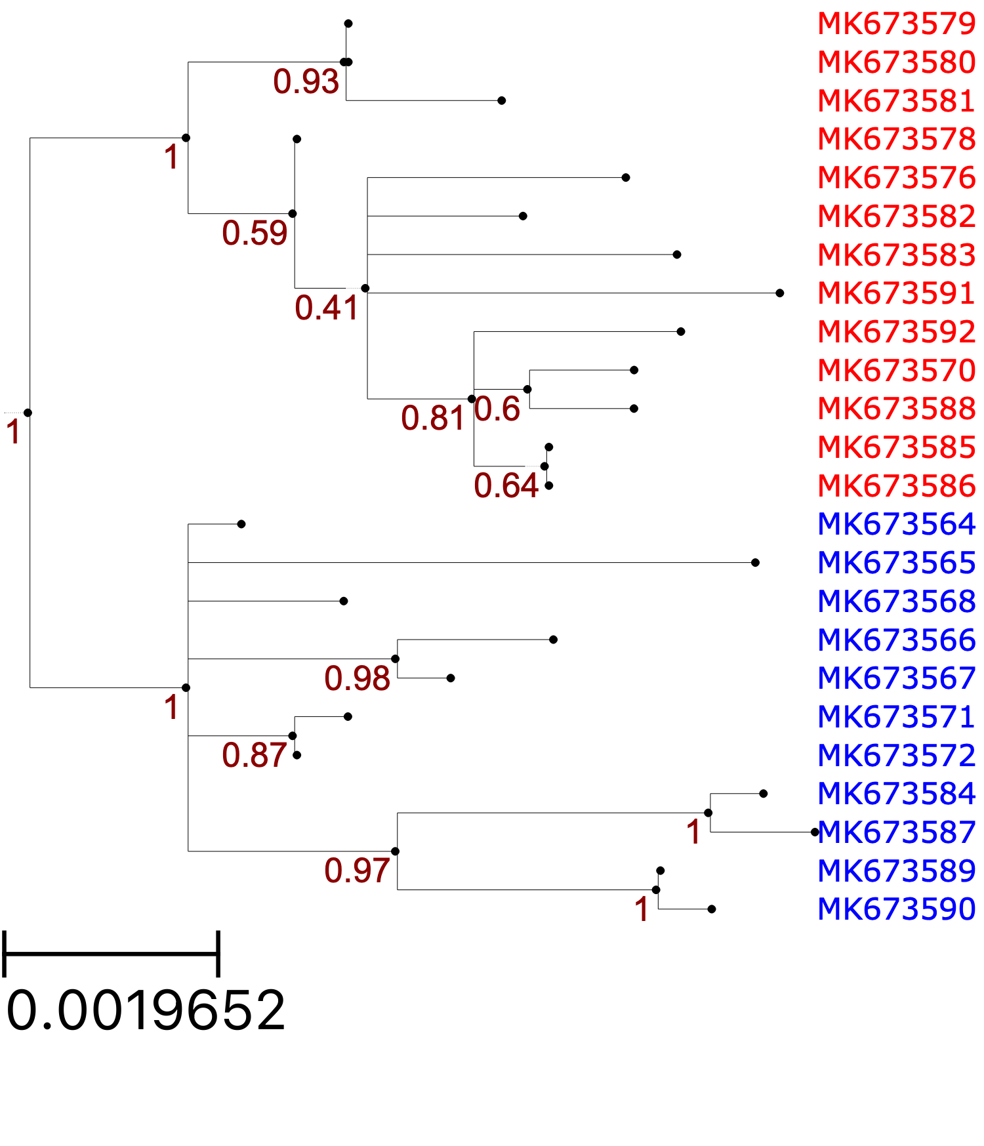
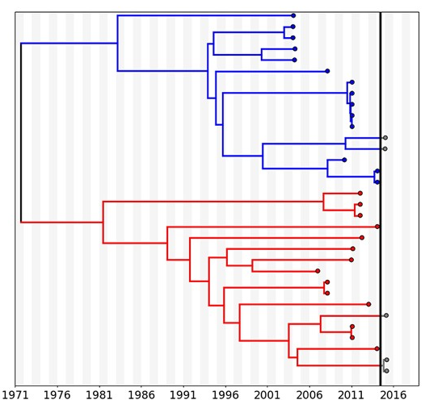
Whitmer et al., 2021 Sequences
Notes:
Has been deduplicated!

Slide 7
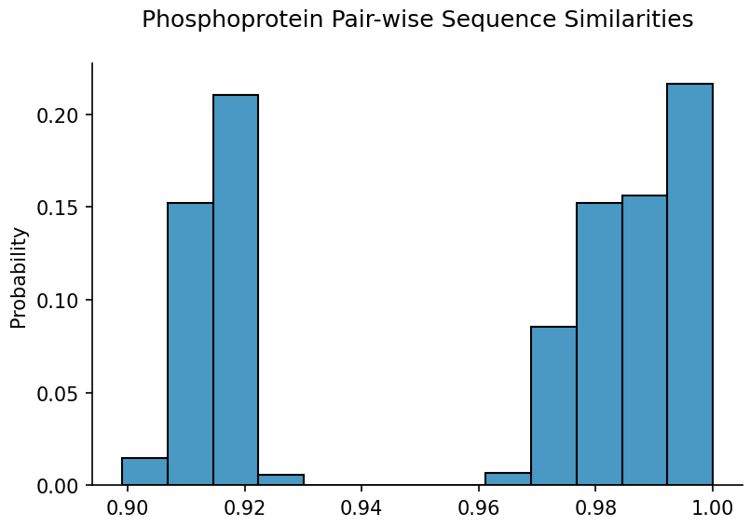
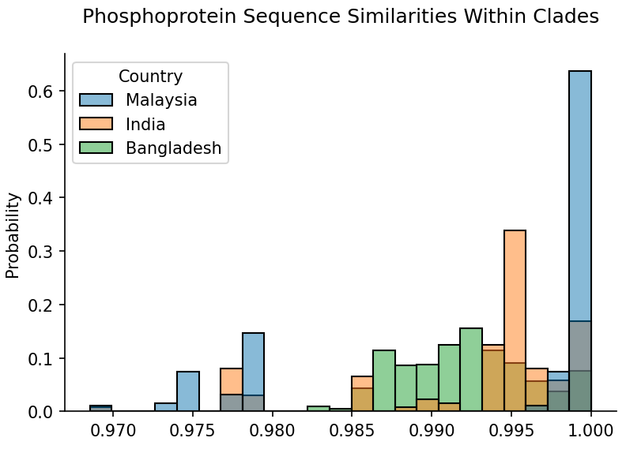
Between clades
Within clades
Notes:
More similarity among Bangladesh and India sequences, maybe because they were collected around outbreak times?

