Slide 1
Nipah Virus Phosphoprotein Evolutionary Selection Analysis

Slide 2
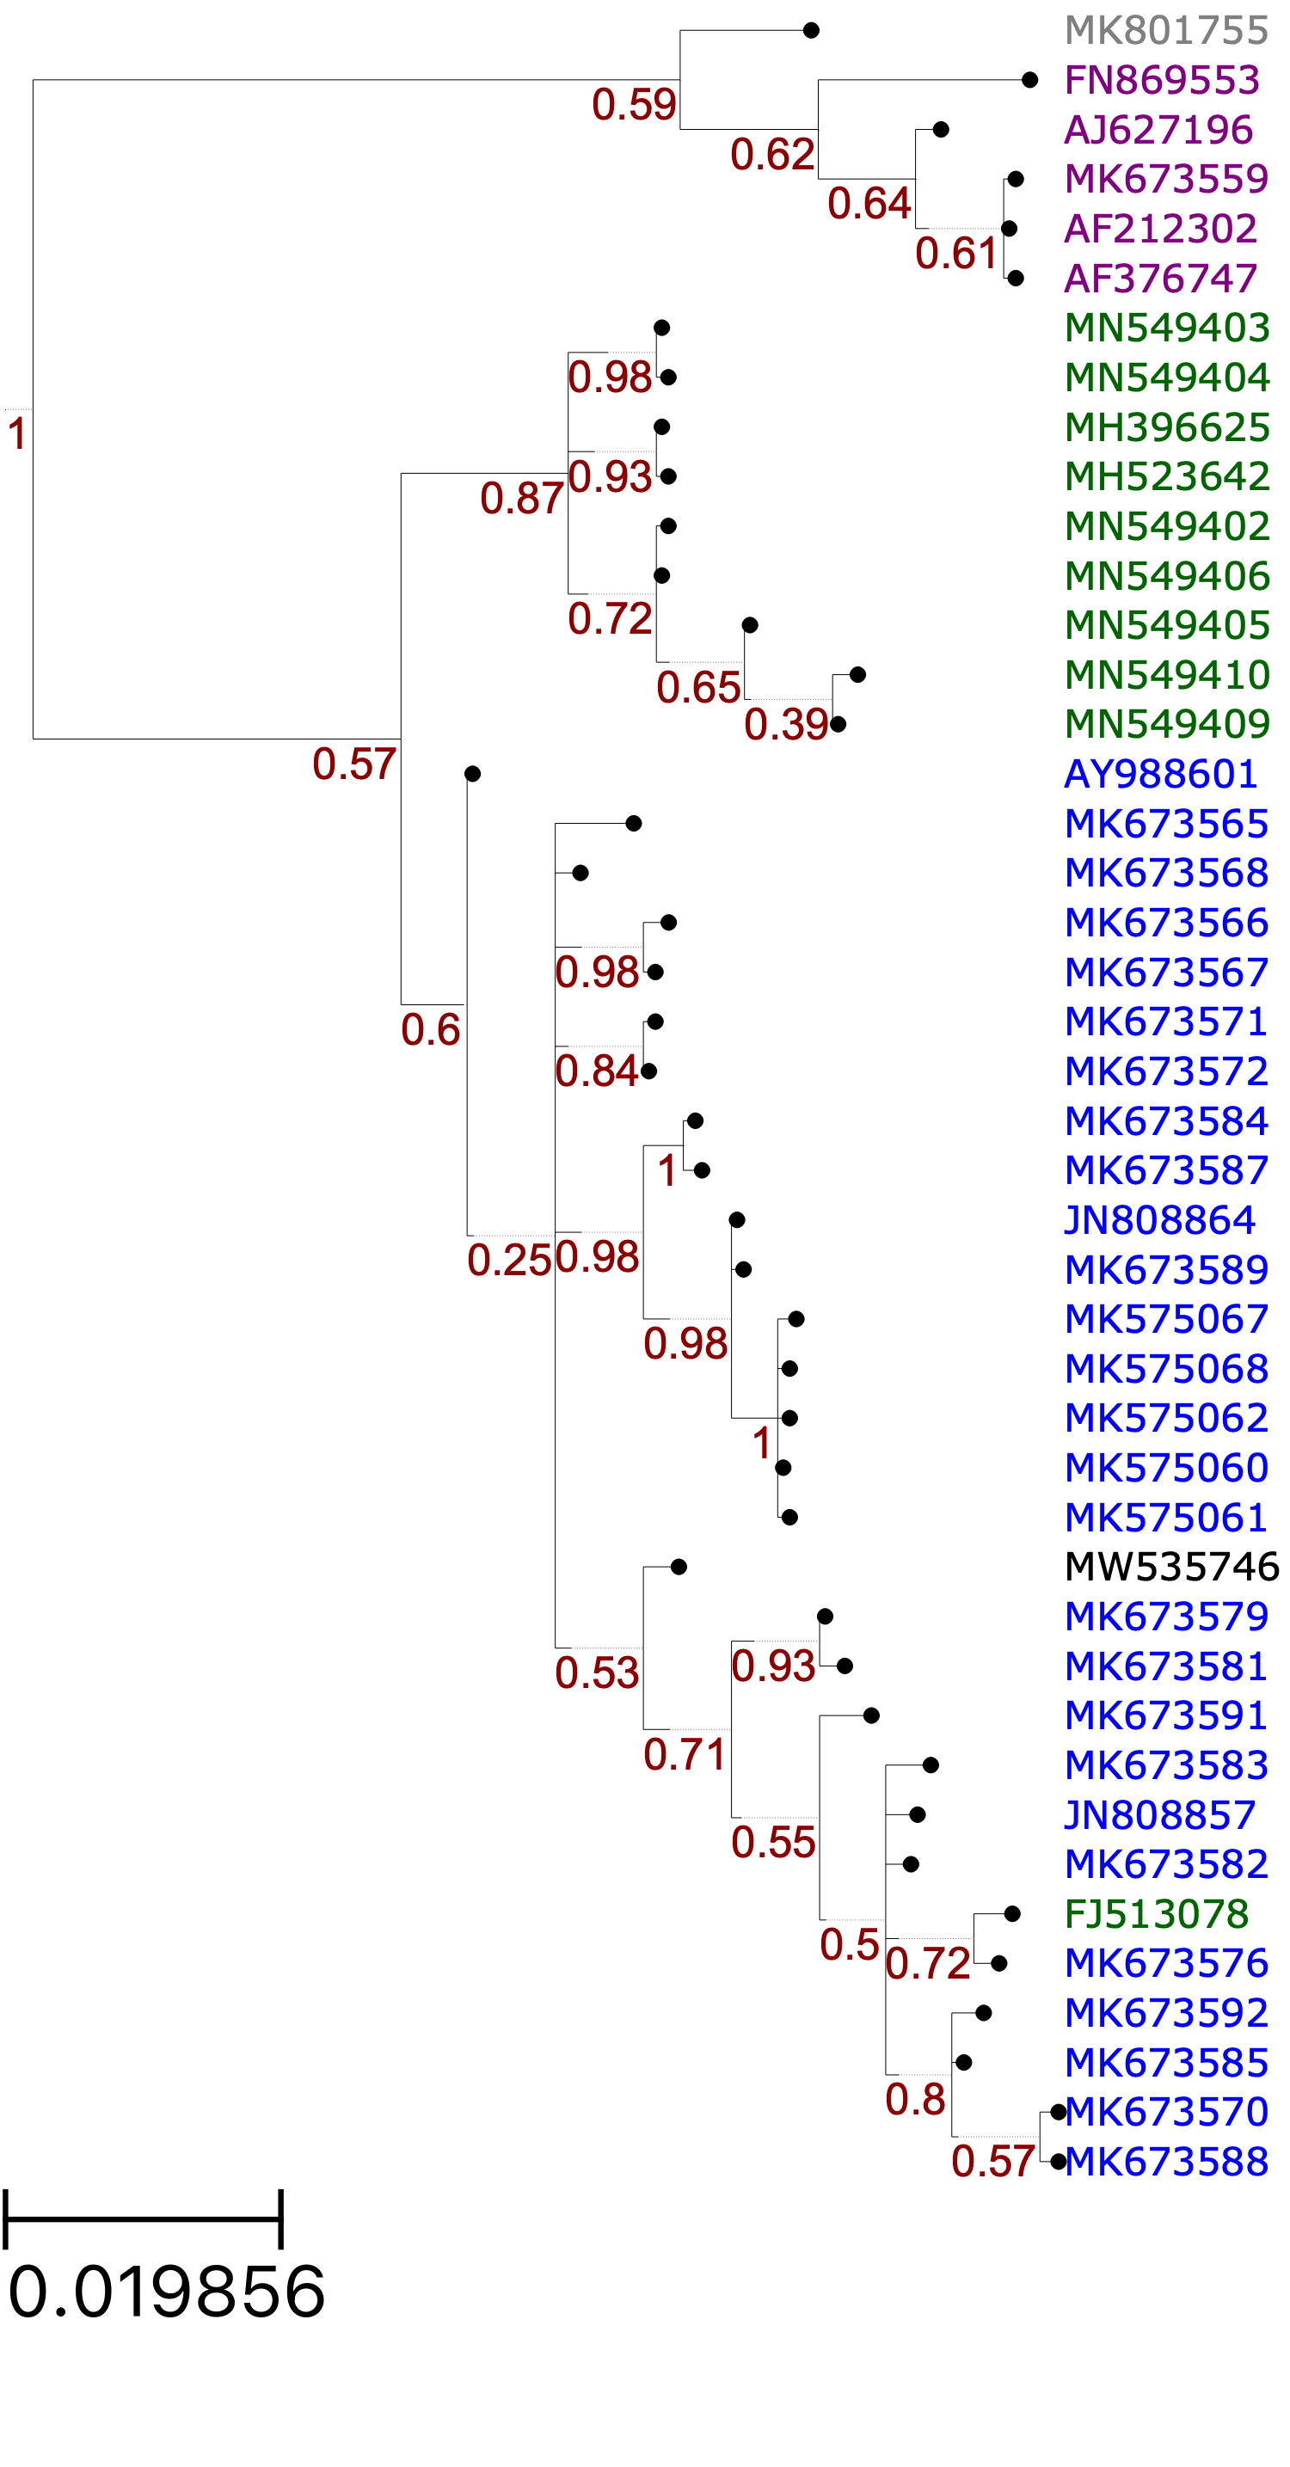
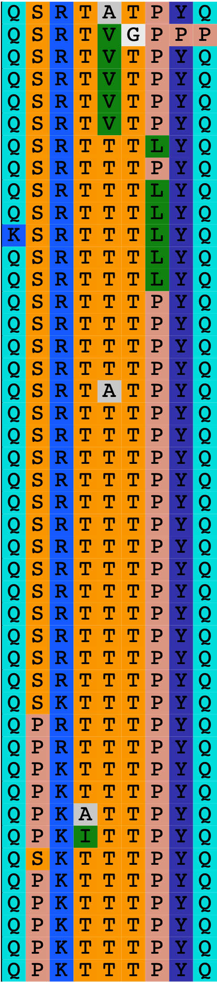
MEME: Sites under Positive Selection
Sites:
58
64
228
377
380
408
421
437
438
0.02
Notes:
FEL also identified site 380
Not sure how to use the Empirical Bayes Factor to help with analyses. Provides a confidence measure of whether diversification occurred in a given branch? The paper seems to mention EBF values > 1, but the table outputs proportions between 0 and 1.

Slide 3
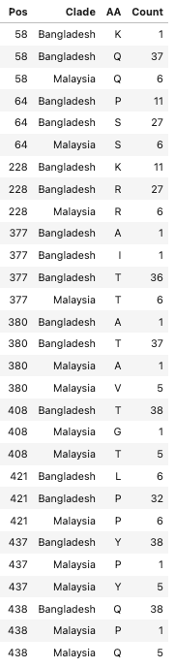
MEME: Sites under Positive Selection
Notes:
44 sequences: 38 B, 6 M.

Slide 4
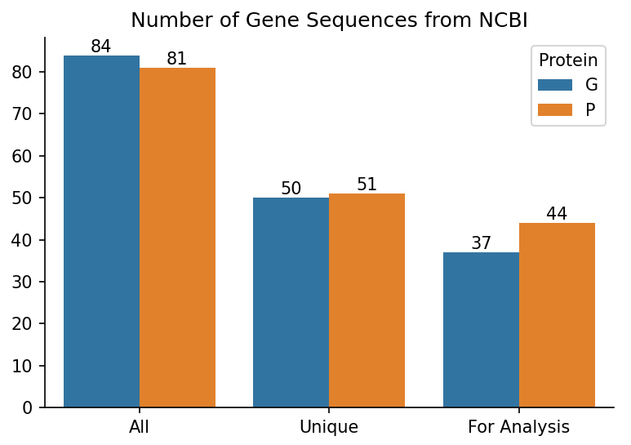
Rebuilding Trees
Removed all sequences containing ambiguous nucleotides because the dataset is not robust.
Used iqtree to select best codon substitution model.
Branch support values = non-parametric bootstrap with 1000 replicates.
1 Hendra virus sequence as an outgroup
Notes:
Make a side by side bar chart of the number of isolates originally, after deduplication, and then after ambiguous nucleotide removal.

Slide 5
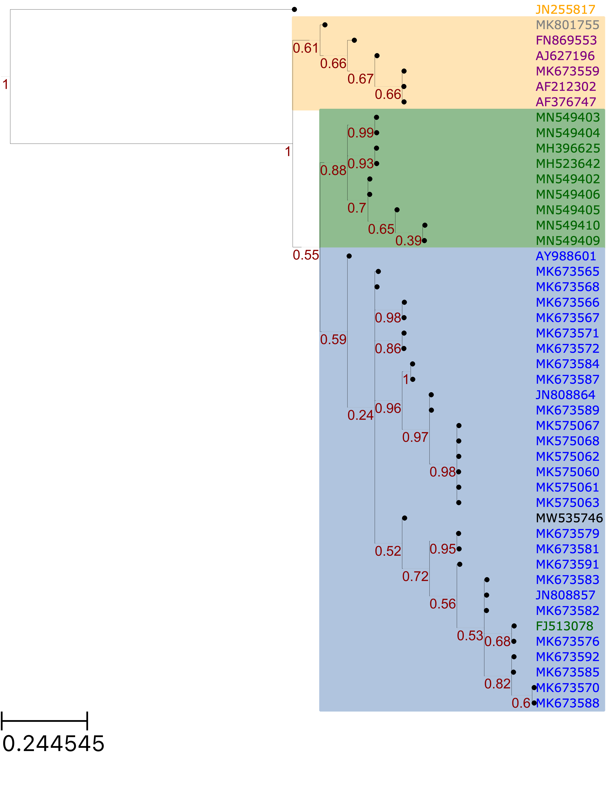
All Unique Phosphoprotein Sequences
HeV
Cambodia
India
Bangladesh
Thailand
India

Slide 6
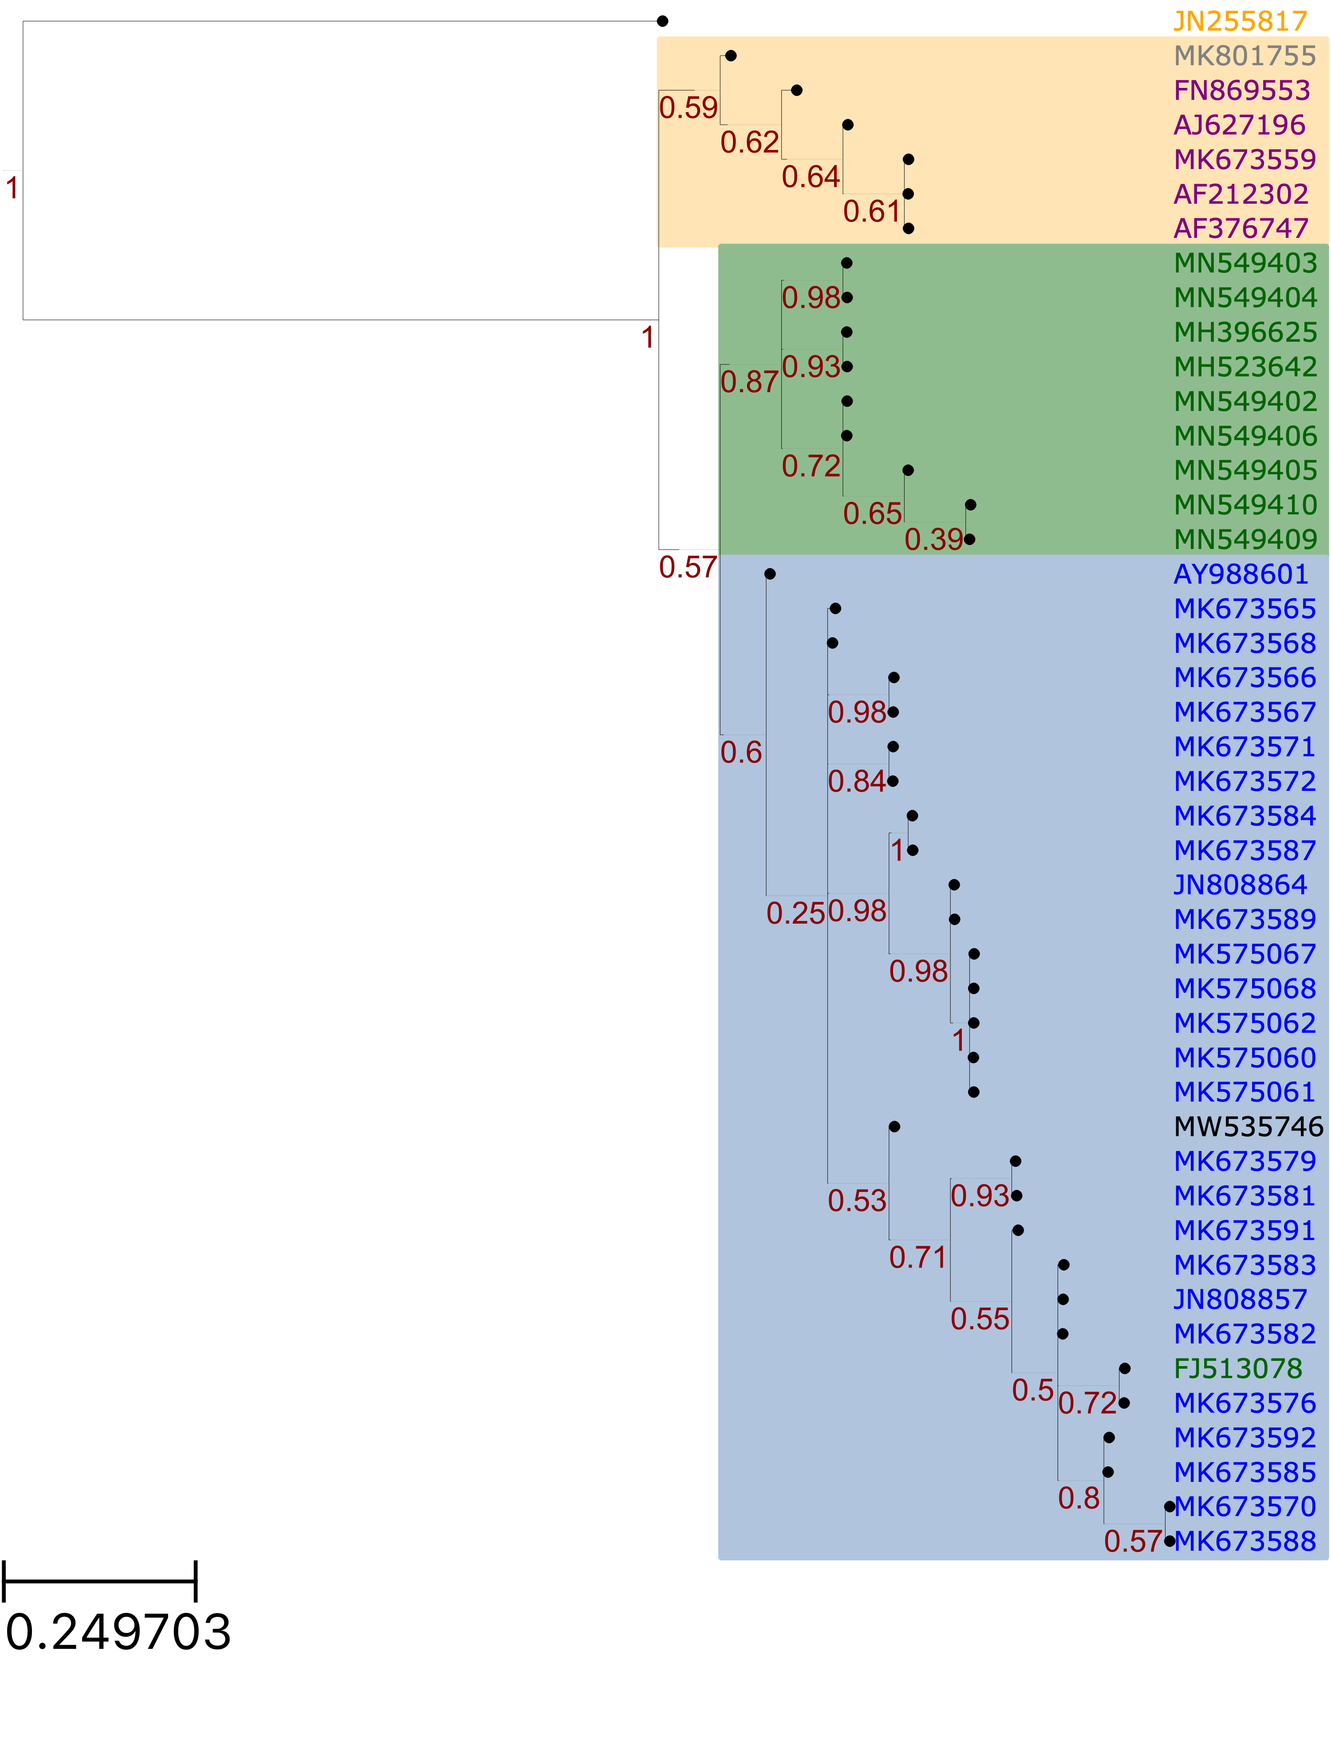
Phosphoprotein Sequences Minus 1 with Premature Stop Codon
HeV
Cambodia
India
Bangladesh
Thailand
India

Slide 7
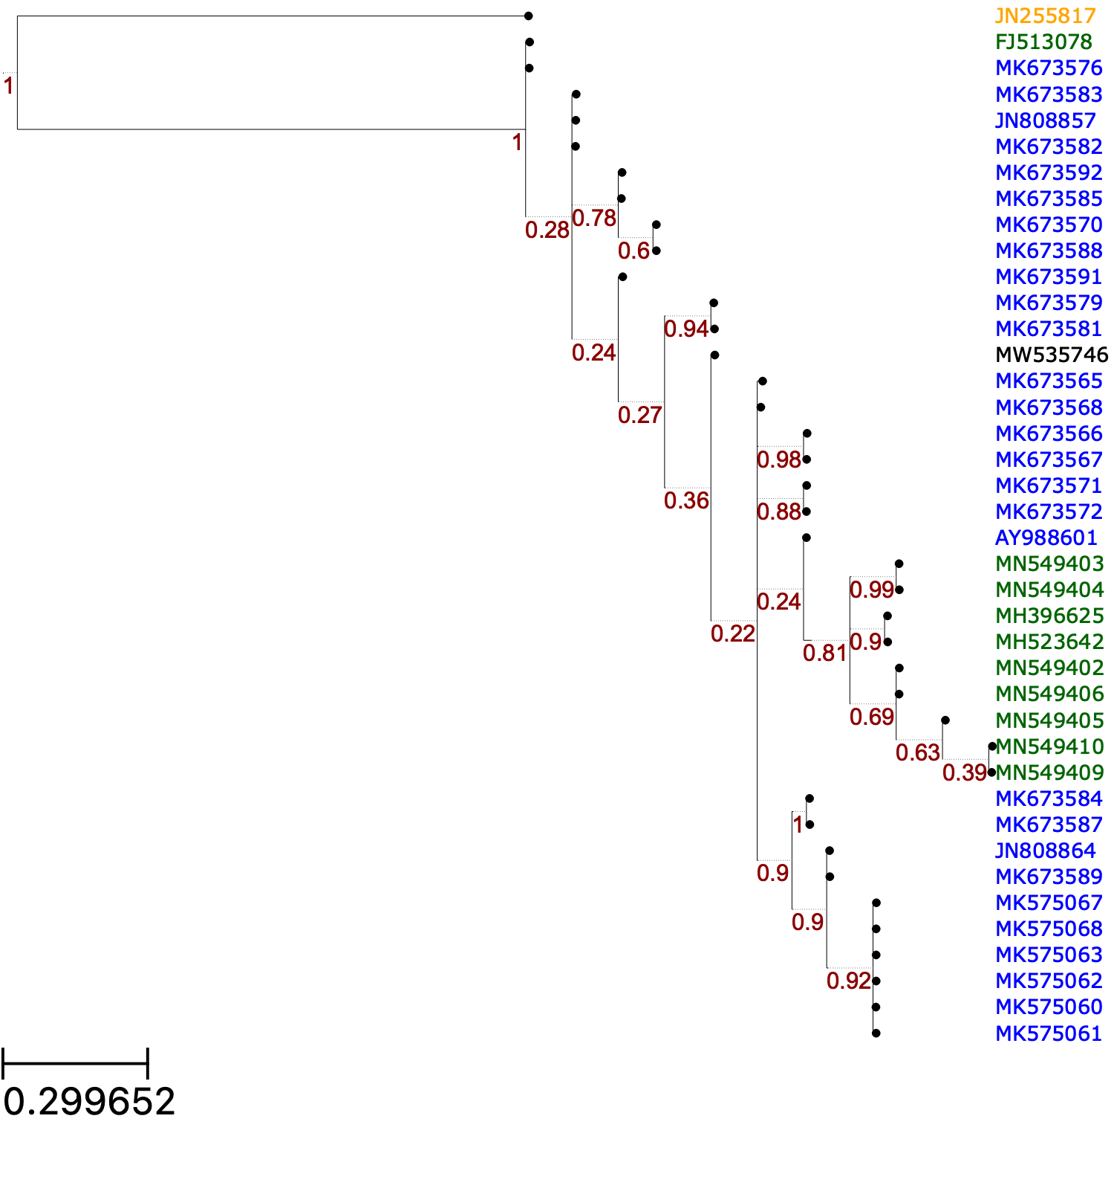
Bangladesh Clade
B-2
B-1
India
Notes:
Whitmer et al = MK67…..

Slide 8
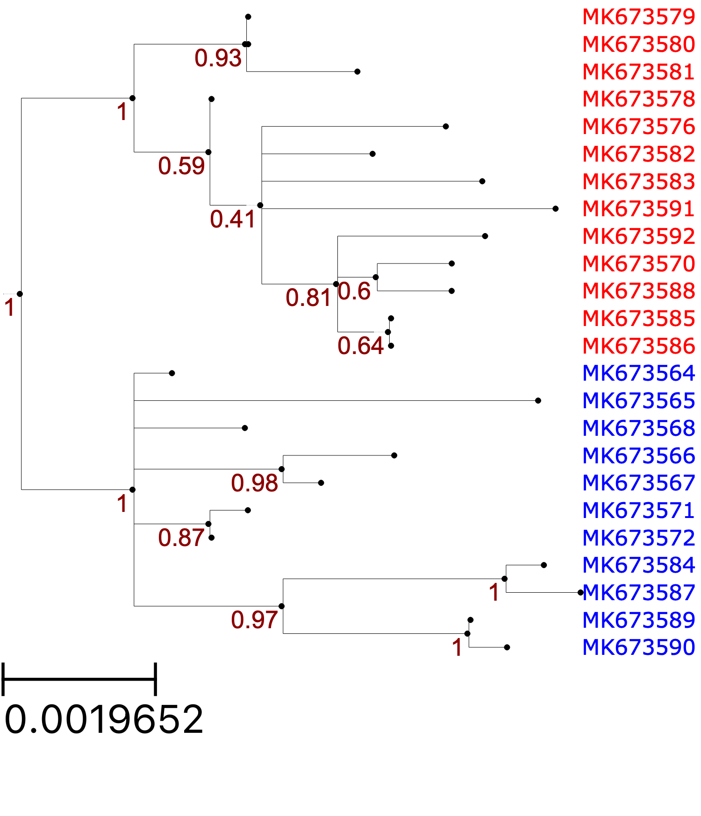
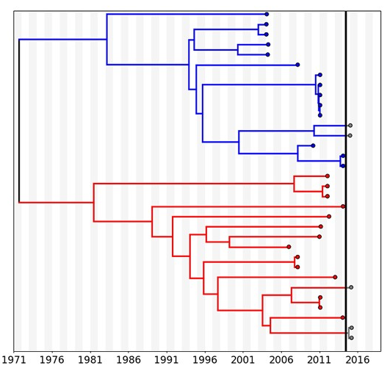
Whitmer et al., 2021 Sequences
Notes:
Has been deduplicated!

Slide 9
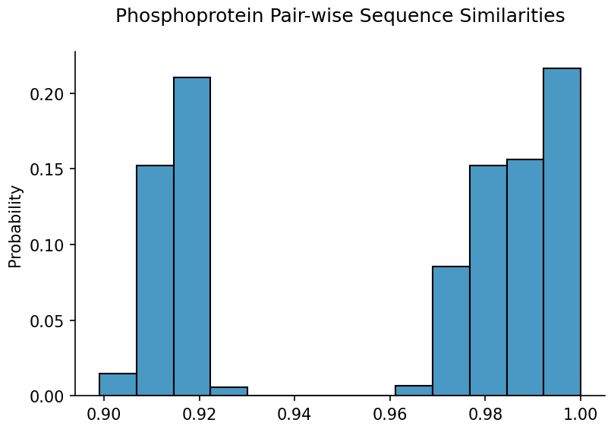
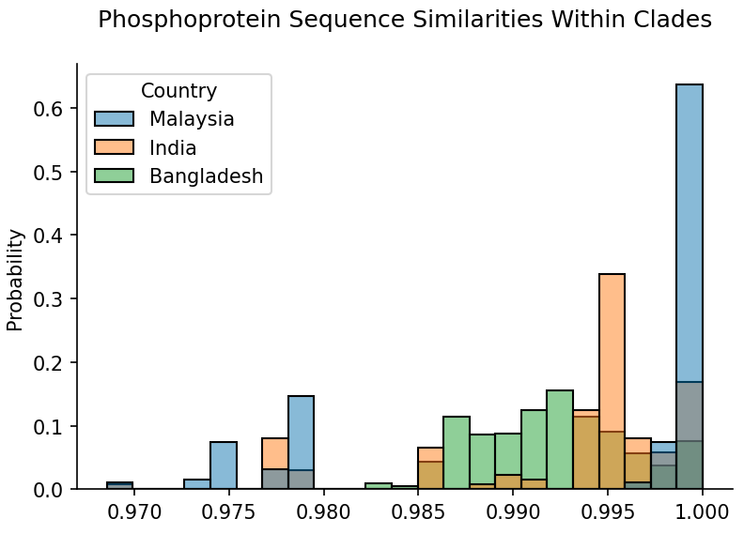
Between clades
Within clades
Notes:
More similarity among Bangladesh and India sequences, maybe because they were collected around outbreak times?

