Slide 1
Nipah Virus Evolutionary Selection Analysis Updates

Slide 2
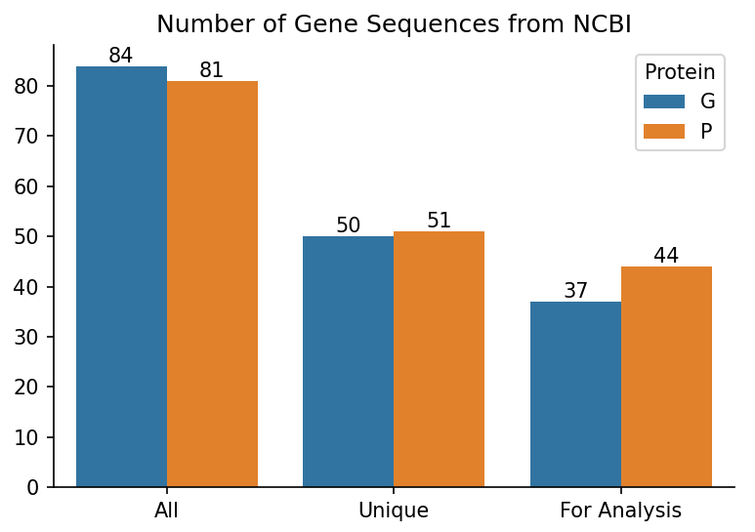
Rebuilding Trees
Removed all sequences containing ambiguous nucleotides because the dataset is not robust.
Used FastTree to construct initial tree topologies.
Used PhyML to construct a maximum likelihood tree using the FastTree tree as a starting point.
Branch support values = non-parametric bootstrap with 1000 replicates.
Notes:
Make a side by side bar chart of the number of isolates originally, after deduplication, and then after ambiguous nucleotide removal.

Slide 3
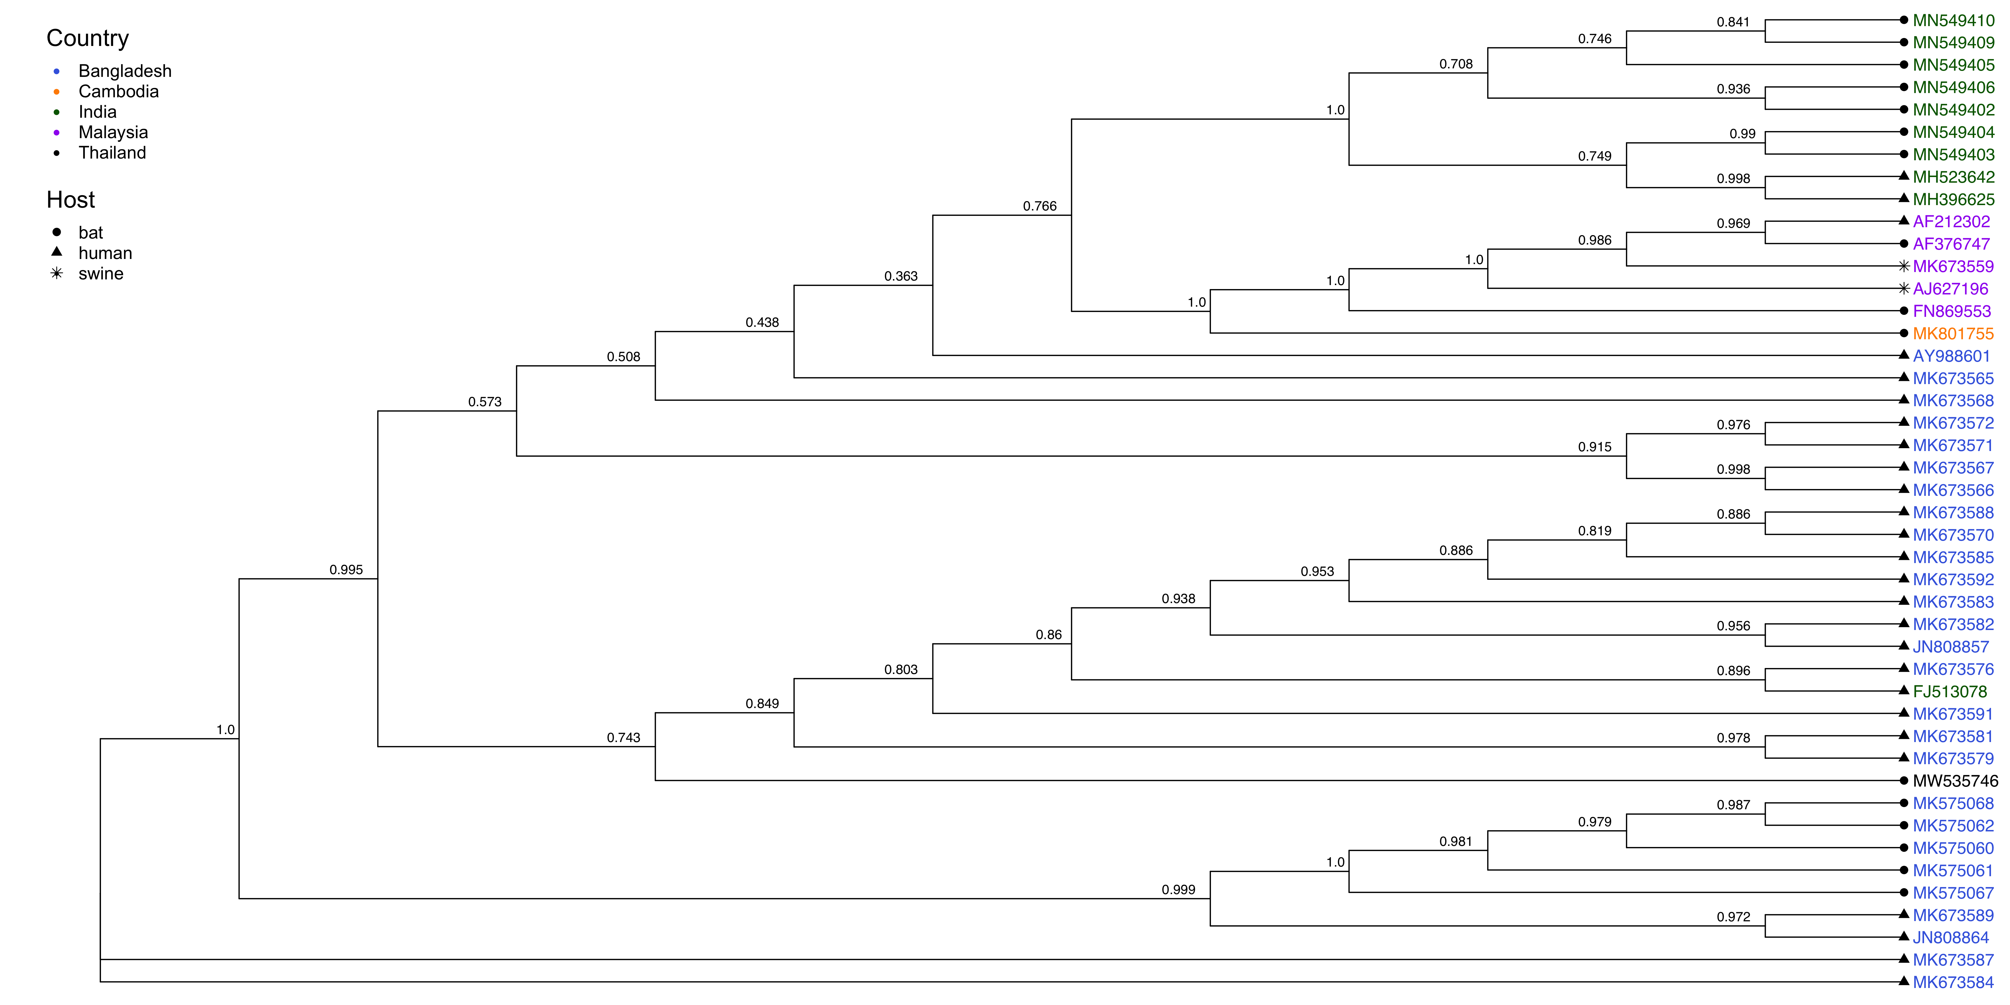
Phosphoprotein Tree, 44 Isolates

Slide 4
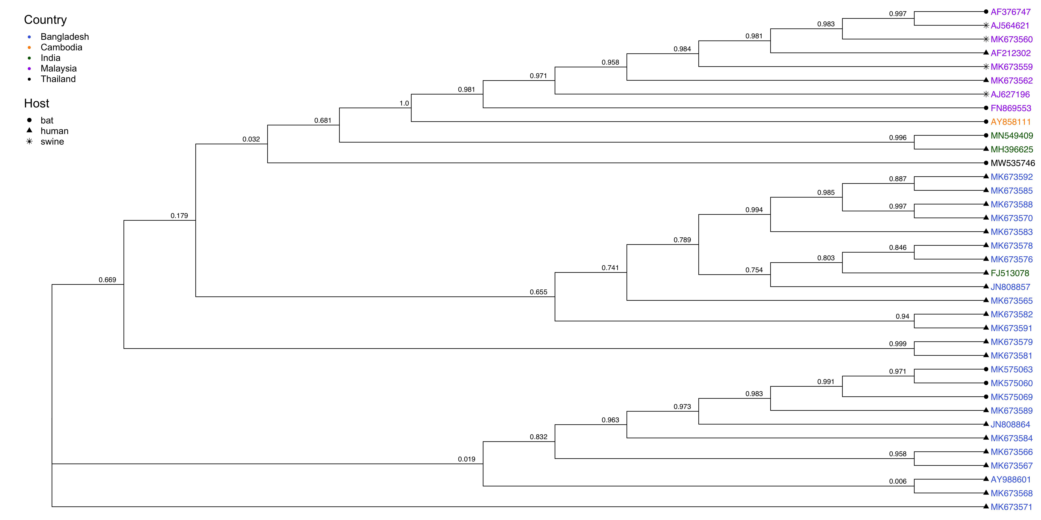
Glycoprotein Tree, 37 Isolates

Slide 5
Questions
Log-likelihood magnitudes? Getting -4000 or -5000. Does this pass the sniff test?

Slide 6
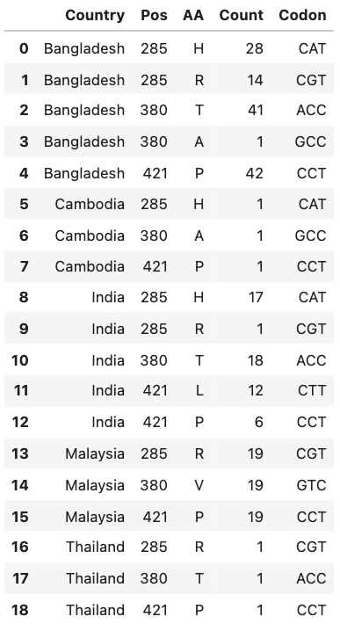
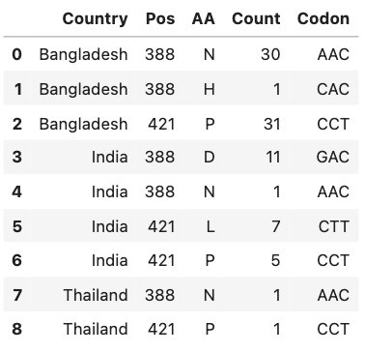
Sites under positive selection in the NiV Phosphoprotein, FUBAR
All sequences: 285, 380, 421
Bangladesh clade only: 388, 421
Notes:
FUBAR maybe better at detecting very weak positive selection.

Slide 7
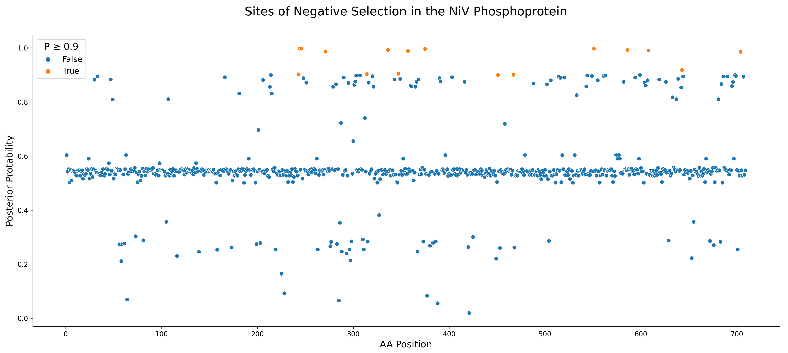
Notes:
Bangladesh, India, and Thailand only

Slide 8
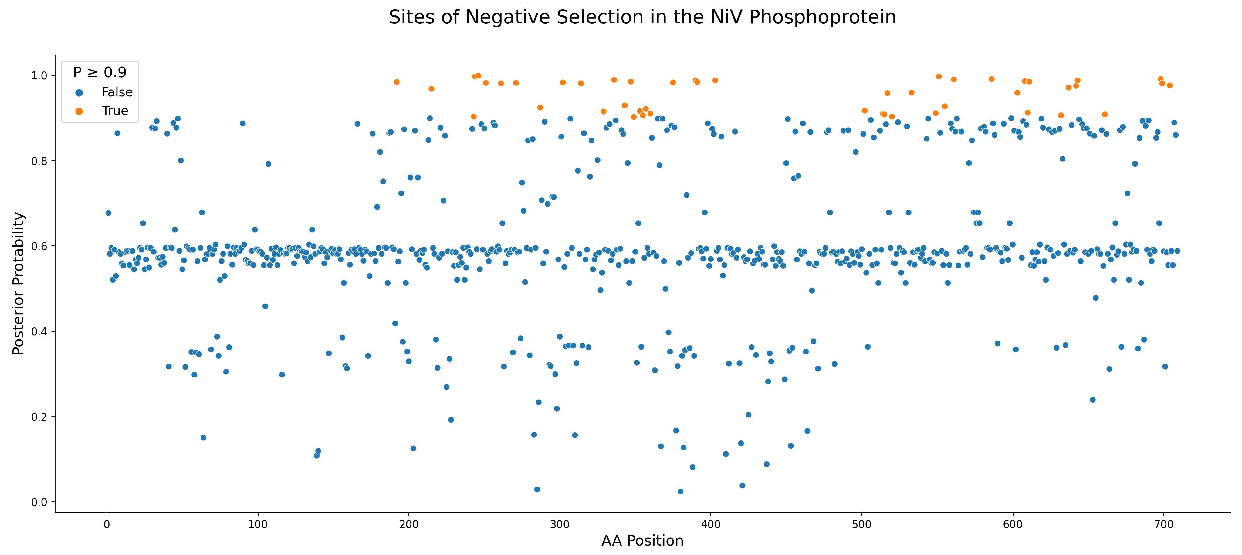
Notes:
Exact sites: 192-403, 502-704
All sequences

Slide 9
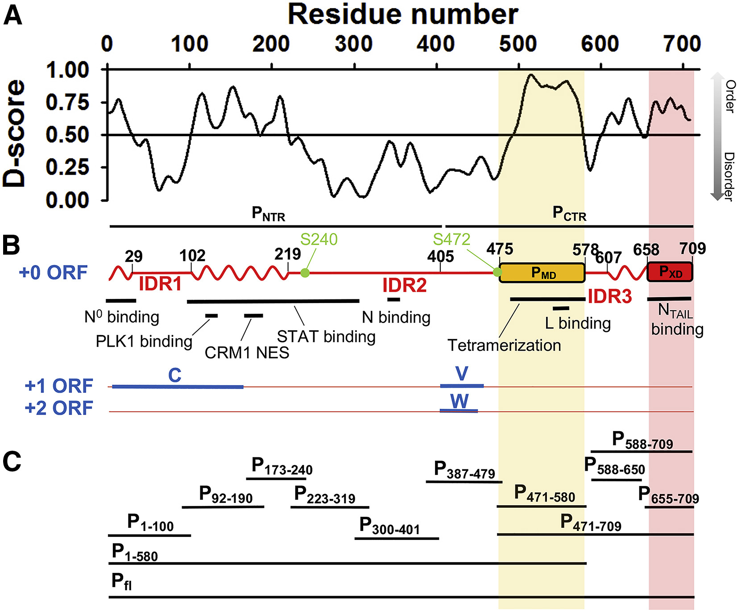
Jensen et al., Biophysical Journal, 2020
Notes:
Exact sites: 192-403, 502-704
Intrinsically disordered proteins may allow more mutations (diversifying selection) because structure isn't very constrained. BUT intrinsically disordered viral proteins also tend to bind a lot of other proteins. It's like both things at once -- constrained for binding, but unconstrained structurally.
Look at short proteins in evolutionary selection. If you have small proteins and small datasets, can you find anything? Look at some papers.

