Slide 1
See if G and P negative selection sites are in the binding sites.

Slide 2

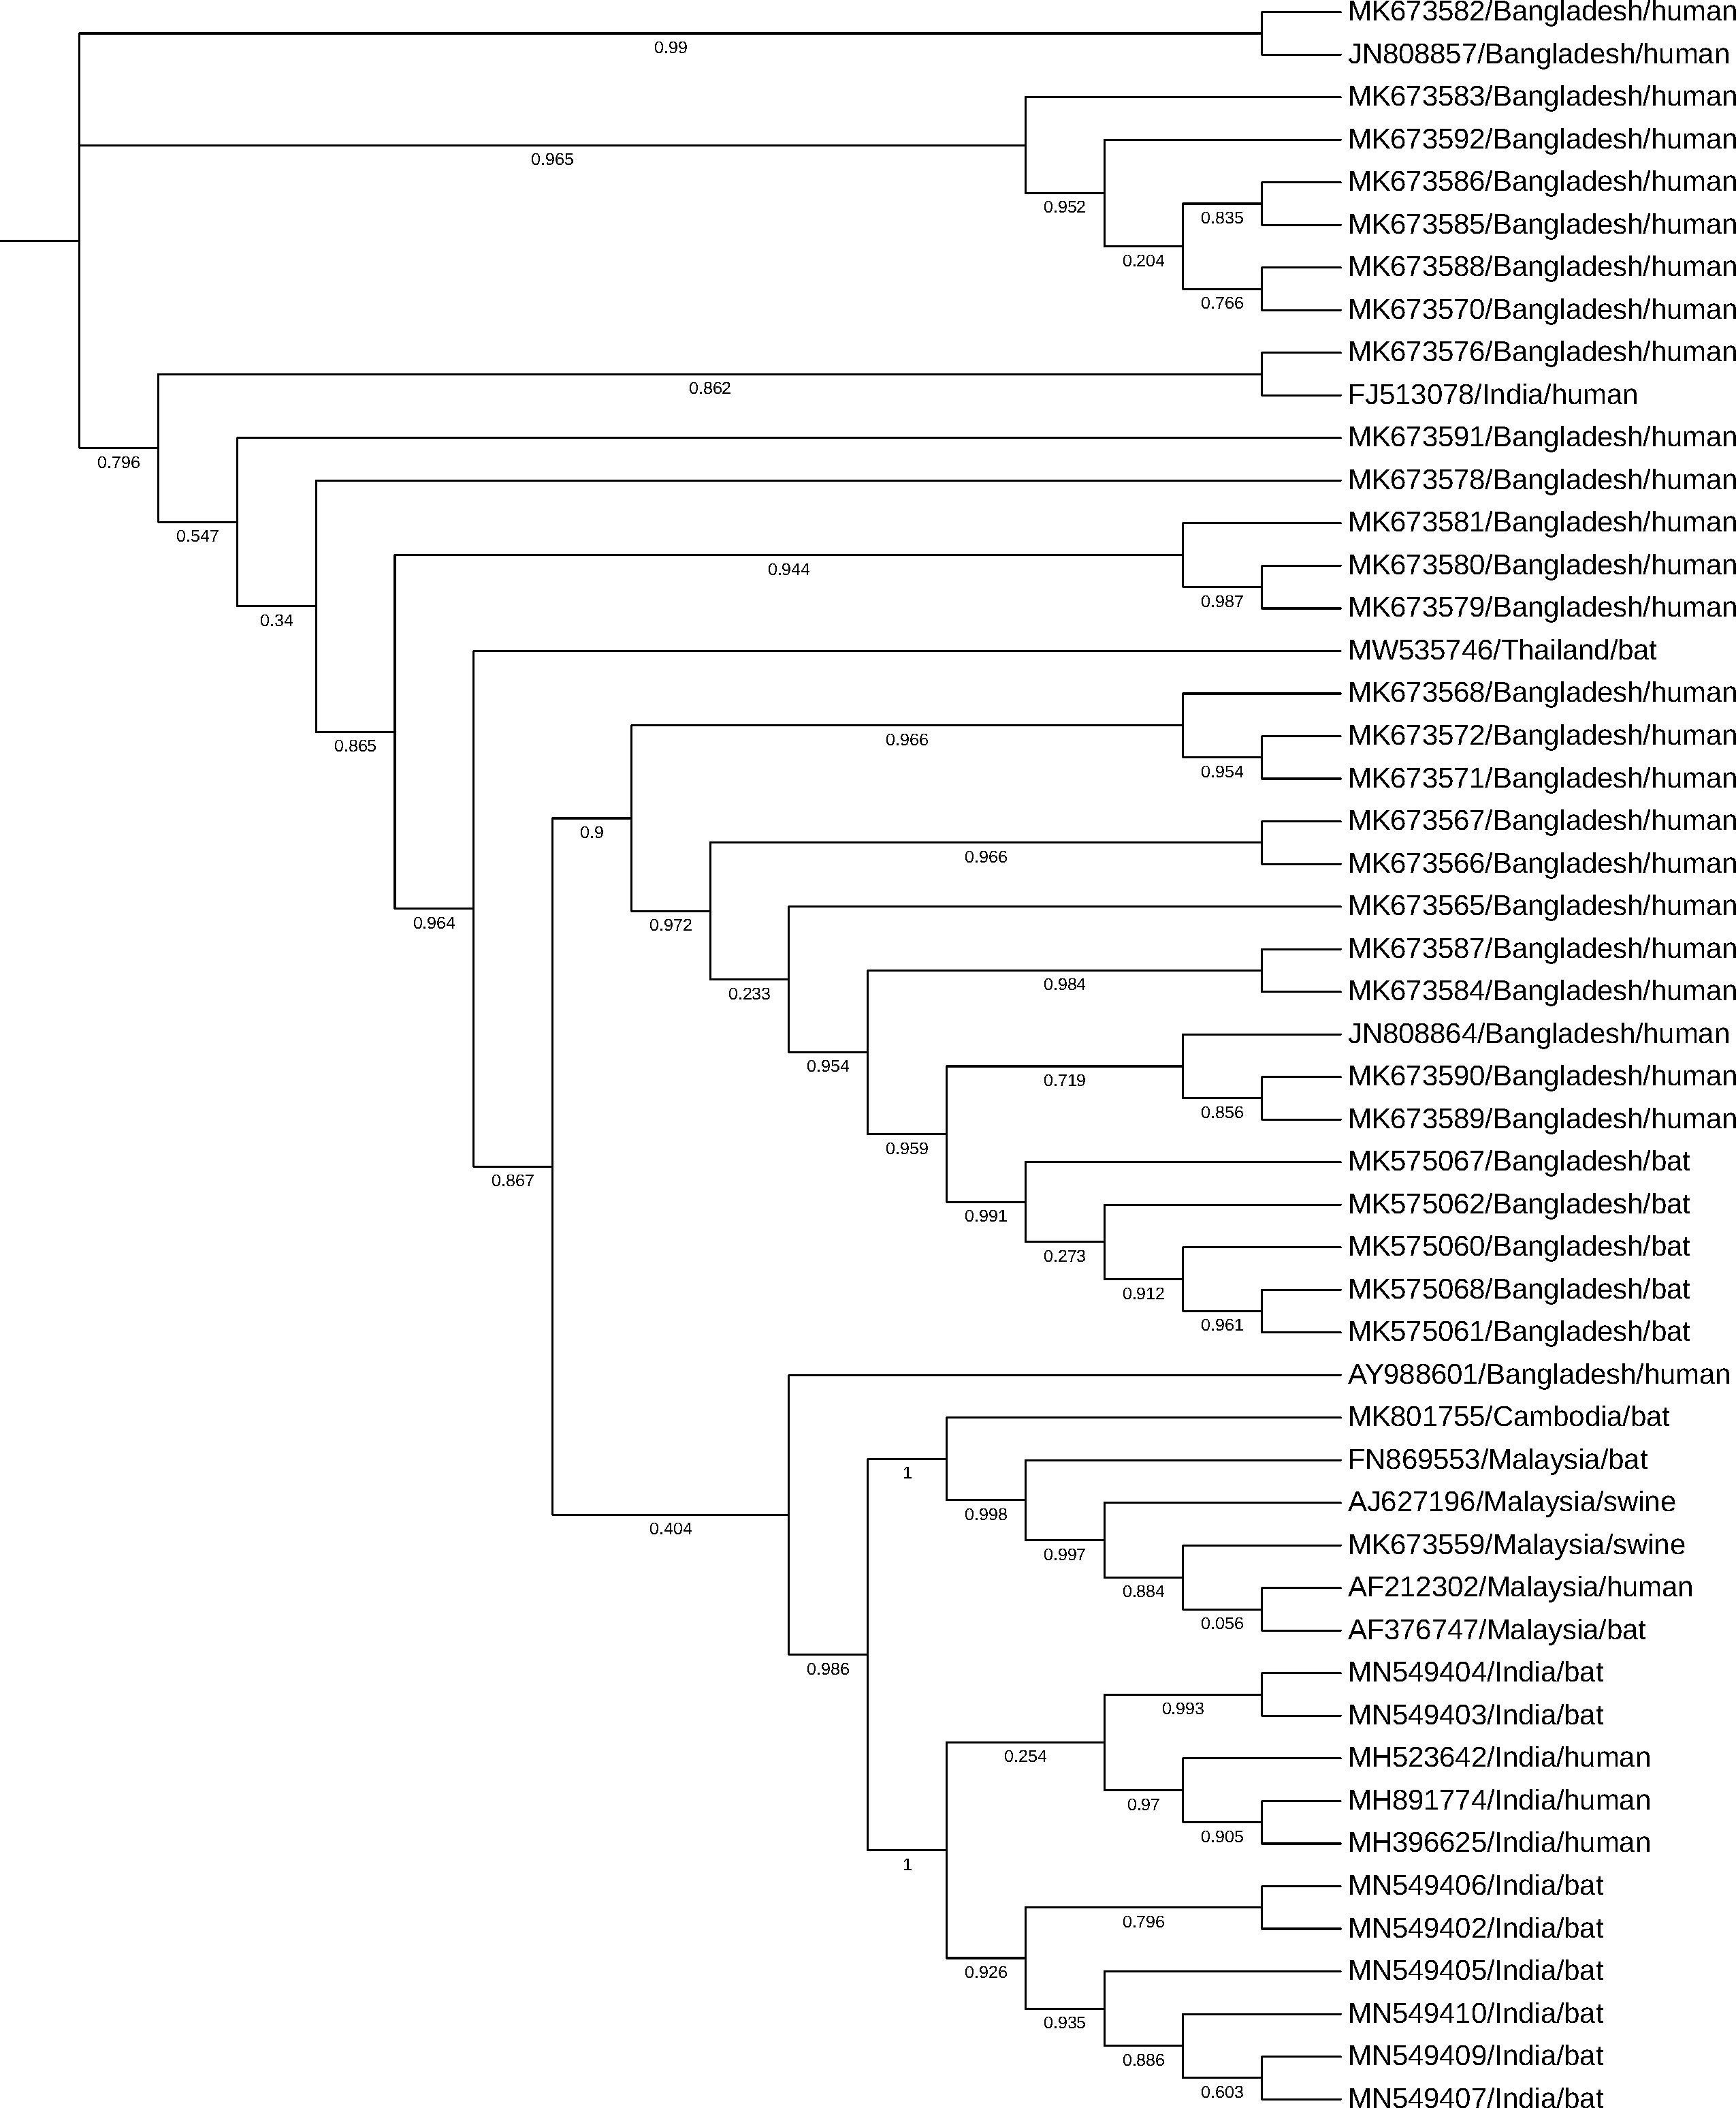
Notes:
Positive selection at 3 sites in the phosphoprotein.

Slide 3
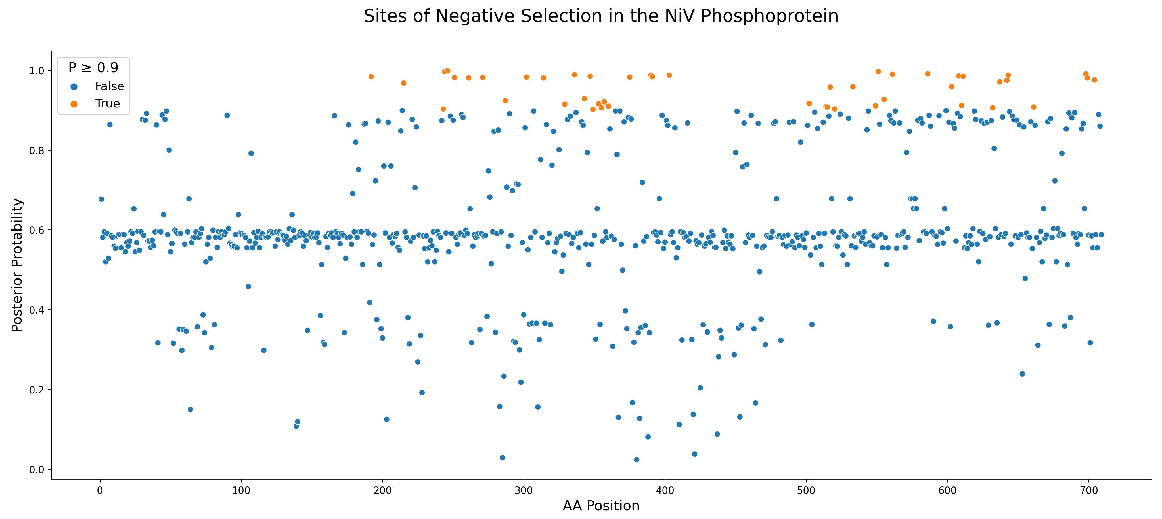

Slide 4
