Slide 1
Building Bioinformatics Workflows with Snakemake
Sanjana Kulkarni
BST 281 Guest Lecture
April 28, 2025

Slide 2
About
4th year PhD student in Maha Farhat’s lab (Department of Biomedical Informatics)
BST 281 student in Spring 2022, TF in Spring 2023
I research Mycobacterium tuberculosis using bioinformatics, statistics, and machine learning.

Slide 3
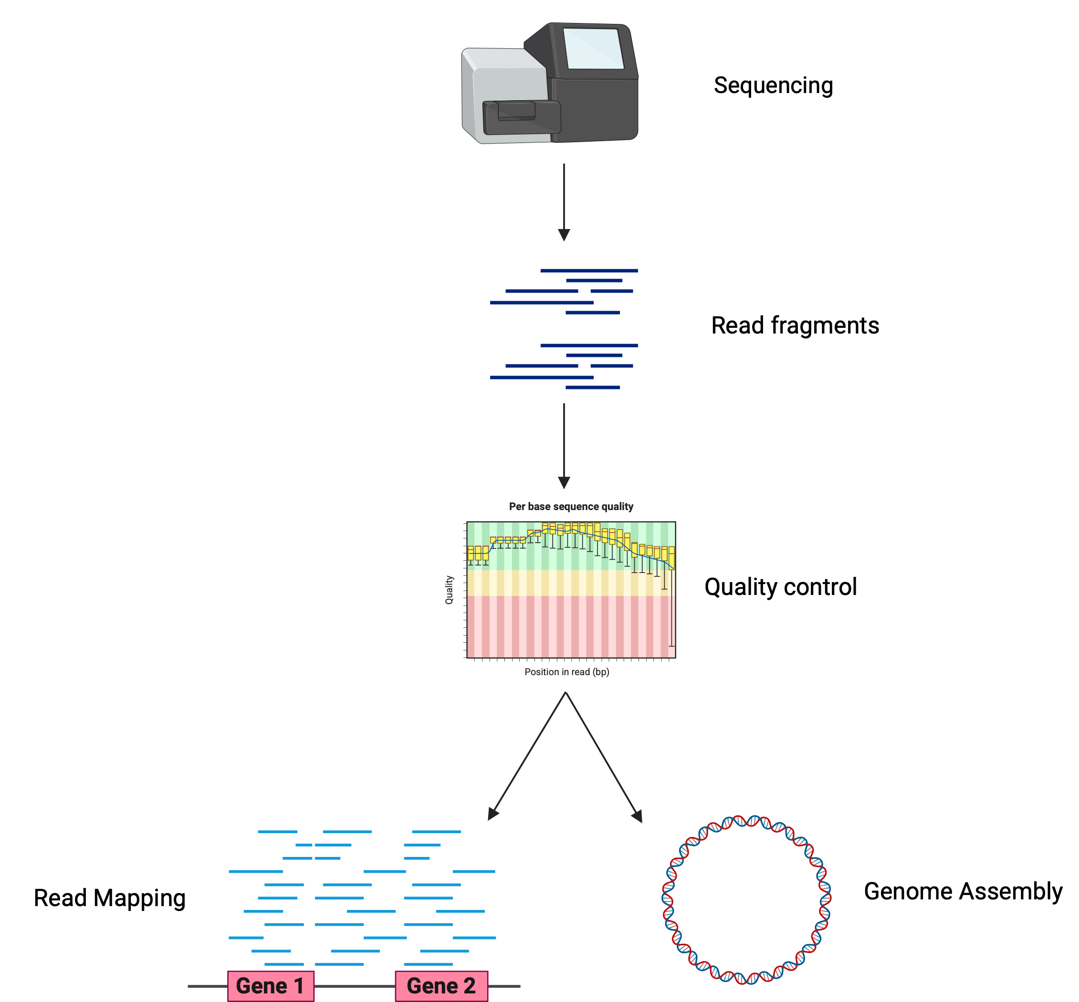
Bionformatics workflows need to be reproducible
x 1000s of samples
Different parameters
Different software versions

Slide 4
Workflow languages allow you to build scalable, reproducible, modular workflows
Parameters
Software
Input 1
Output 1
Input 2
Parameters
Software
Output 1
Final Output

Slide 5




Slide 6
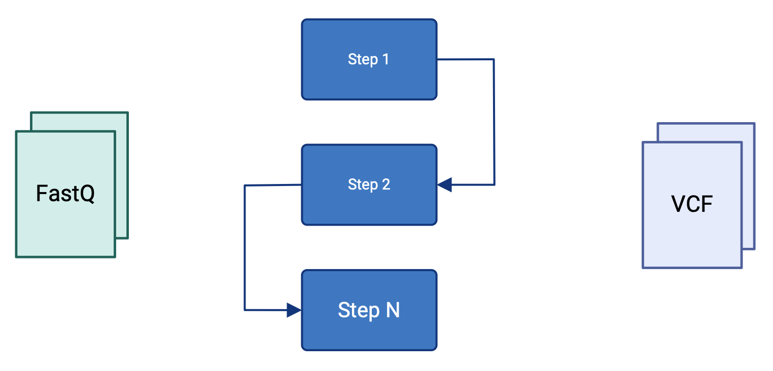
How to build a workflow
Input
Steps
Output

Slide 7
How to build a workflow in Snakemake: Rules
rule my_rule:
input:
fName1 = “path/to/inputfile”,
fName2 = “path/to/other/inputfile”,
output:
output1 = “path/to/output/file”,
output2 = “path/to/output/file”,
params:
threshold_val = 10,
conda:
“envs/my_env.yaml”
shell:
"""
some_command {input.fName1} {output.output1} -p {params.threshold_val}
some_command {input.fName2} {output.output2} -p {params.threshold_val}
"""
Input and output files
Additional parameters
Conda environment (can also be the path to an environment)
Inputs, outputs, and params are accessible like so

Slide 8
Because Snakemake is python-based, you can run python commands
rule my_rule:
input:
fName1 = “path/to/inputfile”,
fName2 = “path/to/other/inputfile”,
output:
output1 = “path/to/output/file”,
output2 = “path/to/output/file”,
params:
threshold_val = 10,
conda:
“envs/my_env.yaml”
run:
"""
print(f"Filename 1: {input.fName1}, Filename 2: {input.fName2}")
"""

Slide 9
How to build a workflow in Snakemake: Snakefile
include: "rules.smk”
rule all:
input:
“output_file_1.txt”,
“output_file_2.txt”
Rules file(s) with steps
Output files of the full workflow

Slide 10
Snakefile: Passing in a list of samples
include: "rules.smk”
rule all:
input:
“output_file_1.txt”,
“output_file_2.txt”
Rules file(s) with steps
Output files of the full workflow

Slide 11
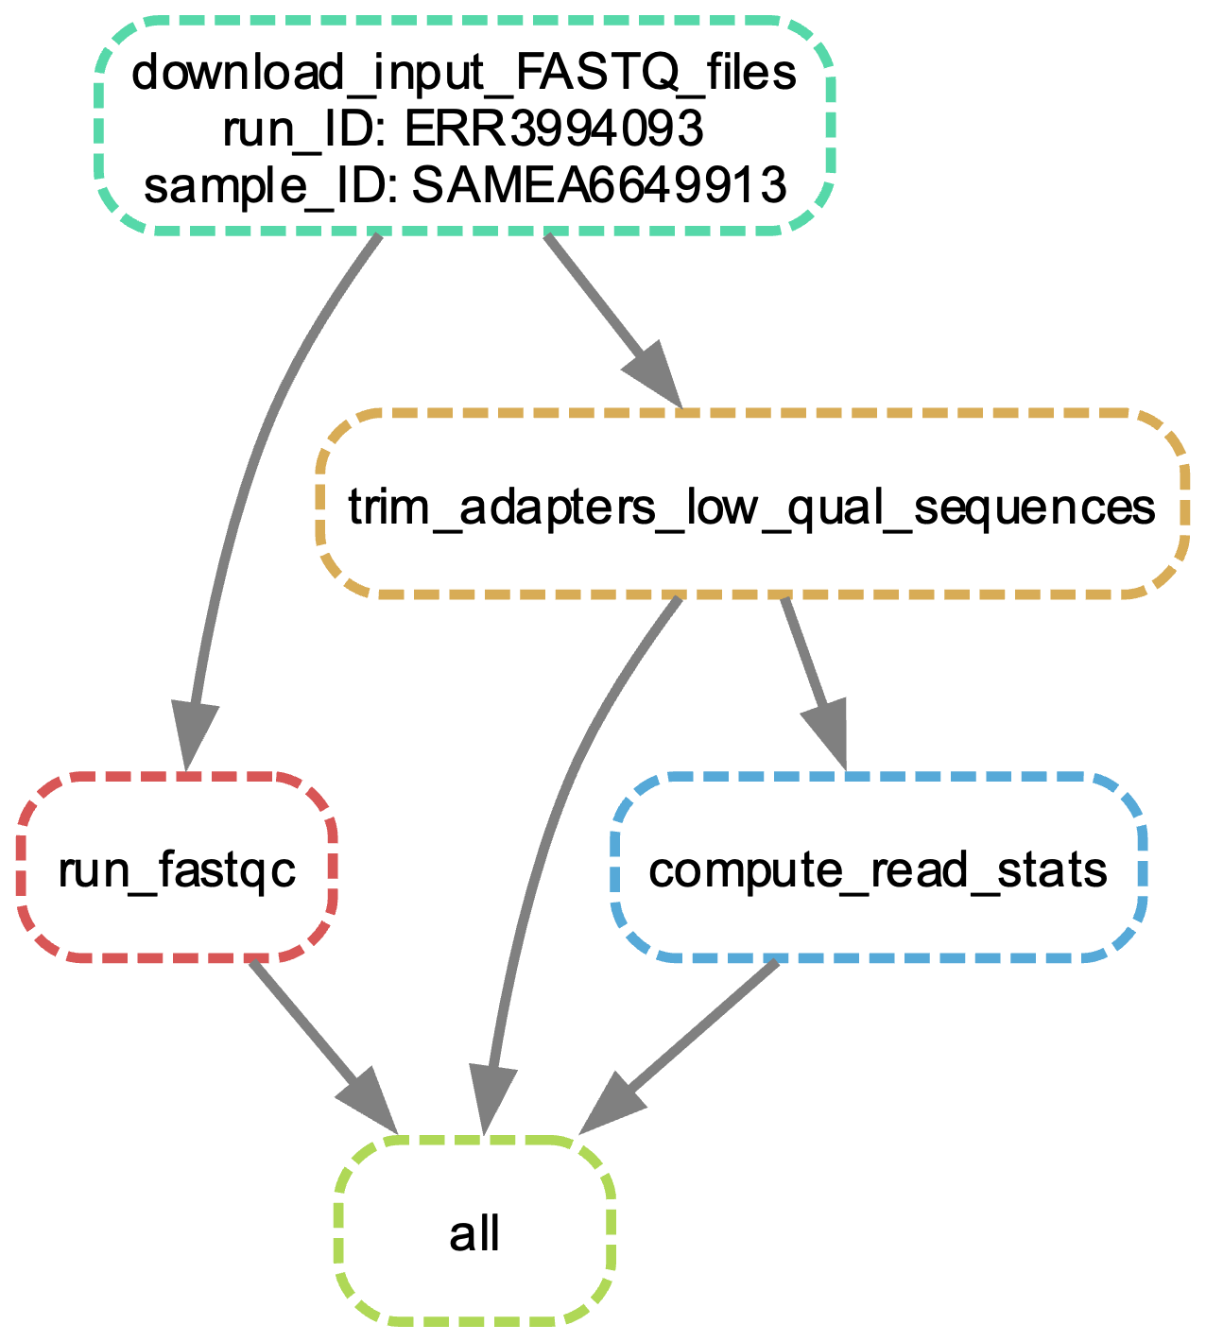
Directed Acyclic Graph of Jobs

Slide 12
Activity

Slide 13
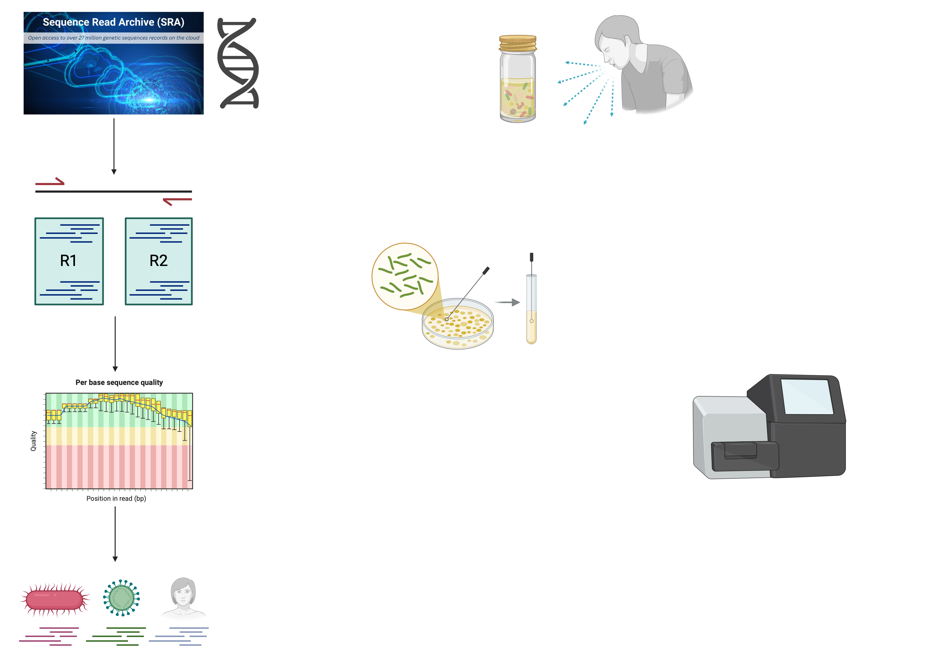
Short background on whole-genome sequencing for M. tuberculosis
Collect sputum sample from symptomatic patient
Culture mycobacteria to
Enrich mycobacterial DNA
Screen out contaminants
Direct from sputum sequencing
Whole-genome sequencing

Slide 14
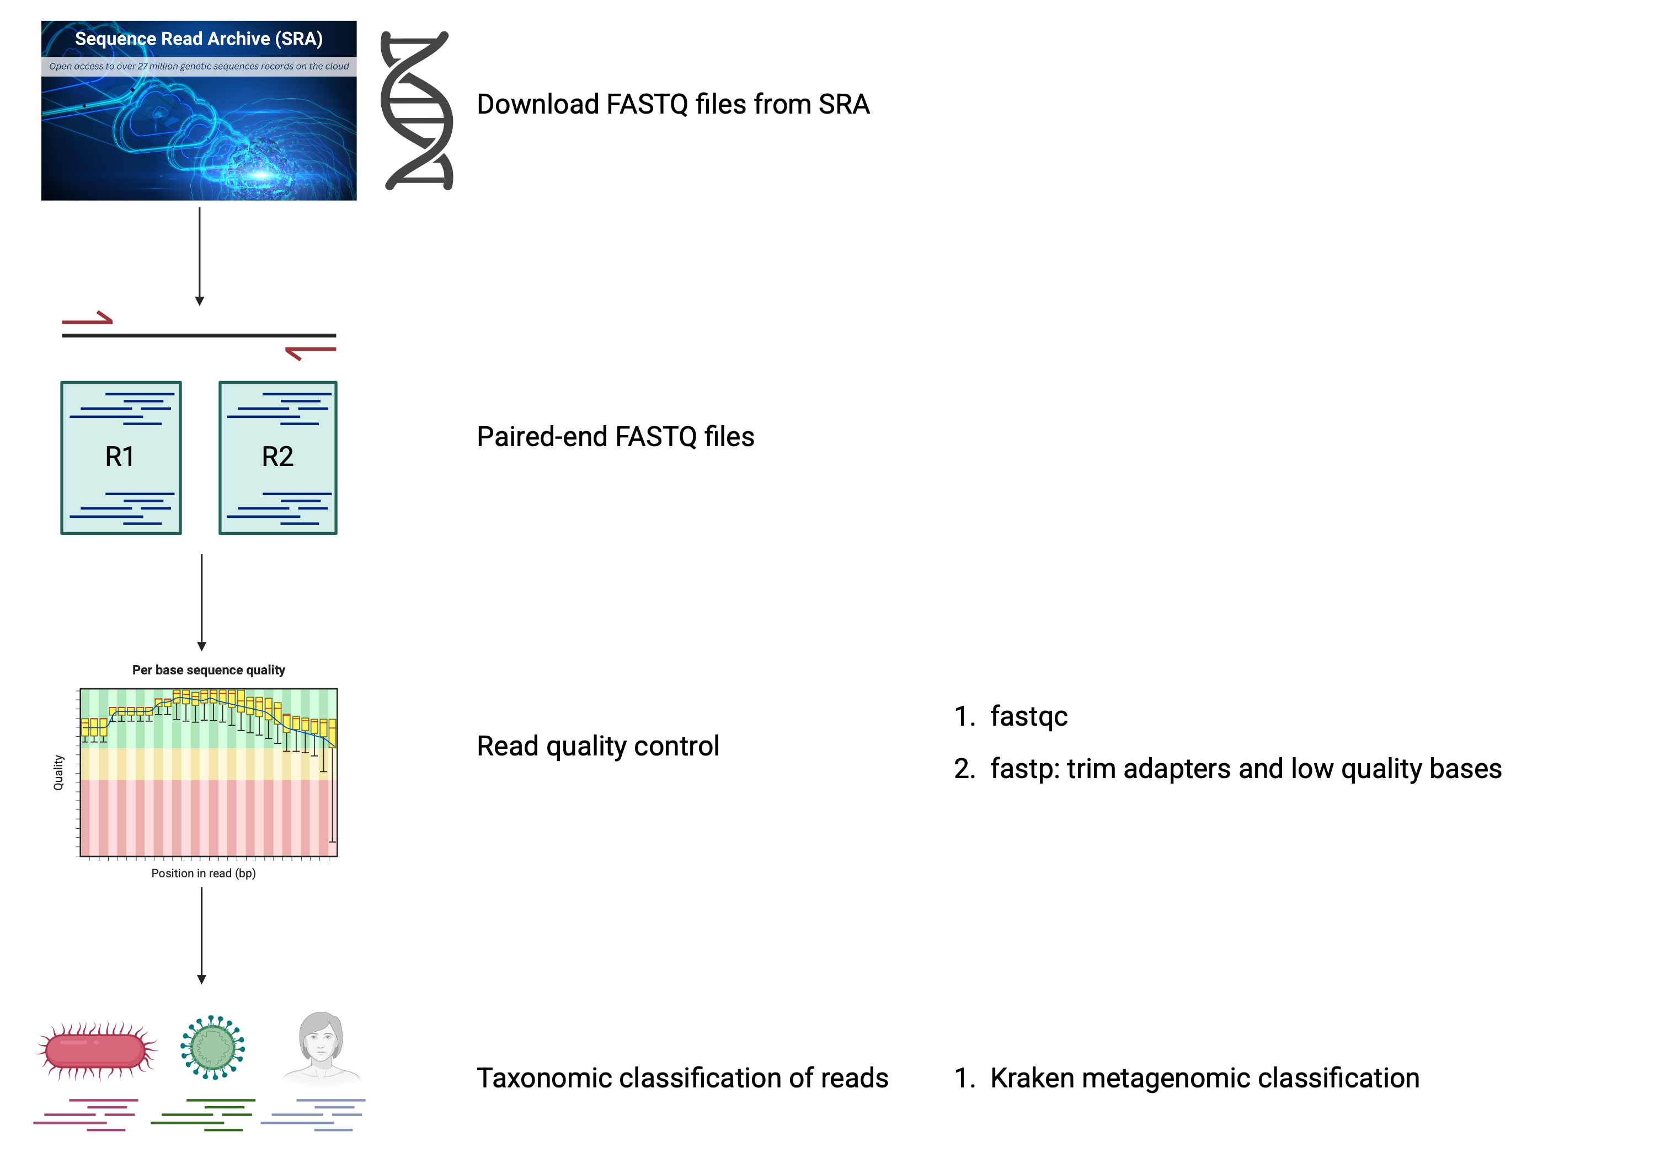
1
2
Download FASTQ files from SRA
Samples were sequenced by paired-end, so there are 2 read files for each isolate.
3
4
Taxonomic classification and contaminant removal

Slide 15
Kraken Tools for Metagenomic Classification

