Slide 1
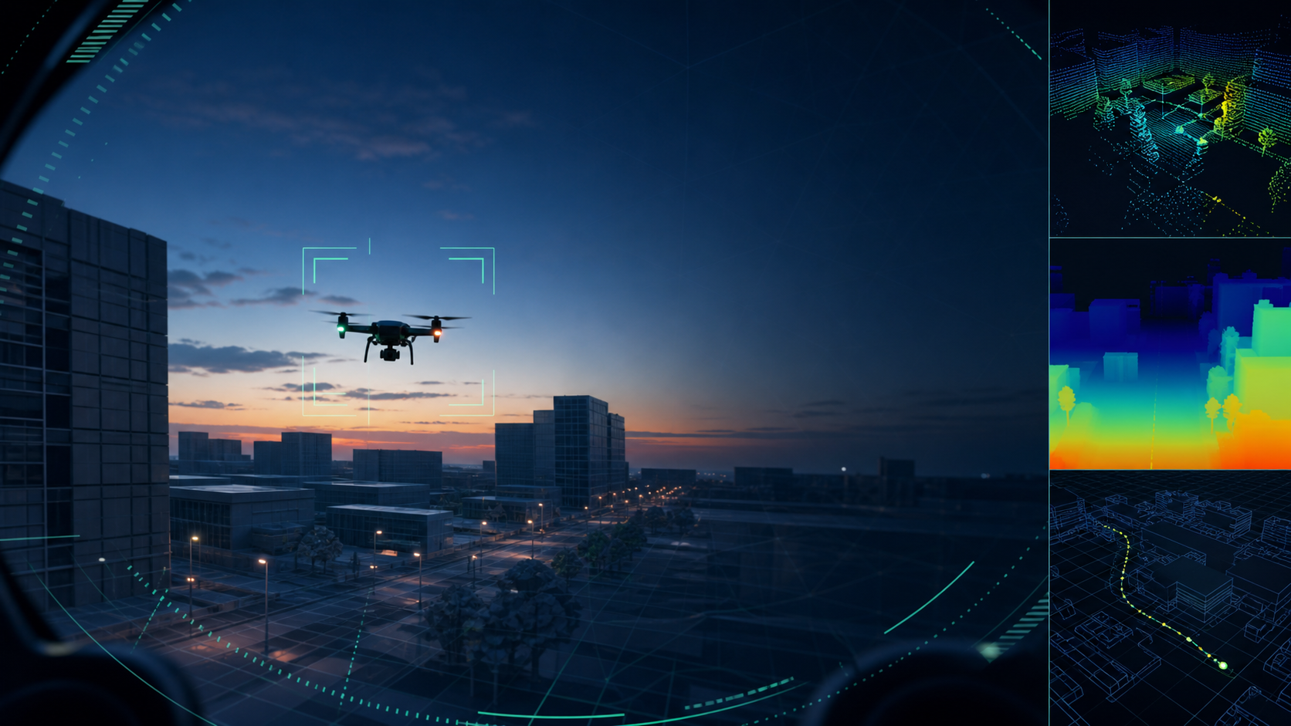
VISION-ONLY UAV SYSTEM
Vision-only navigation & target tracking
Detect, track, self-localize and avoid — even when GPS is jammed.
Sim-validated in AirSim · roadmap to real hardware (RealSense + Jetson)

Slide 2
THE PROBLEM
Why vision, not GPS
• GPS can be jammed or spoofed in contested airspace.
• A GPS-reliant drone is effectively blind without it.
• Our approach: navigate by what the camera sees.
• One camera does two jobs — see the target, and know its own position.
• Vision is the backup that cannot be jammed.
GPS vs VISION
GPS → jammable, single point of failure
VISION → passive, self-contained, jam-proof
2/10

Slide 3
SYSTEM CONCEPT
How it works, end to end
SEE
TRACK
LOCATE
AVOID
ACT
detect + segment
lock + predict
VIO self-position
depth steering
follow + fly
One camera feed splits into two pipelines: tracking OTHERS (detect + follow the target) and locating SELF (visual-inertial odometry). They share pixels, run independently.
3/10

Slide 4
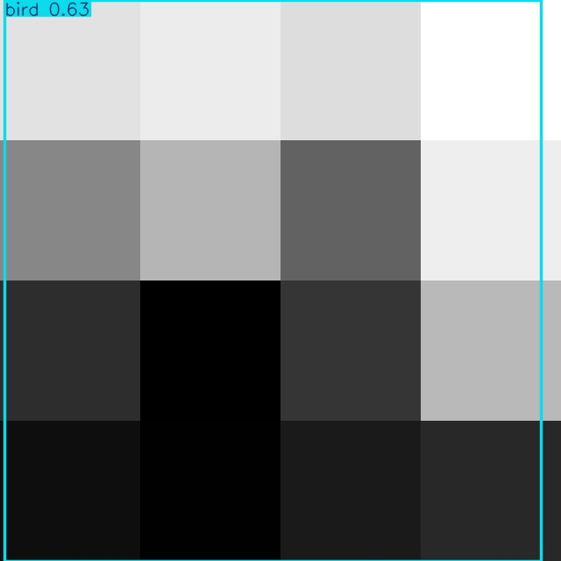
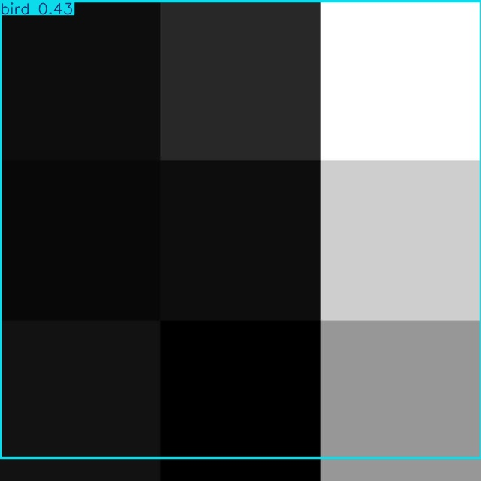
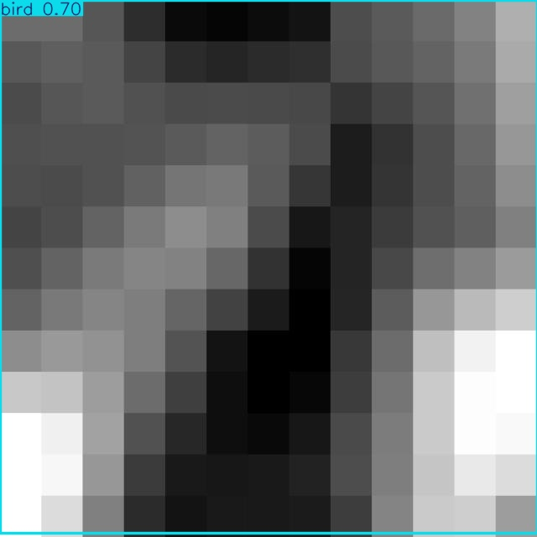
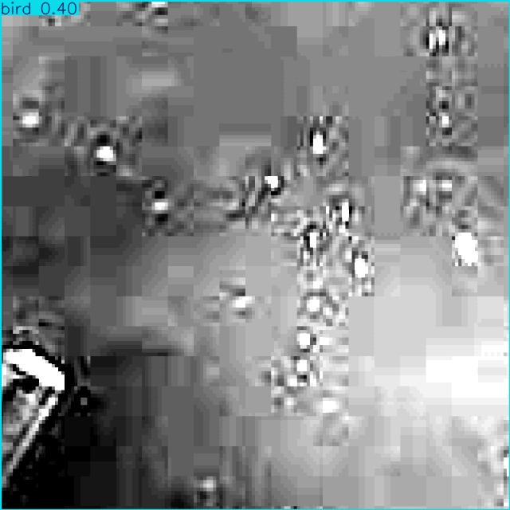
PERCEPTION
Seeing the target — on real data
• YOLO26 detector + instance segmentation.
• Two classes: drone target + bird (false-lock filter).
• Trained on ~56k real + synthetic images (Shahed, Mjolnir, AirSim).
• Real held-out mAP50 ≈ 0.77 and climbing.
• Boxes below are our model on unseen real frames.
4/10

Slide 5
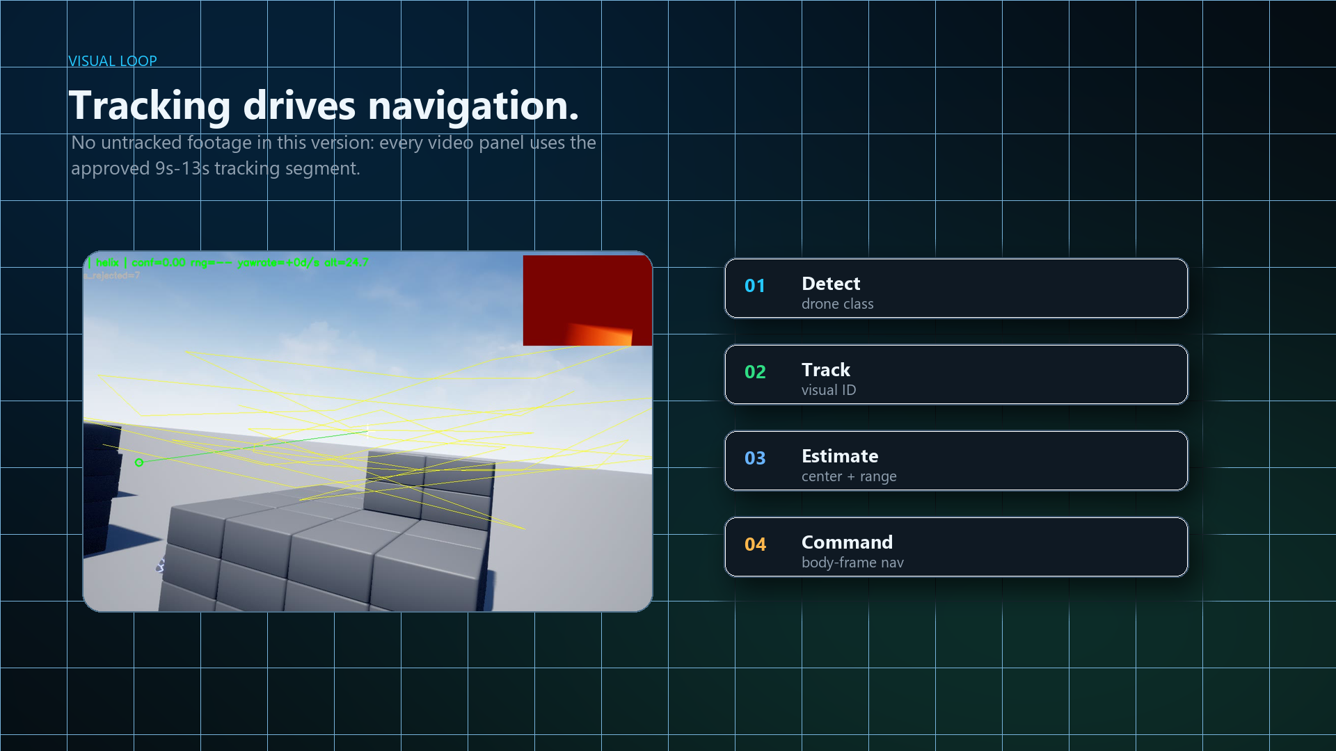
TRAINING & TESTING
How it learns — and how we prove it
• Learns from real + simulated drone footage.
• Segmentation outlines the exact target; filtering drops birds, clutter, shadows.
• Guidance is learned by imitating the classical expert, then improved with reinforcement learning (hybrid).
• Tested across orbit, zigzag, weave, climb and dive maneuvers in simulation.
• Imitation policy keeps the target in frame ~100% (sim); RL tightens the stand-off hold.
data → segmentation → filter → imitate → RL → sim test
5/10

Slide 6
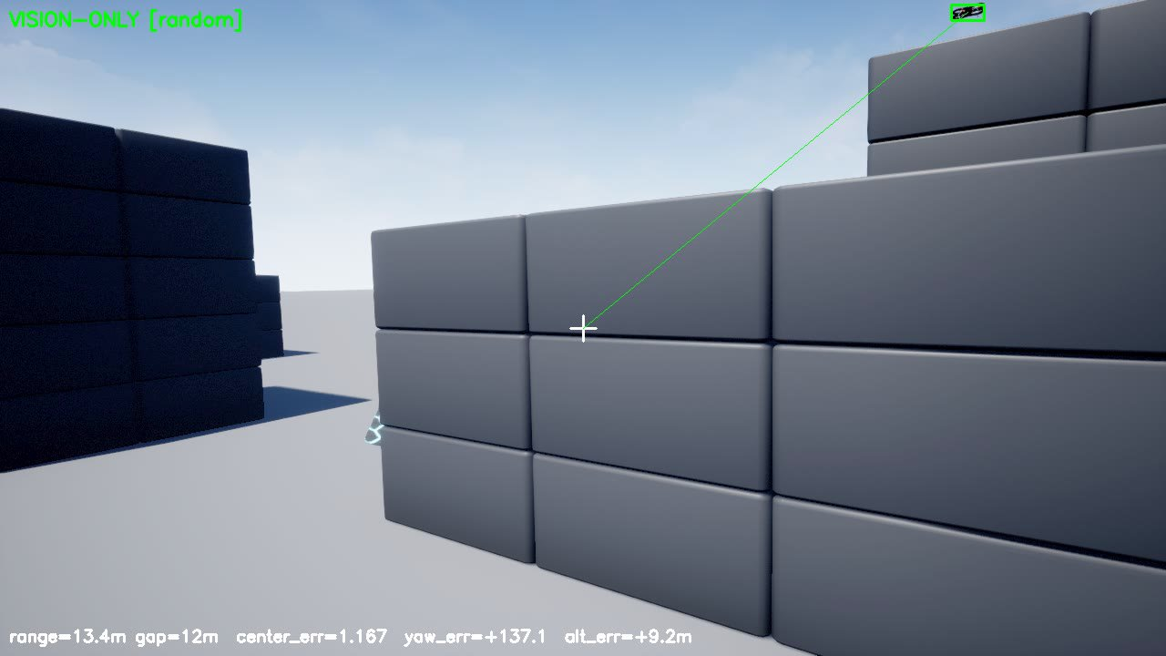
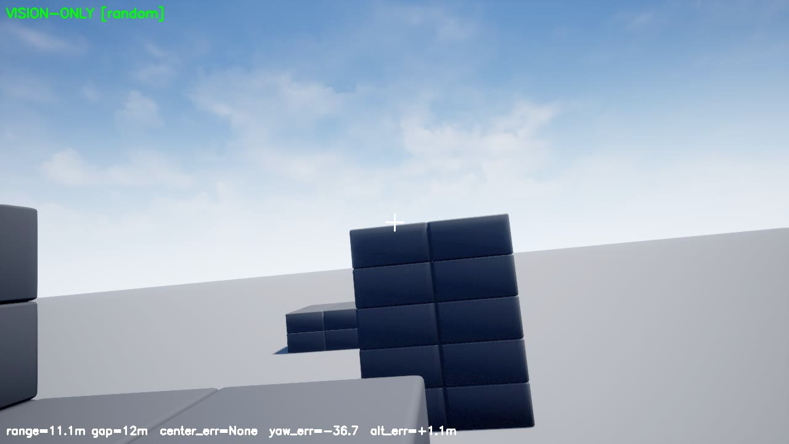
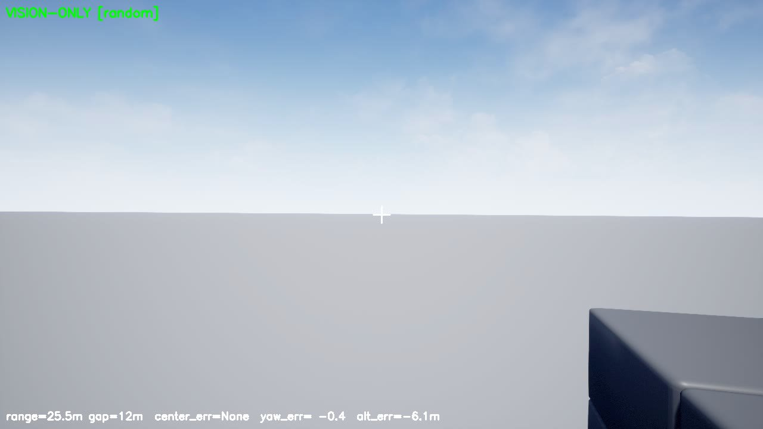
TRACKING
Target following — live web UI
• Click-to-lock the target in the live web UI.
• Predicts motion (Kalman), coasts through detection drop-outs.
• Holds a set stand-off distance, no spin.
• Kept in frame ~90%+ vision-only.
6/10

Slide 7
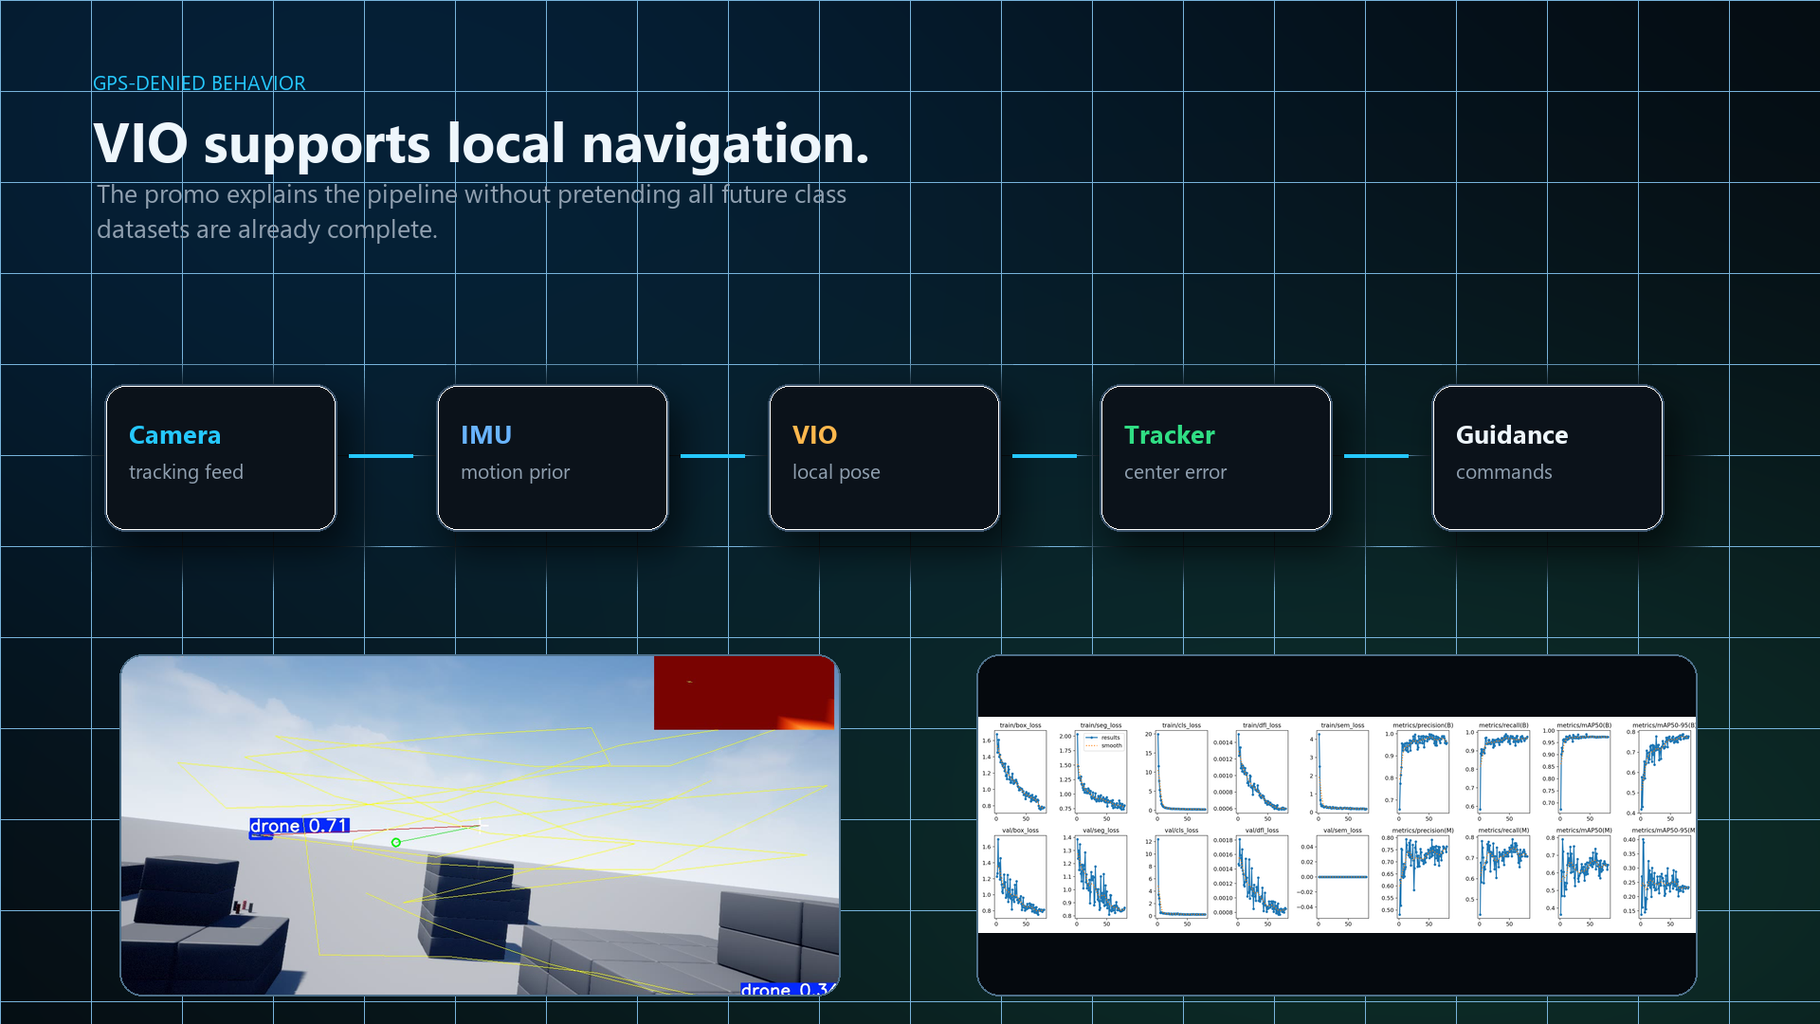
SELF-LOCALIZATION
VIO / VINS · depth · SLAM
• Camera + IMU estimate the drone's own position with no GPS (visual-inertial odometry).
• Depth camera gives true distance and a live 3D sense of the scene.
• Place recognition (SLAM-style) corrects accumulated drift.
• Magnetometer bounds heading drift.
• Production path: OpenVINS (MSCKF) — target under 1 m drift, fed to PX4 EKF2.
7/10

Slide 8
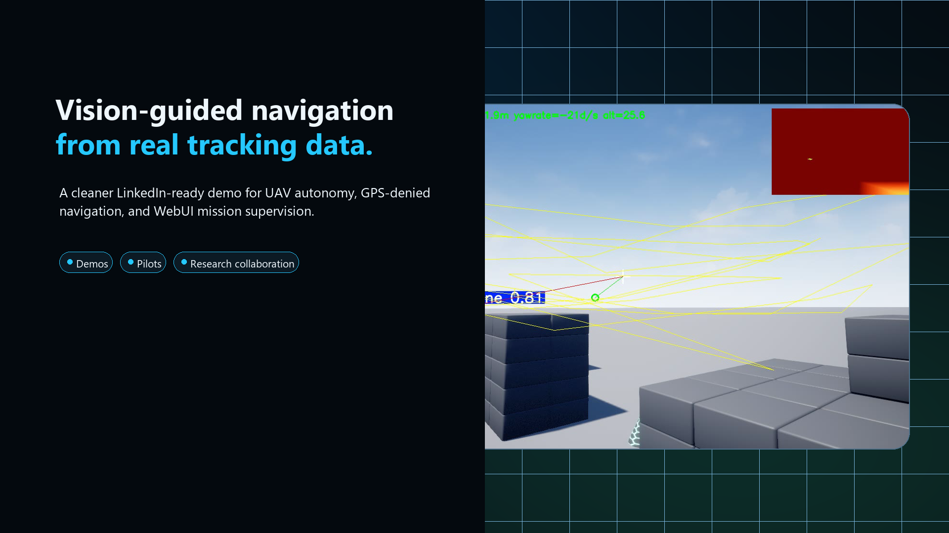
SAFETY
Obstacle avoidance
• Depth is read like a wall of distances (depth-as-LiDAR).
• The drone steers around whatever is close.
• It keeps chasing and framing the target while it dodges.
• Reactive — runs onboard, no map needed.
8/10

Slide 9
APPLICATIONS
Where it's used
COMMERCIAL
DEFENSE
• Cinematography / follow-me filming
• Infrastructure inspection in GPS-poor sites
• Search & rescue in canyons / indoors
• Warehouse & indoor inventory drones
• Agriculture & survey, delivery in urban canyons
• Counter-UAS / anti-Shahed interception
• ISR in GPS-denied / jammed airspace
• Convoy overwatch & perimeter security
• Contested-airspace navigation & strike
• Comms-denied autonomous missions
9/10

Slide 10
SUMMARY
Status & roadmap
• Vision-only detect → track → follow validated in AirSim simulation.
• Detector now trained on real air-to-air data (Shahed / Mjolnir) for real-world transfer.
• Guidance policy: imitation of the classical expert, then RL fine-tune (hybrid).
• Sim-to-real: the SAME software, swap the sensor — RealSense D455 + Jetson Orin.
• Next: OpenVINS VIO → PX4 EKF2 for GPS-denied flight; lightweight agentic supervisor last.
The eye is the backup that can't be jammed.
10/10

