Slide 1
DATA ANALYTICS PROJECT
Marketplace Profit Leakage
& Fulfillment Risk Intelligence
Finding the $26M hidden inside a profit report — an end-to-end analysis in Python, SQL, and Power BI
PYTHON
MYSQL
POWER BI
Prepared by [Your Name] | [your.email@example.com] | [LinkedIn / GitHub]

Slide 2




THE BUSINESS PROBLEM
Reported Profit Isn't Always Real Profit
Every return is a refund — and the shipping cost already spent is never recovered.
REPORTED PROFIT
$128.78M
Some brands look like top sellers by revenue, but lose money once returns are counted.
Shipping promises like “Next Day” may be failing far more often than customers realize.
TRUE NET CONTRIBUTION
$102.79M
This project answers one question:
Of the profit this business reports, how much is real — and where does the rest disappear?
20.18% LEAKAGE — $25.99M NEVER REACHES THE BOTTOM LINE
MARKETPLACE PROFIT LEAKAGE & FULFILLMENT RISK INTELLIGENCE
2

Slide 3



PROJECT DIFFERENTIATION
Not Another “Top 10 Products” Dashboard
Solves a Real Problem
Full End-to-End Pipeline
Honest, Tested Findings
Quantifies a dollar amount of leaking profit — not just descriptive charts of what sold.
Python for cleaning, MySQL for deep relational analysis, Power BI for the interactive layer.
Hypotheses that didn't hold up (fraud risk, payment method) are reported, not hidden.
MARKETPLACE PROFIT LEAKAGE & FULFILLMENT RISK INTELLIGENCE
3

Slide 4

THE DATASET
A Genuinely Large, Recent Marketplace Dataset
1,000,123
62
2024–2026
100%
Order-level rows
Original data columns
Order date range
Financial columns validated
Global E-Commerce Dataset (+1M Records, 2024–2026) — Kaggle
Chosen deliberately over well-worn datasets (Olist, UK Retail) so the analysis itself — not the data source — is the differentiator.
Scope decision: financial analysis is restricted to “finalized” orders (Completed + Returned) — Cancelled, Pending, and Processing orders never generated real revenue, and were excluded from every dollar figure in this project.
MARKETPLACE PROFIT LEAKAGE & FULFILLMENT RISK INTELLIGENCE
4

Slide 5




THE APPROACH
One Pipeline, Three Tools, Each Doing What It Does Best
PYTHON
MYSQL
POWER BI
Clean & Engineer
Deep Relational Analysis
Interactive Dashboard
Data quality audit, business-logic cleaning, and the core profit-leakage calculation
18 queries across 6 business themes — window functions, CTEs, RFM, cohorts
A focused 2-page decision-support tool with synced, clickable filters
MARKETPLACE PROFIT LEAKAGE & FULFILLMENT RISK INTELLIGENCE
5

Slide 6


DATA CLEANING
A Real Discovery, Not Just “.dropna()”
What We Found
What We Decided
37,663
Scope every revenue and profit figure to “finalized” orders only — protecting every downstream number in the project from being inflated.
orders marked “Cancelled” were also marked “Delivered” — a logical impossibility uncovered by cross-tabulating order_status against delivery_status before any cleaning began.
Zero duplicate rows across 1M+ records
Zero negative values in any numeric column
Financial columns independently recalculated — 0 discrepancies
MARKETPLACE PROFIT LEAKAGE & FULFILLMENT RISK INTELLIGENCE
6

Slide 7




DEEP ANALYSIS
18 SQL Queries Across 6 Business Themes
18
6
2
SQL Queries Written
Business Themes Covered
Reusable SQL Views Built
CTEs (WITH...AS)
Window Functions
Multi-stage logic, built and read step by step
RANK(), NTILE() for ranking and RFM scoring
Cohort Retention
False-Positive Detection
Monthly customer retention, tracked from first purchase
Revenue rank vs. true-profit rank, compared directly
MARKETPLACE PROFIT LEAKAGE & FULFILLMENT RISK INTELLIGENCE
7

Slide 8
HEADLINE FINDING — 01
20.18% of Reported Profit Is Leakage
$25.99M
LOST TO PROFIT LEAKAGE
of $128.78M reported profit — never reaching the bottom line, hidden by returns and unrecovered shipping cost.
Reported profit minus real net contribution equals the 20.18% leakage — every figure independently validated in both Python and SQL.
MARKETPLACE PROFIT LEAKAGE & FULFILLMENT RISK INTELLIGENCE
8

Slide 9

HEADLINE FINDING — 02
The Fastest Shipping Tier Is the Least Reliable
Actual delivery time barely changes — about 7.5 days — no matter which shipping speed a customer pays for.
The premium promise is the biggest gap between what's sold and what's delivered.
MARKETPLACE PROFIT LEAKAGE & FULFILLMENT RISK INTELLIGENCE
9

Slide 10
HEADLINE FINDING — 03
Some “Top Sellers” Are Quietly Underperforming
Philips and Fitbit rank near the top by revenue — but slide 5–7 places down once returns are counted against real profit.
Found independently in both Python and SQL — the two results matched exactly.
MARKETPLACE PROFIT LEAKAGE & FULFILLMENT RISK INTELLIGENCE
10

Slide 11

ANALYTICAL HONESTY
What We Tested — and Ruled Out
Real analysis means reporting what the data doesn't support, not just what confirms a story.
Fraud risk score
No relationship with cancellations or returns — 99.4% of orders flagged “high risk”
Payment method
Return rate and profit nearly identical across every method
Traffic source
No channel brings measurably more profitable customers than another
Late delivery → returns
12.50% vs. 12.48% return rate — statistically no difference
MARKETPLACE PROFIT LEAKAGE & FULFILLMENT RISK INTELLIGENCE
11

Slide 12
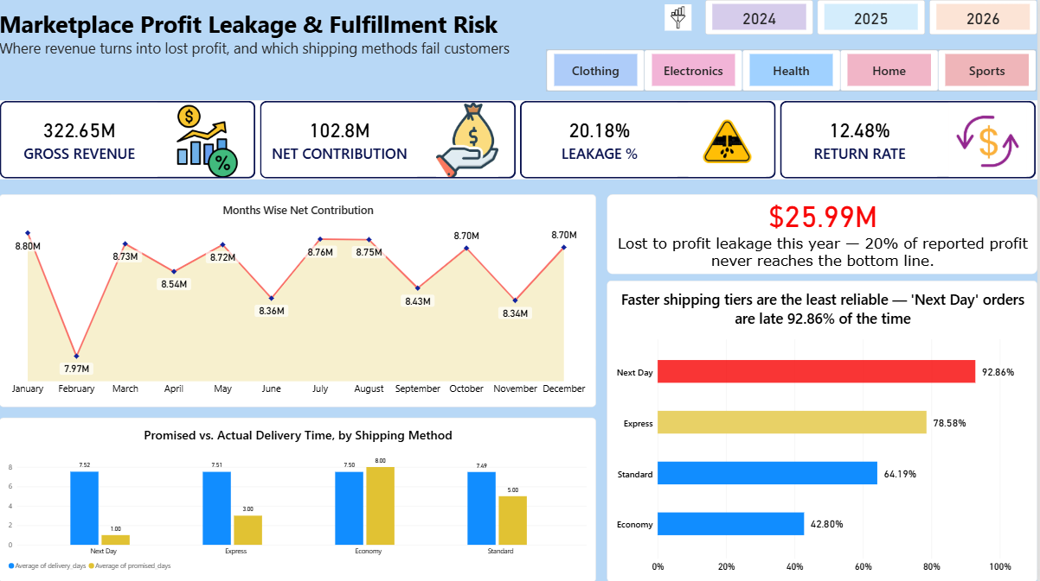
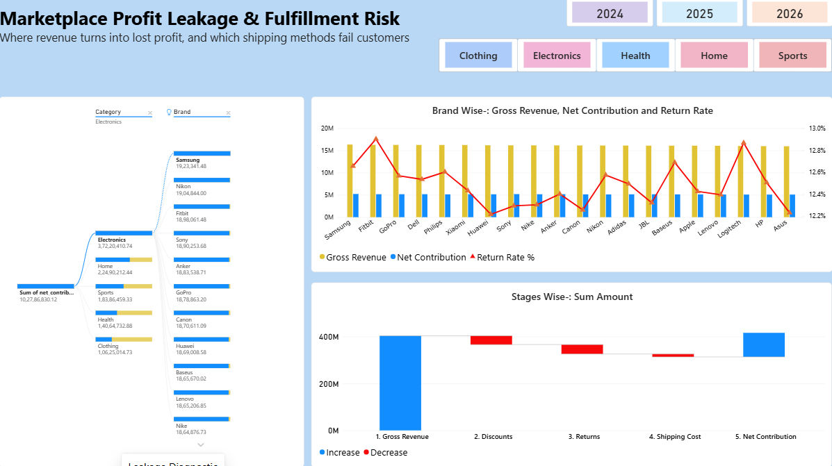
THE DELIVERABLE
A Focused, Two-Page Interactive Dashboard
EXECUTIVE OVERVIEW
LEAKAGE DIAGNOSTIC
Deliberately scoped to two themes — leakage and fulfillment — with synced Year and Category filters across both pages. Customer segmentation and cohort analysis were completed in SQL but intentionally left out of the final build to keep every visual tied directly to the core business question.
MARKETPLACE PROFIT LEAKAGE & FULFILLMENT RISK INTELLIGENCE
12

Slide 13

SO WHAT?
What a Business Should Do With This
Re-price or fix “Next Day”
Audit underperforming brands
Track leakage monthly
Either invest in the fulfillment capability to meet the promise, or stop selling a tier that fails 93% of the time.
Renegotiate return handling or restocking terms with brands like Philips and Fitbit specifically.
Use the dashboard's trend view as an ongoing KPI — leakage % should fall as fixes take effect.
Success metric: watch the Leakage % trend line — it should decline in the months following each intervention.
MARKETPLACE PROFIT LEAKAGE & FULFILLMENT RISK INTELLIGENCE
13

Slide 14
SKILLS DEMONSTRATED
The Full Analytics Toolkit, End to End
pandas & NumPy
Data Quality Auditing
Business-Logic Cleaning
Feature Engineering
MySQL & CTEs
Window Functions (RANK, NTILE)
RFM Segmentation
Cohort Retention Analysis
Power BI & DAX
Interactive Dashboard Design
Hypothesis Testing
Executive Storytelling
MARKETPLACE PROFIT LEAKAGE & FULFILLMENT RISK INTELLIGENCE
14

Slide 15
Thank You
Questions? Let's talk about how this framework applies to real operational data.
[Your Name]
[your.email@example.com] • [LinkedIn] • [GitHub Repository]
MARKETPLACE PROFIT LEAKAGE & FULFILLMENT RISK INTELLIGENCE
15

