Slide 1
550K
transactions
DATA ANALYTICS CASE STUDY
RiskLens
₹58 cr
fraud value
Fraud, stuck payments and KYC exposure in Indian banking
₹203 cr
KYC gap
550,000 transactions | Python | MySQL | Power BI

Slide 2
Three leaks, one question: where should the bank act first?
1
Fraud
2
Stuck money
3
KYC exposure
₹58.2 cr
₹135.7 cr
₹203 cr
lost to fraud, 0.89% of transactions
failed, pending or reversed
moved with KYC pending or expired
If reviewers can check only a few transactions, which ones first?
Where do we start recovery?
Where is identity risk biggest?

Slide 3
From raw file to decision-ready dashboard
1
2
3
4
5
Python
MySQL
SQL views
Power BI
Insights
Audit, clean, build features, explore
Load, query, reconcile with Python
Indexes and summary views
DAX measures, 3-page dashboard
3 findings, 3 recommendations
550,000
20
10
10
transactions
columns
payment types
states

Slide 4
Checked before trusted: the audit shaped the whole project
0
377,134
0.7%
duplicate IDs and zero impossible amounts: the transaction table is clean
blank loan_type cells, filled with "No Loan" because they are blank only when the customer has no loan
of customers have a single credit score, so customer_id is not a real person: no churn or segmentation model

Slide 5
UPI leads on fraud cases; RTGS leads on rupees
A team reviewing by count would look in the wrong place: UPI has 1,211 cases but only ₹0.16 cr, RTGS has 611 cases and ₹38.56 cr.

Slide 6
Fraud jumps tenfold above ₹5 lakh
1.1%
of transactions are above ₹5 lakh (6,025 of 550,000)
84%
of all fraud value sits in those transactions
The step sits exactly at ₹5,00,000, which looks rule-generated. Validate the threshold on real data before using it as policy.

Slide 7
Review the biggest 1% and protect 81% of the rupees
81%
of fraud VALUE caught by reviewing the top 1%
9%
of fraud CASES caught at the same effort

Slide 8
Failure is flat at about 8%; the rupees are not
₹135.7 cr
stuck in total
Failed ₹69.69 cr
Pending ₹33.45 cr
Reversed ₹32.58 cr
RTGS alone holds 53% of the stuck value.

Slide 9
₹203 crore moved with KYC not verified; RTGS drives over half
12.4%
of all value moved had KYC pending or expired
218
transactions of ₹10 lakh or more (₹38.5 cr)
Top states: Maharashtra 36.8, Karnataka 28.5, Tamil Nadu 25.6 (₹ cr)

Slide 10
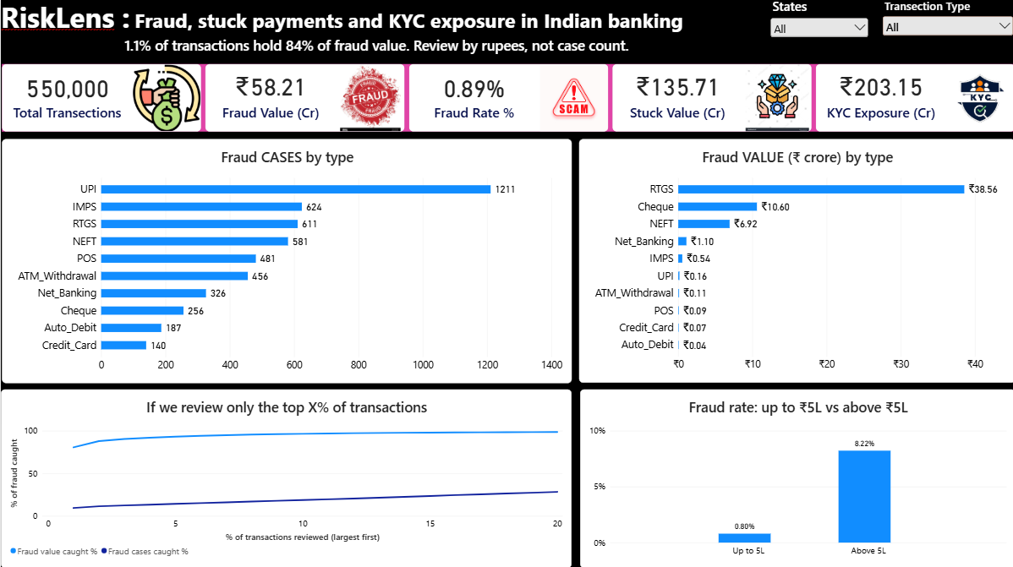
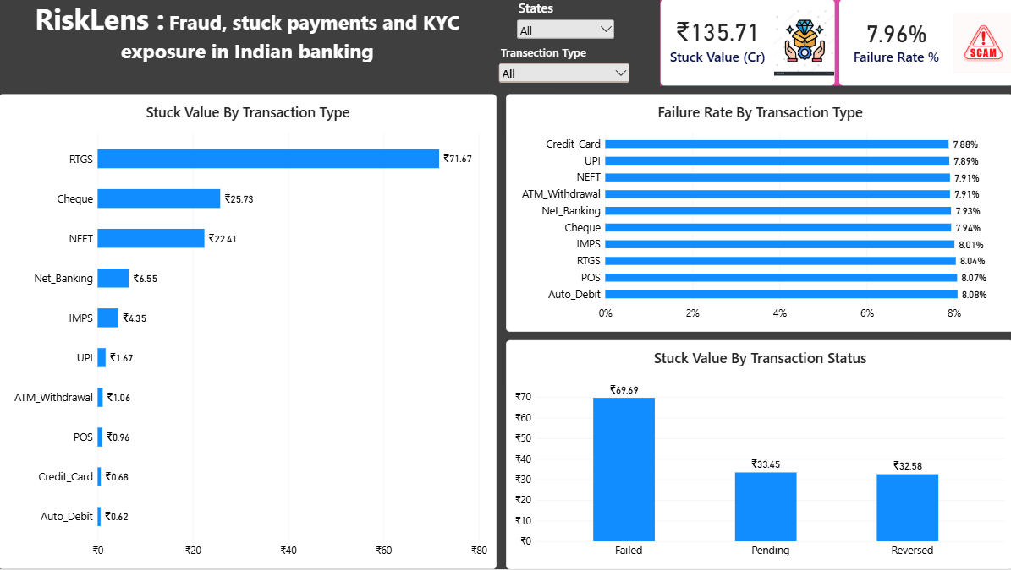
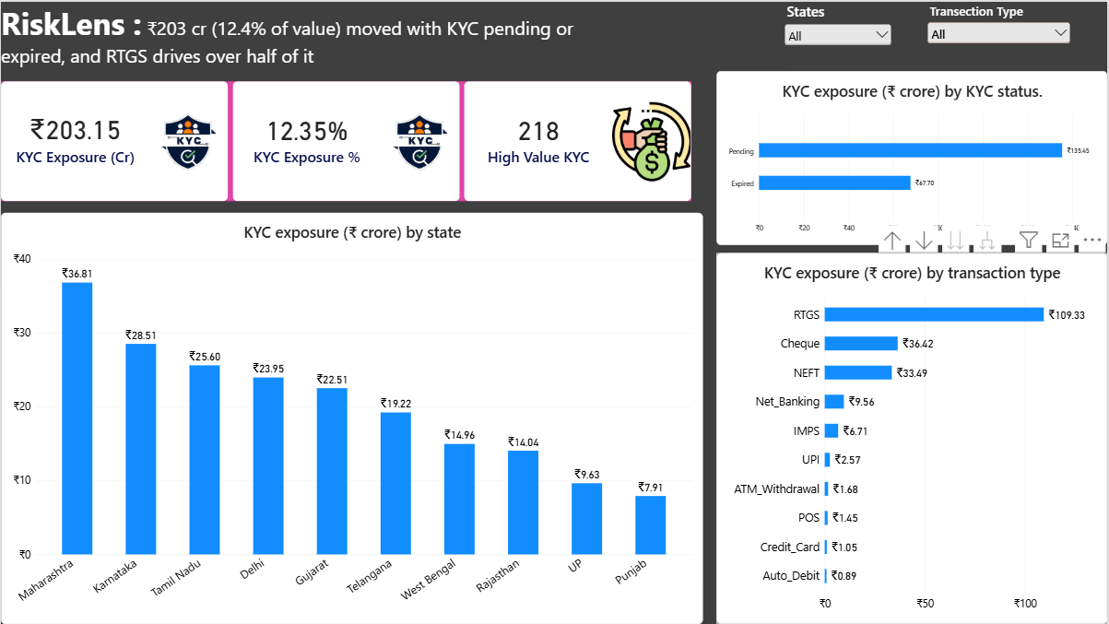
The RiskLens dashboard: one page per problem
Page 1: Fraud
Page 2: Stuck money
Page 3: KYC exposure
Cases versus value, review-capacity curve, ₹5L step
Flat failure rate, uneven rupee impact by type and status
Exposure by state, KYC status and payment type
DAX measures
Slicers
Insight titles
Reconciled to SQL

Slide 11
Three recommendations, each backed by one number
1
2
3
Tier reviews by value
Recover by rupee size
Step-up KYC on large payments
Send transactions above ₹5L to manual review first; use light automated checks for high-volume, low-value channels like UPI.
Work RTGS, Cheque and NEFT first and set an ageing limit for Pending payments.
Require re-verification at ₹10L+ when KYC is pending or expired; start with RTGS and the top three states.
84% of fraud value in 1.1% of transactions
88% of stuck value (₹119.8 cr)
218 transactions, ₹38.5 cr

Slide 12
Honest limits and what comes next
What the data cannot tell us
Next steps
customer_id is not a reliable person, so findings describe transactions only
The ₹5L fraud step looks rule-generated
No variable explained failure (about 8% everywhere)
KYC status belongs to the transaction, not the customer
Validate the ₹5L threshold on real bank data
Add a monthly trend for fraud and failures
With labelled fraud data, train a classifier judged on precision and recall
Schedule a refresh from MySQL to Power BI

Slide 13
Review by rupees, not by case count.
1.1% → 84%
₹135.7 cr
₹203 cr
of transactions hold the fraud value
stuck; recover the biggest first
moved with KYC not verified
Questions? | Python | MySQL | Power BI

