Slide 1
RESALE FLATS - REPORT

Slide 2
AGENDA
Data Overview
Data Processing
Model Building – I
Model Building - II

Slide 3
Data OVERVIEW

Slide 4
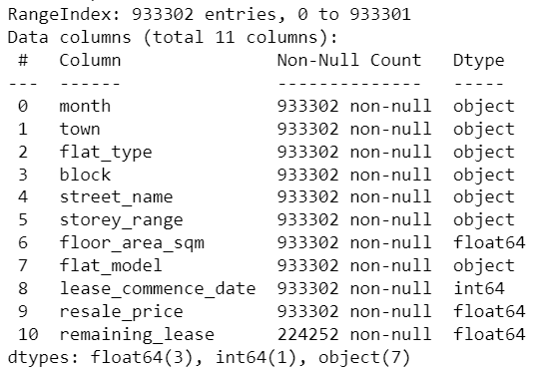
DATASET - OVERVIEW
INSIGHTS
Data Source : Downloaded historical resale flat data from official HDB sources, covering the period from 1990 to the current date.
Our data has a collective of 933302 entries and 11 columns.
The dataset has info on the flat type, model, street, block number, lease span, area, storey range as independent fields and the Resale Price (the value to be predicted) as the dependent field.
As in the image on right, we have null values (only in the remaining lease field). View of the entire data in the image below

Slide 5
Data PROCESSING

Slide 6
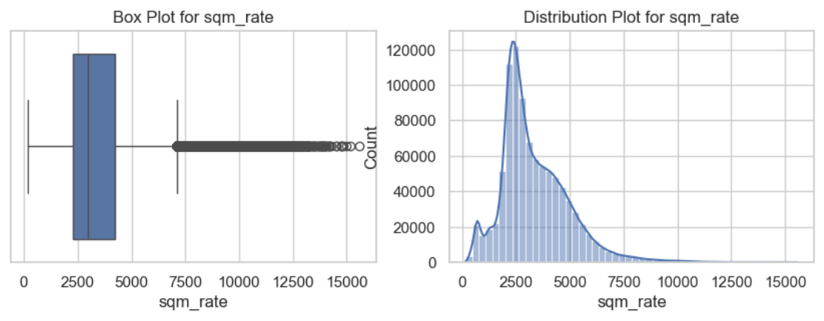
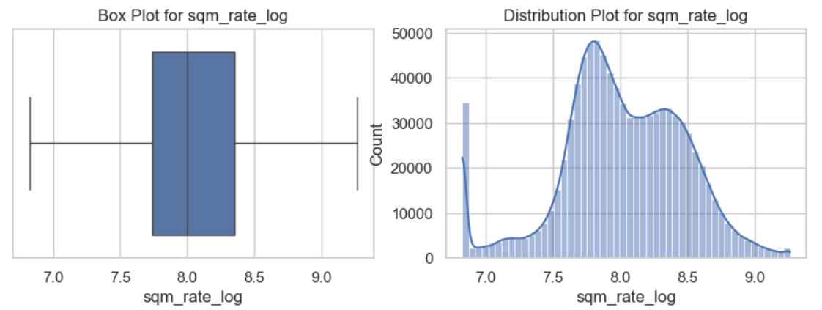
DATA CLEANING
BEFORE & AFTER TREATMENT
Missing value treatment: Treated missing value in remaining lease with the difference the Year and Lease columns. Subtracting that difference with the max value in remaining lease to get consistent values across the field. The values greater than the max value is masked to avoid any outliers.
New features: Formed new fields from existing fields (property age, property holding years, rate per square meter) for better insights.
Skewness: The data in certain columns showed right and left skew. Those were treated with log transformation to make it normally distributed and scaled across numerical values.
Outlier treatment: The outliers present in certain columns of importance were treated with Interquartile Range (IQR) and clipping method, which balanced the data distribution for regression. (Refer images.)

Slide 7
MODEL BUILDING - I

Slide 8
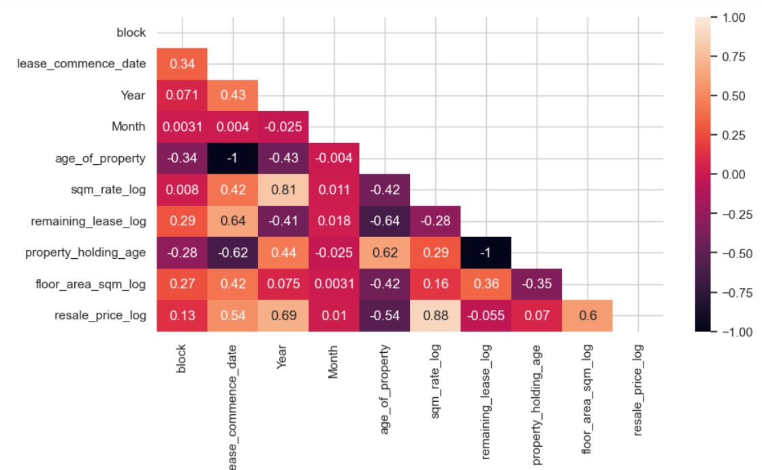
DATA MODELLING
PROCESSES
Feature encoding: Being a regression problem, we have encoded all our categorical fields to support our modelling using LabelEncoder() function in python
Correlation mapping showed the effect of certain variables on the resale price. And also the effect an independent variable can have over other independent variables too
Model building: We chose to run the prediction on 4 regression algorithms: Linear regression, Random Forest Regressor, Extra Trees Regressor and Decision Tree Regressor to find the best one.

Slide 9
MODEL BUILDING - II

Slide 10
PREDICTIVE MODELLING
We split the data to train and test (30%) and started with building all 4 models using the sklearn library.
Fitting the base model on the Train datasets (X_train, y_train)
The training instance is now run on the X_test dataset to predict outcomes of the model. This is saved as y_pred (having the scores of the model)
- This is done for all 4 algorithms of our choice.

Slide 11
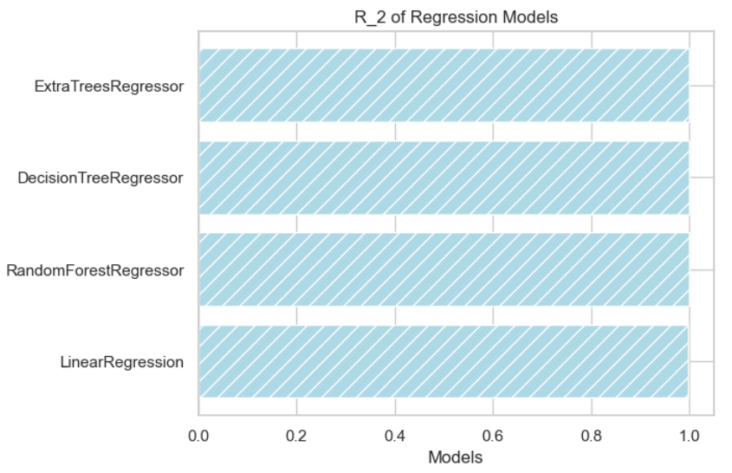
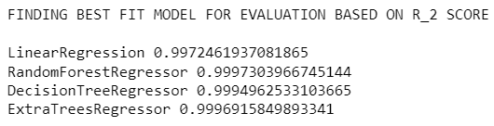
MODEL EVALUATION
Once the models have been built, we should know its performance for which we do the model evaluation. Here, we have the y_test partition which has the actual resale prices from the dataset. This will be compared to the predictions we have made on the X_test data with the trained model to understand the performance of our model.
Model evaluation parameters: A regression model can be evaluated by 3 scores – Mean absolute error, root mean squared error and the R2 score (accuracy) called MAE, RMSE and R2 respectively.
R2 score: The accuracy measure of our models is given in the image to the right, which helps us decide on the right algorithm.

Slide 12
MODEL SCORES COMPARISON
METRIC | MAE | RMSE | R2
Linear regression | 0.007882 | 0.0303 | 0.99724
Random Forest Regressor | 0.001048 | 0.0095 | 0.99973
Decision Tree Regressor | 0.001359 | 0.0129 | 0.99949
Extra Trees Regressor | 0.001175 | 0.0102 | 0.99969
From the scores we have obtained from our 4 algorithms, comparing the important values of determination.
RANDOM FOREST REGRESSOR has the best overall scores of all parameters when compared to the other models.

Slide 13
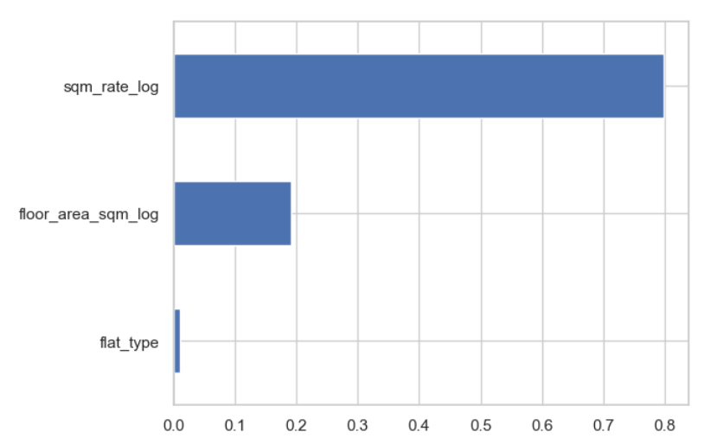
WHY RANDOM FOREST REGRESSOR?
PROS
BAGGING ALGORITHM
ROBUST RESULTS (HIGHLY ACCURATE)
REQUIRES LESS TUNING
FITTED FOR LARGE DATASETS WITH NOISY DATA
FEATURE IMPORTANCE VALUES.
CONS
COMPUTATIONALLY EXPENSIVE
MODEL INTERPRETABILITY
Feature importance scores by Random Forest Regressor

Slide 14
VIEW MY APP ON RENDER:
Link to app

Slide 15
THANK YOU
CONTACT ME
EMAIL: sanjuhwork@gmail.com
GITHUB: https://github.com/sanjuhyacinth/

