Slide 1
ROCKBUSTER STEALTH LLC
A strategic planning for the launch of an online rental service
By: Sanjukta De

Slide 2
INTRODUCTION
Rockbuster Stealth LLC is a movie rental company that used to have stores around the world.
Facing stiff competition from streaming services such as Netflix and Amazon Prime, the Rockbuster Stealth management team is planning to use its existing movie licenses to launch an online video rental service in order to stay competitive.

Slide 3
KEY QUESTIONS
Which movies contributed the most/least to revenue gain?
What was the average rental duration for all videos?
Which countries are Rockbuster customers based in?
Where are customers with a high lifetime value based?
Do sales figures vary between geographic regions?

Slide 4








DATA SUMMARY OF ROCKBUSTER’s MOVIES
Minimum Rental duration: 3 days
Maximum Rental Duration: 7 days
Average Rental Duration: 4.98 days
Most Common:
Movie: Academy Dinosaur
Minimum Rental Rate: $0.99
Maximum Rental Rate: $4.99
Average Rental Rate: $2.98
Release Year: 2006
Minimum Movie Length: 46min
Maximum Movie Length: 185min
Average Movie Length: 115.27min
Language: English
Minimum Replacement Cost: $9.99
Maximum Replacement Cost: $29.99
Average Replacement Cost: $19.98
Rating: PG-13

Slide 5
MOVIES THAT GENERATED THE HIGHEST REVENUE

Slide 6
MOVIES THAT GENERATED THE LOWEST REVENUE

Slide 7
TOP 10 GENRES OF ROCKBUSTER

Slide 8
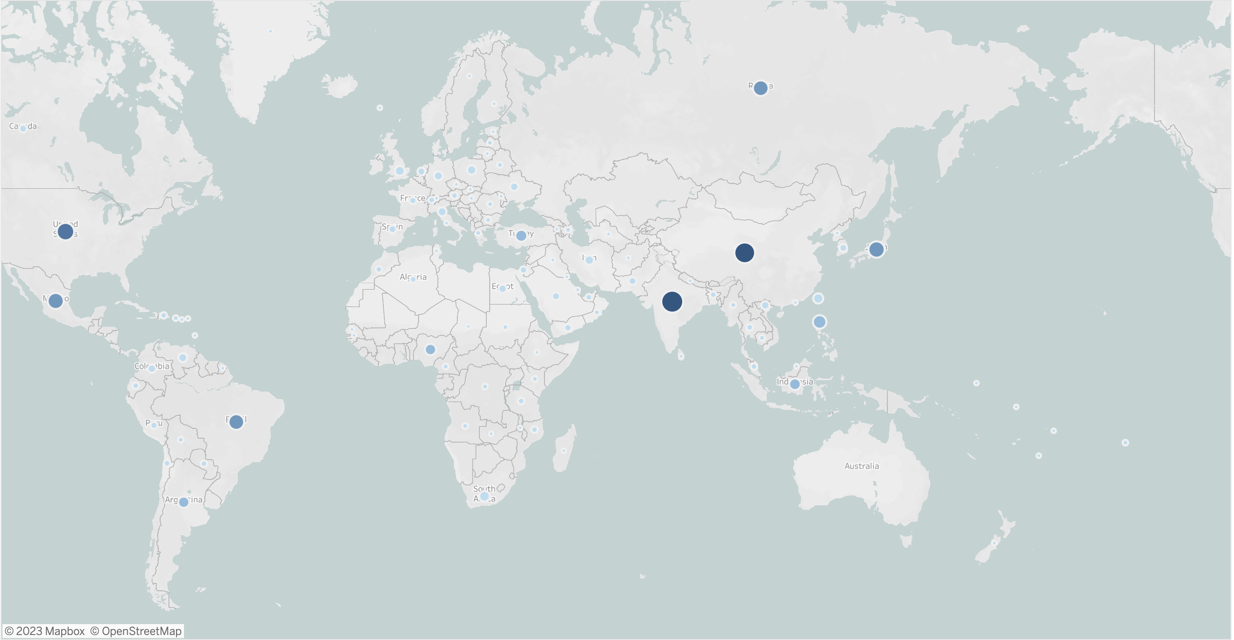
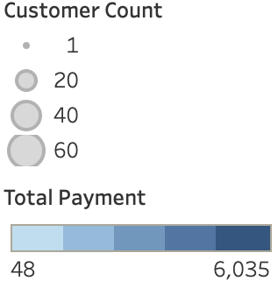
IN WHICH COUNTRIES ARE ROCKBUSTER’S CUSTOMERS BASED IN?
3. UNITED
STATES
4. JAPAN
2. CHINA
1. INDIA
5. MEXICO

Slide 9
TOP 10 COUNTRIES IN TERMS OF CUSTOMERS & REVENUE
RANKING | COUNTRIES | NUMBER OF CUSTOMERS | TOTAL REVENUE
1 | India | 60 | 6034.78
2 | China | 53 | 5251.03
3 | United States | 36 | 3685.31
4 | Japan | 31 | 3122.51
5 | Mexico | 30 | 2984.82
6 | Brazil | 28 | 2919.19
7 | Russian Federation | 28 | 1765.62
8 | Philippines | 20 | 2219.7
9 | Turkey | 15 | 1498.49
10 | Indonesia | 14 | 1352.69

Slide 10
TOP 10 CITIES WITHIN THE TOP 10 COUNTRIES
CITY | COUNTRY | TOTAL CUSTOMERS
Aurora | United States | 2
Acua | Mexico | 1
Citrus Heights | United States | 1
Iwaki | Japan | 1
Ambattur | India | 1
Shanwei | China | 1
So Leopoldo | Brazil | 1
Tianjin | China | 1
Hami | China | 1
Cianjur | Indonesia | 1

Slide 11
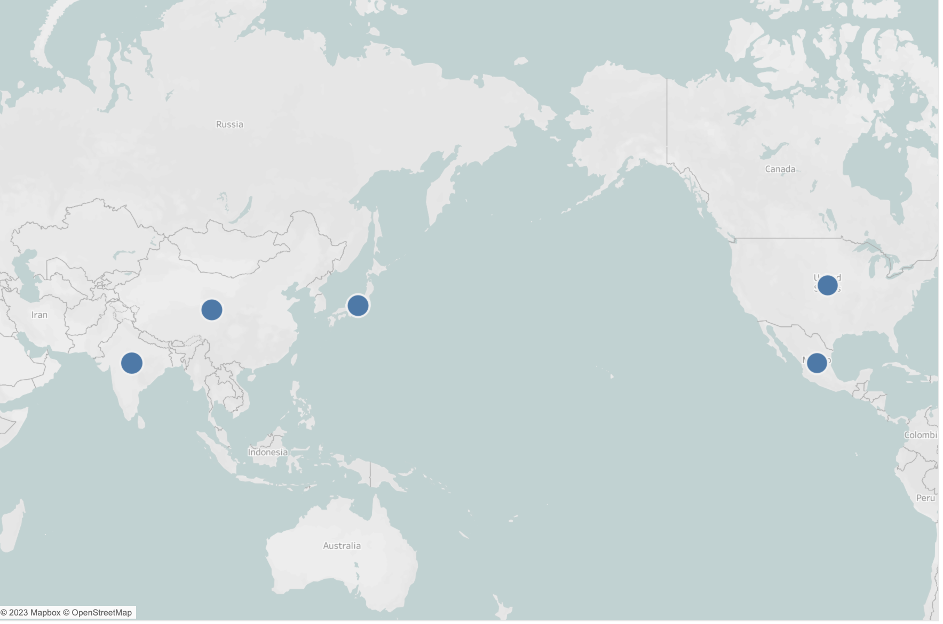
TOP 5 CUSTOMERS
3. MARLENE WELCH
Iwaki, Japan
$106.77
5. CLINTON BUFORD
Aurora, United States
$98.76
2. KYLE SPURLOCK
Shanwei, China
$109.71
1. ARLENE HARVEY
Ambattur, India
$111.76
4. GLEN TALBERT
Acua, Mexico
$100.77

Slide 12
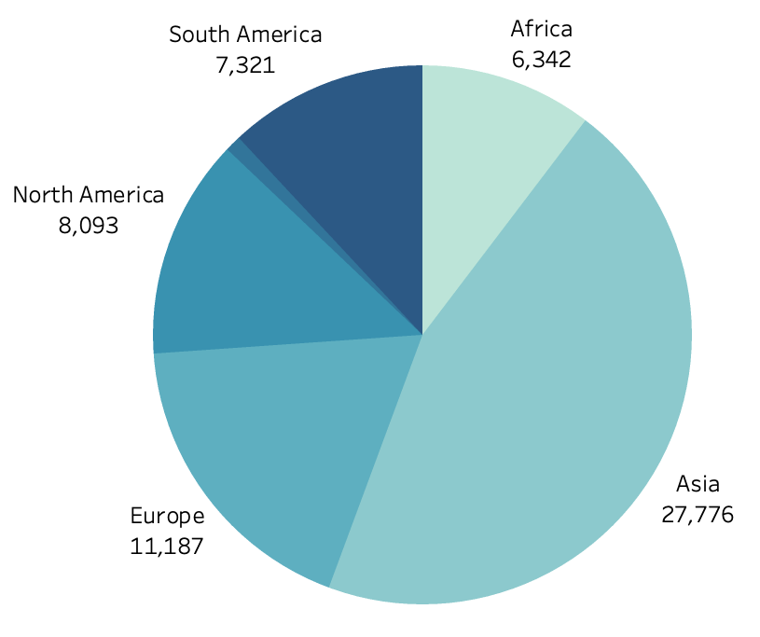
REGIONAL REVENUE DISTRIBUTION
Almost 46% of the global revenue is coming from Asia, followed by Europe 18%, North America 13%, South America 12%, Africa 10% and Oceania 1%.

Slide 13
RECOMMENDATIONS
Since a great chunk of revenue is being generated from Asia, we can at first launch the online platform in Asia and study the customer behavior and then accordingly launch it in the other regions.
We can conduct some more research to identify the reasons why the other regions are not generating more revenue.
We can also implement some loyalty programs or some sort of promotion for retaining the top performing customers and also encouraging then to use the new online platform.
We can also allocate more marketing budget for the average performing regions, to improve the company’s visibility.
Since most of the movies are in English, we can also focus on some regional language movies to target a particular region.
Sports, Sci-Fi, Animation, Drama and Comedy are the top 5 Genres, hence we should focus on increasing the inventories of these genres while launching the online rental platform.

Slide 14


