Slide 1
ONLINE BOOK STORE WITH CHATBOT
Presented by
R.Sanju
under the guidance of
Mr.SRINIVASAN THANUKRISHNAN
CEO OF GLOSYS TECHNOLOGY SOLUTIONS PVT LTD
Dr.G.R.SREEKANTH
ASSISTANT PROFESSOR OF CT-PG
KONGU ENGINEERING COLLEGE

Slide 2
Objectives
The objective of the project is to develop a online book store with chat bot , which encompasses ordering books in an optimal way.

Slide 3
Existing System
1 - Existing system has only websites and can only be ordered from websites.
2 - Does not have live interaction.

Slide 4
Proposed Concept
1 - The book ordering system will interact with the user and respond to their queries with the help of predefined datasets.
2 - Order will be placed by users and processed by databases that are linked to dialogflow for chatbot.

Slide 5
Modules
1 - User Management
2 - Order Management
3 - Dialogflow
4 - Integration.

Slide 6
Order Management
Book Searching
Search books with the help of API (solr).
Cart Process
Adding book to the cart.
Order Books / Place Order
Ordering books by adding to the cart/without adding to cart.

Slide 7
Dialogflow
Intents has been created for default query response.
Follow-up intents has been created for the live interaction purposes.
Firebase database has been connected to dialogflow by fulliment with the help of inline editor.

Slide 8
Integration
Bot has been integrated to dialogflow with API token.
Dialogflow has been integrated with inline editor with its realtime database url.
Client token is used to integrate with other applications.

Slide 9
Database Schema
User
IdNo | Field | Type
1 | User id (PK) | Bigint(20)
2 | User name | Varchar(50)
3 | Email | Varchar(50)
4 | Mobile number | Varchar(50)
5 | Password | Varchar(50)

Slide 10
Database Schema
Product
IdNo | Field | Type
1 | Book id (PK) | Bigint(20)
2 | Book name | Varchar(50)
3 | Author | Varchar(50)
4 | Publisher | Varchar(50)
5 | Description | Varchar(500)
6 | Stock | Varchar(50)
7 | Price | Varchar(60)

Slide 11
Database Schema
Cart
IdNo | Field | Type
1 | Cart id(Pk) | Bigint(20)
2 | User id(FK) | Bigint(20)
3 | Book id (FK) | Bigint(20)

Slide 12
Database Schema
Place Order
IdNo | Field | Type
1 | Order id (PK) | Bigint(20)
2 | User id (FK) | Bigint(20)
3 | Book id (FK) | Char(20)
4 | Paid | Int(50)
5 | Total | Int(50)

Slide 13
Database Schema
Address
IdNo | Field | Type
1 | Address id (PK) | Bigint(20)
2 | User id (FK) | Bigint(20)
3 | Room no | Varchar(20)
4 | Building | Varchar(30)
5 | Street | Varchar(50)
6 | City | Varchar(50)
7 | Zipcode | Int(10)

Slide 14
Data Flow Diagram
Level 0
Online Book Store with chat bot
user
Order books
Admin
Update books
Receive orders

Slide 15
Level 1
User data collection and management
login
signup
Customer
Ading products to API
Admin
Add book
Order books
payment
Edit , delete
User query
Adding query to API
Response
Integrating

Slide 16
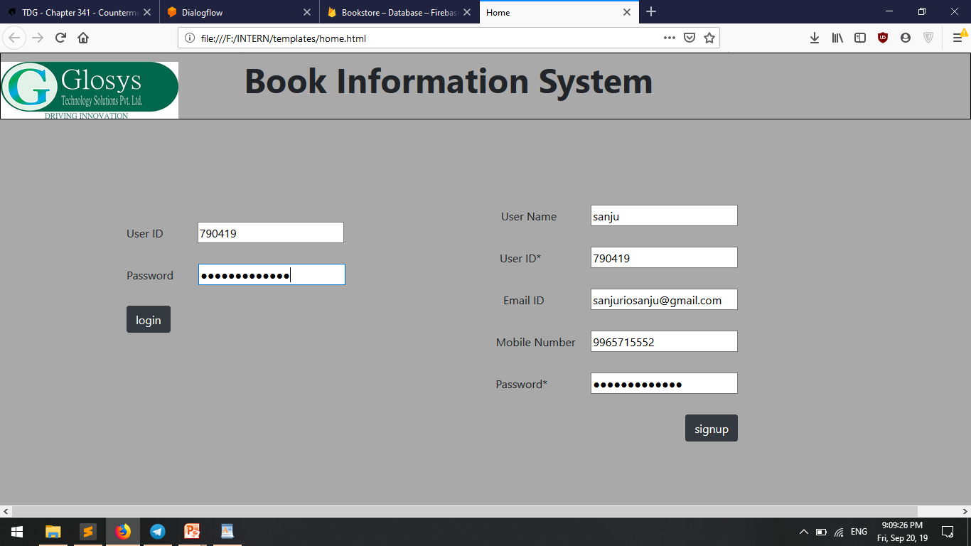
Screenshots

Slide 17
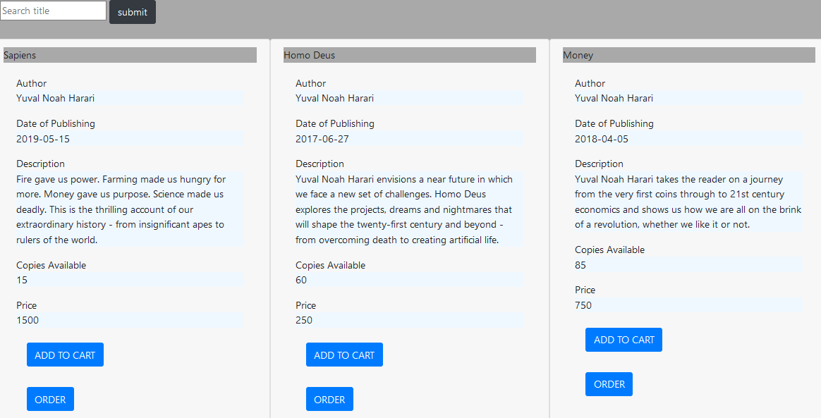
Home

Slide 18
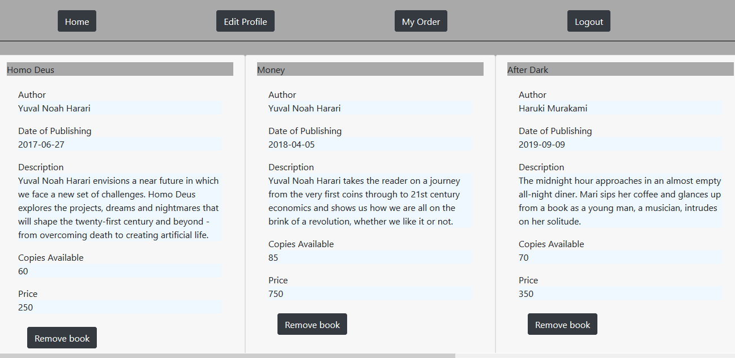
Cart

Slide 19
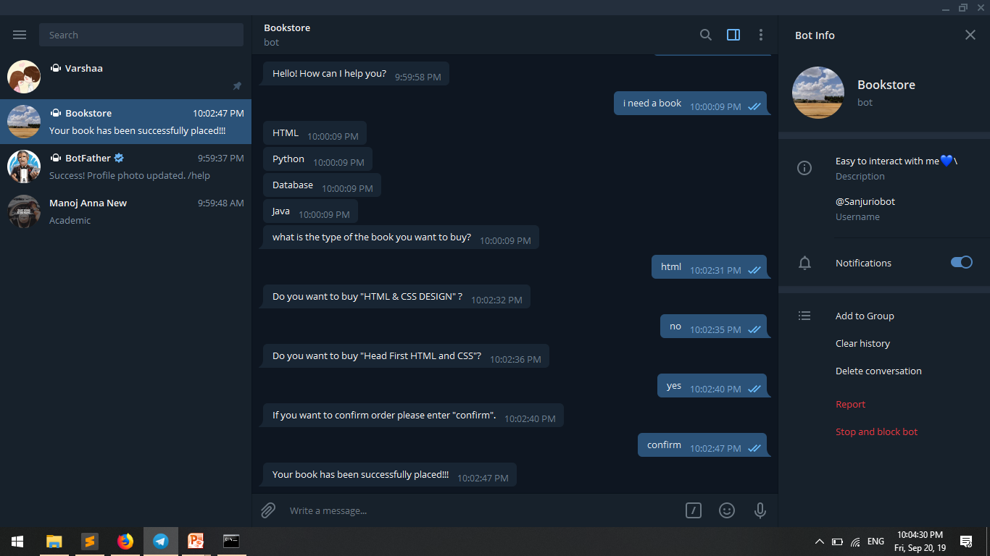

Slide 20
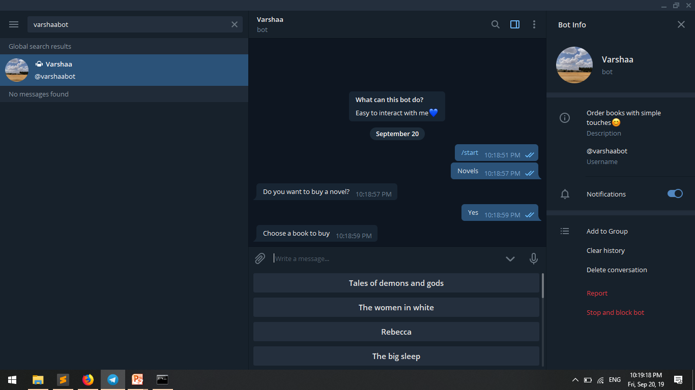

Slide 21
