Slide 1


Department of Computer Science and Engineering
DESIGN AND IMPLEMENTATION OF INTELLIGENT MANHOLE COVER MONITORING SYSTEM BASED ON NARROW BAND (NB-IOT)
Team Members Name / Register Number
SANJANA S - 211419104231
SARAH JACI J - 211419104237
SHAKTHI SRI S - 211419104243
Guide Name & Designation
Mrs.M.Maheswari ME
Assisstant Professor
Coordinator Name & Designation
Valarmathi K ME PHD
Professor

Slide 2
Introduction
A smart city is the future goal to have cleaner and better amenities for the society.
Smart underground infrastructure is an important feature to be considered while implementing a smart city.
Drainage system monitoring plays a vital role in keeping the city clean and healthy.
Since manual monitoring is incompetent, this leads to slow handling of problems in drainage and consumes more time to solve.
To mitigate all these issues, the system using a wireless sensor network, consisting of sensor nodes is designed.
The proposed system is low cost, low maintenance, zigbee based real time which alerts transmit the managing station when any manhole crosses its threshold values.
This system reduces the death risk of manual scavengers who clean the underground drainage and also benefits the public.

Slide 3
Objective of the Project
Manhole opening detection and alerting is mainly based on detecting the manholes which are opened due to overflow of sewage rain water during heavy rainfall and alerting.
When a manhole opening is detected either due to overflow of sewage water, increase in pressure or temperature, it leads to the breakage of the manhole lids.
To avoid such incidents even before it could affect the public, an alerting system is built wherein the buzzer alerts the surrounding and sends the sensed data to the managing authorities using GSM techniques.
So, they can take precautionary action to close the manhole considering public safety.

Slide 4
Literature Survey
TITLE | AUTHOR | YEAR | DESCRIPTION | ADVANTAGES | DISADVANTAGES
On a Working Monitoring System of Manhole Wells Based on Technology of Internet of Things | Yunhong Xie, Hong Wang, Jiong Liu, Renpeng Zhang, Yong Guo | 2021 | This system researches and develops the intelligent monitoring system of manhole well, and realizes the monitoring of manhole well status based on the Internet of things technology. | The lock well cover and the alarm terminal perceive the change of the well cover state, send information to the application layer through the network and notify the user, and the user will process it accordingly. | The ground cable is usually laid in the underground pipeline, and the manhole is used as the entrance and exit of the pipeline for maintenance of pipeline and ground cable.
Design of Intelligent Well Cover Monitoring System Based on Lora | Yaqi Guan, Qun Hou | 2021 | The system terminal selects a variety of sensors, designs the working mode and realizes the collection of well cover node information with high precision and low power consumption, Lora protocol has used as the medium to exchange data to the system server. | The system terminal is tested which verifies the practicability of the system, and can provide efficient and unified intelligent well cover management and control, with a wide range of application scenarios. | Slow and inefficient.

Slide 5
Literature Survey
TITLE | AUTHOR | YEAR | DESCRIPTION | ADVANTAGES | DISADVANTAGES
Design and Implementation of Intelligent Manhole Cover Monitoring System Based on NB-IoT | Guo Xiucai, Liu Bingbing, Wang Lili | 2019 | This paper designs an intelligent manhole cover monitoring system based on narrow band Internet of things (NB-IoT) technology. | The sensing layer is based on the embedded ARM microprocessor and combines sensor technology to collect the manhole cover data. | Immature technology and insufficient comprehensive analysis
An IoT Based Proposed System for Monitoring Manhole in Context of Bangladesh | Saadnoor Salehin, Syeda Sabrina Akter, Anika Ibnat, Tasmiah Tamzid Anannya, Nurun Nahar Liya, Manisha Paramita,Md Mahboob Karim | 2018 | This paper presents an manhole monitoring system which detects harmful chemicals and toxic gases inside the manhole, generates an alarm to the passersby in that situation, alerts the authority about the system state. | The system has been implemented in an academic environment to carry out the automated monitoring of a manhole to evaluate the proposed features. | The concerned authorities can take proper measures to maintain the manhole.

Slide 6
Literature Survey
TITLE | AUTHOR | YEAR | DESCRIPTION | ADVANTAGES | DISADVANTAGES
Research on an intelligent monitoring device for cable manhole covers | ZHANG Chongbiao, QIN Mingbo, CHENG Long, GE Qi, SONG Jiajia , ZHANG Jinbo | 2018 | This paper proposed an monitoring device which uses six axis sensors to monitor the attitude of the cable well covers. Once the attitude changes, it is sent to the supervisors’ mobile phones through wireless network. | Timely monitor whether the cable manhole cover is moved artificially, which is of great significance to improve the safety of road driving. | criminals are given the opportunity to steal covers and cables.
Secure Manhole Monitoring System Employing Sensors and GSM Techniques | Nataraja N, Amruthavarshini R, Chaitra N L, Jyothi K, Krupaa N, S S M Saqquaf | 2018 | Manhole opening detection and alerting is mainly based on detecting the manholes which are opened due to overflow of sewage / rain water during heavy rainfall and alerting when a manhole opening is detected | An alerting system is built wherein the buzzer alerts the surrounding and sends the sensed data to the managing authorities using GSM techniques. | Overflow of sewage water, increase in pressure or temperature, it leads to the breakage of the manhole lids.

Slide 7
Problem Statement
Now a days manhole problems in the populated cities is the major issues. Opening of manholes due to breakage of manhole cover, manhole explosions are major threat in recent days. Manhole cover opening leads to accidental fall of vehicles , pedestrians leading to accidents or loss of life.
Manhole opening detection and alerting is mainly based on detecting the manholes which are opened due to overflow of sewage rain water during heavy rainfall and alerting. When a manhole opening is detected either due to overflow of sewage water, increase in pressure or temperature, it leads to the breakage of the manhole lids.
To avoid such incidents even before it could affect the public, an alerting system is built wherein the buzzer alerts the surrounding and sends the sensed data to the managing authorities using GSM techniques. So, they can take precautionary action to close the manhole considering public safety.

Slide 8
Proposed System
In proposed method, the narrow band technology used to connect all nodes into the single master to update the information.
To prevent manhole accidents using sensor provide the proper data.
Advantages
Reduce the human deaths in the drainage system.
The monitoring system easy to handle

Slide 9
Software / Hardware used
Hardware
Power supply
Arduino MEGA
Arduino UNO
LCD
Ultrasonic sensor
MQ 5 gas sensor 1
IR sensor
Dht11 sensor
Flow sensor
Buzzer
GPS
GSM
Zigbee pair
Software
Embedded C
Arduino Software Ide

Slide 10
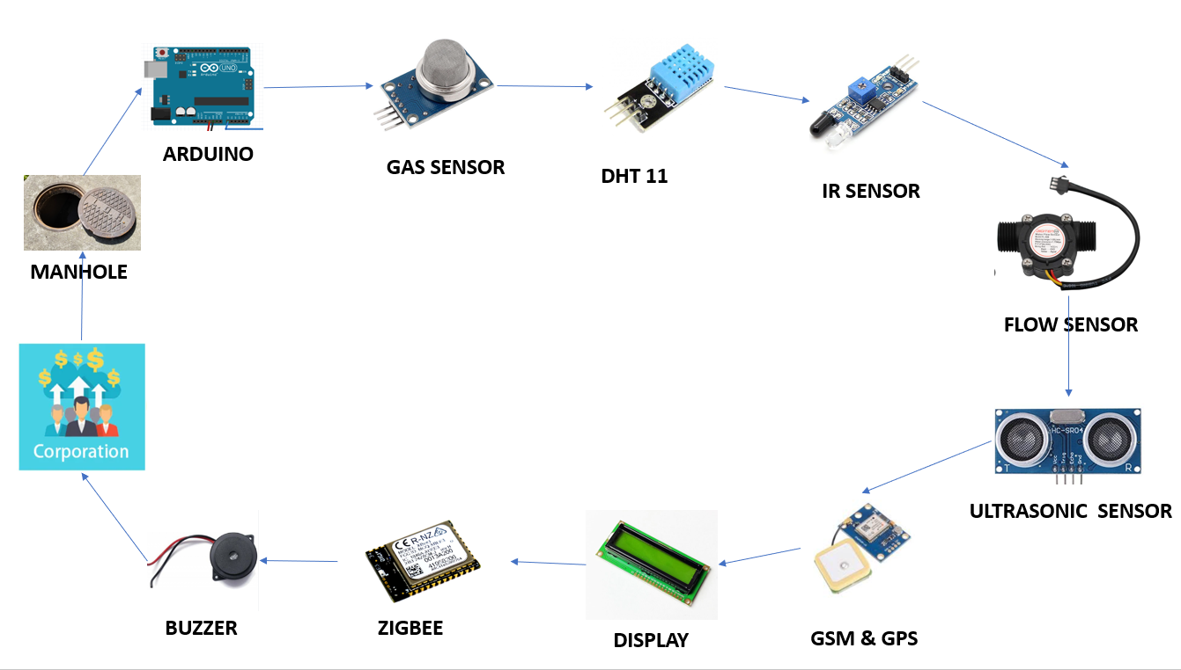
Architecture / Methodology used

Slide 11
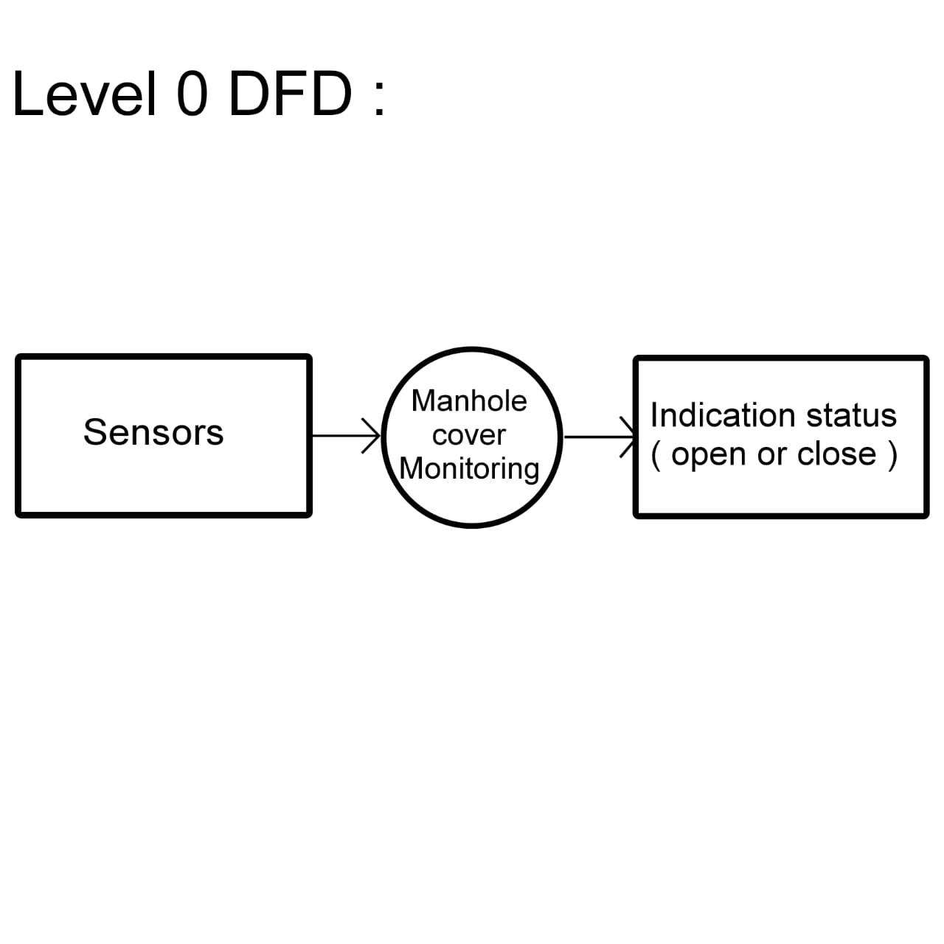
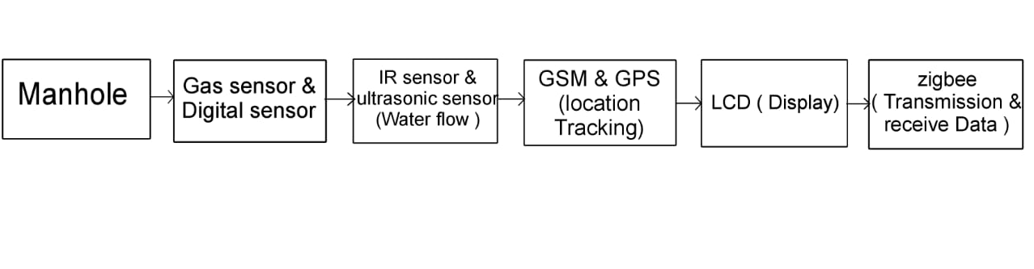
System Design - Flow Chart/DFD/ER
DFD LEVEL-0 DIAGRAM:
DFD LEVEL-1 DIAGRAM:

Slide 12
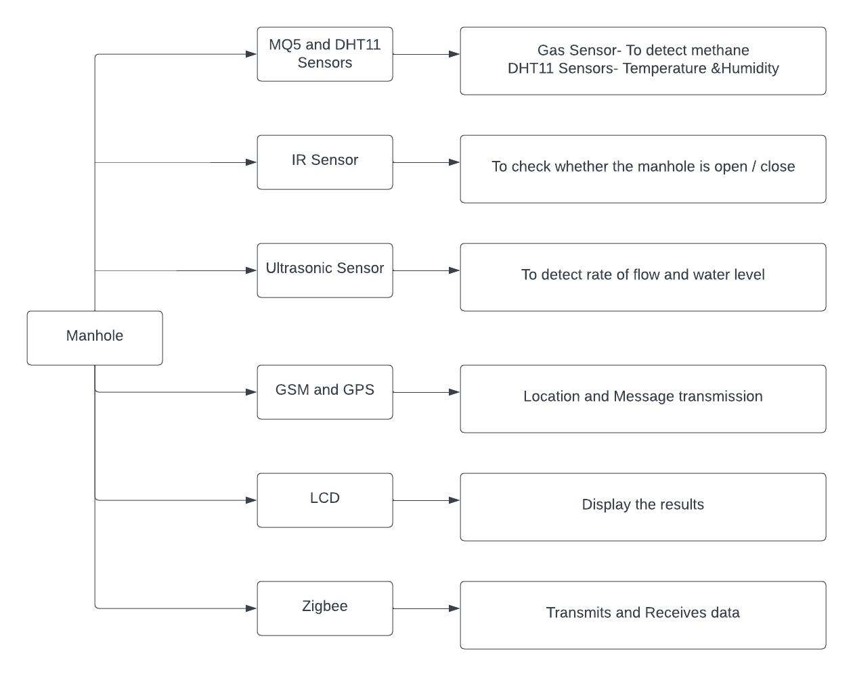
System Design - Flow Chart/DFD/ER
DFD LEVEL- 2 DIAGRAM :

Slide 13
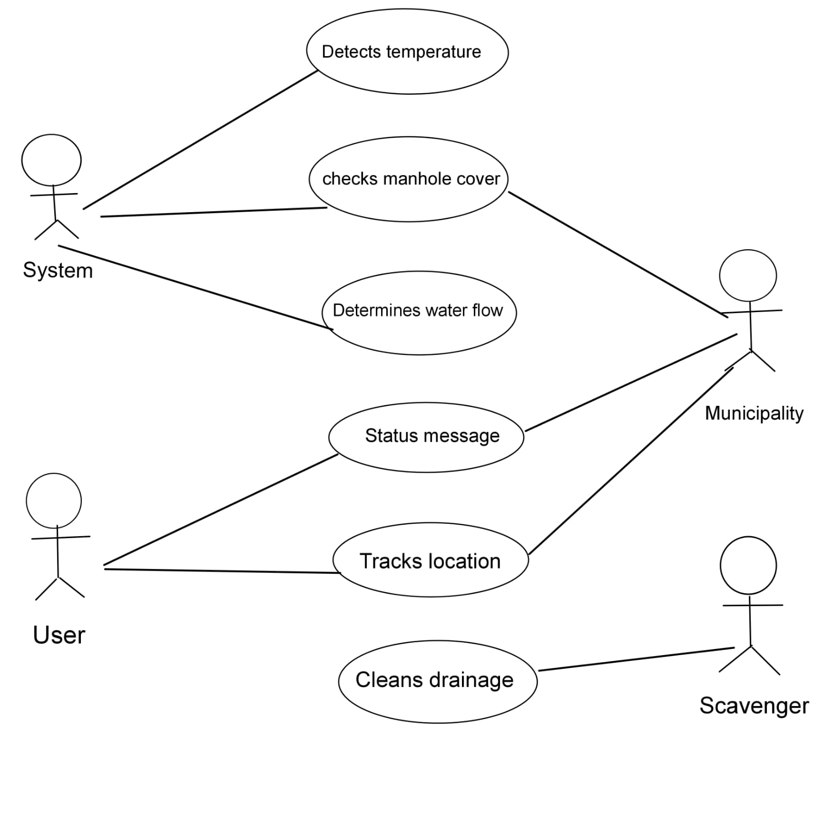
System Design - Flow Chart/DFD/ER
UML DIAGRAM:
USECASE DIAGRAM:

Slide 14
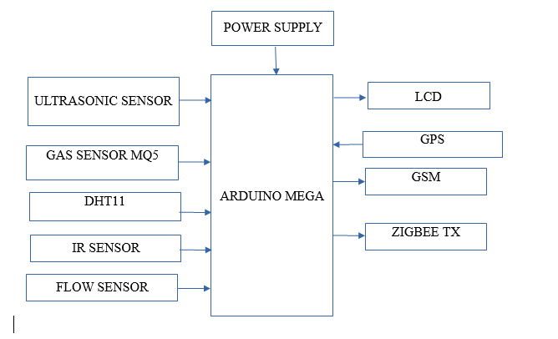
Module Description
TRANSMISSION SIDE BLOCK DIAGRAM

Slide 15
Module Description
TRANSMISSION SIDE WORKING:
In this transmitter side ARDUINO MEGA microcontroller is used to interface with the sensors and to the communication devices.
The MQ 5 – The MQ5 Gas Sensor module is useful for methane gas leakage detecting.
The dht11 –low-cost digital sensor for sensing temperature and humidity.
An infrared (IR) sensor is a device to confirm whether the cover is open or close.
Flow sensors are mainly used to measure the quantity or the rate of flow of liquids. We are using it to detect overflow the ultrasonic sensor provides the water levels of the sewage tanks.
The GPS and GSM is used for track the location and send SMS where problem is occurred and ZIGBEE transmitter is used to transmit signal to the receiver side.

Slide 16
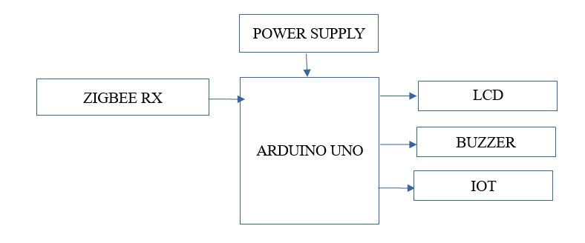
Module Description
RECIEVER SIDE BLOCK DIAGRAM

Slide 17
Module Description
RECIEVER SIDE WORKING:
In receiving side when data receive from transmitting side the receive side ZIGBEE get that data and transmit to Arduino.
If any problem occurred in drainage buzzer gives the alert to receiver LCD also display the problem condition. We store and see the data in cloud by using IOT module.

Slide 18
Testing /Performance Evaluation / Results
The prototype kit is demonstrated and performed well in all circumstances.
All the testing done on the Manhole monitoring hardware kit shows perfect working condition and good performance.

Slide 19
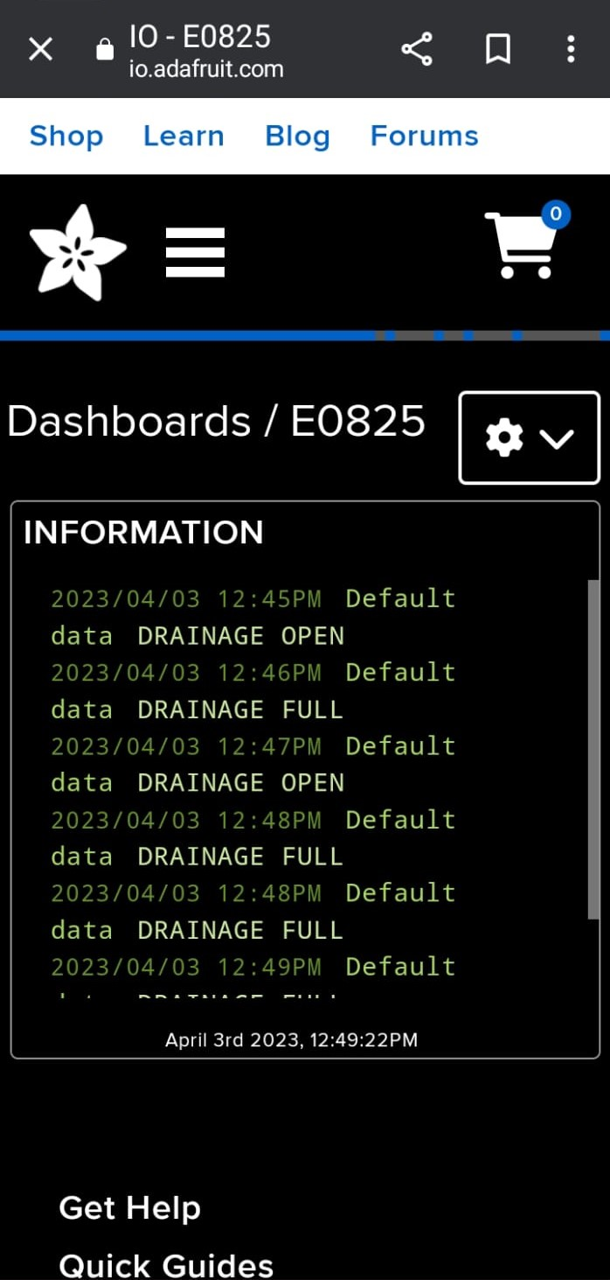
Screen Shots

Slide 20
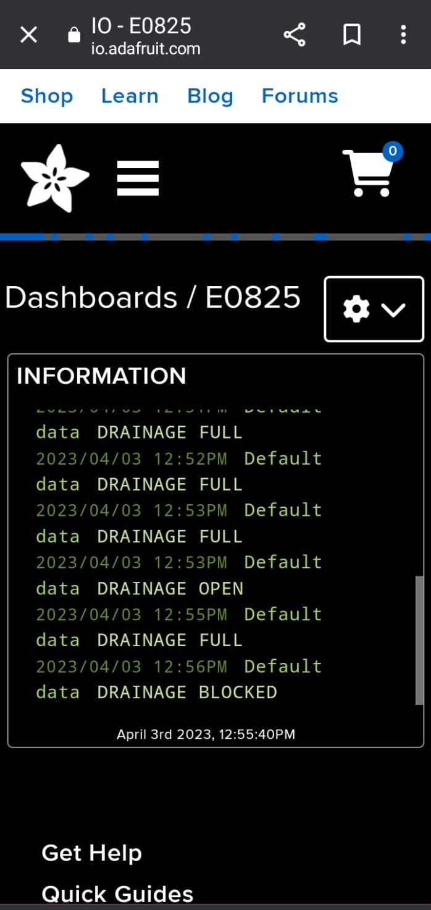
Screen Shots

Slide 21
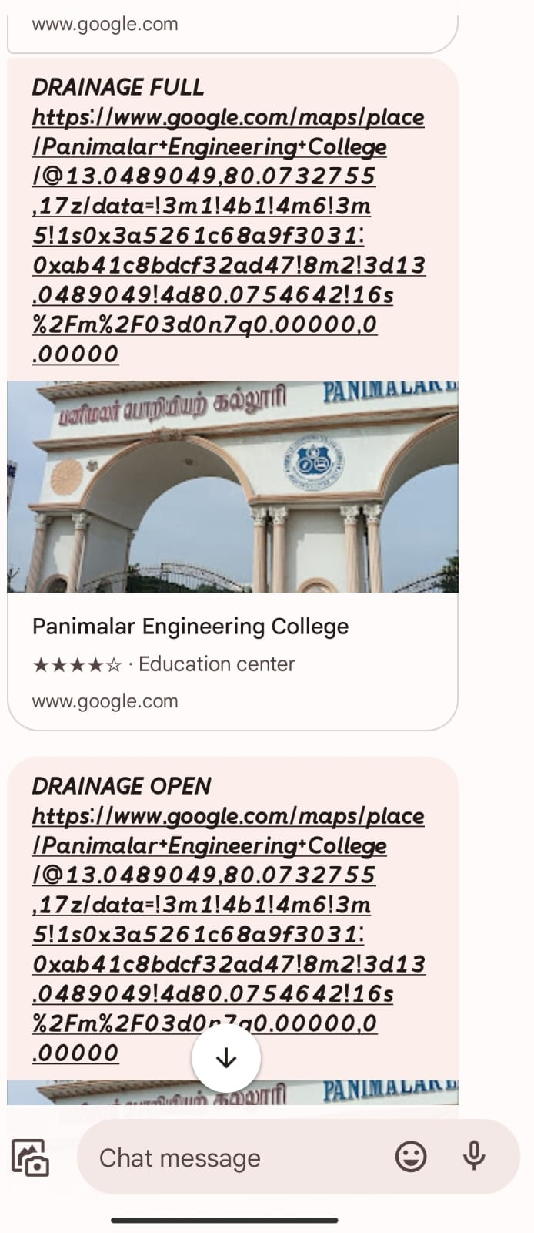
Screen Shots

Slide 22
Conclusion / Feature Enhancement
This article presented the development and validation of an iot system to monitor the trash level and geolocation of trash bins efficiently.
All aspects of an iot system including the design of a tblmu, long-range data transmission, long-time data storage, and visualization of the trash bin level were developed.
Finally, the developed system was validated by evaluating the accuracy of the sensor employed, maximum transmission distance between a tblmu and a gateway, life expectancy of a tblmu, battery charging time, and cost.
Based on the results obtained, the proposed iot system was suitable for the municipality or municipal solid waste management companies to manage the msw efficiently.
Future work in this discipline will be developing a deep learning algorithm to analyze the geolocation coordinates of almost filled and partially filled bins to create an optimized truck route.

Slide 23
Reference Paper/ URL
“A LoRaWAN IoT-Enabled Trash Bin Level Monitoring System” - S.R. Jino Ramson, Vishnu S. , A. Alfred Kirubaraj, Theodoros Anagnostopoulos, and Adnan M. Abu-Mahfouz.
LINK - https://drive.google.com/file/d/1ZT-evYtH1a13hOYRQi-wrTpRkmzSib7Q/view?usp=drivesdk

Slide 24
Thank you

