Slide 1


Motion Detection based Surveillance
System
Team Members
Sanjana S (2019PECCS176)
Sofiya S (2019PECCS191)
24/3/22
Review 0

Slide 2

OBJECTIVE
To design a surveillance system based on motion detection using open cv and python
24-3-22
Review -0
2

Slide 3

PROJECT OVERVIEW
A motion detection based surveillance system that uses background subtraction using open cv and python
The background of our video stream is largely static and unchanging over consecutive frames of a video. Therefore, if we can model the background, we monitor it for substantial changes. If there is a substantial change, we can detect it — this change normally corresponds to motion on our video
24/3/22
3
Review -0

Slide 4
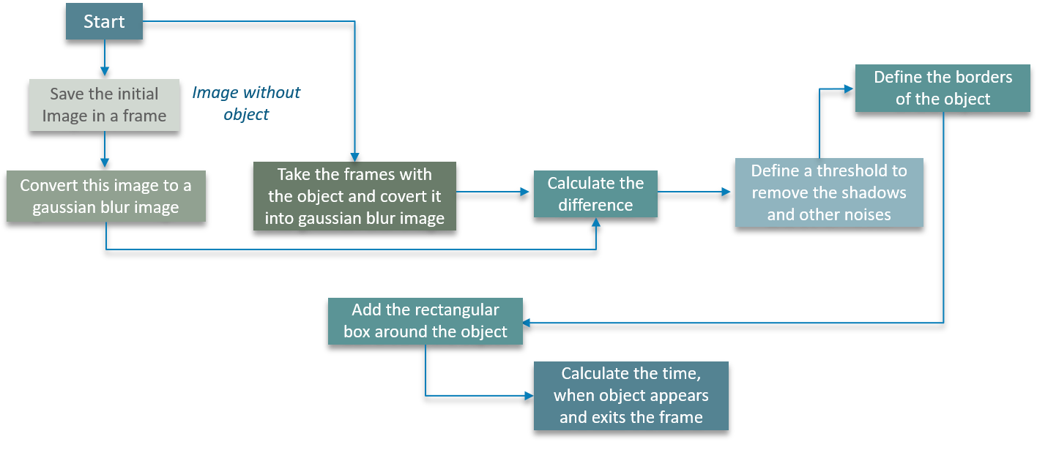
Block Diagram
24/3/22
Review -0
4

Slide 5

SOFTWARE REQUIREMENTS
PYTHON (LATEST VERSION)
OPENCV LIBRARIES
24/3/22
Review -0
5

Slide 6
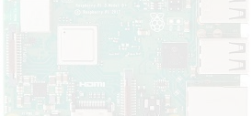


Description of Components
24/3/22
Review 0
6

Slide 7


APPLICATIONS
Can be used with Infrared camera to track wild animals crossing roads.
Can be used to give "Intruder alerts" in borders for protection.
Can reduce the workload of humans in surveillance systems.
24/3/22
7
Review -0

Slide 8

Computer vision
Computer vision is a process by which we can understand the images and videos how they are stored and how we can manipulate and retrieve data from them.
Computer Vision is the base or mostly used for Artificial Intelligence
OpenCV
OpenCV is the huge open-source library for the computer vision, machine learning, and image processing
By using it, one can process images and videos to identify objects, faces, or even handwriting of a human
24/3/22
Review -0
8

Slide 9





