Slide 1
Healthcare Insights Dashboard
Done by : Sanju Sarvashni

Slide 2
Problem Statement
The goal of this project is to analyze a healthcare dataset to identify patterns in patient records, treatment usage, and health indicators. By performing data cleaning, SQL-based analysis, and visualization, the project aims to extract meaningful insights that can support better decision-making in healthcare management.

Slide 3
Objective
The primary objective is to extract meaningful insights from the healthcare dataset by performing data cleaning, SQL analysis, and EDA. Additionally, the project aims to build an interactive Streamlit dashboard that enables easy exploration of trends for decision-making.

Slide 4
Dataset Overview
• Feature Summary
Patient_ID — Unique patient identifier (int64)
Admit_Date — Hospital admission date (object)
Discharge_Date — Hospital discharge date (object)
Diagnosis — Primary medical condition diagnosed (object)
Bed_Occupancy — Bed type / allocation details (object)
Test — Diagnostic tests recommended (object)
Doctor — Consulted doctor’s name (object)
Followup Date — Scheduled follow-up date (7035 non-null) (object)
Feedback — Patient satisfaction rating (float64)
Billing Amount — Total bill amount charged (int64)
Health Insurance Amount — Amount covered by insurance (int64)
Total Records: 7,157

Slide 5
Tools & Technologies Used
Programming & Data Processing
Python – Data cleaning, preprocessing, analysis
Pandas – Handling tabular data, transformations
Data Querying
SQL – Extracting insights, aggregations, filtering operations
Visualization
Matplotlib & Seaborn – EDA visualizations
Plotly – Interactive charts
Application Development
Streamlit – Building the interactive healthcare dashboard
Version Control
Git & GitHub – Code management, documentation, project submission.

Slide 6
Data Cleaning & Preprocessing
Key Steps
Loaded the CSV file into a dataframe using pandas
Handled missing values (Followup Date)
Converted Admit, Discharge, Followup dates to datetime
Derived Length of Stay for analysis

Slide 7
SQL Queries & Insights
Loaded the healthcare dataset into SQL and performed queries to analyze patient admissions, diagnoses, bed occupancy, tests conducted, doctor-wise consultations, follow-ups, billing amounts, and insurance coverage to generate actionable operational and financial insights.

Slide 8
EDA & Visualizations
Key Analyses & Trends

Slide 9
Patient and Admission Trends

Slide 10
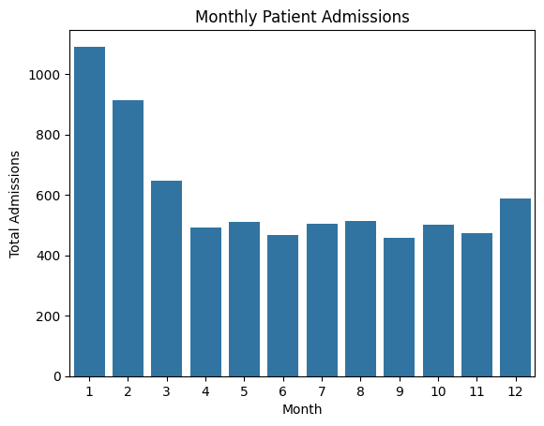
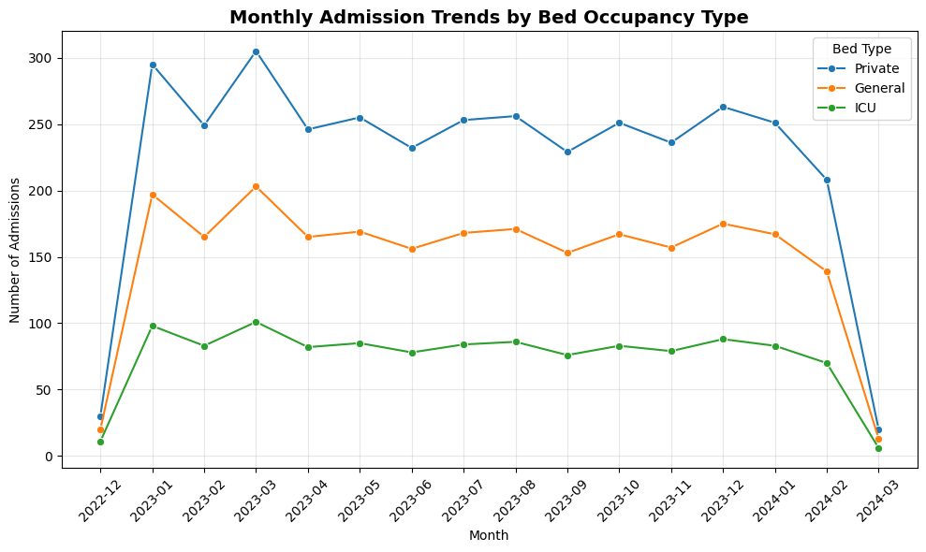
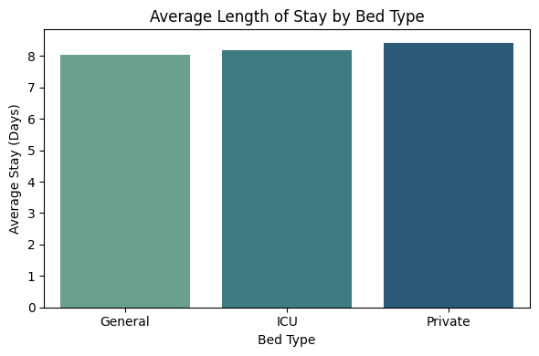
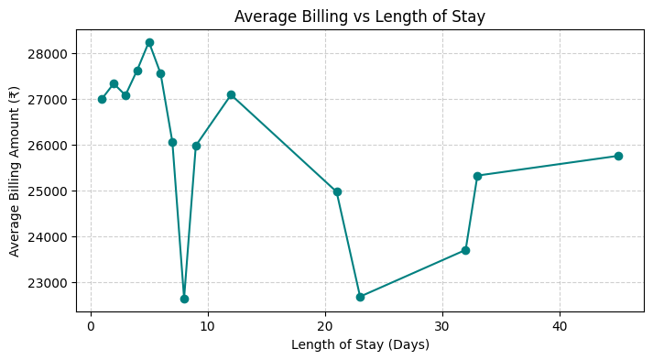

Slide 11
Key Insights
No of admissions were highest during the month of January to March and were mid during the other months.
“Private beds dominate hospital admissions every month, with General and ICU beds showing lower but stable occupancy trends.”
Patients who were admitted to all three bed types stayed for around seven days each with the say in private room slightly longer , just about one day or more in average.
The analysis of average billing against length of stay reveals no strictly linear trend, though a general pattern can be observed. Patients staying up to 5 days tend to incur higher average bills, possibly due to intensive treatments or surgical cases. Billing slightly drops for longer stays (10–25 days), indicating that extended hospitalization may involve more observation-based or recovery care with lower daily costs. The billing then stabilizes beyond 30 days, suggesting a consistent cost structure for chronic or long-term patients.

Slide 12
Financial Insights

Slide 13
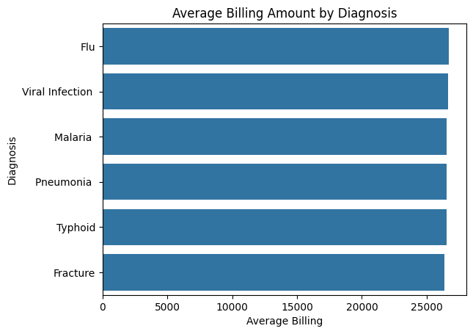
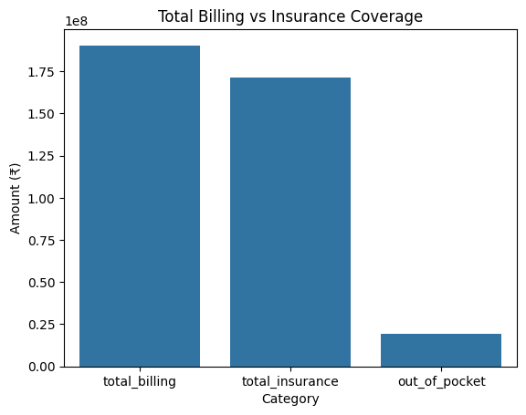
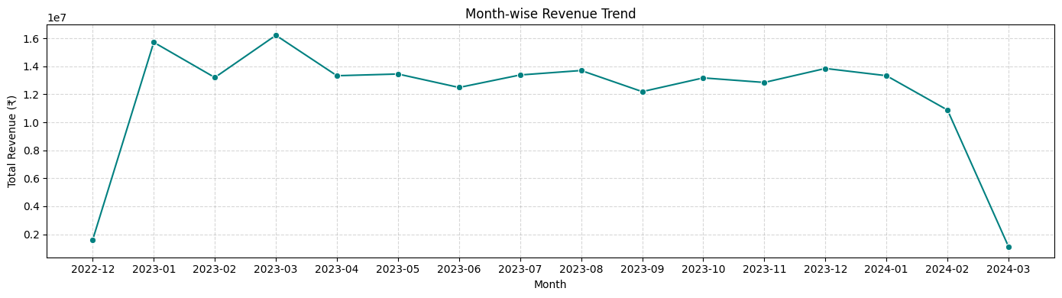

Slide 14
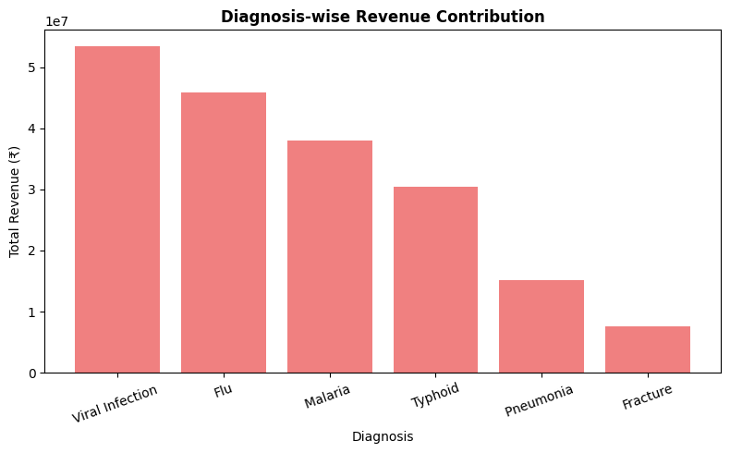

Slide 15
Key Insights
Average billing amount is almost same for every diagnosis.
The majority of patient bills are covered through insurance, accounting for nearly 90% of total billing, while only a small fraction (~10%) is paid out-of-pocket. This indicates that most patients rely on insurance for healthcare expenses, reducing direct financial stress.
The hospital’s revenue shows noticeable fluctuations across months, with peak revenue observed in March 2023 (~₹1.6 crore) and lowest in March 2024 (~₹0.1 crore). Overall, the trend remains stable between ₹1.2–₹1.4 crore for most months after March 2023, suggesting consistent patient inflow and billing.
Viral Infection and Flu are the top revenue contributors, reflecting their high patient count and frequent hospital visits. Pneumonia and Fracture contribute less to total revenue, possibly due to fewer cases or shorter inpatient stays.

Slide 16
Doctor and Performance Insights

Slide 17
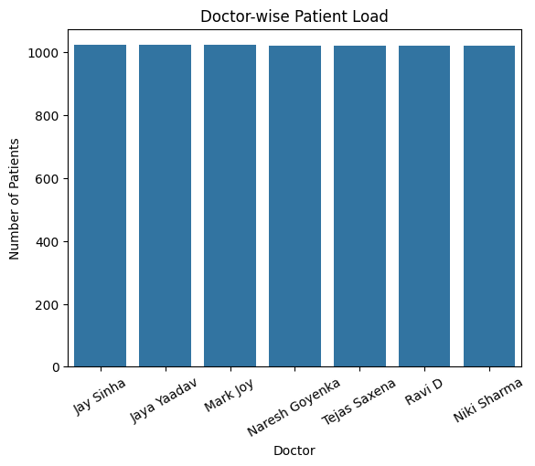
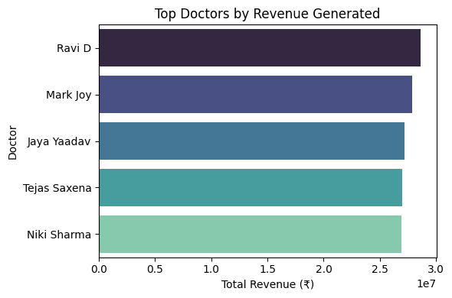
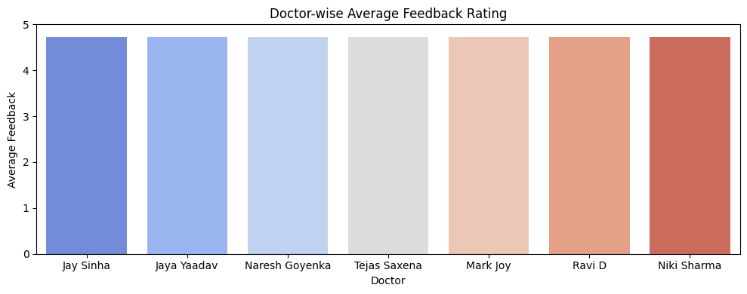

Slide 18
Key Insights
Almost every doctor had treated equal number of patients
Ravi D generated the highest revenue, followed closely by Mark Joy and Jaya Yaadav. The top five doctors show minimal revenue variation, indicating consistent high performance. Niki Sharma, though fifth, still achieved strong results, reflecting an overall competitive and productive team.
all the doctors are performing well equally, everyone of them having average feedback of ~ 4.2

Slide 19
Diagnostics and Feedback Insights

Slide 20
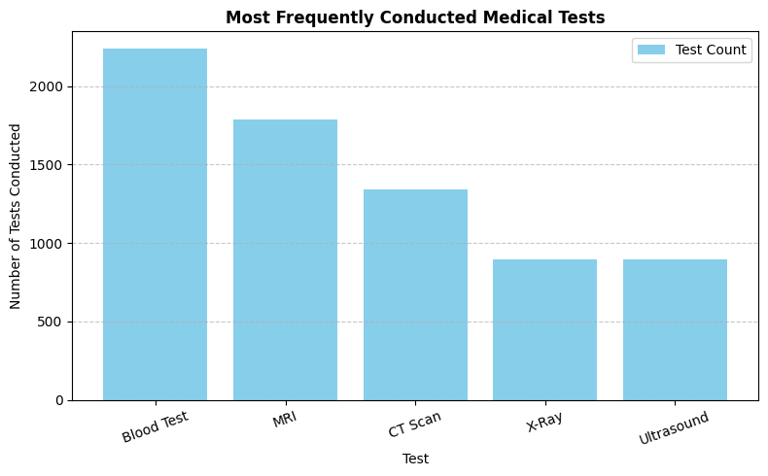

Slide 21
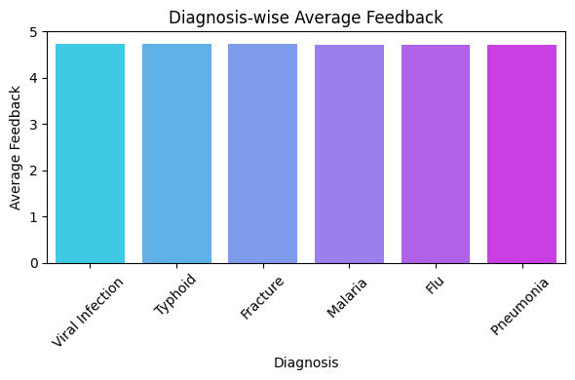

Slide 22
Key Insights
Blood Tests are the most frequently performed diagnostic tests, accounting for the highest volume of all test types. MRI and CT Scans follow next, indicating higher reliance on advanced imaging for diagnosis. Ultrasound and X-Ray have similar frequencies, suggesting their consistent utility in routine diagnostics.This distribution highlights the importance of laboratory diagnostics in the hospital’s service portfolio — while advanced imaging contributes more per test in revenue, blood tests drive high patient throughput.
The average patient feedback across all diagnosis categories remains consistently high (~4.7/5), reflecting strong patient satisfaction.

Slide 23
Business Suggestion/solution
Manage Seasonal Peaks: Boost staff and bed availability during Jan–Mar to handle higher admissions efficiently.
Expand Private Bed Capacity: Focus on private rooms to match demand and increase revenue.
Optimize Short-Stay Treatments: Prioritize efficient care for ≤5-day stays to maximize revenue.

Slide 24
Business Suggestion/solution
Leverage Diagnostics & Imaging: Ensure lab efficiency for high-volume tests; promote MRI/CT for higher revenue.
Maintain High Patient Satisfaction: Keep service quality consistent and use feedback to improve care.

Slide 25
Streamlit Application
Overview
Interactive dashboard built using Streamlit
Allows users to explore patient and hospital data dynamically
Key Features
Filters: By Admission Date, Bed Type, Doctor, and Diagnosis
KPIs: Total admissions, average billing, insurance coverage
Charts: Monthly admission trends, bed occupancy, diagnosis patterns, View detailed patient records and follow-up status

Slide 26
THANK YOU !!

