Slide 1
StayBook
Hotel Booking System
A hotel-booking web app demo for guests and hotel administrators
TEAM
Team name: to be confirmed
Sanjay · [Abhi] · [banif]
Registration numbers: add before submission
GitHub: github.com/sanjutalari/hotel-booking-system_2 · Live: staybook-hotel-booking-system.onrender.com
Notes:
Sources: project README.md and current Render/GitHub deployment details.
Presenter cue: Replace the team name, member names and registration numbers before presenting.

Slide 2
Introduction and problem statement
Hotel discovery and booking need a clear path from search to confirmation.
THE GUEST PROBLEM
STAYBOOK RESPONSE
Finding a room is only the first step.
Search and compare hotels
Filter by destination, nightly price and guest rating.
Guests need to compare locations, prices and room availability, then keep their booking details in one place.
Choose a room and book
Review dates and a server-calculated stay total.
Manage the stay
Guests see their trips; admins manage hotel operations.
StayBook · Hotel Booking System
02
Notes:
Source: README.md, Description and Features sections.
Presenter cue: Explain the guest journey and the admin’s separate operational role.

Slide 3
Project objectives
Build a practical booking flow and demonstrate a protected REST API.
Discover
Search, filter and sort hotels by destination, price and rating.
Compare
Review room types, photos, amenities and availability.
Book safely
Authenticate guests and calculate totals on the server.
Operate
Give admins hotel, room and inspection controls.
StayBook · Hotel Booking System
03
Notes:
Source: README.md, Description and objectives; TEAM-DIVISION.md.
Presenter cue: Connect each objective to a visible feature in the live demo.

Slide 4
Technologies and tools
Current implementation in the deployed project.
Web interface
Backend
Data & security
Delivery
HTML · CSS · JavaScript
Node.js · Express
PostgreSQL · bcryptjs · JWT
GitHub · Render
Responsive guest site and admin console. Fetch API connects screens to JSON routes.
REST endpoints, request validation, JWT middleware and server-side booking totals.
PostgreSQL stores guest accounts. bcryptjs hashes passwords; JWT protects guest and admin routes.
Source repository and a public Render service with PostgreSQL connectivity.
Scope note: the current UI is vanilla JavaScript, not React; only guest accounts persist in PostgreSQL.
StayBook · Hotel Booking System
04
Notes:
Sources: package.json, README.md, db/schema.sql and docs/VIVA-QA.md.
Presenter cue: Faculty handout mentions React/MongoDB in some sections and PostgreSQL in another. State what the project actually uses and ask faculty to confirm the required target stack.

Slide 5
System architecture and workflow
The public site and admin console use the same Express service on Render.
Browser
Express API
JWT checks
Render
Guest site + admin console
Auth · hotels · bookings · admin
Signature · expiry · role
Public deployment
Guest flow: search → choose a room → sign in → book → view or manage the stay
DATA STORES
PostgreSQL · hotel_booking.users
In-memory project data
Guest account ID, name, email and password hash.
Hotels, rooms, inspections and bookings reset when the server restarts.
StayBook · Hotel Booking System
05
Notes:
Sources: server.js, routes/, middleware/auth.js, db/schema.sql, models/data.js and README.md.
Presenter cue: Point out the current persistence boundary; avoid describing all project records as database-backed.

Slide 6
Features and CRUD
Guest booking and admin operations share the project’s API layer.
GUEST EXPERIENCE
ADMIN CONSOLE
Search → rooms → booking
Manage and review
Hotel search, filters and sorting
Room photos, details and availability
Account registration and sign-in
Booking history, cancellation and feedback
Create, read, update and delete hotels
Add and edit rooms; remove rooms
Record hygiene and service inspections
Review bookings and guest feedback
Admin APIs require an admin-role JWT. Guest booking actions require a verified guest JWT.
StayBook · Hotel Booking System
06
Notes:
Sources: routes/admin.js, routes/bookings.js, public/app.js, public-admin/admin.js and README.md.
Presenter cue: Show the search-to-book journey, then the separate admin console.

Slide 7
Database design, APIs and JWT
A relational account table and token middleware support protected actions.
DATABASE TABLE
API AND AUTH FLOW
hotel_booking.users
POST /api/auth/login
GET /api/hotels
POST /api/bookings · GET /api/bookings/me
POST /api/admin/auth/login · /api/admin/*
id
BIGSERIAL · primary key
name
TEXT · required
JWT in four steps
email
TEXT · unique
1. Verify password against its bcrypt hash.
2. Sign a short-lived token with account ID and role.
3. Client sends Authorization: Bearer <token>.
4. Middleware verifies signature, expiry and role.
password_hash
TEXT · bcrypt hash
created_at
TIMESTAMPTZ · default now
Hotels, rooms, inspections and bookings are currently held in memory; moving them into persistent storage is future work.
StayBook · Hotel Booking System
07
Notes:
Sources: db/schema.sql, db/pool.js, routes/auth.js, routes/admin-auth.js, middleware/auth.js and README.md.
Presenter cue: JWT is signed, not encrypted. Its payload is readable; never include passwords or secrets.

Slide 8
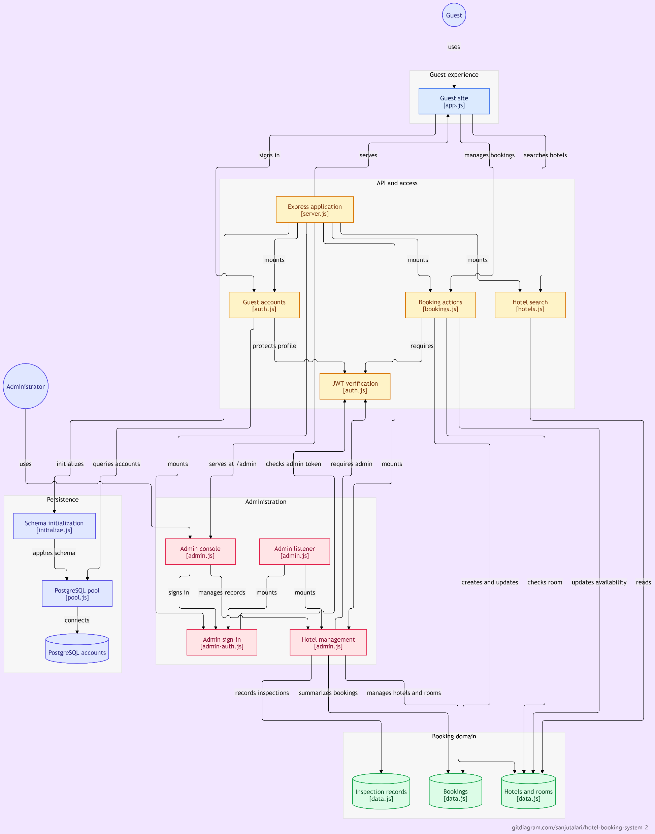
Directory structure:
└── sanjutalari-hotel-booking-system_2/
├── README.md
├── admin.js
├── AGENTS.md
├── build_report.py
├── Hotel Booking System — Mini Project Guide.md
├── package.json
├── server.js
├── supplementary_datasets.csv
├── TEAM-DIVISION.md
├── .env.example
├── db/
│ ├── initialize.js
│ ├── pool.js
│ └── schema.sql
├── docs/
│ └── VIVA-QA.md
├── middleware/
│ └── auth.js
├── models/
│ └── data.js
├── outputs/
│ ├── NSS_Week_F&L_Consolidated_20260927.xlsx
│ └── 20260927_nss/
│ └── NSS_Events_Combined.xlsx
├── public/
│ ├── app.js
│ ├── index.html
│ └── style.css
├── public-admin/
│ ├── admin.css
│ ├── admin.html
│ └── admin.js
├── routes/
│ ├── admin-auth.js
│ ├── admin.js
│ ├── auth.js
│ ├── bookings.js
│ └── hotels.js
└── utils/
└── network.js

Slide 9
Project screenshots
Current live screens to add before final faculty submission.
The two spaces below are editable image placeholders. Replace them with fresh captures before presenting.
Guest search and hotel list
Admin console
Insert homepage capture showing destination search, filters, hotel ratings and nightly prices.
Insert admin sign-in or management capture showing protected hotel and room controls.
staybook-hotel-booking-system.onrender.com
staybook-hotel-booking-system.onrender.com/admin/
Use your demo data only. Check that no guest email, password or booking identifier is visible in screenshots.
StayBook · Hotel Booking System
08
Notes:
Screenshot destinations: https://staybook-hotel-booking-system.onrender.com/ and https://staybook-hotel-booking-system.onrender.com/admin/.
Presenter cue: The placeholders are intentional; this authoring session could not export browser screenshots into the deck.

Slide 10
Challenges and future scope
Separate what is implemented today from what the final submission still needs.
CURRENT CHALLENGES
NEXT STEPS
Faculty instructions conflict: React and MongoDB are named in the MERN brief, while PostgreSQL is also named.
Only guest accounts are persisted in PostgreSQL; other records reset on restart.
The current customer interface uses vanilla JavaScript.
Confirm the required database and frontend with faculty.
Move hotels, rooms, inspections and bookings into persistent storage.
If required, migrate the UI to React and align the stack with the faculty brief.
Complete team details and add real project screenshots to the deck.
Current demo is deployed on Render; confirm major guest and admin flows before submission.
StayBook · Hotel Booking System
09
Notes:
Sources: faculty handout supplied in the conversation; README.md; docs/VIVA-QA.md.
Presenter cue: Call out the stack mismatch plainly and agree the required target before claiming MERN compliance.

Slide 11
Conclusion
StayBook demonstrates a complete guest journey—from hotel search to protected booking—alongside a separate admin workflow.
Speaking roles
Sanjay
Architecture · Render · JWT · booking API
LIVE DEMO
Member 2 · name to confirm
PostgreSQL · schema · CRUD APIs
staybook-hotel-booking-system.onrender.com
SOURCE CODE
Member 3 · name to confirm
Guest/admin UI · demo flow
github.com/sanjutalari/hotel-booking-system_2
Thank you
Notes:
Sources: TEAM-DIVISION.md, README.md and live deployment.
Presenter cue: Keep contributions honest: members 2 and 3 need to replace suggested roles with their actual work.

