Slide 1


Bank of Baroda Hackathon - 2022
Technology Partner
Your Team Name : Sudarshana
Your team bio :
Sudarshana is a team of 3 students pursuing Btech at KMIT and a mentor (Assistant professor at NGIT)
Date :20th September 2022

Slide 2
Problem Statement?
Bank is using video cameras for the purpose of surveillance at many branches, ATMs and digital lobbies. Getting video analytics of different parameters from the video recording will help the bank to resolve many operational issues at the branches. The bank wants to explore video analytics to understand the customer sentiments, understand the patterns /behaviors/actions in certain branches for proactive surveillance and provide better services to customers.
Why did you decide to solve this Problem statement?
We live in a digital world where AI and automation have entered every walk of professional life. It is very tough to operate surveillance cameras with human intervention to detect
abnormal activities. Fully automating surveillance with smart video capturing capabilities using integration of Video Analytics and deep learning technique is one of the most advanced means of remotely monitoring strange activities with exact location, time of event occurred along with facial recognition of criminal.
Theft detection, weapon detection, unusual happenings in crowded places like banks, monitoring the suspicious activities of each individual to provide a secure and hassle free environment.
With video analytics, banks will effectively be able to transform CCTV feeds into solutions that can be leveraged as a part of their customer experience decision-making and operations monitoring workflow.

Slide 3
User Segment & Pain Points
Which user /advertiser segment would be early adopter of your product & why?
Banks :
Banks are on the front line in the face of increasingly sophisticated cyber attacks. The advanced video analytics integrated CCTV systems continuously monitor restricted access and sensitive areas such as the locker area, cash chests, cashier counters, and server rooms etc. If any activity or behaviour which is not appropriate or suspicious is observed by the cameras, such as tampering with ATMs, carrying a weapon or someone trying to enter a restricted area, the system automatically raises alerts to draw attention. This decreases the manual effort.
Retail Industry :
There are two reasons retailers have taken advantage of video analytics far more than other vertical markets. First, retailers generally face more theft than any other vertical market. Analytics can help catch suspects by alerting in real-time. After the fact, analytics used for search purposes are far more effective to identify a theft than rewinding and fast-forwarding through video.
Our product also provides the count of people and the time period for which activity is performed by a customer in real-time.

Slide 4
Pre-Requisite
As it is hard to manage memory while training huge amounts of data for object detection, dgx server or cloud to train the model is required. Softwares like tensorflow, yolo advanced algorithms, advanced cameras are to be provided. Providing good dataset is the major pre-requisite.
It is possible to design scalable to handy devices.
What are the alternatives/competitive products for the problem you are solving?
CCTV systems provide only videos .They are not as efficient as CCTV systems integrated with Video Analytics. Since video analytics keep track of safety measures time to time.

Slide 5
Azure tools or resources
Azure tools or resources which are likely to be used by you for the prototype, if your idea gets selected Azure Video Analyzer : Azure Video Analyzer to extract insights according to requirements from videos. Power new forms of content discovery such as extracting suspicious expressions of thefts, searching for spoken words, faces, characters, and emotions. Azure Machine Learning Tool : Azure Machine Learning tool will be used for building models which is capable of detecting weapons and theft.

Slide 6
Any Supporting Functional Documents
Present your solution, talk about methodology, architecture & scalability
A pre-trained model(YOLO algorithm) is used to detect the weapons and people in a real –time video. It also outputs the number of people in the video and the time period for which the activity is performed by the customer. Our product sends alert signals if any suspicious activity is detected. Frames are generated per second and track of number of people in each frame is maintained. If any suspicious activity is detected by the model ,it immediately alerts us. Further, the continuous monitoring and ability to smartly detect weapons, suspicious behaviour or unattended objects allows the system to raise an alert and provide crucial early response opportunity.

Slide 7
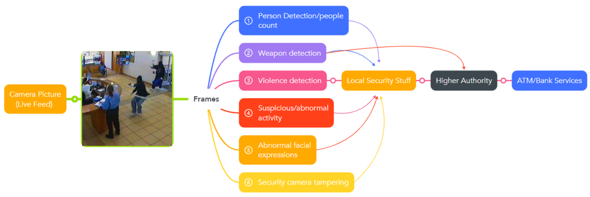

Solution Overview
Alerts
Shutdown services

Slide 8
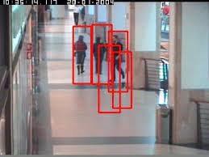
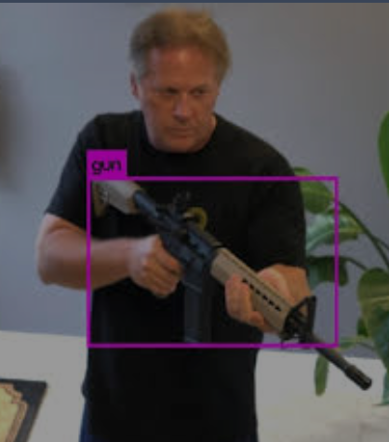
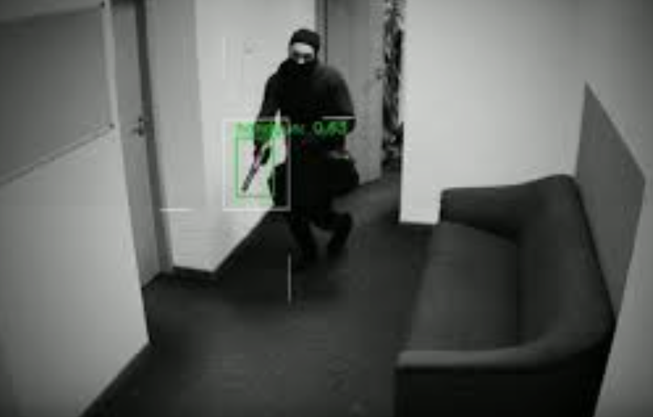
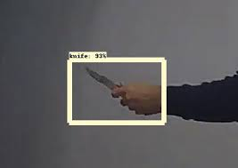
Object Detection
Using advanced pre trained CNN models and computer vision ,human and weapon detection is achieved in every frame of the live video.
The count of the people in the frame can be maintained
and when this count exceeds a certain value the local security
and staff can be alerted.
If any weapons are detected in any of the frames,
immediately an alert signal is sent to the local security and the higher authority.
Persons=4

Slide 9
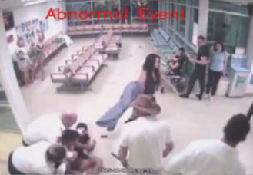
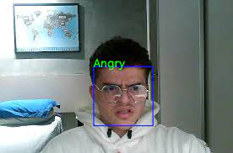
Suspicious/Abnormal Activity detection
If any suspicious activity like sudden movement of the person or
huge gathering of people, a person staying for a long time in the
bank or ATM are detected, then the local security is notified and
immediately violence detection is done.
Facial Expressions of people in the bank/ATM are also tracked.
If any expression like anger/anxiety/fear which may lead to any
violent activity are detected, this is also considered as a
suspicious activity and violence detection is performed besides
notifying local security.
If the working of camera is stopped abruptly/live feed is not
available an alert signal will be sent.

Slide 10
Key Differentiators & Adoption Plan
How is your solution better than alternatives and how do you plan to build adoption?
Deploying video analytics technology can help banks convert their existing CCTV systems into a smart tool to enhance their operational efficiency and customer delight. Our product provides high accuracy for detection of people and weapons. If given a chance we can enhance the model with some special features like giving the exact area/location in the bank where the suspicious activity is performed.
These extra features over ordinary cctv cameras and other video analytic systems with given higher accuracy and better services besides regular upgradation of features and maintenance
sets this product apart from others.
YOLO is used for training the model and detecting persons, weapons.

Slide 11
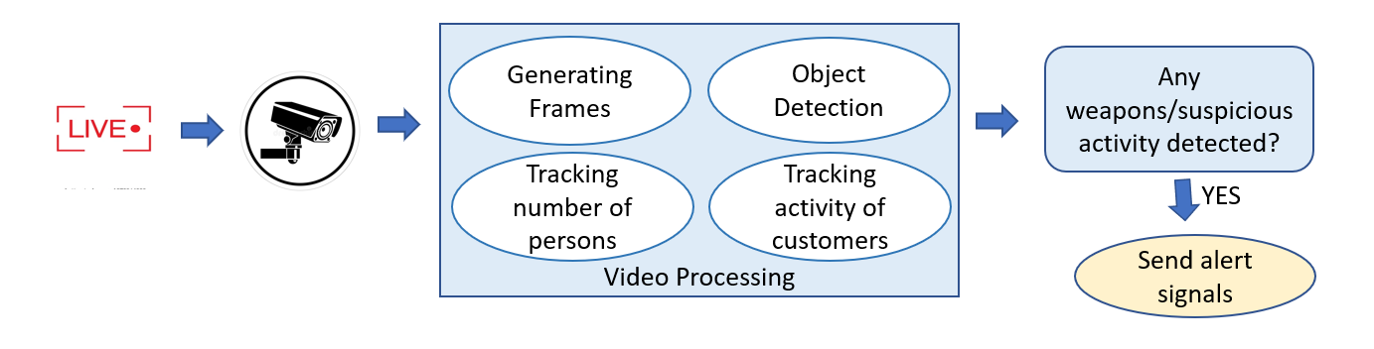
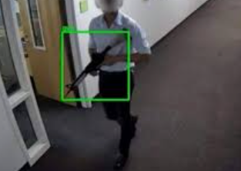
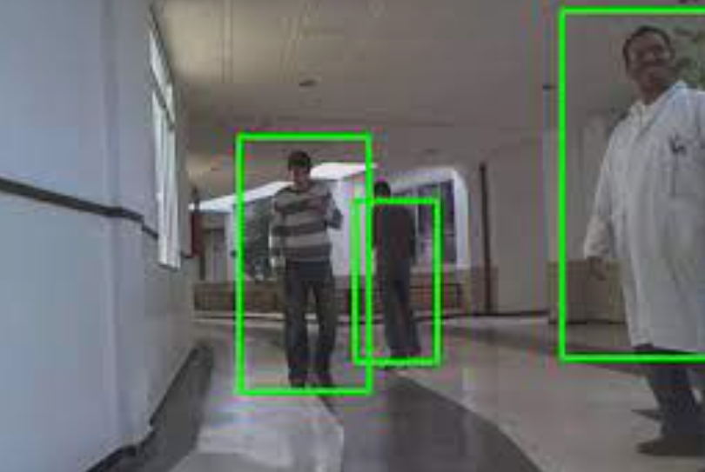

GitHub Repository Link & supporting diagrams, screenshots, if any
Persons = 3

Slide 12
Thank You
Team member names
P V N Balarama Murthy (Leader)
Sanjuth Reddy. P
P V V S Sai Kiran
Sai Likhita Rage

