Slide 1
EXCEL REASSESSMEANT NAME:SANJU YADAV

Slide 2
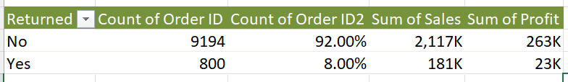
Q.1
Insights:
We can see sum of profut and sales
Returned or not
returned | Yes
Sum of Sales | Sum of Profit
180504.2779 | 23232.3615
Inference:
Total no. of returned order = 800
It is 8.0048% of total orders
Loss in term of sales = 180504
Loss in terms of = 23232
Formula Used:=COUNTA(V2:V9995)
=COUNTIF(V:V,"Yes")

Slide 3
Q.2
Inference:from this data we can see that
Same day mode is fastest
Standard class is slowest
Row Labels | Average of day diff
Standard Class | 5.006534853
Second Class | 3.238046272
First Class | 2.182704811
Same Day | 0.044198895
Formula Used: we used piviot table in which we put ship mode in rows and time diff in value
Insights:from this data we can see that
As class changes how average day diffence changes
Diy diff means total day taken to complete order

Slide 4
Q.3
Insights:we used piviot table
Here we can see for different segment different sales values and frequency of orders
Sales | Number of Customers | Total Profit
0-100 | 6226 | 33.3K
100-200 | 1189 | 26.1K
200-300 | 675 | 17.9K
400-500 | 293 | 12.0K
800-900 | 119 | 11.7K
300-400 | 449 | 10.1K
500-600 | 218 | 10.0K
600-700 | 175 | 9.1K
1200-1300 | 45 | 8.9K
Inference:
Most valuable segment is consumer
Consumer orders most frequently
INFERENCE:
the group of sale
which gives the highest profit
which is 0-100 category

Slide 5
Q.4
Insights:we used piviot table and we can see the top category and sub category based on total sales and we can also notice the profit
Category | Sub-Category | Sum of Sales | Sum of Profit
Furniture | Chairs | 328449.103 | 26590.1663
Furniture | Tables | 206965.532 | -17725.4811
Furniture | Bookcases | 114879.9963 | -3472.556
Furniture | Furnishings | 91705.164 | 13059.1436
Furniture Total |  | 741999.7953 | 18451.2728
Office Supplies | Storage | 223843.608 | 21278.8264
Office Supplies | Binders | 203412.733 | 30221.7633
Office Supplies | Appliances | 107532.161 | 18138.0054
Office Supplies | Paper | 78479.206 | 34053.5693
Office Supplies | Supplies | 46673.538 | -1189.0995
Office Supplies | Art | 27118.792 | 6527.787
Office Supplies | Envelopes | 16476.402 | 6964.1767
Office Supplies | Labels | 12486.312 | 5546.254
Office Supplies | Fasteners | 3024.28 | 949.5182
Office Supplies Total |  | 719047.032 | 122490.8008
Technology | Phones | 330007.054 | 44515.7306
Technology | Machines | 189238.631 | 3384.7569
Technology | Accessories | 167380.318 | 41936.6357
Technology | Copiers | 149528.03 | 55617.8249
Technology Total |  | 836154.033 | 145454.9481
inference:
Most selling category based on total sale is “technology”
For each category top selling sub category are:
Chairs in furniture category
Storage in office supplies
Phones in technology
Profit for each category
Furniture:18451
Office supplies:122490
Technology:145454

Slide 6
Q.5
Insights:by analyzing graph
Central and south region are low in profit and west
east are high in profit
Row Labels | Sum of Sales
West | 725457.8245
East | 678781.24
Central | 501239.8908
South | 391721.905
Row Labels | Sum of Profit
Central | 39706.3625
East | 91522.78
South | 46749.4303
West | 108418.4489
inference:
Highest sales region = west
Lowest sales region= south

Slide 7
Q.6
Insights:
We can notice that as discount increase sales decrease
As discount increase profit decrease
Row Labels | Sum of Sales | Sum of Profit
0-0.2 | 1169836.342 | 331435.7717
0.2-0.4 | 882314.4818 | 77576.8909
0.4-0.6 | 180821.298 | -46056.5896
0.6-0.8 | 64228.738 | -76559.0513
Inference:
Correlation between profit and discount is -3%%
Discount Rate Vs Quantity Sold-50.53%
Discount Rate Vs Profit Margin-63.12%

Slide 8
Q.7
Insights:So, we can clearly see that average
shipping time is more in central region,and moreover we are making loss for the returned products in central region.
So we should focus on central region to increase the sales and profit.
Region | Returned | Average of Shipping Time | Sum of Sales | Sum of Profit
Central | No | 4.08 | 487232.91 | 43340.79
Central | Yes | 3.61 | 14006.98 | -3634.43
Central Total |  | 4.06 | 501239.89 | 39706.36
East | No | 3.90 | 637076.10 | 86537.98
East | Yes | 3.98 | 41705.14 | 4984.80
East Total |  | 3.91 | 678781.24 | 91522.78
South | No | 3.92 | 374412.81 | 44530.82
South | Yes | 4.72 | 17309.10 | 2218.61
South Total |  | 3.96 | 391721.91 | 46749.43
West | No | 3.97 | 617974.77 | 88755.07
West | Yes | 3.71 | 107483.06 | 19663.38
West Total |  | 3.93 | 725457.82 | 108418.45
Region | Returned | Average of Shipping Time | Sum of Sales | Sum of Profit
Central | No | 4.08 | 487K | 43K
Central | Yes | 3.61 | 14K | -4K
Central Total |  | 4.06 | 501K | 40K
East | No | 3.90 | 637K | 87K
East | Yes | 3.98 | 42K | 5K
East Total |  | 3.91 | 679K | 92K
South | No | 3.92 | 374K | 45K
South | Yes | 4.72 | 17K | 2K
South Total |  | 3.96 | 392K | 47K
West | No | 3.97 | 618K | 89K
West | Yes | 3.71 | 107K | 20K
West Total |  | 3.93 | 725K | 108K
Formula Used: we use piviot table for it

Slide 9
Q.8
Insights:
Table 1 shows the customer who orders most
Table two shows customer who orders most and not reurn the order.
Row Labels | Count of Customer Name
William Brown | 37
Paul Prost | 34
John Lee | 34
Matt Abelman | 34
Seth Vernon | 32
Jonathan Doherty | 32
Chloris Kastensmidt | 32
Edward Hooks | 32
Zuschuss Carroll | 31
Arthur Prichep | 31
INFERENCE:
TO IMPROVE THE CUSTOMER RETENTION LOOK THE
CATEGORY WHERE ORDERS ARE RETURNED MOST
AND WE CAN IMPROVE IN THAT SEPCIFIC CATEGORY
SECOND THING IS THAT WE CAN SEE WHICH CATEGORY ORDER
ARE MOST PLACED BY ANY CUSTOMER WE CAN PROVIDE MORE
PRODUCT OF THEIR CHOICE IN SAME CATEOGRY
Row Labels | Count of Customer Name
Seth Vernon | 14
Ted Butterfield | 13
Anthony Johnson | 11
William Brown | 11
Dan Reichenbach | 10
Clay Ludtke | 10
Stefania Perrino | 10
Sandra Glassco | 9
Lena Creighton | 9
Brosina Hoffman | 9
Formula Used:we used piviot table for this observation

Slide 10
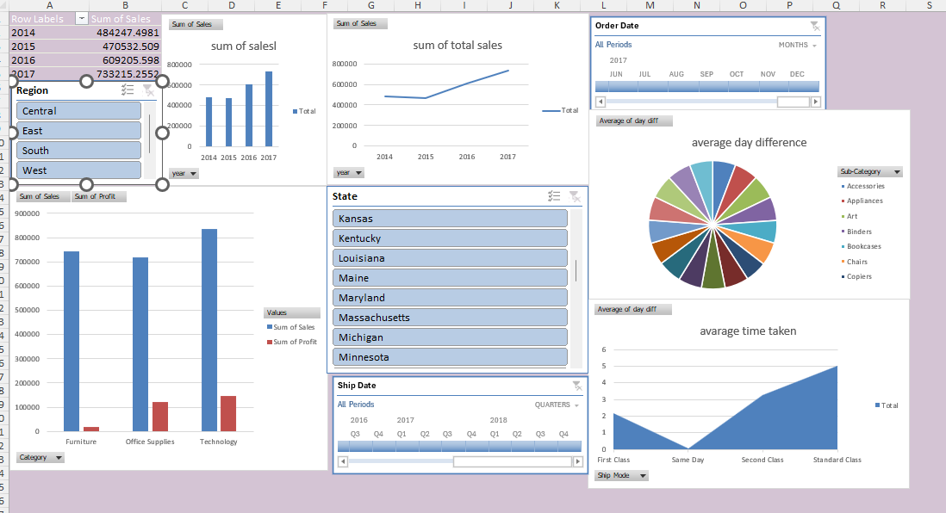
Q.9 Dashboard

Slide 11
DASHBOARD INSIGHTS:
We can notice how sum of sales and profit varies based on region
Based on years of order
We can see the average tim etaken and can observe which category and which mode has morr time
Also we can see sub category and time difference for them
We also used time timeline and slicer which helps in analyzing data

