Slide 1
CS 1150 – Lab #13 – Artificial Intelligence
TA – Sanjaya Wijeratne
E-mail – wijeratne.2@wright.edu
Web Page - http://knoesis.org/researchers/sanjaya/

Slide 2
TA Labs, Office Hours Laboratory Polices
Lab Hours
2:30 PM - 4:20 PM, Monday and Friday at Room 320 - Oelman Hall
TA Office Hours
4:40 PM - 5:40 PM, Monday and Friday at Room 316 - Russ Engineer Center
By appointment – Please email to wijeratne.2@wright.edu
Refer to CS 1150 Course Syllabus for Class and Laboratory Policies
Zero tolerance policy for Academic Misconduct – All parties will get 0% marks

Slide 3
Lab # 13 Overview
Learn how semantic networks and rule-based natural language systems can simulate intelligent behavior
Answer all questions in Exercises 1 and 2
Lab #13 Due Date - Nov 11, 2013 12:30 PM

Slide 4
How to Submit Lab # 13
Hard copy (Preferred)
When you complete, hand it over to me
Pilot
Go to Pilot Course Page and Use Dropbox Submission Link to upload your files
My Mailbox at CS Department
Go to CS Department Front Desk and ask them to put your assignment into my mailbox – Please write my name on your assignment (TA – CS 1150 – Sanjaya Wijeratne)

Slide 5
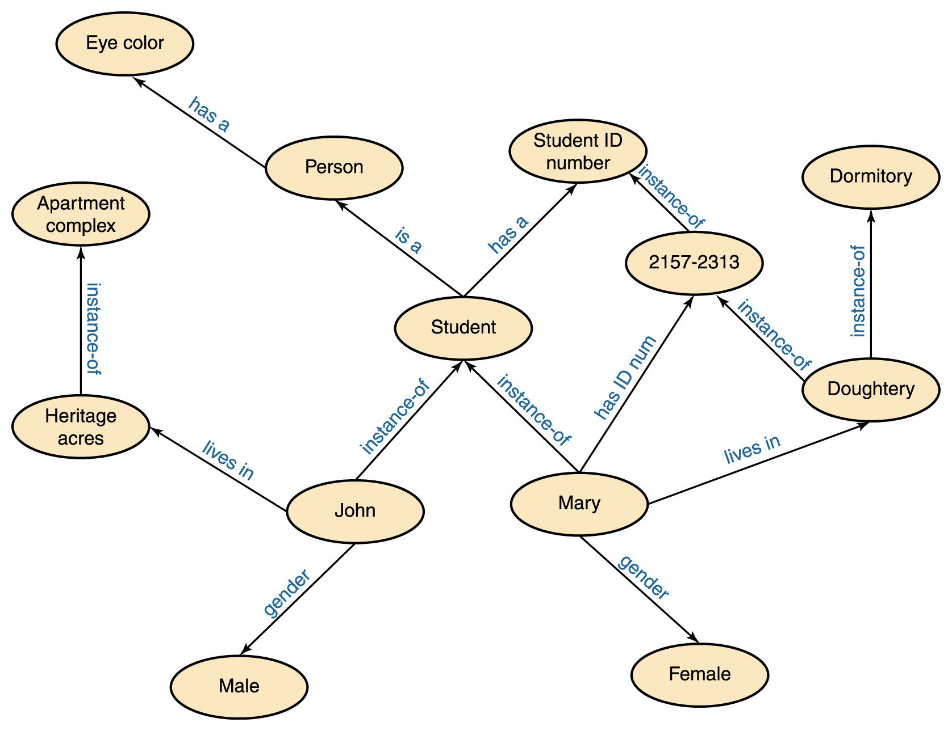
Introduction to Semantic Networks
Knowledge is represented as a set of concepts that are connected by different relationships among them.
Nodes = Concepts
Arcs = Relationships
Graph = Semantic Network

Slide 6
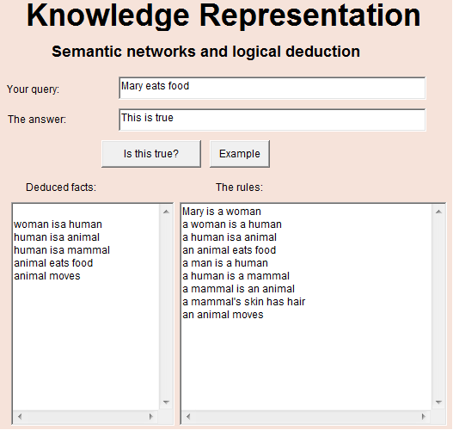
Building Semantic Networks
Food
eats
Animal
moves
Place
is-a
is-a
Mammal
is-a
has
Human
is-a
is-a
Skin
Man
Woman
has
instance-of
Hair
Mary

Slide 7
Inheritance and Instantiation
Instantiation – X is an INSTANCE of Y if X is a specific example of the general concept Y.
Eg – Mary is a Woman (Woman is a General Concept and Mary is an example of a Woman)
Inheritance – X ISA Y if X and Y both are general concepts and X is a subset of the more general concept Y.
Eg – Woman is a Human (Humans are consist of Men and Women and Woman is a subset of Human)

Slide 8
Close World and Open World Assumptions
Close World Assumption – What is not currently known to be true is false
Anything that is not in our Semantic Network is false.
Open World Assumption – Truth-value of a statement is independent of whether or not it is known by an observer to be true
Anything that is not in our Semantic Network, we cannot say that they are true or false.

Slide 9
Rule Patterns Supported by the Applet
noun isa noun
Eg – Mary is a woman
noun verb
Eg – Animal moves
noun verb object
Eg – Animal eats food
noun’s noun verb object

Slide 10
How Deduction Works - Woman eats food??
Rules We Have
R1 – woman isa human
R2 – human isa animal
R3 – animal eats food
Deduction
human isa animal (R2) and animal eats food (R3), therefore:
human eats food (I1)
woman isa human (R1) and human eats food (I1), therefore:
woman eats food (I2)

Slide 11
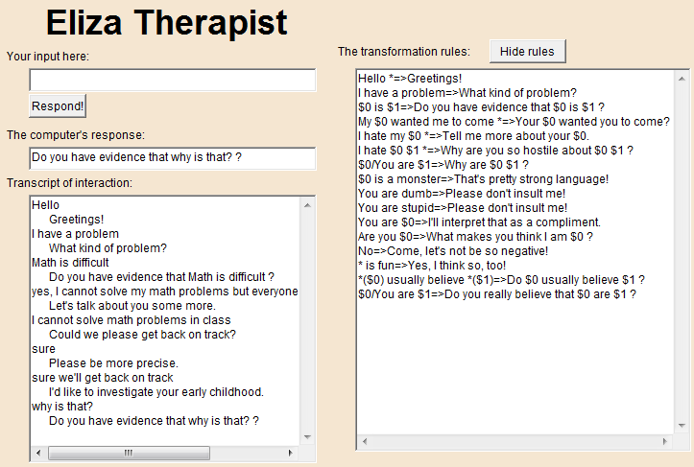
Eliza Therapist Applet
Read the rules
$ is used to define variables
Eg - $0 is the first variable
Variables are single words
* - More than one word

Slide 12
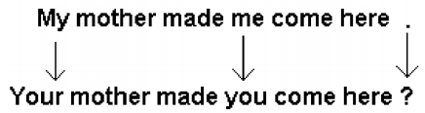
How Eliza Therapist Applet Works?
Eliza turns what you type into a question merely by appending a question mark to the statement and switching the pronouns, as shown below:
What would you do if you want to use a variable to replace mother? How would Eliza turns it to a question?

Slide 13
Writing Rules for Eliza Therapist
Rules takes the form pattern=>response
Eg.1 – I have a problem=>What kind of problem?
Eg.2 – I hate my $0 *=>Tell me more about your $0.
Variables can appear in pattern part and response part both (See Eg.2)
To match more than one word for a variable, surround the variable with an asterisk and parentheses *($0)=>$0 ?
Eg.3 – *($0) usually believe *($1)=>Do $0 usually believe $1 ?

Slide 14
Writing Rules for Eliza Therapist Cont.
Forbid the matching of some words, use / with variable
Eg – $0/You are $1=>Do you really believe that $0 are $1 ? This rule tries to match a sentence that has “are” as the second word, but the first word cannot be You.
Limitations of Eliza Therapist Applet Program
Doesn’t know about English grammar rules
Cannot recognize uppercase and lowercase words as essentially the same word

Slide 15
Additional Help
Artificial Intelligence (Chapter 13) Slides by Ms. Karen Meyer discussed in Class
Chapter 13 of Course Text Book – Artificial Intelligence

Slide 16
Questions ?
If you have questions, please raise your hand, Colin or myself will come to help you

