Slide 1
CS 1150 – Lab #16A & 16B – HTML
TA – Sanjaya Wijeratne
E-mail – wijeratne.2@wright.edu
Web Page - http://knoesis.org/researchers/sanjaya/

Slide 2
TA Labs, Office Hours Laboratory Polices
Lab Hours
2:30 PM - 4:20 PM, Monday and Friday at Room 320 - Oelman Hall
TA Office Hours
4:40 PM - 5:40 PM, Monday and Friday at Room 316 - Russ Engineer Center
By appointment – Please email to wijeratne.2@wright.edu
Refer to CS 1150 Course Syllabus for Class and Laboratory Policies
Zero tolerance policy for Academic Misconduct – All parties will get 0% marks

Slide 3
Lab # 16 Overview
Learn some basic HTML concepts
Make simple web pages with links and images
Answer all questions in Lab 16A Exercises 1 and Lab 16B Exercise 1 to Exercise 5
Lab #16 Due Date - Dec 03, 2013 12:30 PM

Slide 4
How to Submit Lab 16
Use Pilot Page for this Weeks’s Submission
Go to Pilot Course Page and Use Dropbox Submission Link to upload your files
Also upload all your files to wright state web server – Steps on how to do this is described at the end of the slideshow
You need to upload your work to Pilot and to University Web server to receive credit

Slide 5
Introduction to HTML
Markup language to create Web pages
First introduced by Sir Tim Berners-Lee and developed and maintained by World Wide Web Consortium
Based on Tags. Eg – <h1></h1>, <br />, <img />
Some tags have closing tags but some don’t. Tags have attributes too. Eg – <img src=“mypic.jpg” />

Slide 6
Writing Your First HTML Web Page
HTML Code
<html>
<head>
<title>My Web Page</title>
</head>
<body>
<h1>Hello World</h1>
<p>
Hi, this is Sanjaya, Welcome to my Web page!!!
</p>
</body>
</html>
HTML Header Tag
Title Tag
Heading Style 1
HTML Body
Paragraph Tag

Slide 7
HTML Heading Styles
There are 6 different heading styles in HTML from H1 to H6
Also note that the header section is optional in HTML
<html>
<body>
<h1>Hello World</h1>
<h2>Hello World</h2>
<h3>Hello World</h3>
<h4>Hello World</h4>
<h5>Hello World</h5>
<h6>Hello World</h6>
</body>
</html>

Slide 8
HTML – Simple Text Formatting
<html>
<body>
<p align="justify">
<b>This text is in bold face</b> while
<i>this text is italicized.</i>
</p>
</body>
</html>

Slide 9
HTML Lists – Ordered Lists
There are two types of lists
Ordered
Unordered
<html>
<body>
<h3>My Favorite Bands</h3>
<ol>
<li>Lamb of God</li>
<li>Linkin Park</li>
<li>Hoobastank</li>
</ol>
</body>
</html>

Slide 10
HTML Lists – Un-ordered Lists
There are two types of lists
Ordered
Unordered
<html>
<body>
<h3>My Favorite Bands</h3>
<ul>
<li>Lamb of God</li>
<li>Linkin Park</li>
<li>Hoobastank</li>
</ul>
</body>
</html>

Slide 11
Adding an Image to Your Web Page
<html>
<body>
<h2>My Pic</h2>
<img src="sanjaya.jpg" />
<!-- change sanjaya.jpg with your image file name -->
</body>
</html>

Slide 12
Creating Links to Other Web Pages
<html>
<body>
<h2>Link to My Real Home Page</h2>
My real home page is
<a href="http://knoesis.org/researchers/sanjaya/">here</a>.
</body>
</html>

Slide 13
Uploading Your Web Page to Web Server
Please read the PDF document first. Everything you need to know to upload your Web page to the university Web server is very well explained there
http://www.wright.edu/cats/docs/web/personal_website.pdf

Slide 14
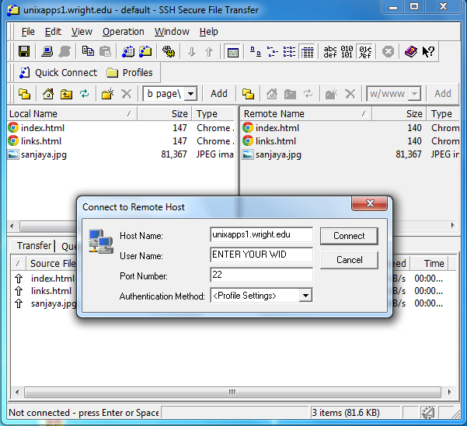
Uploading Your Web Page to Web Server Cont.
Open SSH Secure File Transfer Client Program
Click Quick Connect
Host Name – unixapps1.wright.edu
User Name – Your WID
Click Connect

Slide 15
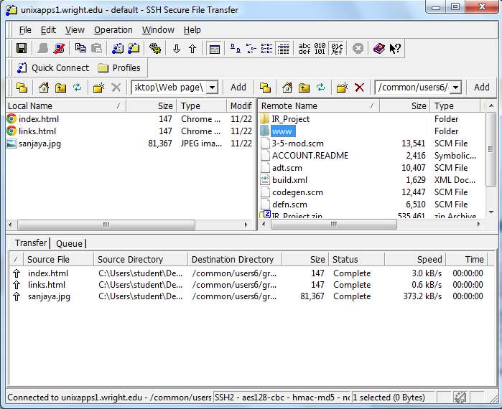
Uploading Your Web Page to Web Server Cont.
Go to the place where you saved your HTML file (image, index.htm, links.htm etc.) using left pane
Double click on www directory in the right pane
Drag and Drop your files from left pane to right pane

Slide 16
Access your Web Page on the Web
Type the following URL into your Web browser after uploading your HTML files to www directory as described in the earlier slides http://www.wright.edu/~your_email_name/
My e-mail is wijeratne.2@wright.edu so this is how I access my web page http://www.wright.edu/~wijeratne.2/

Slide 17
Additional Help
The WWW and HTML Programming (Chapter 16) Slides by Ms. Karen Meyer discussed in Class
Chapter 16 of Course Text Book – The World Wide Web

Slide 18
Questions ?
If you have questions, please raise your hand, Colin or myself will come to help you

