Slide 1
CS 1150 – Lab #8 – Using Algorithms for Painting
TA – Sanjaya Wijeratne
E-mail – wijeratne.2@wright.edu
Web Page - http://knoesis.org/researchers/sanjaya/

Slide 2
TA Labs, Office Hours Laboratory Polices
Lab Hours
2:30 PM - 4:20 PM, Monday and Friday at Room 320 - Oelman Hall
TA Office Hours
4:40 PM - 5:40 PM, Monday and Friday at Room 316 - Russ Engineer Center
By appointment – Please email to wijeratne.2@wright.edu
Refer to CS 1150 Course Syllabus for Class and Laboratory Policies
Zero tolerance policy for Academic Misconduct – All parties will get 0% marks

Slide 3
Lab # 8 Overview
Learn How to use Palgo and Palgo Programming
Do Activities and Complete Exercises 1, 2, 3 and 4
Write a Top-down Design for Sorting a list of Names into Alphabetical Order
Lab #8 Due Date - Oct 14, 2013 11:55 AM

Slide 4
How to Submit Lab # 8
Hard copy (Preferred)
When you complete, hand it over to me
Pilot
Go to Pilot Course Page and Use Dropbox Submission Link to upload your files
My Mailbox at CS Department
Go to CS Department Front Desk and ask them to put your assignment into my mailbox – Please write my name on your assignment (TA – CS 1150 – Sanjaya Wijeratne)

Slide 5
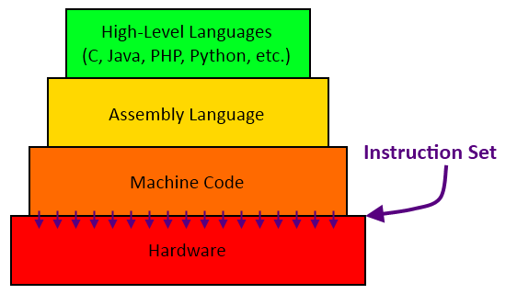
Programming – Why We Need it?
Human Communication VS Machine Communication
int x = a + b
MOV ax, opr1
ADD ax, bx
000000 00001 00010 00110 00000 100000
Logic Gates – AND, OR, XOR, NOT
Source – http://trycatch22.com/blog/the-computer-architecture-analogy-part-4-assembly-programming/

Slide 6
Palgo Applet’s Programming Language
Uses special keyword constructs – Eg – color, goto, pen down, repeat times, end etc.
Those have special meanings
Syntax of the program should be correct to run it without errors
Special constructs to define functions (not covered) and loops

Slide 7
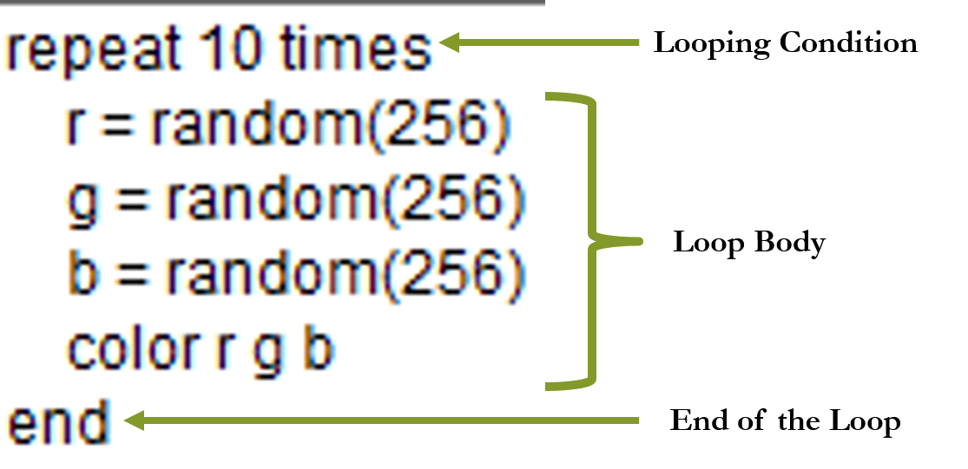
Palgo Applet’s Language – Loop Instructions

Slide 8
Exercise 1 Corrections
Question 2 – Section (b)
Draw a line from 7,2 to 17,2
Question 2 – Section (d)
Draw a vertical line starting at 7,2
NOTE – In all Coordinates, the Column is listed first, then the Row

Slide 9
Exercise 1 Help – Commands to Use
Read page 104 in Lab 8
color – Changes the Color of the Pen. Eg – color “red”
pen down – Starts coloring squares with color selected
goto – Moves the Pen to a Cell (Jumps to a Cell). Eg – goto 1 19
up/down/left/right – Moves the Pen X number of cells in the given direction. Eg – up 20

Slide 10
Exercise 2 Help – Commands to Use
Read page 105 – 107 in Lab 8
Open Example 4 – Squares and alter it
x = 5 – Setting variable x’s value to 5
random(256) – Select a random value from 1 to 256. Eg – r = random(256)
x = x + 1 – Add 1 to variable x

Slide 11
Exercise 2 Help – Commands to Use Cont.
repeat 3 times – A loop that executes the statements in its body 3 times
end – Stops the loop
square(x) – Invoke square function using variable x. random(256) was also a function, we invoked it with the value 256 instead of a variable.

Slide 12
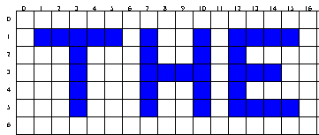
Exercise 3 Help
Start the letter T at coordinate 1,1 Start the letter H at coordinate 7,1 and Start the letter E at coordinate 12,1
Commands to Use – color, pen down, goto, up/down/left/right

Slide 13
Exercise 4 Help
Question 7 – If you stand 10 – 15 feet away from your computer, the ragged line would look more like a straight line.
Omit Question 8
Write a Top-down Design for Sorting a list of Names into Alphabetical Order

Slide 14
Additional Help
Chapter 7 – Problem Solving and Algorithms Slides by Ms. Karen Meyer discussed in Class
Chapter 7 of Course Text Book – Problem Solving and Algorithms

Slide 15
Questions ?
If you have questions, please raise your hand, Colin or myself will come to help you

