Slide 1
CS 1150 – Lab #4 – Logic Circuits
TA – Sanjaya Wijeratne
E-mail – wijeratne.2@wright.edu
Web Page - http://knoesis.org/researchers/sanjaya/

Slide 2
TA Labs, Office Hours Laboratory Polices
Lab Hours
2:30 PM - 4:20 PM, Monday and Friday at Room 320 - Oelman Hall
TA Office Hours
4:40 PM - 5:40 PM, Monday and Friday at Room 316 - Russ Engineer Center
By appointment – Please email to wijeratne.2@wright.edu
Refer to CS 1150 Course Syllabus for Class and Laboratory Policies
Zero tolerance policy for Academic Misconduct – All parties will get 0% marks

Slide 3
Lab # 4 Overview
Learn the Basic Logic Gates
NOT, AND, OR, XOR
Truth Values
Build Simple Circuits suing Basic Logic Gates
Complete Exercises 1, 2 and 4
Lab #4 Due Date - Sep 29, 2013 11:55 PM

Slide 4
How to Submit Lab # 4
Hard copy (Preferred)
When you complete, hand it over to me
Pilot
Go to Pilot Course Page and Use Dropbox Submission Link to upload your files
My Mailbox at CS Department
Go to CS Department Front Desk and ask them to put your assignment into my mailbox – Please write my name on your assignment (TA – CS 1150 – Sanjaya Wijeratne)

Slide 5
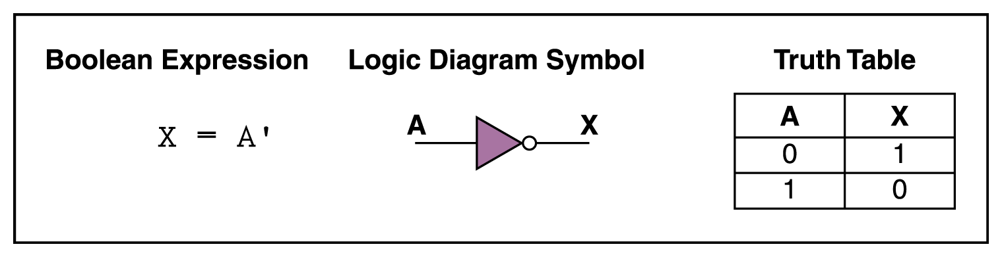
NOT Gate
Takes an Input (0 or 1) and negate it
Source – CS 1150 Slides for Logic Circuits by Karen Mayer

Slide 6
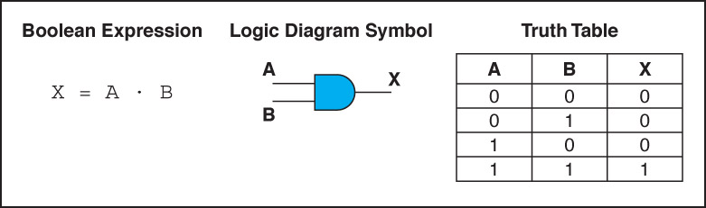
AND Gate
Accepts multiple inputs (0s and 1s) and returns true when all inputs are true, otherwise false
Eg – Job Application Requirement – Age 18+ AND US Citizen
Source – CS 1150 Slides for Logic Circuits by Karen Mayer

Slide 7
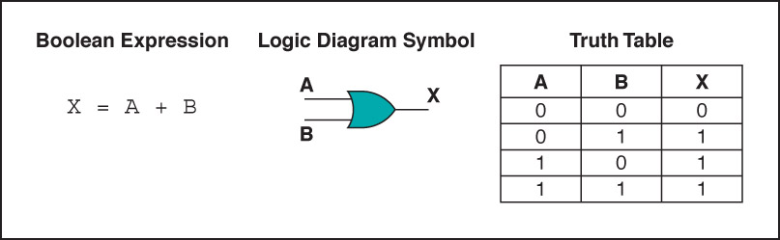
OR Gate
Accepts multiple inputs (0s and 1s) and returns true at lease one input is true, otherwise false
Eg – Alarm System – Sounds at lease one window/door is broken
Source – CS 1150 Slides for Logic Circuits by Karen Mayer

Slide 8
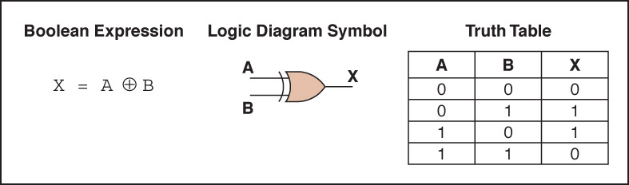
XOR Gate
Accepts multiple inputs (0s and 1s) and returns true if one and only one of the inputs is true, else false
Eg – Can be used to check variables are not equal
Source – CS 1150 Slides for Logic Circuits by Karen Mayer

Slide 9
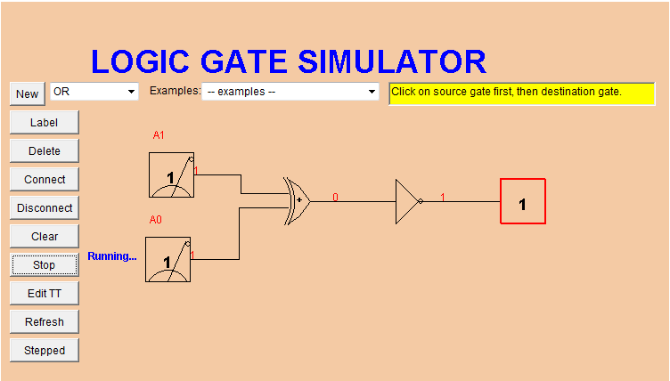
Lab #4 – Logic Gate Simulator Applet

Slide 10
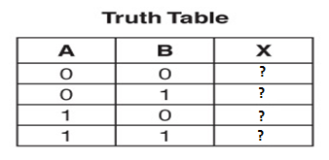
Lab #4 – Exercise 1 and 2 Help
Arrange the Gates and Connect Switches to the Gate and Output of the Gate to the Output Box
Write down truth values for all combinations
Take a Screenshot of the Circuit

Slide 11
Lab #4 – Exercise 4 Help
Think how many inputs you have
Think how many outputs you have
What are the input columns of the Truth Table?
What are the output columns of the Truth Table?

Slide 12
Additional Help
Chapter 4 Slides by Ms. Karen Meyer discussed in Class
Chapter 4 of Course Text Book – Gates and Circuits

Slide 13
Questions ?
If you have questions, please raise your hand, Colin or myself will come to help you

