Slide 1
CS 1150 – Lab #12B – Databases
TA – Sanjaya Wijeratne
E-mail – wijeratne.2@wright.edu
Web Page - http://knoesis.org/researchers/sanjaya/

Slide 2
TA Labs, Office Hours Laboratory Polices
Lab Hours
2:30 PM - 4:20 PM, Monday at Room 320 - Oelman Hall
TA Office Hours
4:45 PM - 5:45 PM, Monday at Room 316 - Russ Engineer Center
By appointment – Please email to wijeratne.2@wright.edu
Refer to CS 1150 Course Syllabus for Class and Laboratory Policies
Zero tolerance policy for Academic Misconduct – All parties will get 0% marks

Slide 3
Lab # 12B Overview
Write simple SQL queries using “Simple SQL” applet
Answer all questions in Exercises 1, 2, 3 and answer up to 8th question in Exercise 4.
Lab #12B Due Date - Mar 31, 2013 11:55 AM

Slide 4
How to Submit Lab #12B
Hard copy (Preferred)
When you complete, hand it over to me
Pilot
Go to Pilot Course Page and Use Dropbox Submission Link to upload your files
My Mailbox at CS Department
Go to CS Department Front Desk and ask them to put your assignment in my mailbox – Please write my name on your assignment (TA – CS 1150 – Sanjaya Wijeratne)

Slide 5
Introduction to SQL
Standard language for accessing and manipulating databases.
What can we do with SQL?
Create new databases and tables
Execute queries against a database
Retrieve data from a database
Insert, update, delete records in a database and many more
Source – http://www.w3schools.com/sql/sql_intro.asp

Slide 6
SQL SELECT Statement
SQL select statement is used to extract data from a table
select Column_name_1, Column_name_2 from Table_name
MovieID | MovieName | Rating
1 | Gravity | PG-13
2 | Man of Steel | PG-13
3 | World War Z | PG-13
4 | The Hangover Part III | R
Question – Select all movie names from table Movie
Answer – select MovieName from Movie

Slide 7
SELECT all (*) Records
select * is used to extract all data from a table
select * from Table_name
MovieID | MovieName | Rating
1 | Gravity | PG-13
2 | Man of Steel | PG-13
3 | World War Z | PG-13
4 | The Hangover Part III | R
Question – Select all records (rows, tuples) from table Movie
Answer – select * from Movie

Slide 8
SELECT Statement with WHERE Clause
SQL where clause is used to extract only those records that fulfill a specified criterion.
select Column_name_1, Column_name_2 from Table_name where criteria
MovieID | MovieName | Rating
1 | Gravity | PG-13
2 | Man of Steel | PG-13
3 | World War Z | PG-13
4 | The Hangover Part III | R
Question – Select all movie names with a PG-13 Rating
Answer – select MovieName from Movie where Rating = “PG-13”

Slide 9
SELECT Records from Multiple Tables
Often you will need more than one table to query at once
MovieID | MovieName | Rating
1 | Gravity | PG-13
2 | Man of Steel | PG-13
3 | World War Z | PG-13
4 | The Hangover Part III | R
DirectorID | MovieID | DirectorName
101 | 1 | Alfonso Cuarón
102 | 2 | Zack Snyder
103 | 3 | Marc Forster
104 | 4 | Todd Phillips
Question – Select movie names and their directors

Slide 10
SELECT Records from Multiple Tables Cont.
select Table_name_1.Column_name_1, Table_name_2.Column_name_2 from Table_name_1, Table_name_2 where criteria
MovieID | MovieName | Rating | DirectorID | DirectorName
1 | Gravity | PG-13 | 101 | Alfonso Cuarón
2 | Man of Steel | PG-13 | 102 | Zack Snyder
3 | World War Z | PG-13 | 103 | Marc Forster
4 | The Hangover Part III | R | 104 | Todd Phillips
Answer – select Movie.MovieName, Director.DirectorName from Movie, Director where Movie.MovieID = Director.MovieID

Slide 11
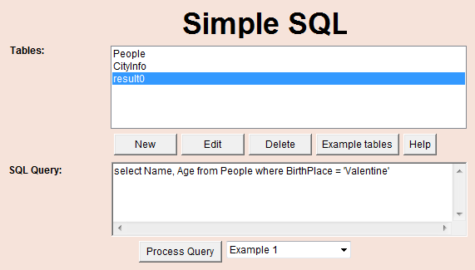
Simple SQL Applet

Slide 12
Additional Help
Database Slides by Mr. Chris Fickert discussed in Class
Chapter 12 of Course Text Book – Information Systems

Slide 13
Questions ?
If you have questions, please raise your hand, Colin or I will come to help you

