Slide 1
CS 1150 – Lab #3 – Representing Numbers
TA – Sanjaya Wijeratne
E-mail – wijeratne.2@wright.edu
Web Page - http://knoesis.org/researchers/sanjaya/

Slide 2
TA Labs, Office Hours Laboratory Polices
Lab Hours
2:30 PM - 4:20 PM, Monday at Room 320 - Oelman Hall
TA Office Hours
4:45 PM - 5:45 PM, Monday at Room 316 - Russ Engineer Center
By appointment – Please email to wijeratne.2@wright.edu
Refer to CS 1150 Course Syllabus for Class and Laboratory Policies
Zero tolerance policy for Academic Misconduct – All parties will get 0% marks

Slide 3
Lab #3 Overview
Learn How Negative Numbers are Represented in Computers
Sign-Magnitude and Two’s Complement Representations
Learn How Colors and Text are Represented in Computers
Complete Section 3A – Ex 1, Section 3B – Ex 1 and Ex 3
Lab #3 Due Date - Feb 10, 2014 11:55 AM

Slide 4
How to Submit Lab #3
Hard copy (Preferred)
When you complete, hand it over to me
Pilot
Go to Pilot Course Page and Use Dropbox Submission Link to upload your files
My Mailbox at CS Department
Go to CS Department Front Desk and ask them to put your assignment in my mailbox. – Please write my name on your assignment (TA – CS 1150 – Sanjaya Wijeratne)

Slide 5
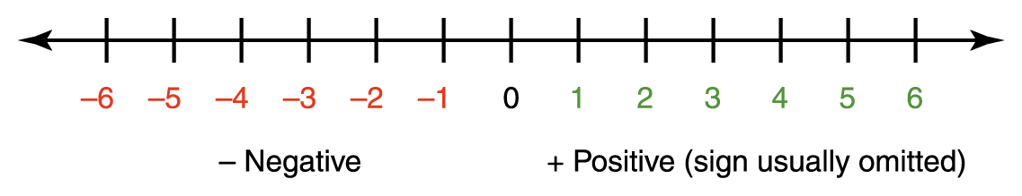
Sign-Magnitude Representation
Sign-Magnitude Representation
Sign – Ordering of the number (Positive or Negative)
Value – Magnitude
Source – Chapter 3 by Chris Fickert

Slide 6
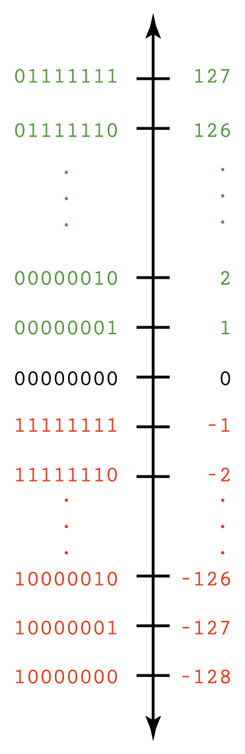
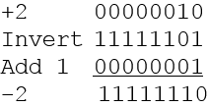
Two’s Complement
MSB Represents the Sign
Negative – MSB is 1
Convert numbers to Two’s Complement
Invert the bits and add 1
Source – Chapter 3 by Chris Fickert

Slide 7
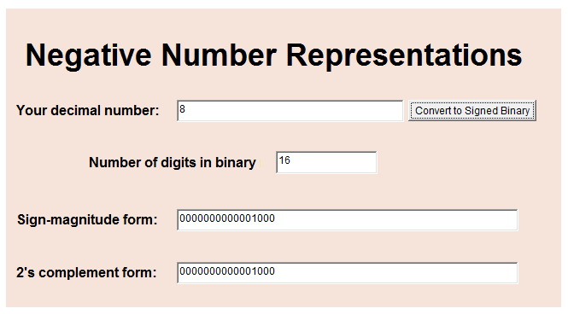
Lab #3 – Section 3A
Run Negative Binary Numbers Applet

Slide 8
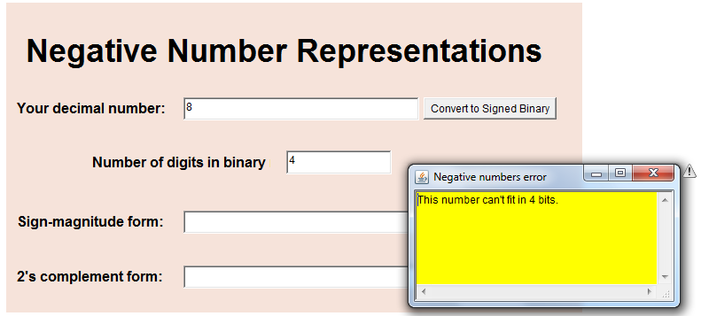
Lab #3 – Section 3A Ex 1 Question 9

Slide 9
Representing Text
ASCII Character Set
7 bits to represent a character + 1 check bit
First 32 ASCII characters are special purposes – Eg Tab, Return
Unicode Character Set
16 bits to represent a character
Can represent every character in every language in the world
8 Bits = 1 Byte

Slide 10
Lab #3 – Section 3B Ex 1 Question 6
Think about the relationship you found between upper case letters and lower case letters in question 5
Assume you have to write an applet
What would be the input to your applet program?
What would be the output you show to the user?
Now try to answer question #6

Slide 11
Additional Help
Chapter 3 Slides by Mr. Chris Fickert discussed in Class
Chapter 3 of Course Text Book – Data Representation

Slide 12
Questions ?
If you have questions, please raise your hand, Colin or I will come to help you

