Slide 1









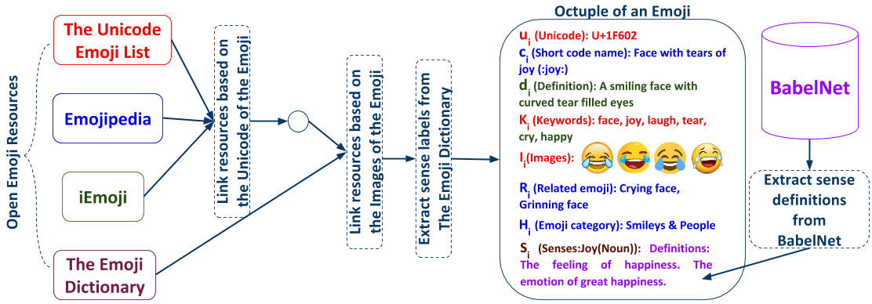
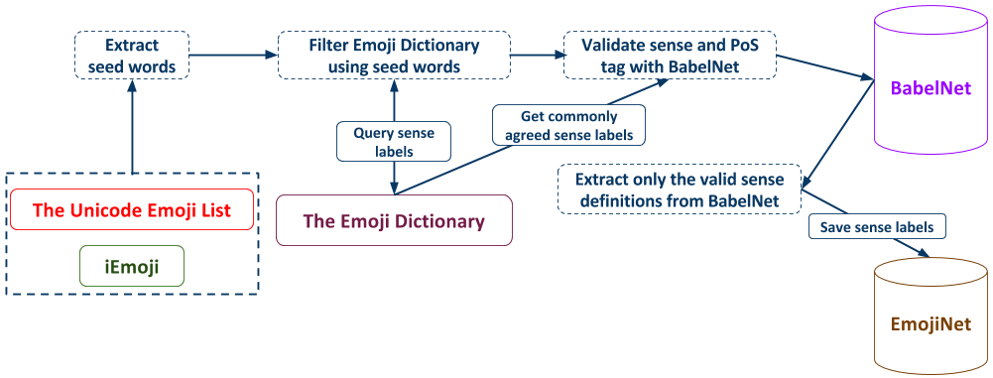
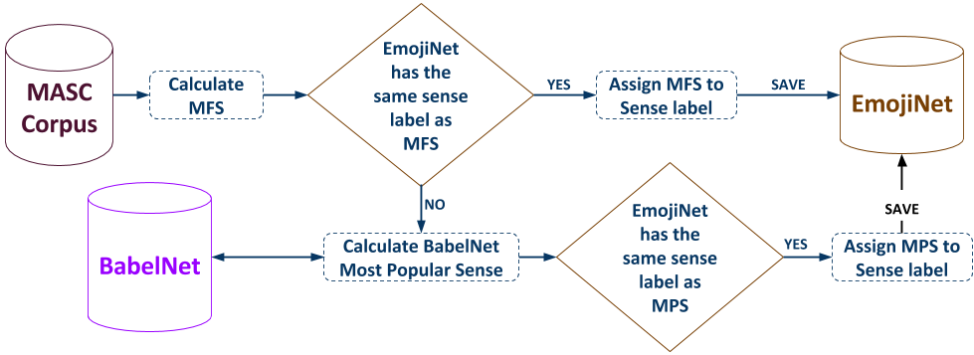



EmojiNet: A Machine Readable Emoji Sense Inventory
Sanjaya Wijeratne, Lakshika Balasuriya, Amit Sheth, Derek Doran
Ohio Center of Excellence in Knowledge-enabled Computing (Kno.e.sis), Wright State University, Dayton OH, USA
{sanjaya, lakshika, amit, derek}@knoesis.org
Motivation
Real World Examples
Emoji symbols take on different meanings based on the context of a message as no rigid semantics are attached to emoji by design.
Hence, for machines to understand emoji, a machine readable sense inventory that lists different emoji senses is needed.
EmojiNet is a machine readable sense inventory which enables this.
Laugh(N) | Can’t stop laughing | Anger(N) | Angry as hell | Costly(A) | Can't buy class la
Happy(N) | Got all A’s but 1 | Shot(N) | Oooooooh shots fired! | Work Hard(N) | Up early on the grind
Funny(A) | That was damn hilarious! | Kill(V) | He tried to kill one of my brothers | Money(N) | Earn money when one register /w ur link
Approach
Evaluation
For each emoji e_{i} in EmojiNet, it records the octuple e_{i} = (u_{i} c_{i} d_{i} K_{i} I_{i} R_{i} H_{i} S_{i}), where u_{i} is the Unicode of e_{i}, c_{i} is the short code name of e_{i}, d_{i} is the description of e_{i}, K_{i} is the set of keywords of e_{i}, I_{i} is the set of images of e_{i}, R_{i} is the set of related emoji of e_{i}, H_{i} is the set of categories of e_{i}, S_{i} is the set of emoji senses of e_{i}.
The Emoji Dictionary was merged with other open resources by matching the images in The Emoji Dictionary with images found in other resources. A nearest neighborhood-based image processing algorithm was used for this task and its accuracy was 98.42%.
Two Word Sense Disambiguation (WSD) algorithms based on the Most Frequent Sense (MFS) and the Most Popular Sense (MPS) were used to assign meaning to emoji senses extracted from The Emoji Dictionary. Their combined WSD accuracy was 85.18%.
Emoji Resource | u | c | d | K | I | R | H | S
Unicode Website | ✓ | ✓ | ✗ | ✓ | ✓ | ✗ | ✗ | ✗
Emojipedia | ✓ | ✓ | ✓ | ✗ | ✓ | ✓ | ✓ | ✗
iEmoji | ✓ | ✓ | ✓ | ✓ | ✓ | ✗ | ✓ | ✗
Emoji Dictionary | ✗ | ✗ | ✗ | ✗ | ✓ | ✗ | ✗ | ✓
Table 1 – Emoji Data Available in Open Resources
Step 1 – Extract Data from Open Web Resources and Integrate them based on Unicode Character and Image Representations
 | Correct | Incorrect | Total
Noun | 1,271 (83.28%) | 255 (16.71%) | 1,526
Verb | 735 (84.00%) | 140 (16.00%) | 875
Adjective | 725 (90.06%) | 80 (9.93%) | 805
Total | 2,731 (85.1 8%) | 475 (14.81%) | 3,206
Emoji Resource | u | c | d | K | I | R | H | S
# of Emoji with each Feature | 1,074 | 845 | 1,074 | 1,074 | 1,074 | 1,002 | 705 | 875
# of Records Stored for each Feature | 1,074 | 845 | 1,074 | 8,069 | 28,370 | 9,743 | 8 | 3,206
Step 2 – Filter Senses and Part-of-Speech for each Emoji Sense to Populate EmojiNet
Step 3 – Perform Word Sense Disambiguation to Assign Meanings to Emoji Senses
Table 2 –Word Sense Disambiguation Statistics
Table 3 – EmojiNet Statistics
EmojiNet at Work
Future Work
Expand EmojiNet sense deﬁnitions with words extracted from tweets, using a word embeddings model trained on tweets with emoji.
Evaluate the usability of EmojiNet using Emoji Sense Disambiguation and Emoji Similarity Finding tasks and expose EmojiNet as a web service. EmojiNet demo is available at http://emojinet.knoesis.org/
Let’s disambiguate the sense of the emoji in the tweets T1 and T2, where T1:Pray for my family God gained an angel today and T2: Hard to win, but we did it man Lets celebrate. EmojiNet lists two senses for and they are pray(V) and highfive(N). We extract words from sense definitions available in EmojiNet for the above two senses. They are: highfive(N) – {palm, high, hand, slide, celebrate, raise, person, head, five} and pray(V) – {worship, thanksgiving, saint, pray, higher, god, confession}. We then calculate the overlap of the words in tweets with the words extracted from the sense definitions in EmojiNet. This leads us to decide that the emoji in T1 refers to pray(V) and the emoji in T2 refers to highfive(N).
Reference – Sanjaya Wijeratne, Lakshika Balasuriya, Amit Sheth, Derek Doran. EmojiNet: Building a Machine Readable Sense Inventory for Emoji. In 8th International Conference on Social Informatics (SocInfo 2016). Bellevue, WA, USA.
Acknowledgement – We acknowledge partial support from NIDA Grant No. 5R01DA039454-02: “Trending: Social Media Analysis to Monitor Cannabis and Synthetic Cannabinoid Use”, NIH Award: MH105384-01A1: “Modeling Social Behavior for Healthcare Utilization in Depression”, and Grant No. 2014-PS-PSN-00006 awarded by the Bureau of Justice Assistance.
Link to Paper
Link to Demo

