Slide 1





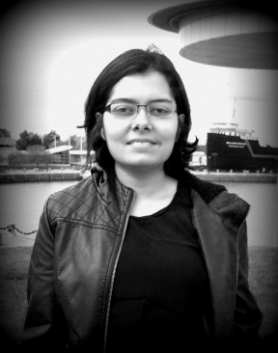
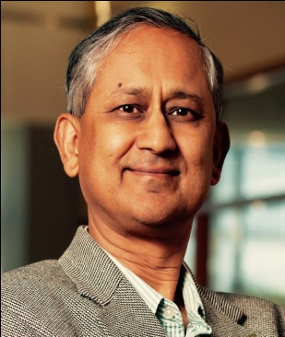
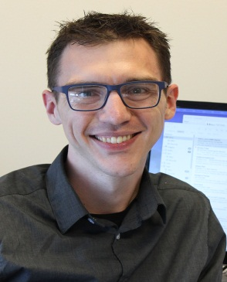


EmojiNet: Building a Machine Readable Sense Inventory for Emoji
Presented at the 8th International Conference on Social Informatics (SocInfo 2016)
Bellevue, WA, USA, 14th – 17th November, 2016
Sanjaya Wijeratne
sanjaya@knoesis.org
Lakshika Balasuriya
lakshika@knoesis.org
Amit Sheth
amit@knoesis.org
Derek Doran
derek@knoesis.org
Ohio Center of Excellence in Knowledge-enabled Computing (Kno.e.sis)
Wright State University, Dayton, OH, USA

Slide 2








What are Emoji
Emoji are pictographs
Invented by Shigetaka Kurita in late 1990s
Emoji are extremely popular
6B messages exchanged per day contain emoji¹
Face with tears of joy was the word of the year in 2015
Eggplant emoji was the most notable emoji in 2015
Businesses extensively use emoji in their applications
777% increase of emoji use in marketing campaigns²
20% month over month increase in 2016²
¹Swift Key Report – http://bit.ly/2c5biPU ²Appboy Blog – https://www.appboy.com/blog/emojis-used-in-777-more-campaigns/

Slide 3







Emoji Usage in Social Media
People use emoji to:
Add color and whimsiness to their messages
To maintain conversational connections in a playful manner [Kelly, 2015]
To replace emoticons [Pavalanathan, 2016]
Emoji are being used as a new language
Emoji were deﬁned with no rigid semantics, hence people assign meanings to them
Celebration hands are often used as prayer hands
Punching hand is often used to fist bump someone

Slide 4
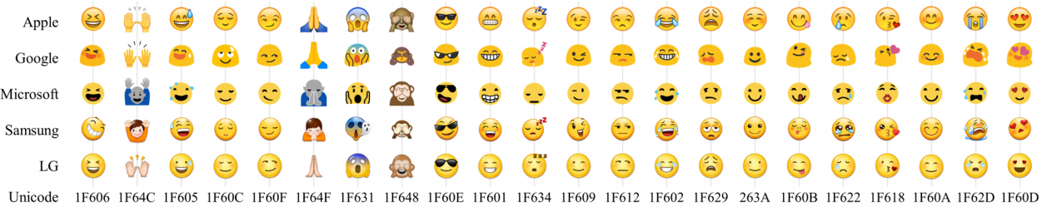
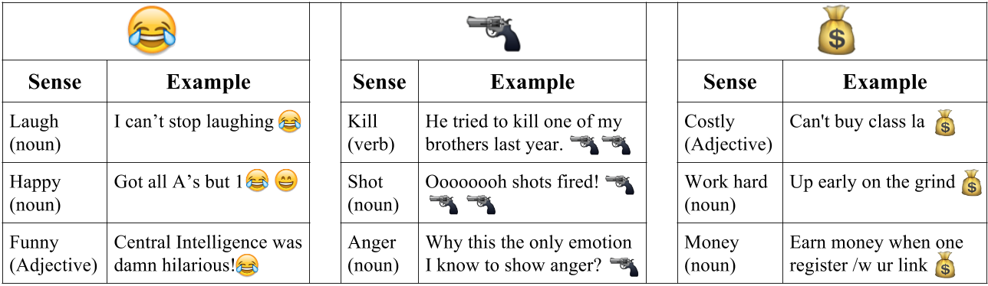


Ambiguity in Emoji
Ambiguity in emoji occurs due to two reasons
Differences in rendering platforms [Miller, 2016]
People have assigned different meanings to emoji
Image Source – [Miller, 2016]

Slide 5


Disambiguating Emoji Senses
Emoji Sense Disambiguation requires:
A machine readable dictionary of emoji meanings
Algorithms for emoji sense disambiguation
Our contributions:
EmojiNet: A machine readable emoji sense inventory
Integrates four emoji resources on the web
Assigns sense definitions to emojis
Provides a web resource that is openly available at http://emojinet.knoesis.org

Slide 6


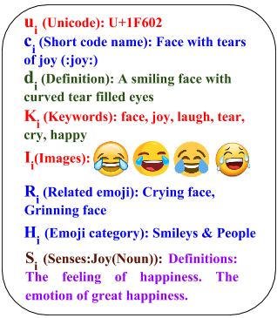

Building EmojiNet
Representing an Emoji (e_{i})
u_{i} – Unicode character
c_{i} – Short code name
d_{i} – Emoji definition
K_{i} – Set of keywords
I_{i} – Set of images
R_{i} – Set of related emoji
H_{i} – Set of categories
S_{i} – Set of senses with definitions

Slide 7
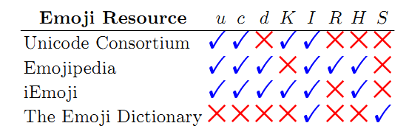

Building EmojiNet Cont.
Different emoji resources on the web carries valuable information that can complement each other when they are combined
Unicode.org and The Emoji Dictionary are integrated based on the images of the emoji, and the rest are integrated on the Unicode of emoji

Slide 8
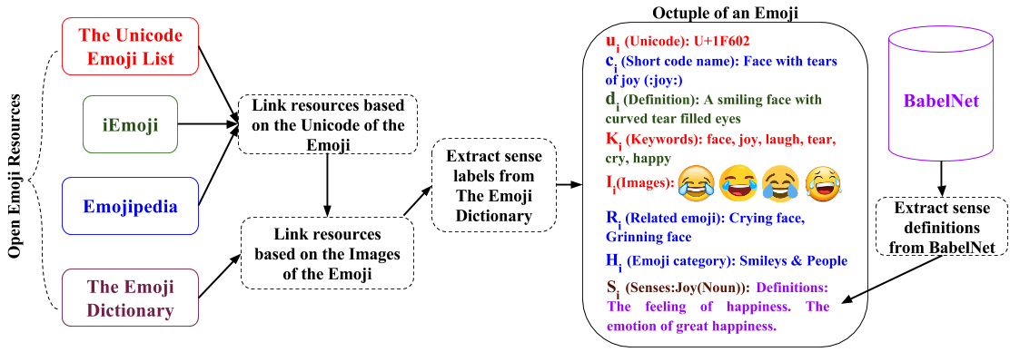
Building EmojiNet Cont.
Steps involved in building EmojiNet

Slide 9

Integrating The Emoji Dictionary
A nearest neighborhood-based image processing algorithm was used to integrate Unicode.org with The Emoji Dictionary
Two images sets were used:
13,387 images downloaded from Unicode.org representing 1,791 emoji
1,074 images downloaded from The Emoji Dictionary representing 1,074 emoji
We use color intensities of each image to compute similarities between the images

Slide 10

Integrating The Emoji Dictionary Cont.
Image processing algorithm in simple steps:
Re-size each image to 300 X 300 pixels and divide each image to 25 non-overlapping regions of size 25 X 25 pixels
Find average color intensity of each region by averaging R, G and B pixel color values
Compare the color intensities of corresponding image regions and calculate the dissimilarity between the images using L2 distance
Select the least dissimilar image as the match

Slide 11




Evaluation – Image Processing
The image processing algorithm achieved 98.42% accuracy when evaluated manually
Only 17 images were labeled incorrectly from 1,074 instances we checked
Error analysis revealed that the algorithm fails when the two compared images represent two different objects but similar in color
Eg. – Clocks with arms displaying different times, Flags with slight changes

Slide 12
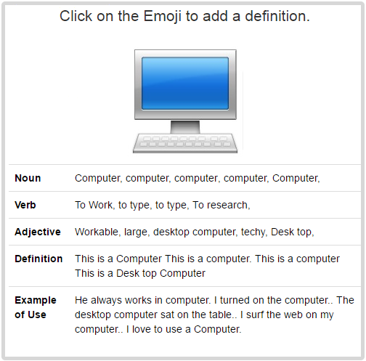
Sense Labels in The Emoji Dictionary
Emoji Definitions from The Emoji Dictionary Website

Slide 13
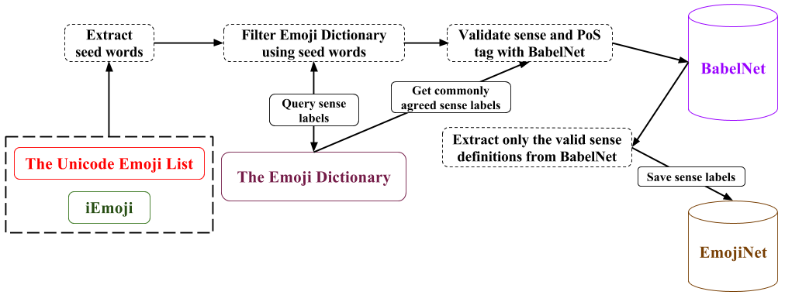
Extracting Sense Labels
Joy(N), laugh(N), tear(N), cry(V), happy(A), funny(A)
Joy(N), laugh(N), tear(N), cry(V), happy(A), funny(V), funny(A)
face, joy, laugh, tear, cry, happy
Extracting Sense Labels from The Emoji Dictionary

Slide 14
Assigning BabelNet Sense IDs
A sense label can have multiple BabelNet sense definitions
Eg. – Laugh(Noun) has 6 BabelNet senses
We use Manually Annotated Sub Corpus (MASC) to assign the correct sense
Words in MASC is already sense disambiguated
We use MASC-based Most Frequent Sense (MFS) baseline to assign senses to sense labels
When MFS fails, we use a Most Popular Sense (MPS) based on BabelNet

Slide 15
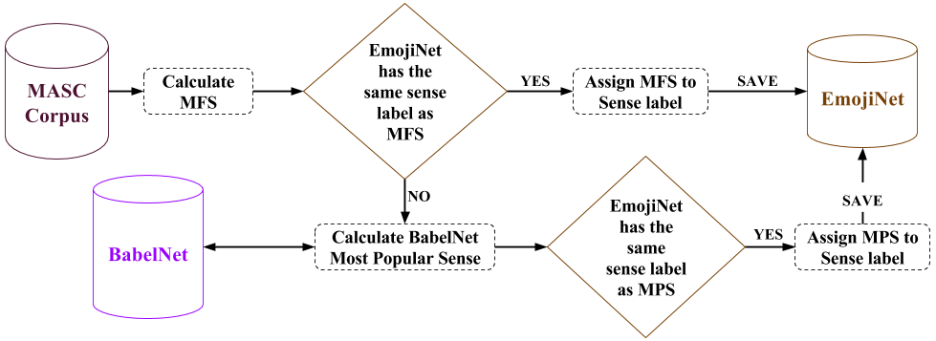
Assigning BabelNet Sense IDs Cont.
Is Laugh(N) in EmojiNet?
Laugh(N): bn:00050198n (5)
Laugh(N): bn:00050199n (3)
Laugh(N) = bn:00050198n
Gun(N): bn:00042221n (6)
Gun(N): bn:02379114n (1)
Gun(N) = bn:00042221n
Is Gun(N) in EmojiNet?
Assigning BabelNet SenseIDs to Sense Labels extracted from The Emoji Dictionary

Slide 16
Evaluation – Word Sense Disambiguation
Most Frequent Sense Baseline Results
# of total sense labels | 3,206
# of disambiguated sense labels using MFS method | 2,293
# of correctly disambiguated sense labels | 2,031
# of incorrectly disambiguated sense labels | 262
Accuracy of MFS-baseline method | 88.57%
Most Popular Sense Baseline Results
# of total sense labels | 3,206
# of disambiguated sense labels using MPS method | 913
# of correctly disambiguated sense labels | 700
# of incorrectly disambiguated sense labels | 213
Accuracy of MFS-baseline method | 76.67%

Slide 17
Evaluation – Word Sense Disambiguation Cont.
 | Correct | Incorrect | Total
Nouns | 1,217 (83.28%) | 255 (16.71%) | 1,526
Verbs | 735 (84.00%) | 140 (16.00%) | 875
Adjectives | 725 (90.06%) | 80 (9.93%) | 805
Total | 2,731 (85.18%) | 475 (14.81%) | 3,206
Aggregated Word Sense Disambiguation Statistics

Slide 18
EmojiNet Statistics
EmojiNet Data Features | # of emoji with feature | Amount of data stored for the feature
u_{i} – Unicode character | 1,074 | 1,074
c_{i} – Short code name | 845 | 845
d_{i} – Emoji definition | 1,074 | 1,074
K_{i} – Set of keywords | 1,074 | 8,069
I_{i} – Set of images | 1,074 | 28,370
R_{i} – Set of related emoji | 1,074 | 9,743
H_{i} – Set of categories | 705 | 8
S_{i} – Set of senses with definitions | 875 | 3,206

Slide 19

EmojiNet at Work
T1 – Pray for my family God gained an angel today
T2 – Hard to win, but we did it man Lets celebrate!
Sense | Context words extracted from EmojiNet for each Sense
Pray (verb) | worship, thanksgiving, saint, pray, higher, god, confession
High five (noun) | Palm, high, hand, slide, celebrate, raise, person, head, five
We use the Simplified LESK algorithm which is based on the word overlap between the words in the sense definitions and tweets

Slide 20

Challenges and Future work
Extend EmojiNet sense definitions with words extracted from Tweets
Word embedding models trained on tweets with emoji
Evaluate the usability of EmojiNet
Emoji similarity and emoji sense disambiguation tasks
Applying EmojiNet for real world tasks
Sentiment analysis and Emoji understanding
Image Source – http://i.ytimg.com/vi/dqyYvIqjuFI/maxresdefault.jpg
Notes:
Image Source - http://i.ytimg.com/vi/dqyYvIqjuFI/maxresdefault.jpg

Slide 21







Connect with me
sanjaya@knoesis.org
@sanjrockz
http://bit.do/sanjaya
Image Source – http://www.pcb.its.dot.gov/standardstraining/mod08/ppt/m08ppt23.jpg
Notes:
Image Source - http://www.pcb.its.dot.gov/standardstraining/mod08/ppt/m08ppt23.jpg

Slide 22



Slide 23
References
[Kelly, 2015] Kelly, R., Watts, L.: Characterizing the inventive appropriation of emoji as relation-ally meaningful in mediated close personal relationships. Experiences of Technology Appropriation: Unanticipated Users, Usage, Circumstances, and Design (2015).
[Pavalanathan, 2016] Pavalanathan, Umashanthi, and Jacob Eisenstein. "Emoticons vs. emojis on Twitter: A causal inference approach." arXiv preprint arXiv:1510.08480 (2015).

Slide 24
References Cont.
[Miller, 2016] Miller, Hannah, Jacob Thebault-Spieker, Shuo Chang, Isaac Johnson, Loren Terveen, and Brent Hecht. “Blissfully happy” or “ready to fight”: Varying Interpretations of Emoji. ICWSM’16 (2016).
[Wijeratne, 2016] Sanjaya Wijeratne, Lakshika Balasuriya, Amit Sheth, Derek Doran. EmojiNet: Building a Machine Readable Sense Inventory for Emoji. In 8th International Conference on Social Informatics (SocInfo 2016). Bellevue, WA, USA; (2016).

