Slide 1










A Semantics-Based Measure of
Emoji Similarity
Presented at the 2017 IEEE/WIC/ACM International Conference on Web Intelligence (WI’17)
Leipzig, Germany, 23rd – 26th August, 2017.
Sanjaya Wijeratne
sanjaya@knoesis.org
Lakshika Balasuriya
lakshika@knoesis.org
Amit Sheth
amit@knoesis.org
Derek Doran
derek@knoesis.org
Ohio Center of Excellence in Knowledge-enabled Computing (Kno.e.sis)
Wright State University, Dayton, OH, USA

Slide 2
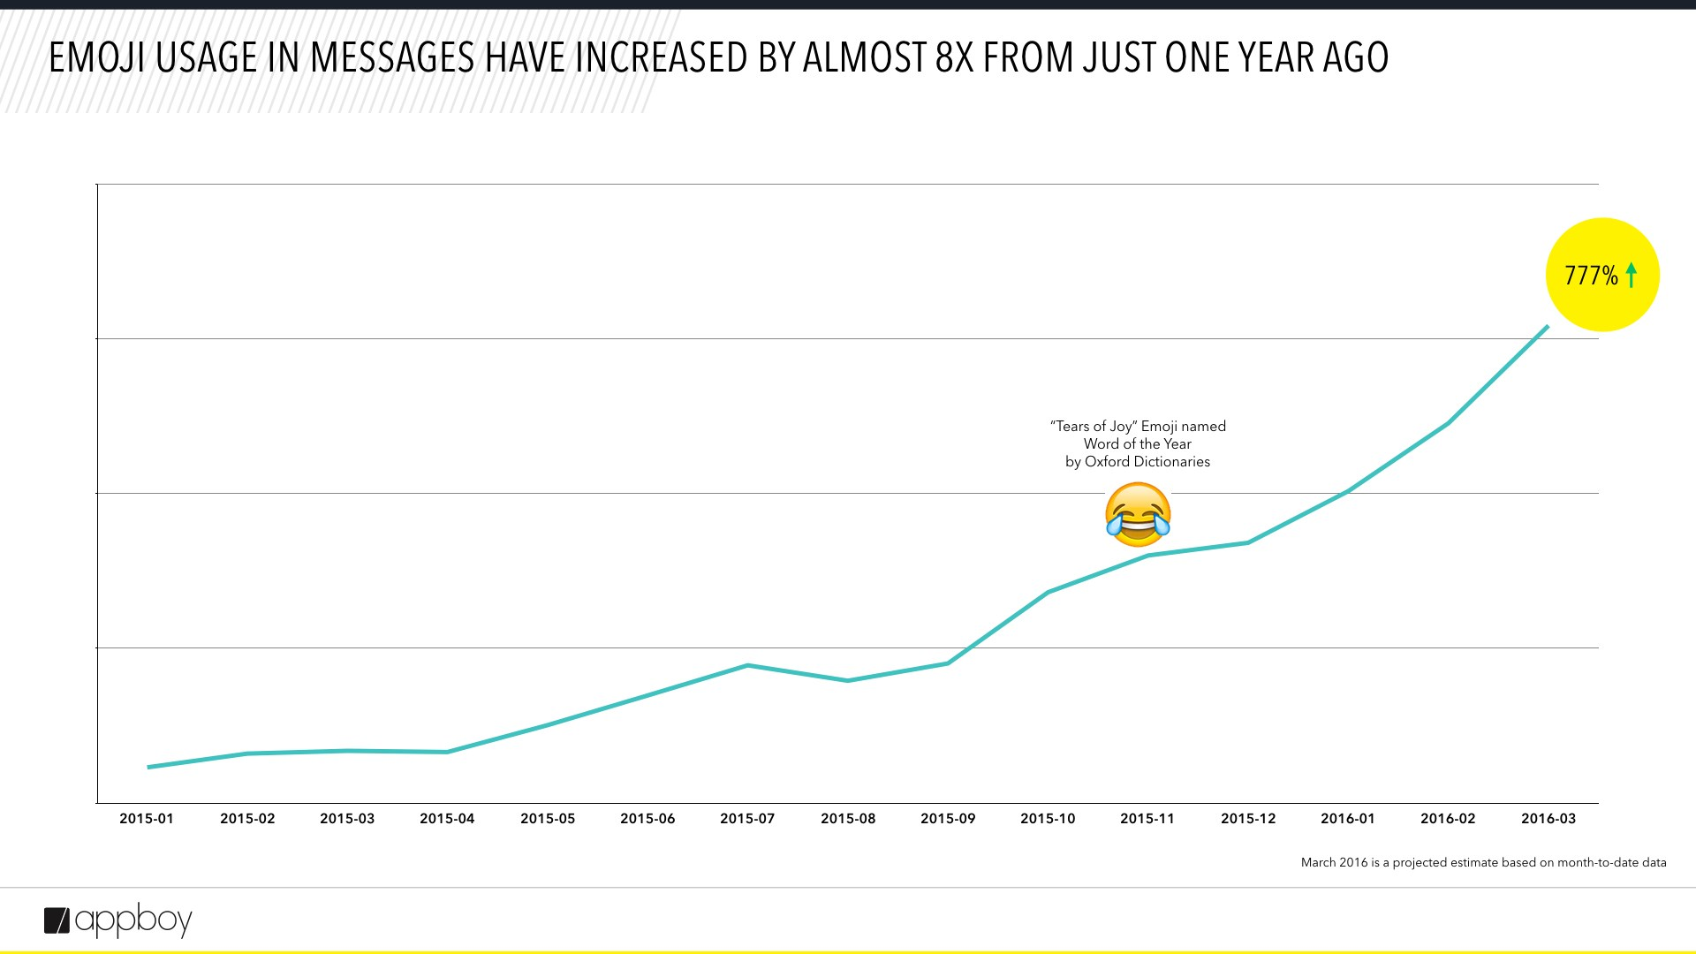



Businesses extensively use emoji in consumer applications
Dominos App support ordering pizza by texting a pizza emoji
Recent research shows emoji can improve sentiment, emotion and sarcasm detection (MIT’s DeepMoji)
¹Appboy Blog – https://www.appboy.com/blog/emojis-used-in-777-more-campaigns/

Slide 3
Why Emoji Similarity?
Measuring the Emoji Similarity can lead to improvements in numerous tasks including;
Sentiment Analysis – Emoji features improve sentiment analysis
Emoji-based Search – Similar emoji can improve recall
Designing of optimized emoji keyboards – To provide intuitive emoji groups to show ~2,700 emoji on small-sized screens
Suggesting alternative emoji domains – If an emoji domain is already taken
Notes:
Sentiment Analysis – It has been shown that using emoji as features can improve sentiment analysis, so similar emoji can further strengthen sentiment analysis results.
Emoji-based Search – Similar words can improve the recall of information retrieval and search. Similarly, similar emoji can help improving the recall for emoji-based search.
Optimized Keyboard Design – Currently, there are close to 2,700 emoji supported by the Unicode Consortium and none of the emoji keyboards can show the full list of emoji in small display screens. Emoji similarity can be used to group emoji based on their similarity, which could lead to optimized emoji keyboard designs.
Emoji domain name suggestions – Emoji domain names are getting popular now and emoji similarity can be used to suggest alternate emoji domain names if a particular domain name is already taken.

Slide 4
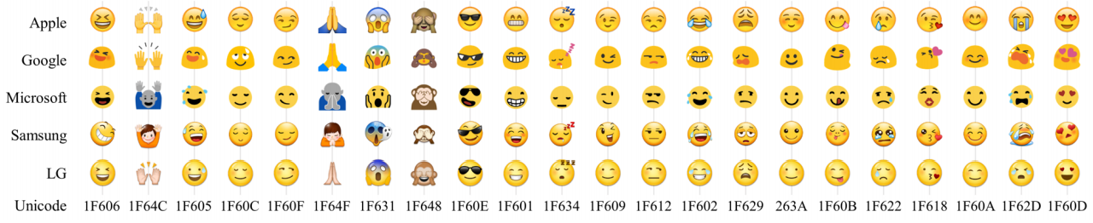
Emoji Similarity Problem
The notion of the similarity of two emoji is very broad
Pixel-based emoji similarity – Would not work as different platforms use different emoji pictures to represent the same emoji (Miller et al., 2016)
Can we devise a notion of emoji similarity that reflects the meaning or intended use of the emoji?
Notes:
We are interested in measuring the semantic similarity of emoji such that the measure reflects the likeness of their meaning, interpretation or intended use.

Slide 5
Related Research
EmoTwi50 by Barbieri et al.: Used Word2Vec to learn distributional semantics of emoji usage to calculate emoji similarity
emoji2vec – Eisner et al.: Used emoji keywords (4 words on average) from Unicode Consortium website and converted them to emoji vectors using distributional semantics of words learned via Word2Vec
Phol et al.
Used Word2Vec to learn distributional semantics of emoji
Used Jaccard Similarity on emoji keywords obtained from the Unicode Consortium (Similar to Wijeratne et al. ICWSM 2017)
Notes:
EmoTwi50 by Barbieri et al. – They used a collection of tweets to train a word2vec model which they then used to learn the distributional semantics of emoji.
emoji2vec – Eisner et al. – They represented an emoji using the keywords listed in the Unicode Consortium Webpage. Then they replaced each keyword listed for emoji using their corresponding word embeddings learned by the Google News corpus and summed the word embeddings for all keywords belong to a given emoji. They used the resulting embedding model as the emoji embedding for a given emoji.
Phol et al. – They learned distributional semantics of emoji the same way Barbieri et al. learned using Word2Vec. They also calculated Jaccard Similarity of two emoji using the overlap between the emoji keywords listed in the Unicode Consortium website. This is similar to our previous work which we published in ICWSM 2017 (Link - http://knoesis.org/people/sanjayaw/papers/2017/ICWSM_2017_EmojiNet_Final_Wijeratne.pdf).

Slide 6
Our Emoji Embedding Approach
Extract emoji definitions from a knowledge base of emoji senses and definitions (EmojiNet)
Learn distributional semantics of words as word embeddings using two corpora (Tweets and Google News)
Convert the words in emoji meanings to vectors using word embeddings (emoji embeddings)
Evaluate the similarity (distance) of emoji in the embedding space using EmoSim508, a new dataset with 508 emoji pairs
Notes:
Our approach is based on representing emoji definitions available in a machine-readable emoji sense inventory using distributional semantic models to learned over a large corpus of text. This is the first effort that uses a machine-readable sense inventory with distributional semantics models.

Slide 7
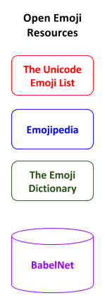
Building EmojiNet
The Unicode Consortium maintains a complete list of the standardized Unicodes for each emoji along with other information such as manually curated keywords and images.
Emojipedia is a human-created emoji reference website that provides useful emoji information such as emoji descriptions and short codes.
The Emoji Dictionary is the first crowdsourced emoji reference website that provides emoji definitions with their sense labels based on how emoji are used in sentences.
BabelNet is the most comprehensive multilingual machine-readable semantic network available to date that links words into their corresponding Wikipedia pages.

Slide 8
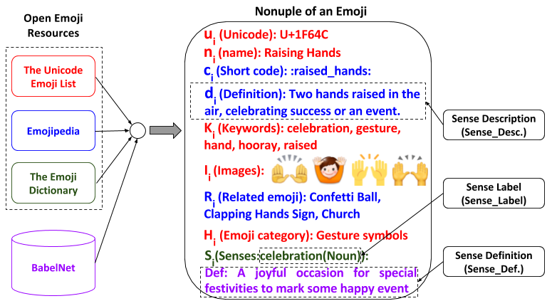
EmojiNet
Figure 1 – EmojiNet

Slide 9
Representing Emoji using Definitions
Emoji Description (Sense_Desc.)
Gives an overview of what is depicted in an emoji – E.g., “A gun emoji, more precisely a pistol. A weapon that has potential to cause great harm. Displayed facing right-to-left on all platforms”
Emoji Sense Labels (Sense_Label)
Word-POS tag pairs (such as laugh(noun)). For gun emoji, EmojiNet lists 6 nouns (gun, weapon, pistol, violence, revolver, handgun), 3 verbs (shoot, gun, pistol) and 3 adjectives (deadly, violent, deathly)
Emoji Sense Definitions (Sense_Def.)
Textual descriptions that explain each sense label and how those sense labels should be used in a sentence
Combination of all of the above (Sense_All)

Slide 10
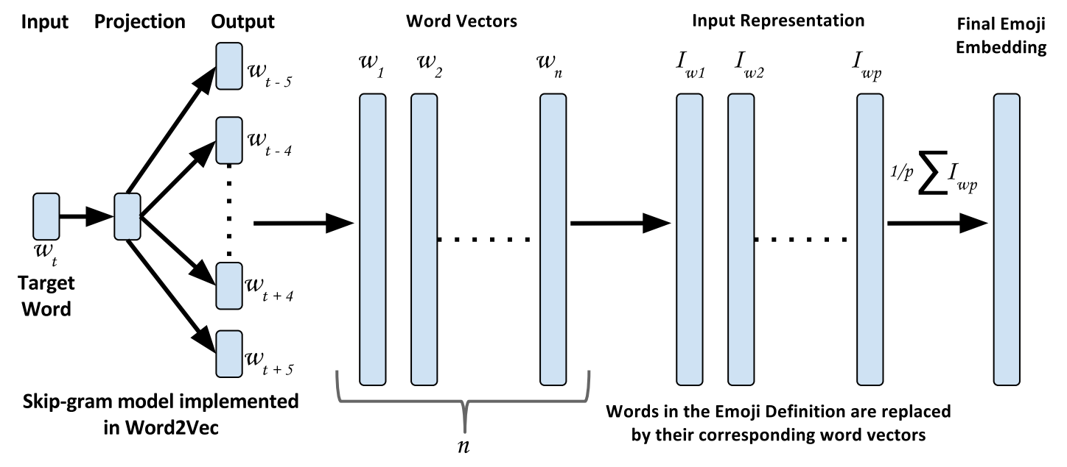
Learning Emoji Embeddings
Figure 2 – Learning Emoji Embedding Models using Word Vectors
Notes:
We use Word2Vec model to first learn word vectors using a large corpus of text. Then for each word in each emoji definition, we replace the word with its corresponding word vector. Then we take the vector average of all vectors that belongs to words in an emoji difinition.

Slide 11
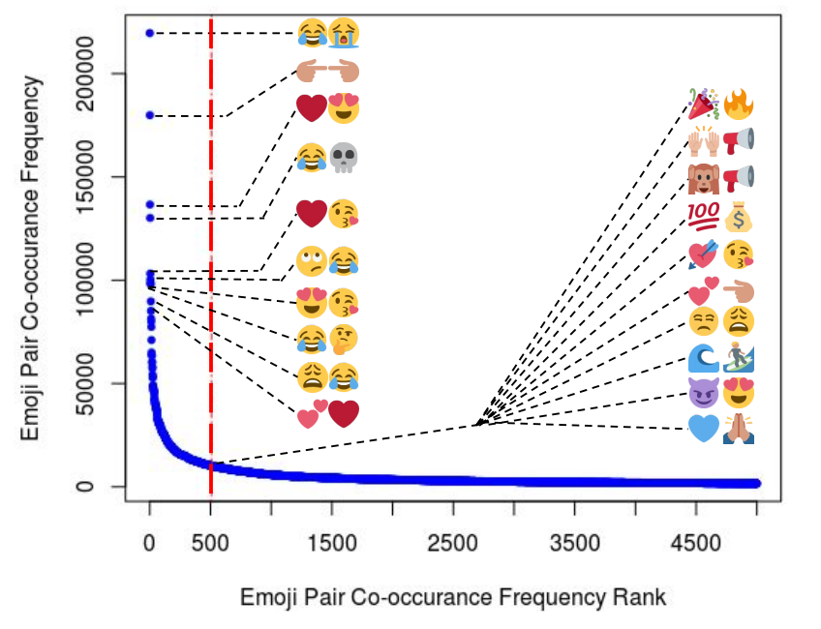
Ground Truth Data Creation
110M Tweets were used to identify 508 most frequently co-occurred emoji pairs, which covered 25% of the dataset. The full emoji list is at –http://emojinet.knoesis.org/emojipairs508.htm
Figure 3 – Emoji Co-Occurrence Frequency Graph
Notes:
We didn’t want to hand pick emoji pairs as past studies have done. At the same time, we didn’t want to randomly select emoji pairs too, as it is shown that the random emoji pairs are not meaningful in majority of the cases. Thus, we wanted to come up with a way to get a meaningful set of emoji pairs without hand picking them. To do that, we followed the below approach.
We first collected 147 million tweets by using emoji as query terms. Then we removed retweets, which gave us a sample of 110 million unique tweets. Then, we created a graph where we plot the most frequently co-occurring emoji pairs against the co-occurring frequency. We selected the 508 most co-occurring emoji pairs as those 508 emoji pairs alone covers 25% of the whole dataset (110 million).

Slide 12
Ground Truth Data Creation Cont.
Given an emoji pair, we asked 10 human annotators to evaluate them for equivalence (Q1) and relatedness (Q2)
Q1 – Can the use of one emoji be replaced by the other?
Q2 – Can one use either emoji in the same context?
Lickert scale from 0 to 4 was used to rate equivalence and relatedness
We averaged the equivalence and relatedness values for each emoji to calculate the final similarity value for the two emoji – http://emojinet.knoesis.org/emojipairs508_userstudy.htm
Krippendor’s alpha coefficient was used to calculate the inter annotator agreement (α for Q1 = 0.632 and α for Q2 = 0.567)

Slide 13
Intrinsic Evaluation
Using four different emoji definitions (Sense_Desc., Sense_Label, Sense_Def., Sense_All) and two corpora (Twitter and Google News), we trained eight emoji embedding models for each emoji
We calculated emoji similarity of the 508 emoji pairs using each embedding model
Using Spearman’s Rank Correlation Coefficient (Spearman’s ρ), we compared the similarity rankings of each model with ground truth data

Slide 14
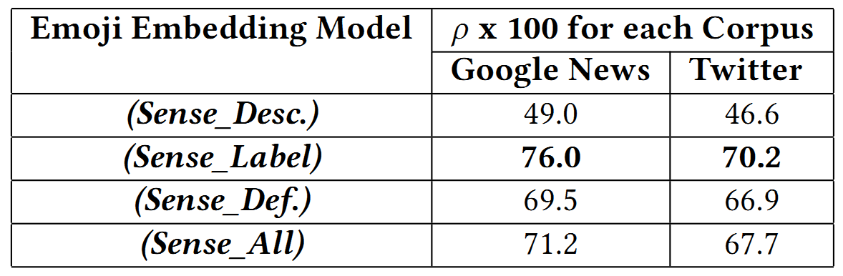
Intrinsic Evaluation Cont.
Table 1 – Spearman’s Rank Correlation Results
Except for Sense_Desc.-based embedding models which correlated moderately with ground truth data (40.0 < ρ < 59.0), all other models show a strong correlation (60.0 < ρ < 79.0)
Sense_Labels-based embedding models correlate best with ground truth data

Slide 15
Extrinsic Evaluation
We tested our emoji embedding models using a sentiment analysis baseline
Our baseline had 12,920 English tweets, and 2,295 of them had emoji
All words in the tweets were replaced with their corresponding word embeddings and emoji were replaced with emoji embeddings learned
Emoji embeddings based on Sense-labels outperformed previous best performing model

Slide 16
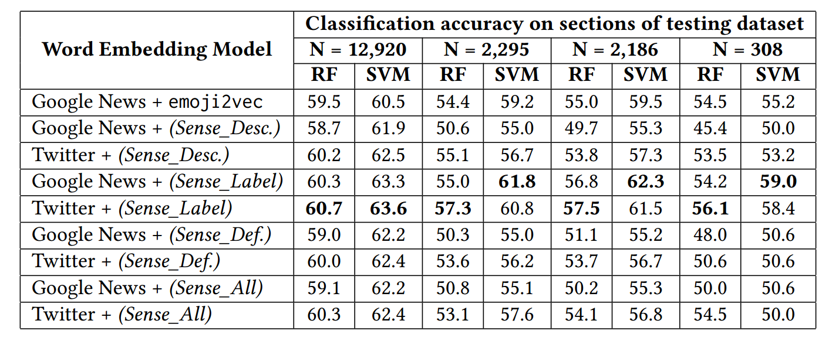
Extrinsic Evaluation Cont.
Table 2 – Accuracy of the Sentiment Analysis task using Emoji Embeddings

Slide 17
Key Takeaways
We created a dataset that can be used to evaluate emoji similarity tasks – Download link http://emojinet.knoesis.org/
Combining emoji sense knowledge with distributional semantics could improve the emoji embedding models
Longer sense definitions are not suitable to learn emoji embeddings
Longer definitions contain words that do not directly contribute to the meaning of an emoji, thus, add noise to the learned embedding models.
Sense labels, which are directly related to the meaning of emoji tend to result in better embedding models

Slide 18
Future Work
Extend emoji embeddings to capture the differences in emoji interpretations due to how they appear across different platforms or devices
Use emoji embedding models in other downstream applications such as emoji-based search

Slide 19


Acknowledgement
We are thankful to the annotators who helped us in creating the EmoSim508 dataset. We acknowledge partial support from the National Institute on Drug Abuse (NIDA) Grant No. 5R01DA039454- 03: “Trending: Social Media Analysis to Monitor Cannabis and Synthetic Cannabinoid Use”, and the National Science Foundation (NSF) award: CNS-1513721: “Context-Aware Harassment Detection on Social Media”. Points of view or opinions in this document are those of the authors and do not necessarily represent the official position or policies of the NIDA or NSF.

Slide 20
Related Publications
Sanjaya Wijeratne et al. A Semantics-Based Measure of Emoji Similarity (Web Intelligence 2017)
Sanjaya Wijeratne et al. EmojiNet: An Open Service and API for Emoji Sense Discovery (ICWSM 2017)
Sanjaya Wijeratne et al. EmojiNet: Building a Machine Readable Sense Inventory for Emoji (SocInfo 2016)

Slide 21



Thank You! Visit us at http://emojinet.knoesis.org/
amit@knoesis.org
http://knoesis.org/amit

