Slide 1
Online Food Delivery - SQL Data Analysis Project
A_RealLife_Data_Analyst_Case_Study
Prepared By: SANJYOT SANJAY TEKALE

Slide 2
Introduction
As a data analyst, one of the most intriguing aspects of my job is uncovering insights about customer behavior through database analysis. Recently, I had the opportunity to work on a Case Study that involved analyzing multiple tables in a database to gain a better understanding of customer behavior for a popular online retailer.
The database consisted of five tables: Sales, Product, Goldusers_Signup, Users, and User_name. Each table contained unique information about the customers and products sold on the website.
SQL-based analysis of customer & sales data
Focus on revenue trends and Gold membership impact
Objective: Data-driven business insights

Slide 3
Methodologies
Joins (INNER, LEFT)
Aggregations (SUM, COUNT, AVG)
Window Functions (ROW_NUMBER, RANK, LAG)
Date Functions (YEAR, DATEDIFF)

Slide 4
Aggregation Functions
SUM() → Total revenue calculation
COUNT() → Total orders and frequency analysis
AVG() → Average spending and membership analysis
GROUP BY → Product-wise and year-wise breakdown
Window Functions
Used advanced analytical functions for ranking and trend comparison:
RANK() → Ranking transactions during Gold membership
ROW_NUMBER() → Identifying first purchase
LAG() → Calculating year-over-year revenue change
PARTITION BY → User-level transaction analysis

Slide 5
Key Findings
Total Revenue: ₹7220
Butter Chicken highest revenue item
100% Gold membership adoption
High-frequency users drive major revenue

Slide 6
Gold Membership Adoption:
Butter Chicken generated the highest revenue among all menu items.
Premium items such as Mutton Biryani and Fish Curry also contributed strong revenue despite fewer purchases.
Low-priced items like Chole Bhature had higher frequency but lower overall revenue contribution.
Insight: High-priced items significantly influence revenue growth.
Gold vs Non-Gold Spending Behavior:
Customers tend to increase their order frequency after becoming Gold members.
Post-membership transactions show higher engagement levels.
Gold members contribute a major portion of total revenue.
👉 Insight: Gold membership increases customer lifetime value (CLV).

Slide 7
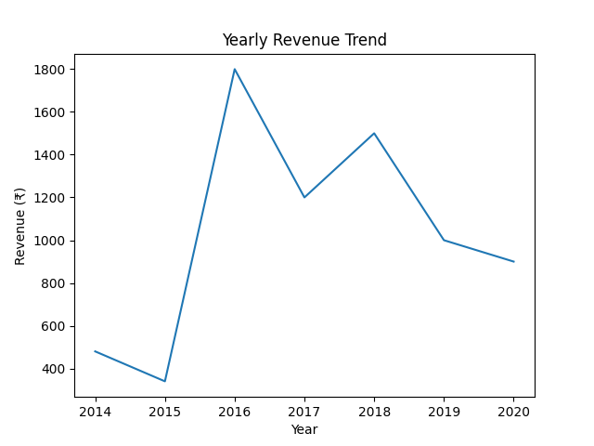
Yearly Revenue Trend

Slide 8
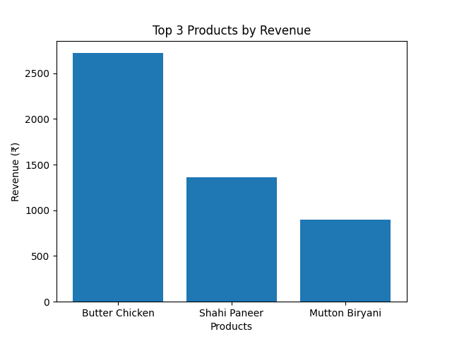
Top 3 Products by Revenue

Slide 9
Actionable Recommendations
Promote top-performing menu items
Offer personalized loyalty rewards
Target high-spending customers
Improve engagement strategies

Slide 10
Strengthen the Gold Membership Program:
Recommendation : Enhance the Gold membership benefits with exclusive discounts , early access offers, and reward points.
Why?: Gold members show higher engagement and revenue contribution.
Action Steps: Offer bonus reward points on premium items.
Provide birthday or anniversary special offers.
Expected Impact : Increased customer retention and higher lifetime value

Slide 11
Business Insights
Gold membership increases engagement
Revenue trends help forecasting
Data supports strategic marketing decisions

Slide 12
A Small Segment of Customers Generates Major Revenue: Analysis shows that a limited number of customers contribute a significant portion of overall revenue through repeat purchases.
Insight: Customer segmentation is essential.
High-value customers should be prioritized with exclusive benefits.
Customer Preference Are Identifiable: First purchase and most purchased item analysis reveal clear taste patterns among customers.
Insight: Personalized recommendations can significantly improve conversion rates.

Slide 13
Conclusion
In conclusion, my Case Study on online delivery using SQL has successfully addressed some of the key queries and challenges faced by companies in the online delivery industry.
By analyzing customer data, I have been able to provide insights into customer behavior, such as the frequency of orders, popular food items, and the effectiveness of the gold membership program. With this information, companies can make data-driven decisions to improve their services and increase customer satisfaction.
My Case Study has also demonstrated the power and usefulness of SQL in handling large and complex datasets, allowing companies to extract meaningful insights from their data. Overall, my project has shown that leveraging data through SQL can be an effective tool for companies in the online delivery industry to stay competitive and provide better services to their customers.

Slide 14
THANK YOU

