Slide 1
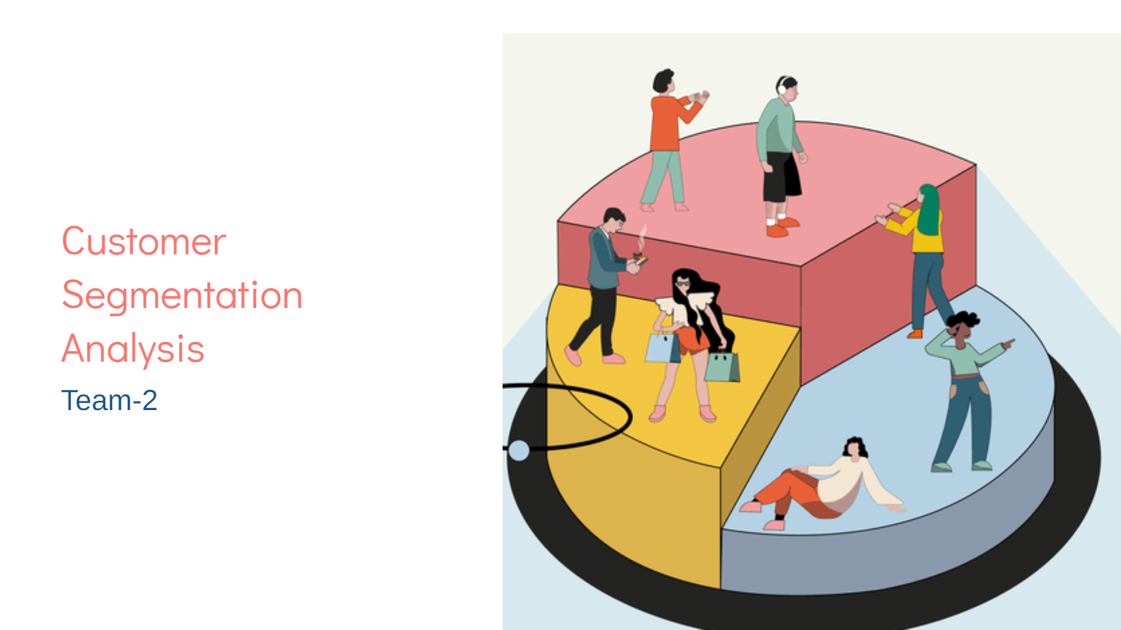

Slide 2


Slide 3
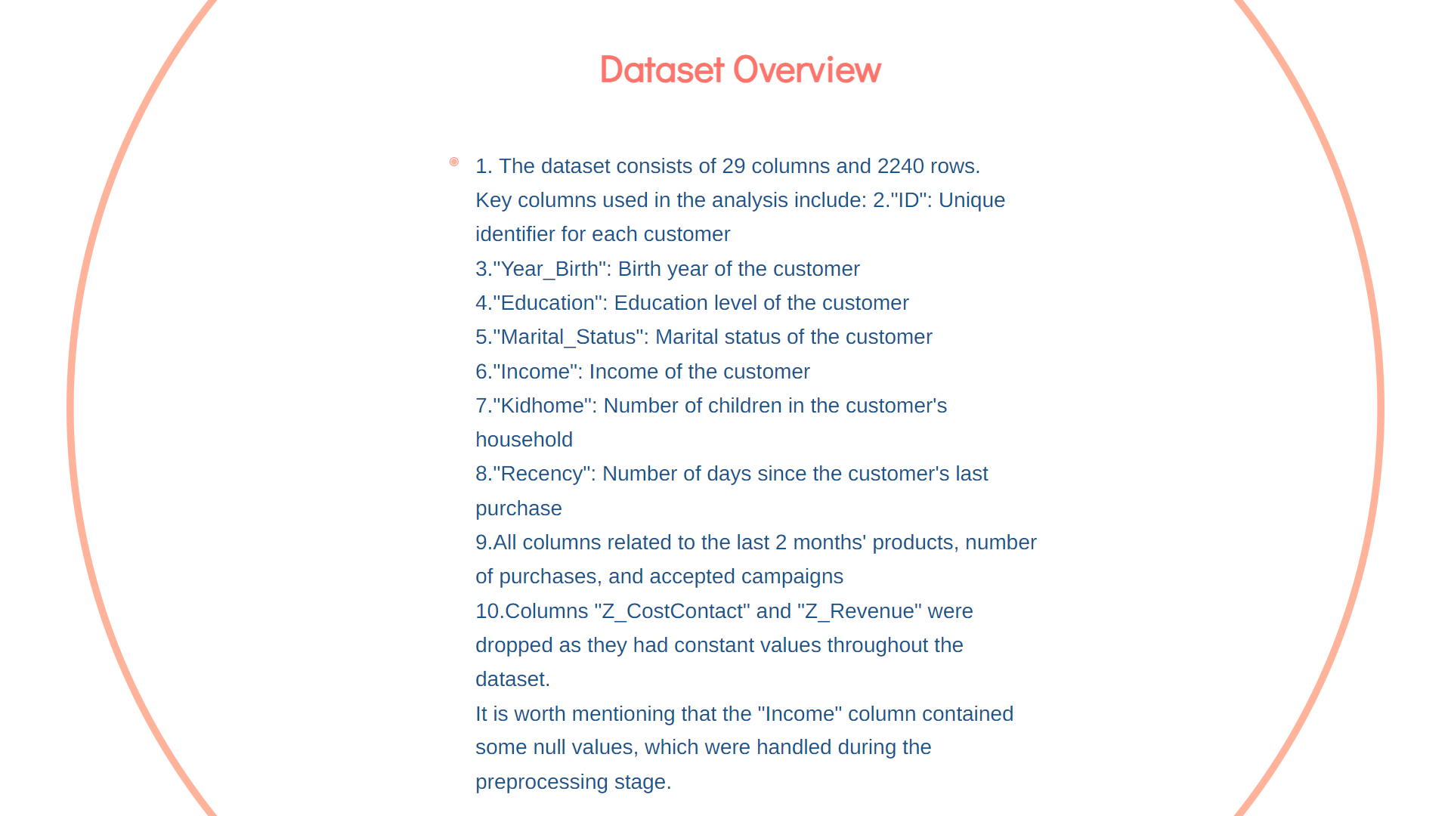

Slide 4


Slide 5
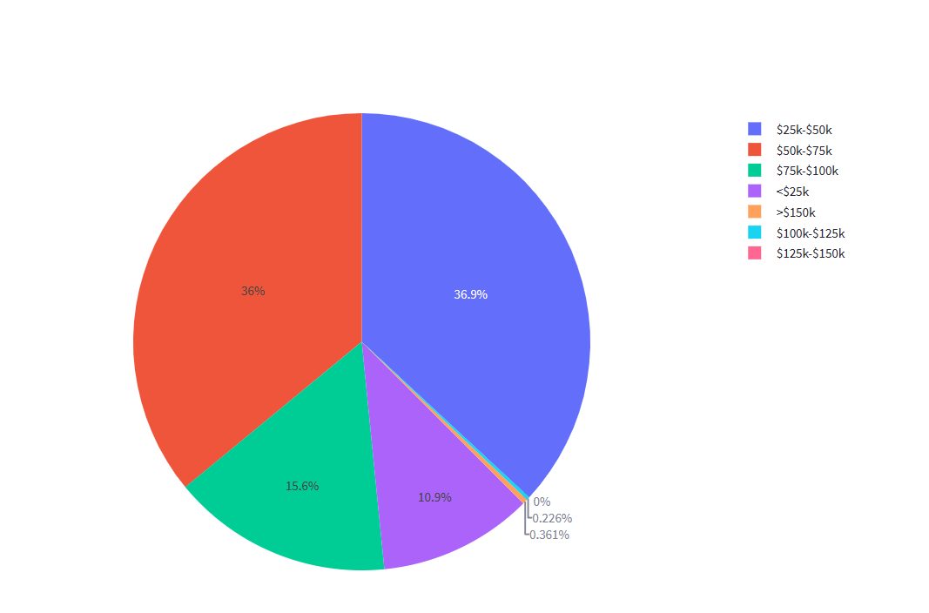
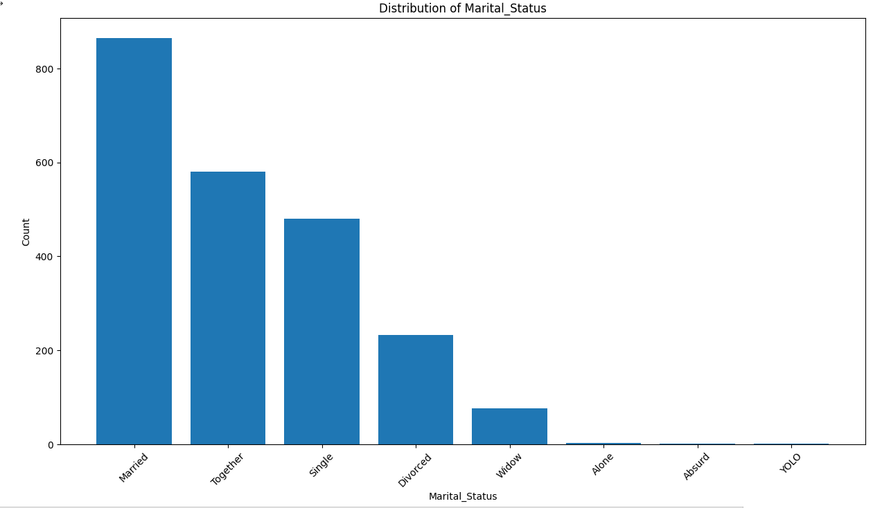
Marital Status
higher prevalence of customers in the "Married" and "Together" categories, while the "Single" and "Alone" categories show a smaller representation.
Income
The income distribution graph shows that 10.9% of
customers earn less than 25k, while 3% earn more
than 150k.

Slide 6
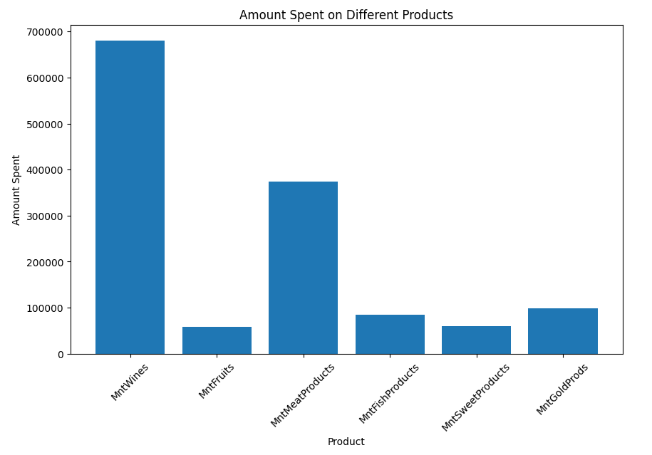
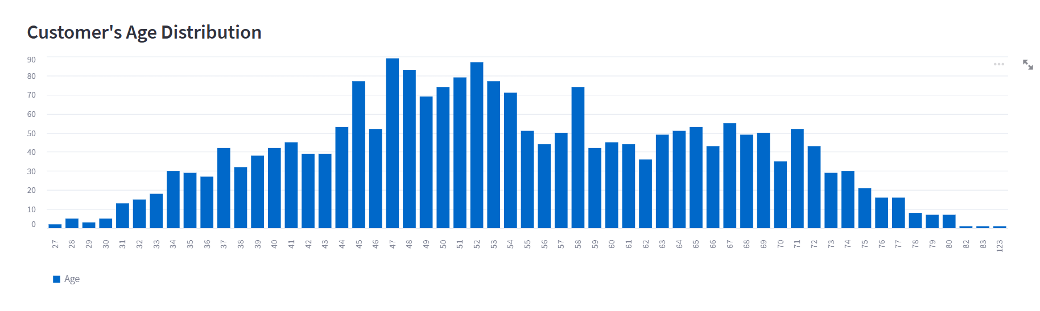
Spend On Products
The graph reveals that customers have a higher preference for purchasing wines compared to other product categories in the last 2 years.
Age Distribution of Customer

Slide 7
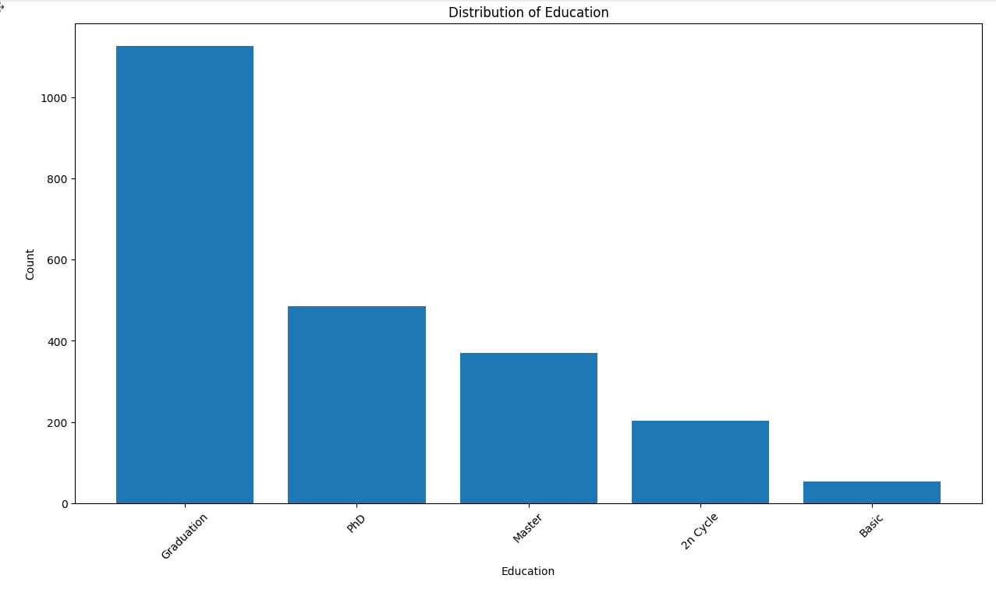
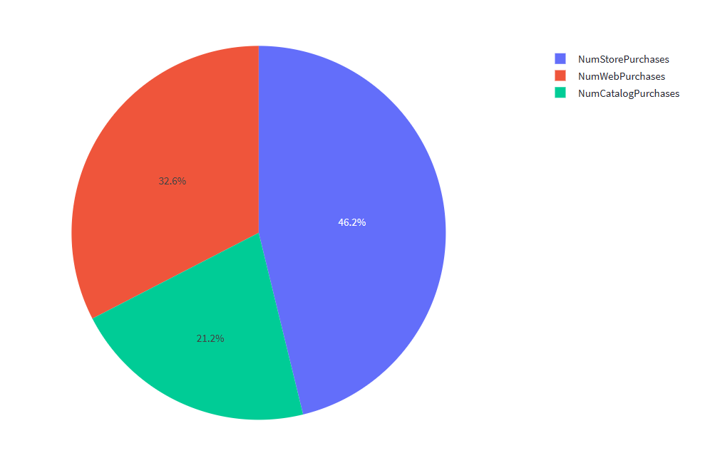
Education Distribution
higher prevalence of customers are “Graduation” categories, while the “Basic" and “2N Cycle " categories show a smaller representation.
Number Of Purchases
The graph reveals that customers tend to make more purchases in physical stores (NumStorePurchases)
compared to online channels (NumWebPurchases and NumCatalogPurchases).

Slide 8
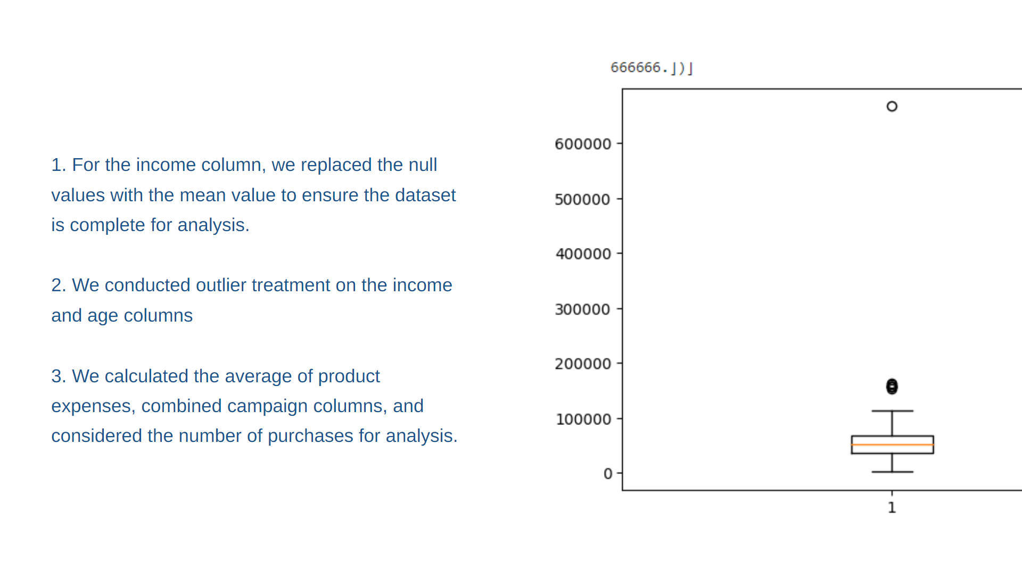

Slide 9
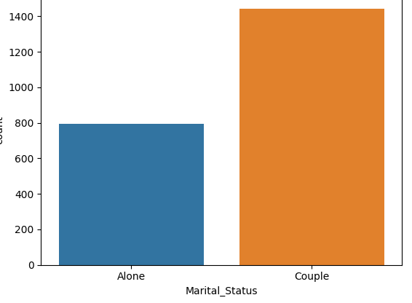
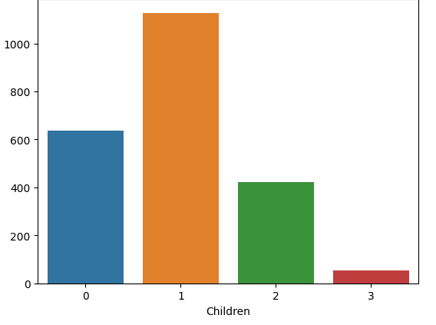
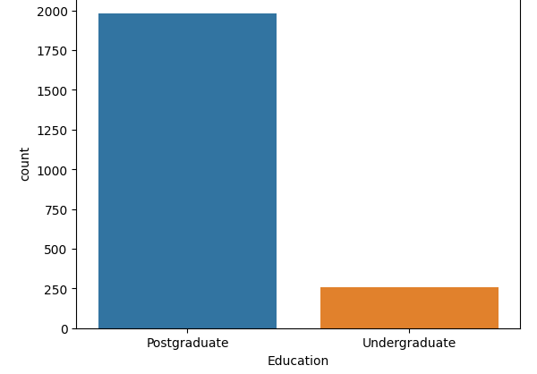
Feature Engineering
Feature engineering was performed on the 'Education' and 'Marital_Status' columns to transform them into numerical representations suitable for analysis. Additionally, the 'Kidhome' and 'Teenhome' columns were combined to create an 'is_parent' column, indicating whether the customer has children or not.

Slide 10
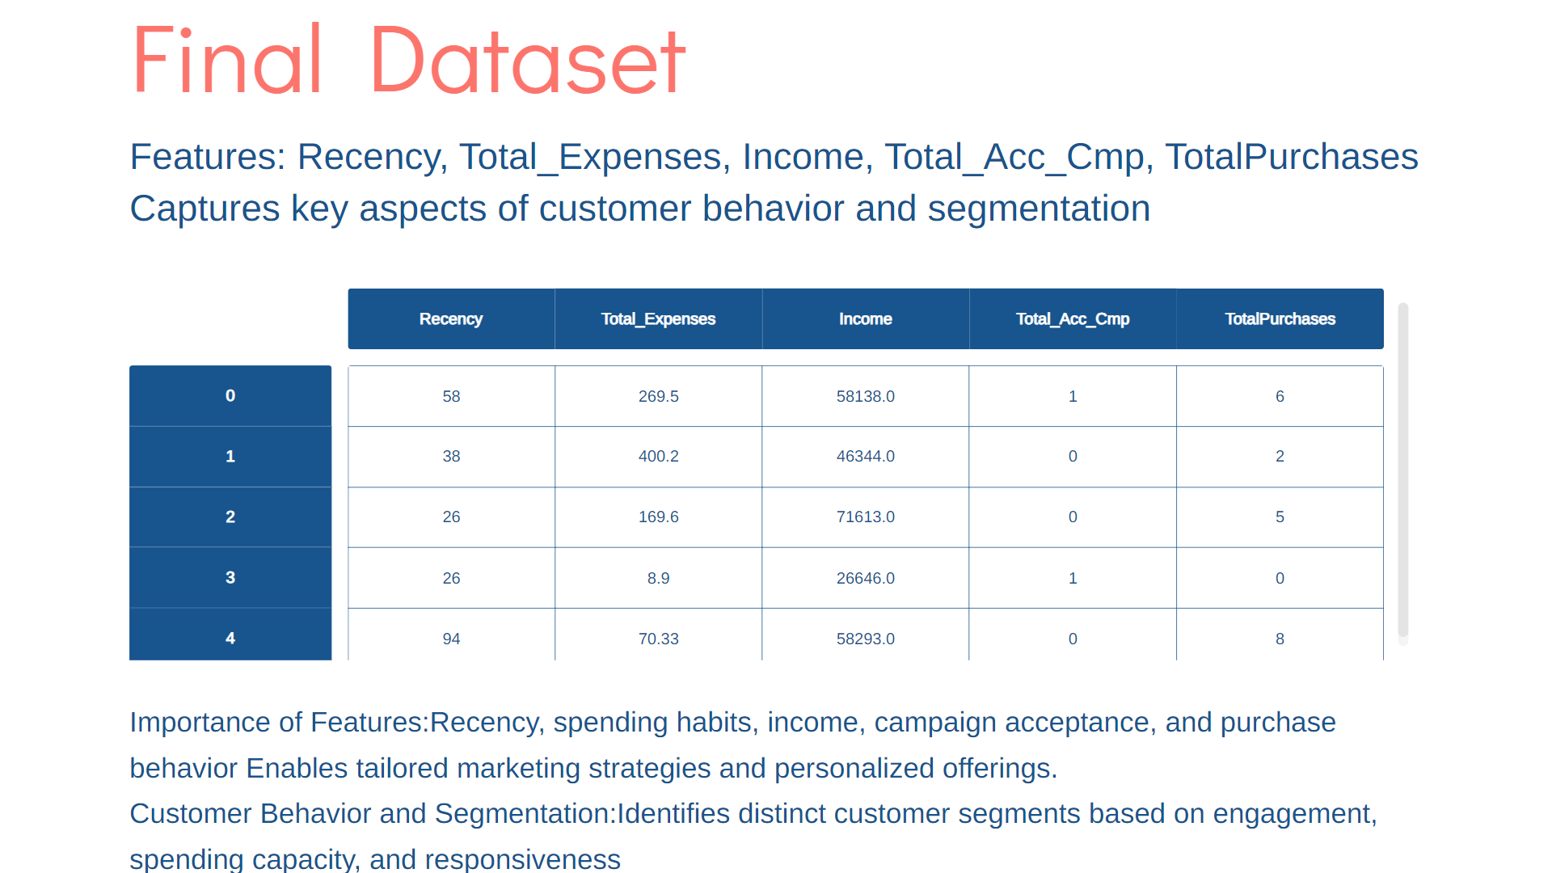

Slide 11


Slide 12
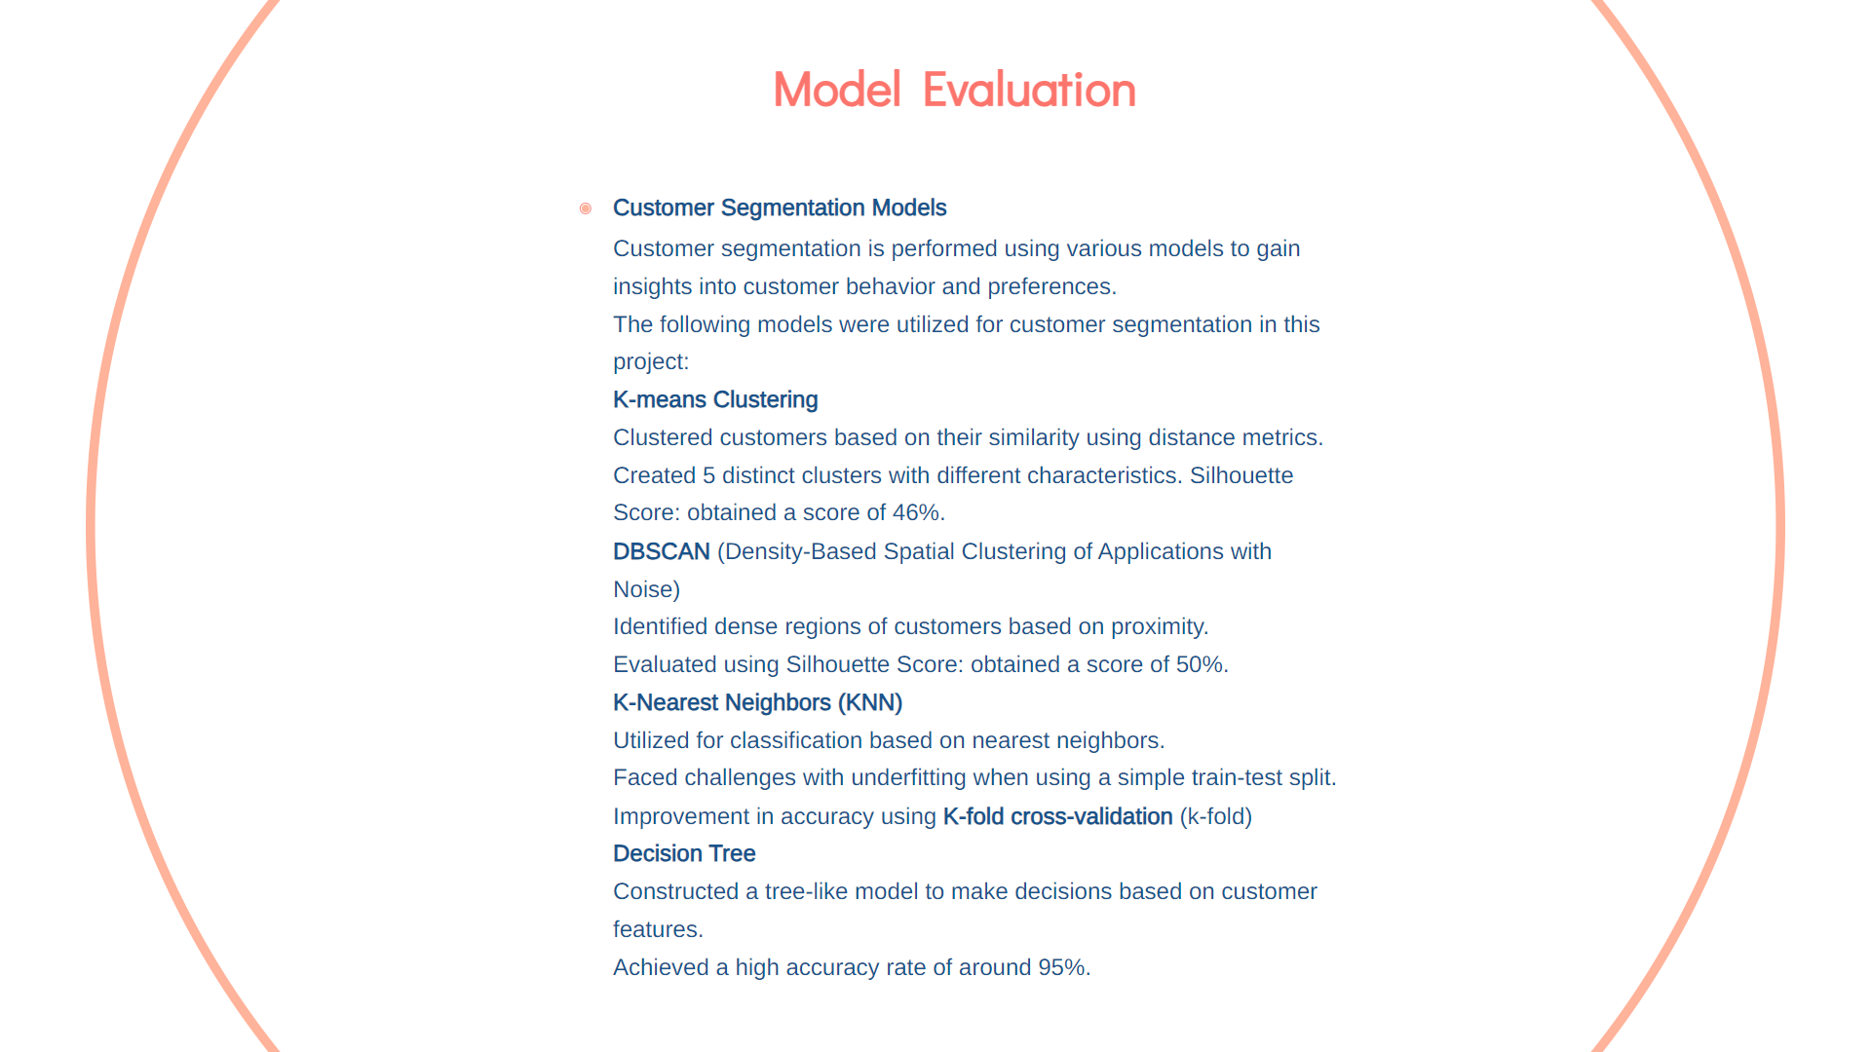

Slide 13
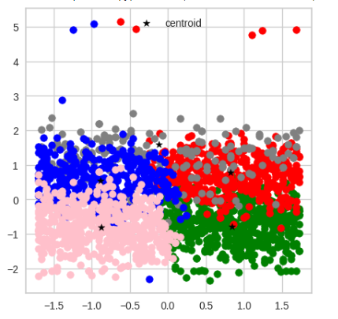
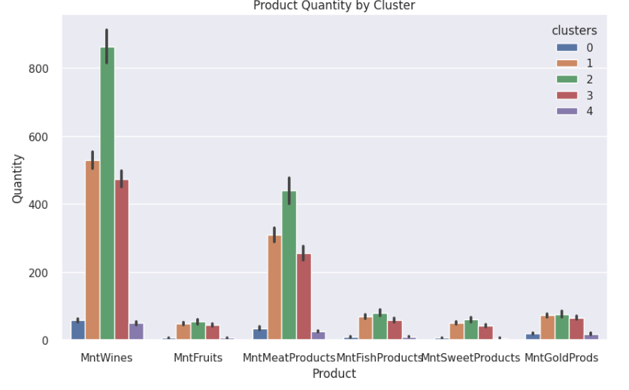
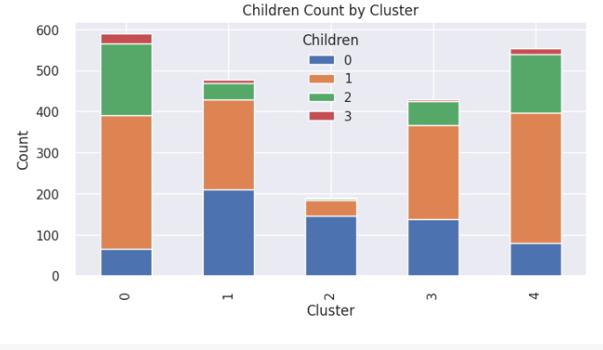
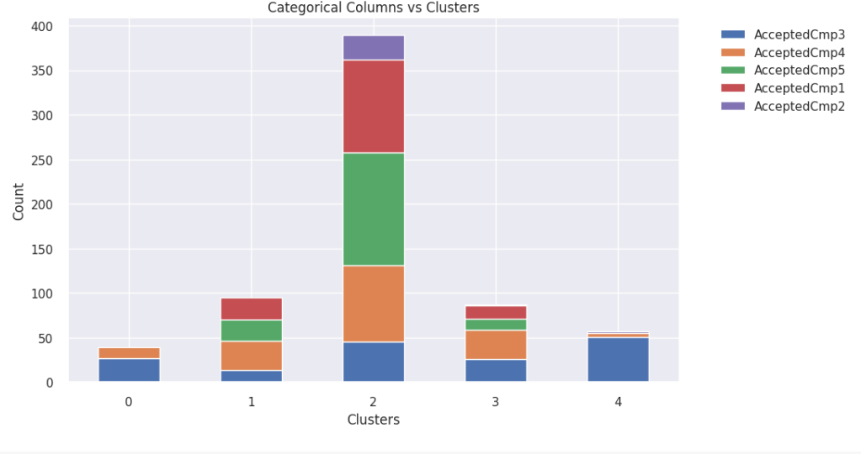
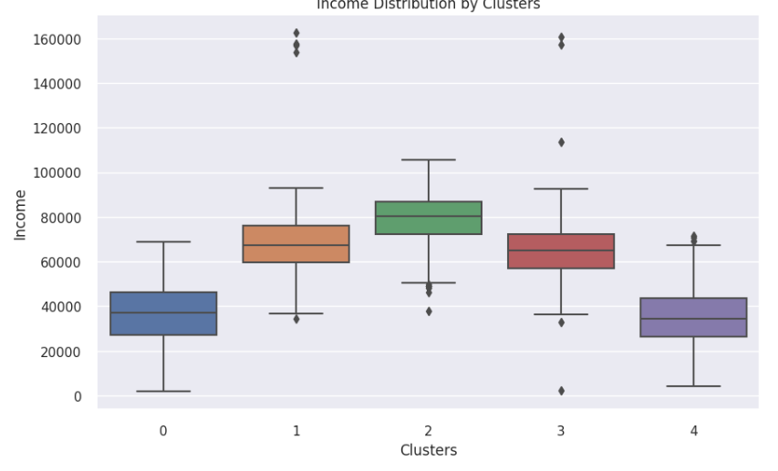
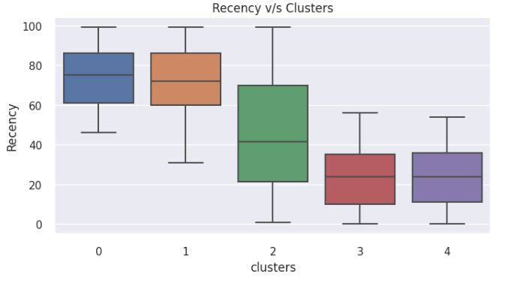
Cluster Visualization

Slide 14
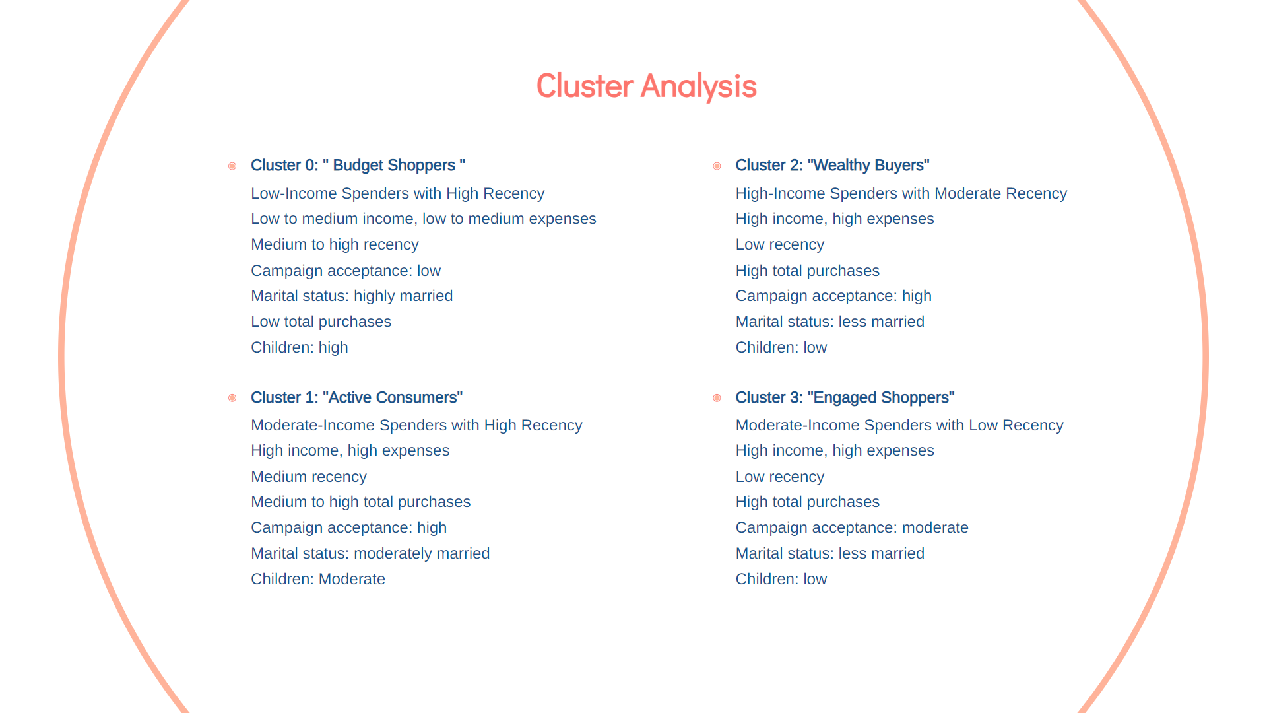

Slide 15
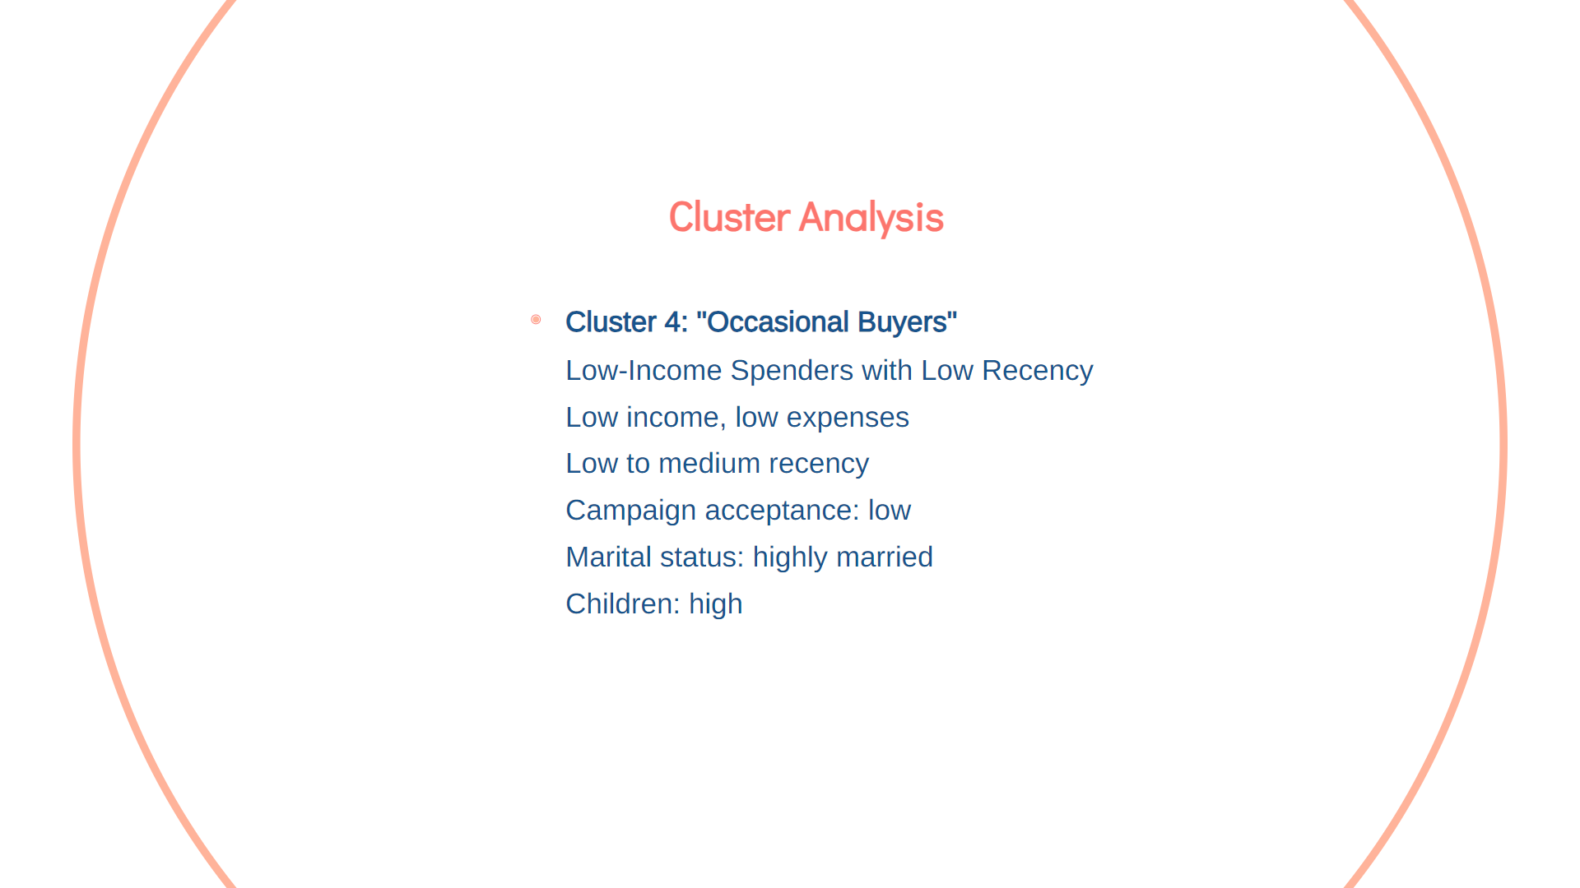

Slide 16


Slide 17


Slide 18


