Slide 1
Introduction to Git and GitHub
Ready To Learn?

Slide 2
01
What will we be learning today?
What is a Version Control Basic CLI Commands Introduction to Git Setting up VS Code Introduction to GitHub Final Quiz

Slide 3

What is a Version Control System?

Slide 4
Let's Visualize
You are a designer
poster.png
final-poster.png
final-final-poster.png
pls-stop.png

Slide 5


What is Version Control System?
Version Control System manages the entire process of version and keeps the track of the changes made.
We need VCS to:
track the changes made,
revert back to any versions when needed, compare the changes made between any two versions,
to know information like who, when, why made
the changes,
to get all these benefits with minimal effort.

Slide 6
Before we learn Git Let's learn about CLI
02

Slide 7
Command line Interface
Graphical User Interface

Slide 8
Prints the full name (the full path) of current/working directory
Changes the working directory to Desktop. Use this to navigate around CLI
$ pwd
$ cd Desktop
$ ls
List directory contents.
$ mkdir name
Create a new directory called name.
$ rm file.txt
Removes the file file.txt

Slide 9
What is Git?
Let's Install Git
https://git-scm.com/downloads
Let's Install VSC
https://code.visualstudio.com/
Git is a free and open source distributed version control system designed to handle everything from small to very large projects with speed and efficiency.

Slide 10
Setup Git
Check version
$
git --version
Add in your name
$ git config --global user.name “[firstname lastname]”
Add in your email id
$
git config --global user.email “[valid-email]”
Initialize an existing directory as a Git repo
$
git init

Slide 11
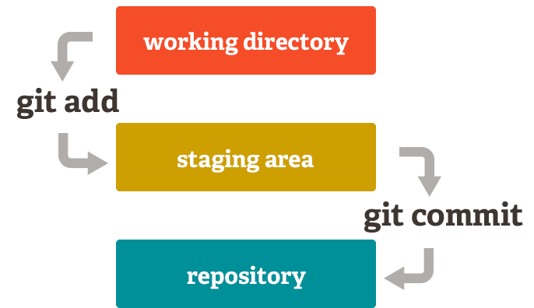
How Git works

Slide 12
Git Commands
It displays the state of working tree and staging area.
$
git status
It starts to track a fileby adding it to the staging area
$
git add [file]
It unstages the file
$
git reset [file]

Slide 13
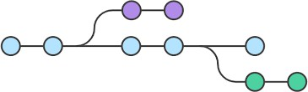
Git Commands
It commits your changes and captures a new snapshot
$ git commit -m "Some valuable message"
It displays all the commits in the current branch.
$
git log
Branching

Slide 14
Git Commands
List your branches
$ git branch
Creates a new branch from the current commit
$
git branch [name]
Switchs to another branch
$ git checkout [name]
Merges the specified branch’s history into the current one
$
git merge [branch]

Slide 15
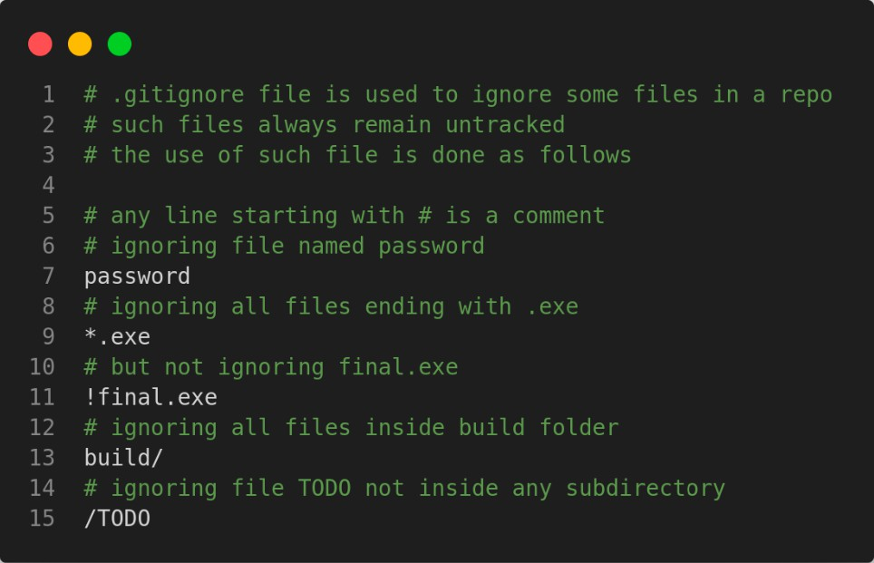
Git ignore

Slide 16


What is GitHub
Till now, we have all the changes made saved in our local system only.
To host our repository online, we need a server or hosting platform.
GitHub is a repository hosting platform that uses Git in its core.
Let's make an account!

Slide 17
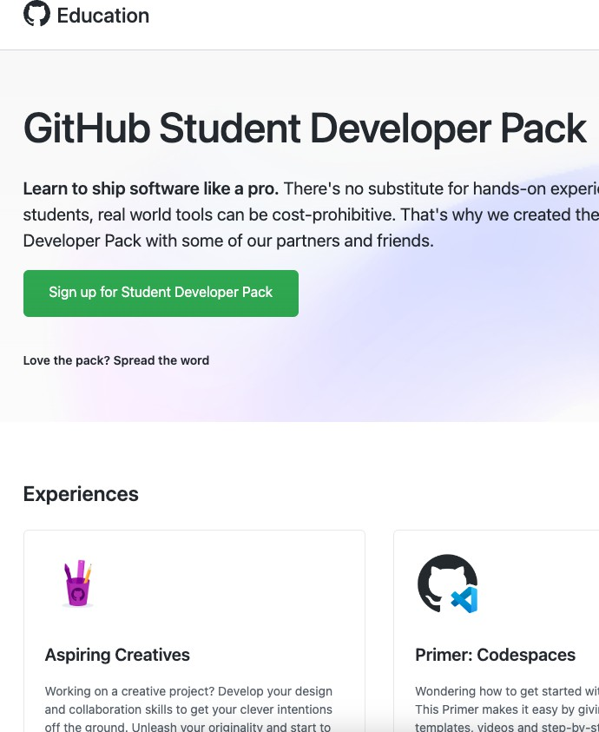


Free Goodies
Btech-FY

Slide 18
Some More Git Commands
Add a remote repo link
$ git remote add origin [link]
Push local repo changes to remote repo
$
git push
Fetch and merge changes from remote repo
$ git pull
Retrieve an hosted repository from a URL
$
git clone [link]

Slide 19

Some Terminologies
Fork: A fork is a copy of a repository that allows you to freely experiment with changes without affecting the original project.
Pull requests: A PR is request sent to the repo to merge new commits into the repo.
Issues: Issues is what it sounds. It can be a new feature, bug, documentation problem and many more.

Slide 20
Workflow to Contribute
01
Find a issue or Suggest a feature
02
Ask the maintainer to assign the issue
03
Fork and Clone the Repo
04
Branch and make changes
05
Commit your changes
06
Create a Pull Request
07
Listen to Review and do changes if needed
08
Hurray! accepted
The PR got

Slide 22
Thank You!

