Slide 1
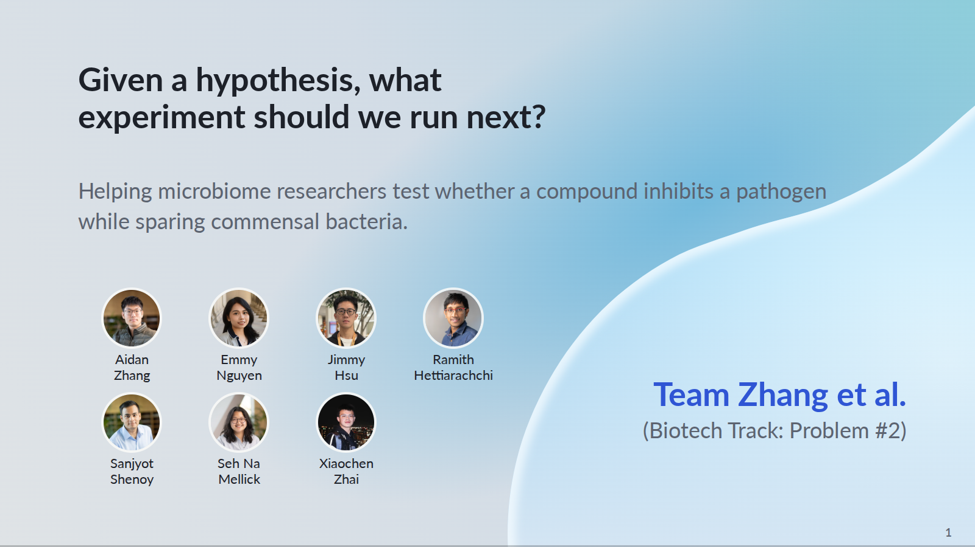
Notes:
Open with the researcher’s decision: given a hypothesis, what experiment should we run next? Our motivating user is a microbiome researcher testing whether a supplied compound inhibits a pathogen while sparing commensals. We propose evidence-grounded experiments for researcher review; selective inhibition is the hypothesis, not a demonstrated outcome.
PowerPoint: click to reveal successive captured states; smooth HTML motion is represented by discrete reveals. Demo: https://zhang-etal-biohack.pages.dev/talks/biohack/graph/

Slide 2
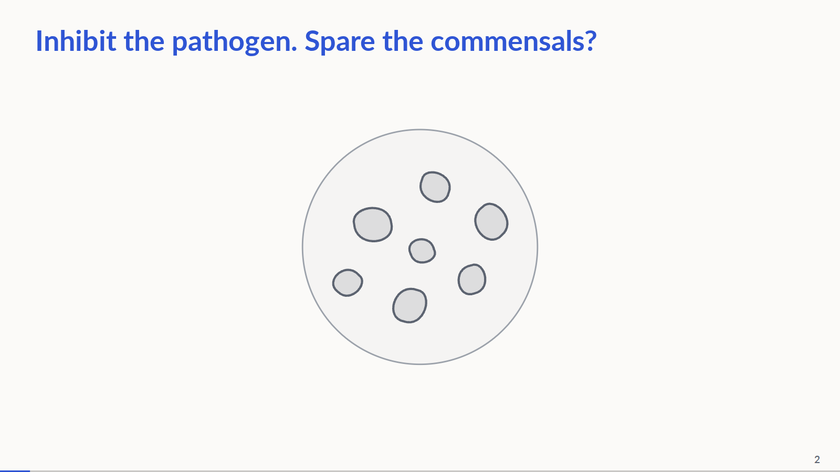
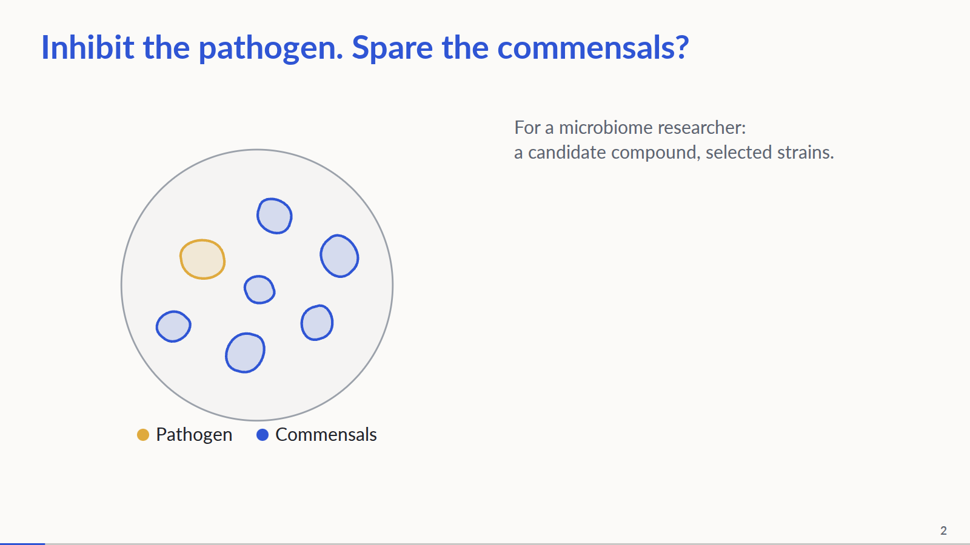
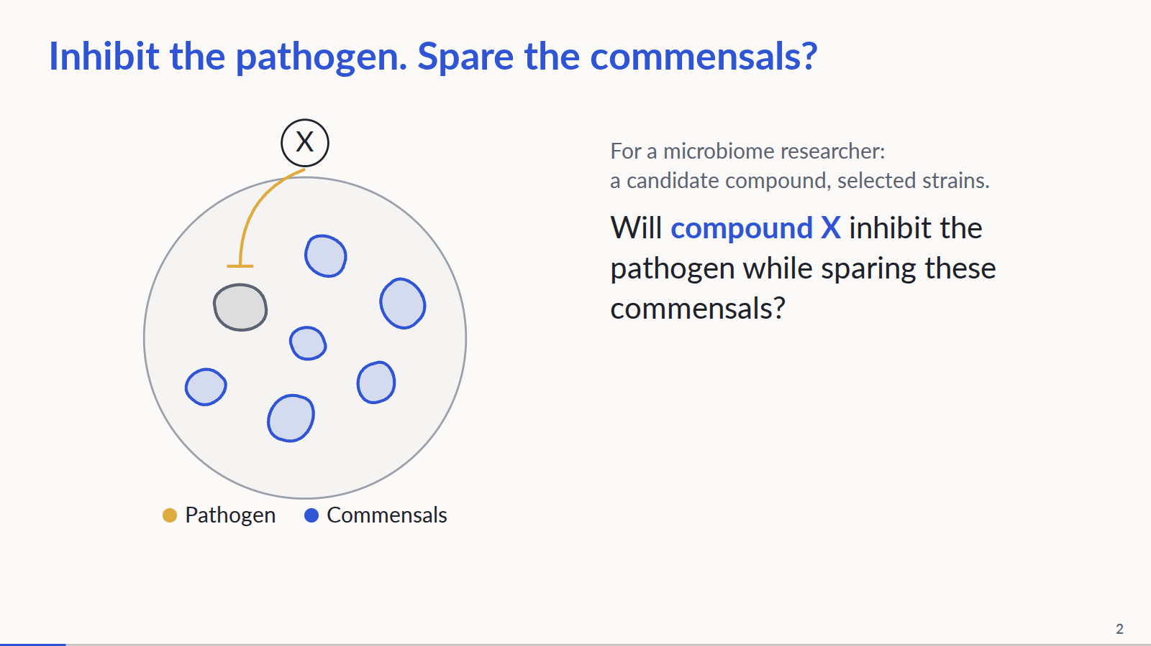
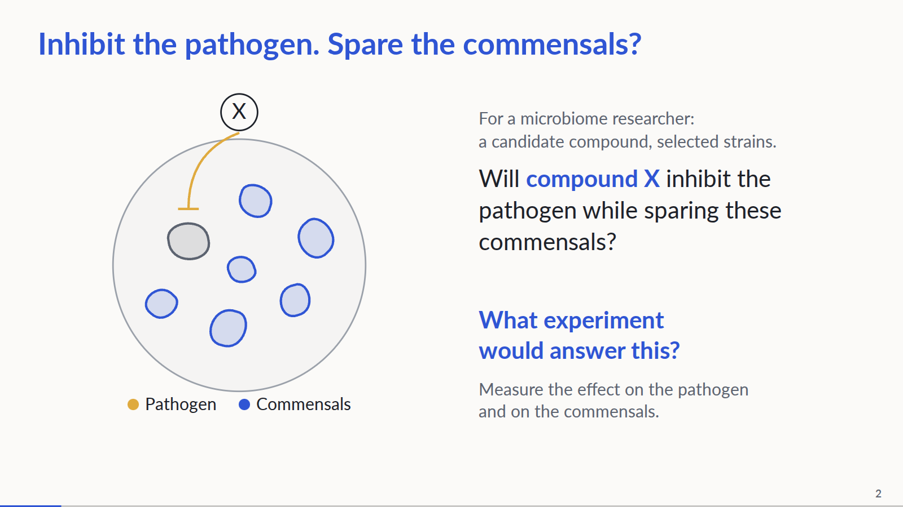
Notes:
0:00–0:50. Step 1: show only the title and a centered neutral bacterial plate. Step 2: introduce a microbiome researcher with a candidate compound and selected strains. Explain that activity against the pathogen alone is not enough: the experiment must also measure the effect on commensals. Color the pathogen and commensals, reveal the labels and move the plate left. Step 3: reveal compound X and the question, draw a T-ended inhibitory connection to the pathogen, then grey it out. This visualizes the hypothesized selective effect, not measured inhibition or survival; keep the spoken framing as a question. Step 4: ask what experiment would answer it, then advance to the missing-link graph. Compound discovery and strain selection are upstream. We support turning a supplied research question into a justified experiment. No clinical or wet-lab outcome is claimed.
PowerPoint: click to reveal successive captured states; smooth HTML motion is represented by discrete reveals. Demo: https://zhang-etal-biohack.pages.dev/talks/biohack/graph/

Slide 3
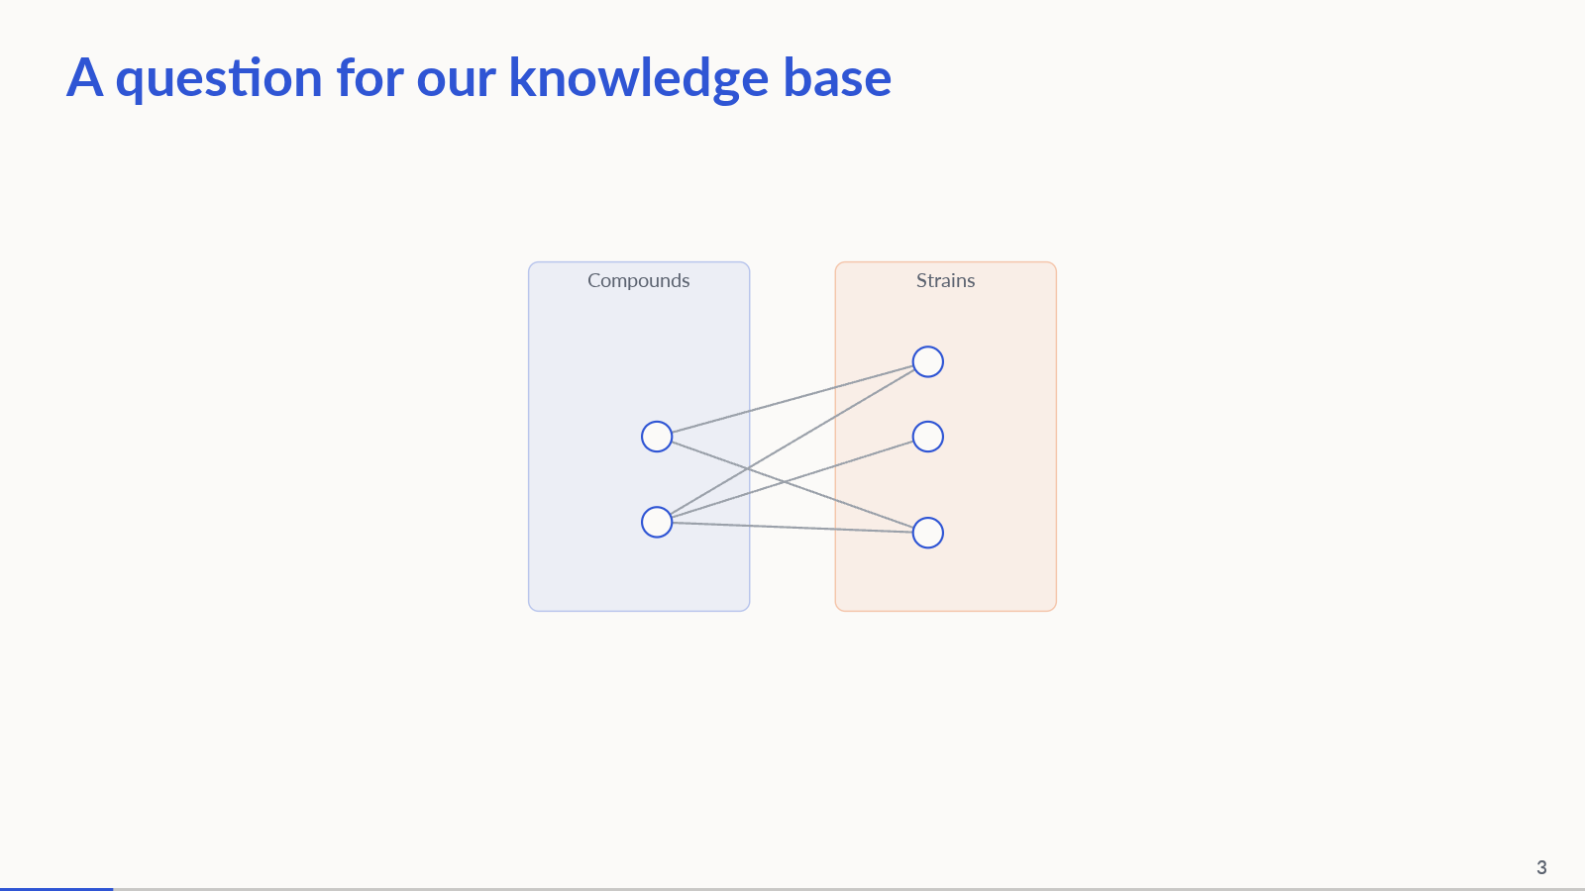
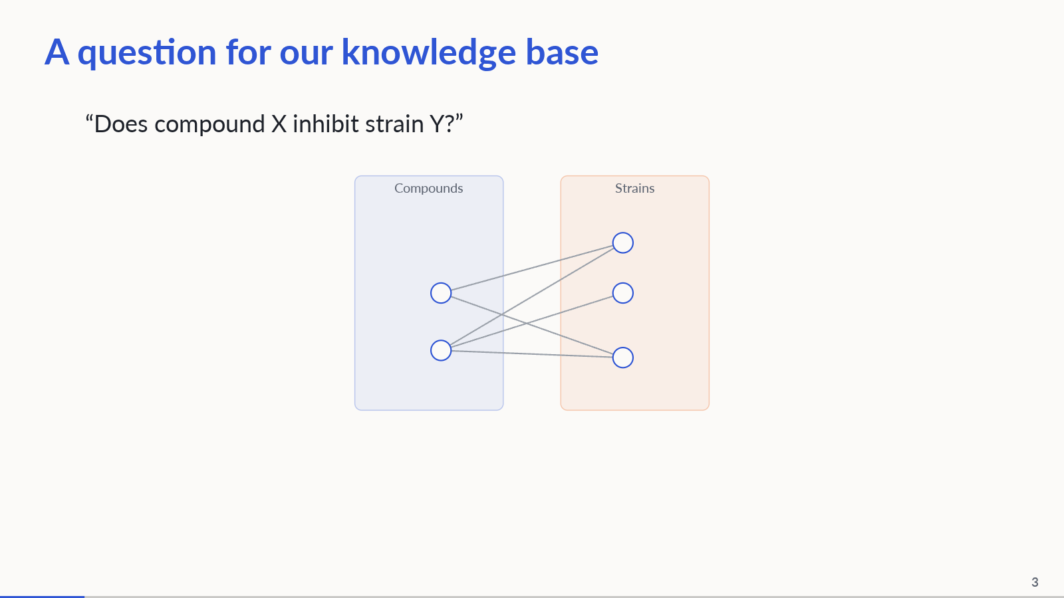
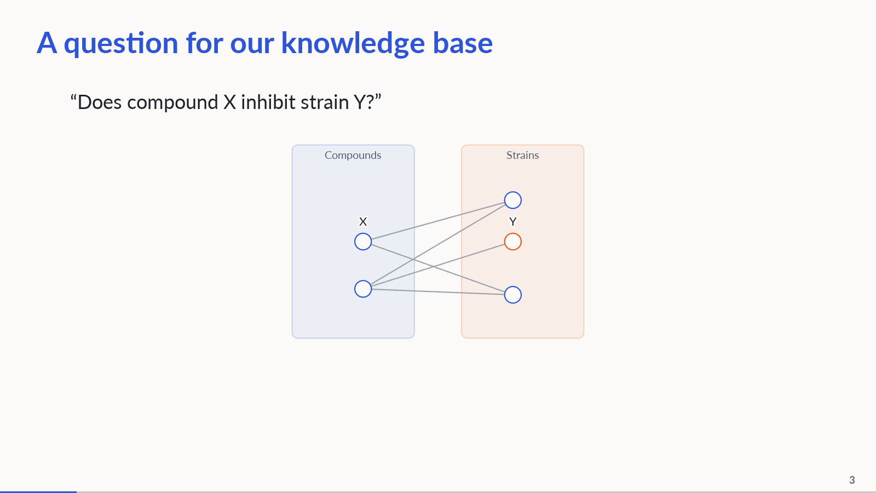
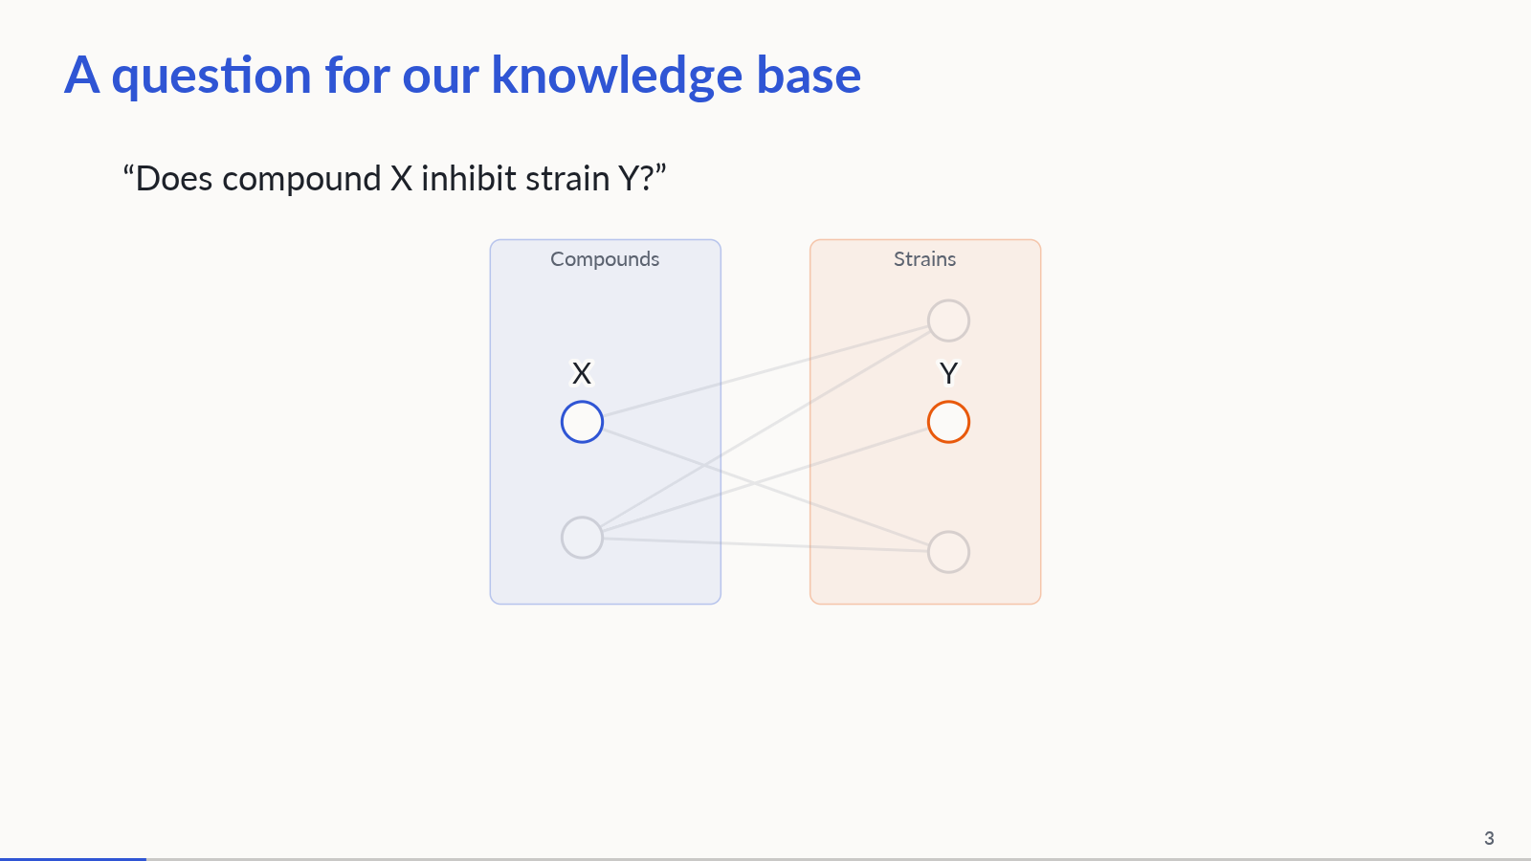
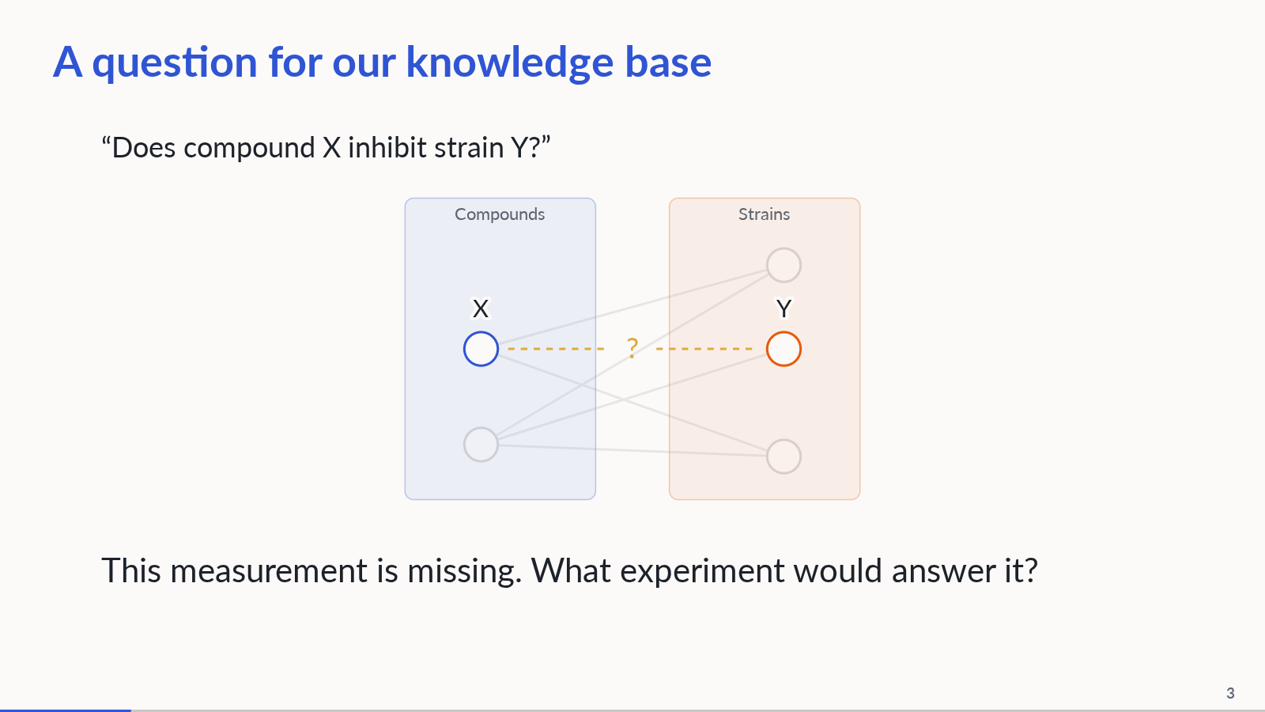
Notes:
Abstract bipartite knowledge base: two compound nodes on the left and three strain nodes on the right. All existing edges cross the partitions. Start unlabeled; reveal the researcher question; identify X and Y; zoom and dim surrounding knowledge; highlight the missing X–Y measurement. The demonstration assumes an up-to-date KB and researcher-supplied identities. Known evidence would be returned with citations; the researcher decides whether another experiment is worthwhile. The missing link here is genuinely unanswered under an up-to-date-KB assumption, not a literature-completeness judgment. Concealing evidence is reserved for benchmark simulation. This is not an actual query trace.
PowerPoint: click to reveal successive captured states; smooth HTML motion is represented by discrete reveals. Demo: https://zhang-etal-biohack.pages.dev/talks/biohack/graph/

Slide 4
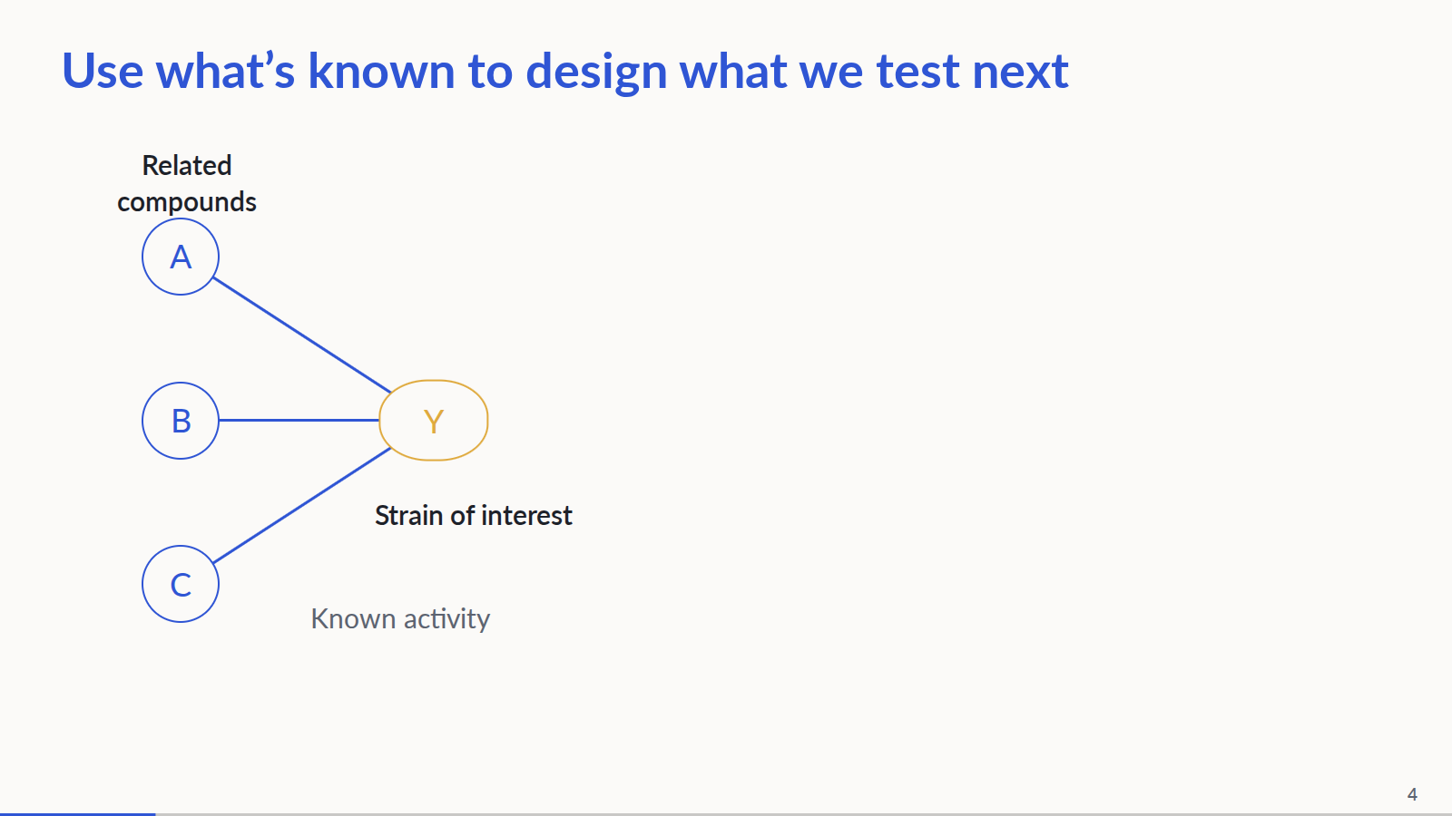
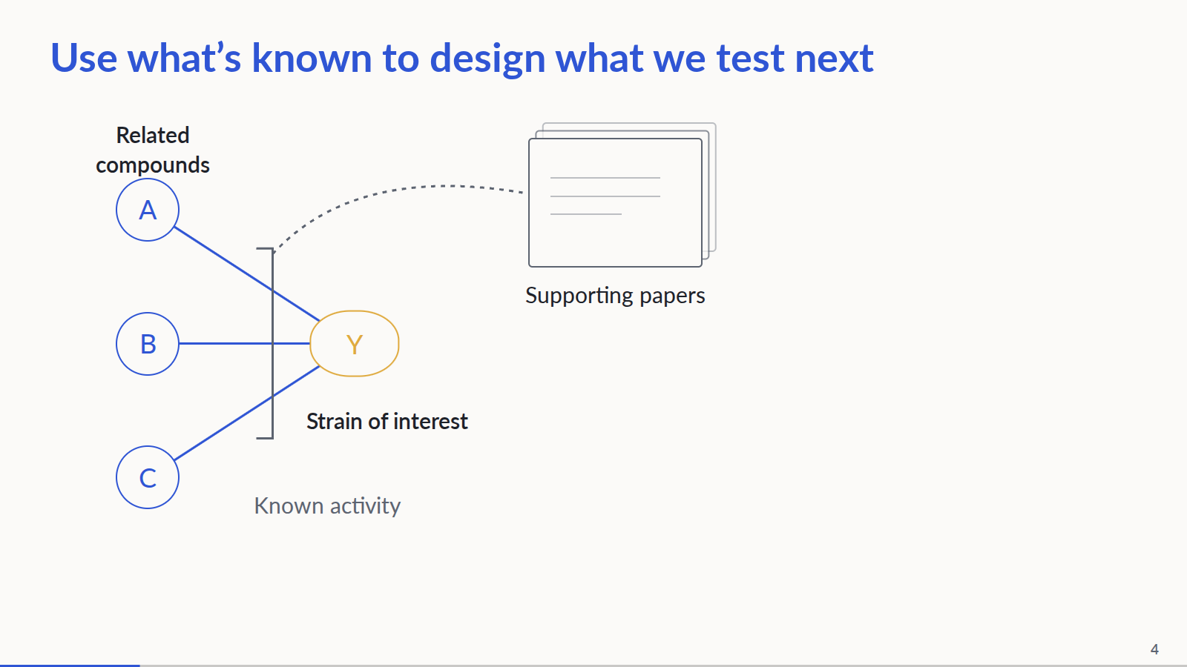
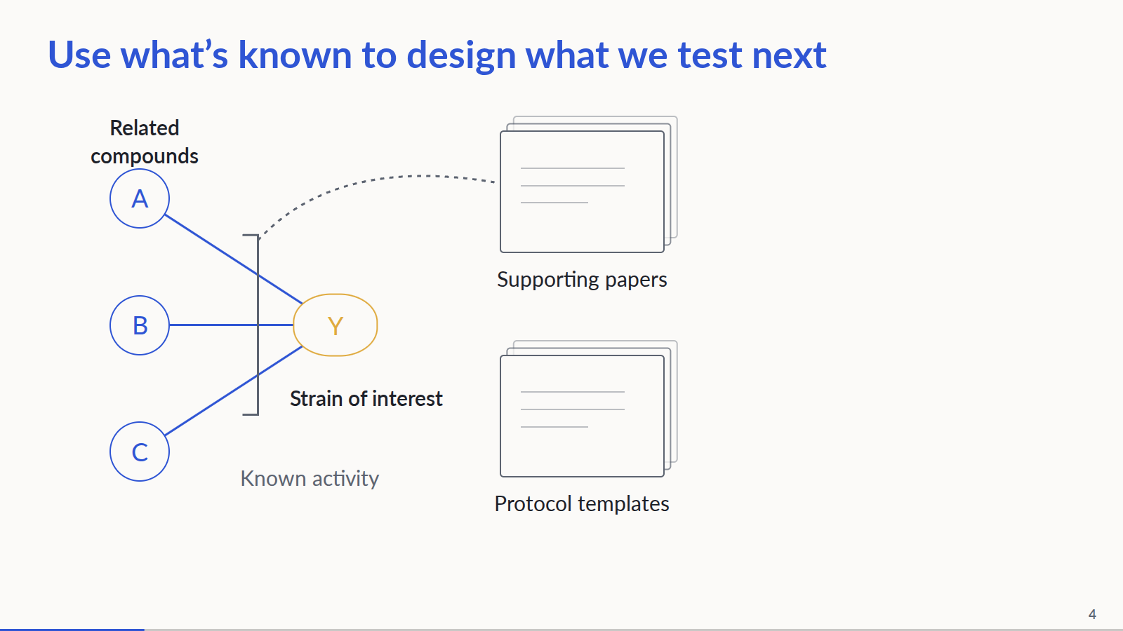
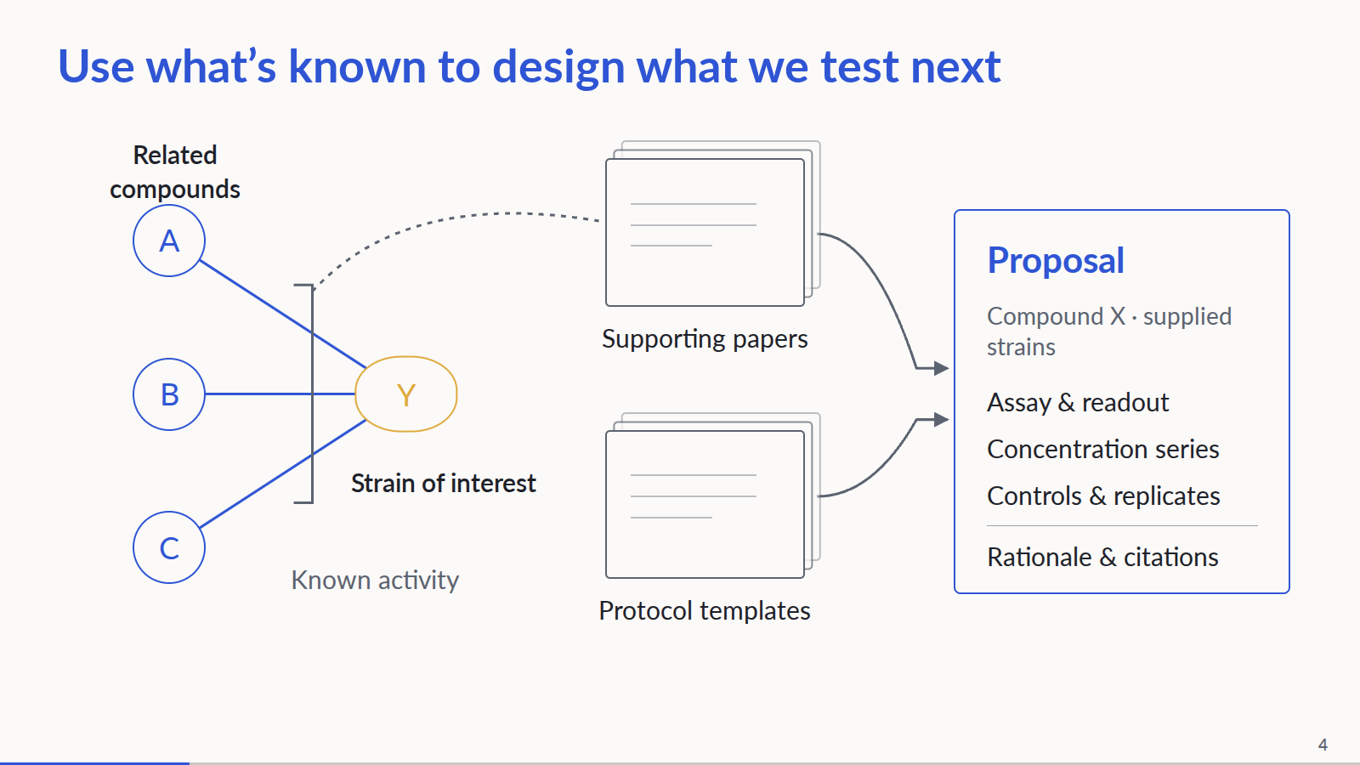
Notes:
Conceptual bacterial workflow. Related compounds have measured activity on the organism of interest. Papers support those measurements; protocol templates are a separate source of assay structure, controls and defaults, not necessarily the original protocols from those papers. Together they inform a reviewable experiment proposal for compound X and the supplied panel. Species-level evidence does not establish a result for every strain. Current agent retrieval is IC50-based; the bacterial graph and downstream MIC execution exist separately. No end-to-end bacterial run or measured inhibition is claimed. Proposal fields shown here are categories, not populated experimental recommendations.
PowerPoint: click to reveal successive captured states; smooth HTML motion is represented by discrete reveals. Demo: https://zhang-etal-biohack.pages.dev/talks/biohack/graph/

Slide 5
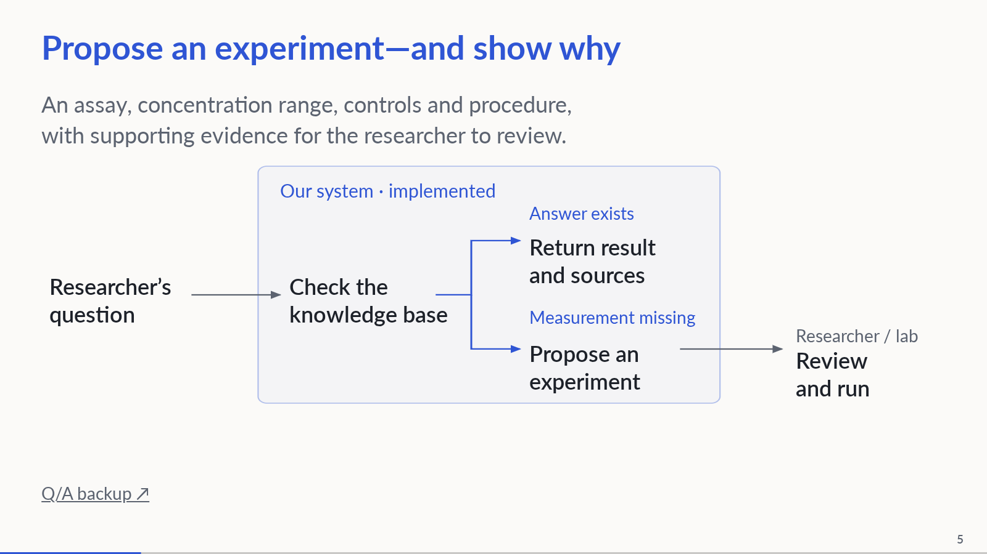
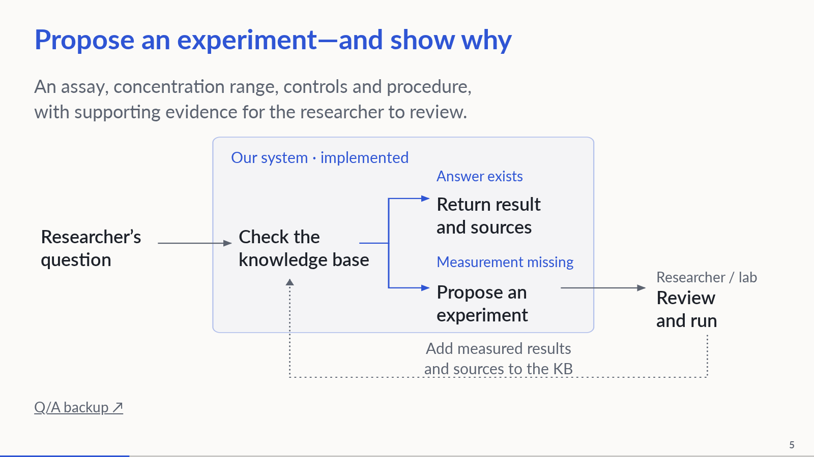
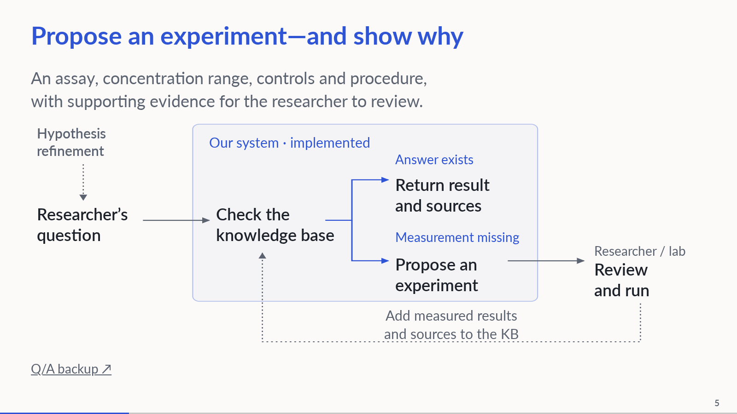
Notes:
3:00–4:00. The accented region identifies implemented system behavior: both returning an existing answer and proposing an experiment when a measurement is missing. Solid internal connections represent these implemented paths; the distinction is implementation status, not benchmark coverage. The researcher supplies the question and reviews a proposed experiment before the lab runs it. Show both implemented branches and the researcher/lab handoff on arrival; then reveal the result feedback loop, followed by upstream hypothesis refinement. Muted dotted arrows identify proposed connections: hypothesis refinement and measured-result ingestion. Researcher/lab review and execution remain outside the system box; the solid handoff does not claim autonomous experimental execution. The feedback loop adds measured results, assay conditions and provenance, including negative results, to the KB. Hypothesis refinement sharpens an existing idea into a testable question. The current connected agent is IC50-based; this conceptual diagram does not establish an end-to-end bacterial run. Existing evidence does not prevent confirmatory experiments.
PowerPoint: click to reveal successive captured states; smooth HTML motion is represented by discrete reveals. Demo: https://zhang-etal-biohack.pages.dev/talks/biohack/graph/

Slide 6
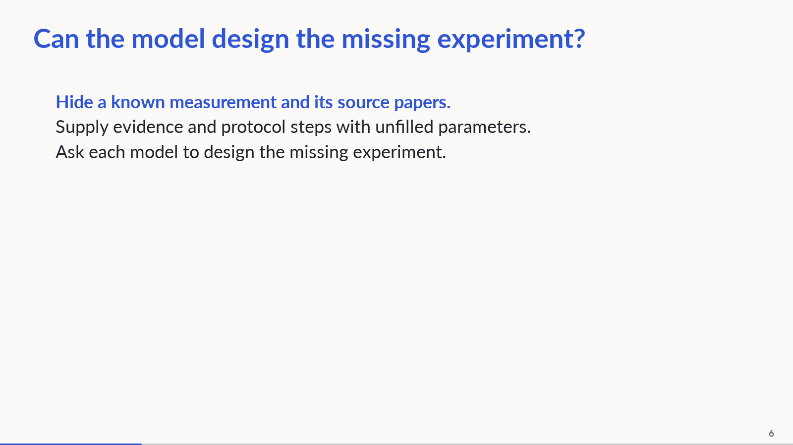
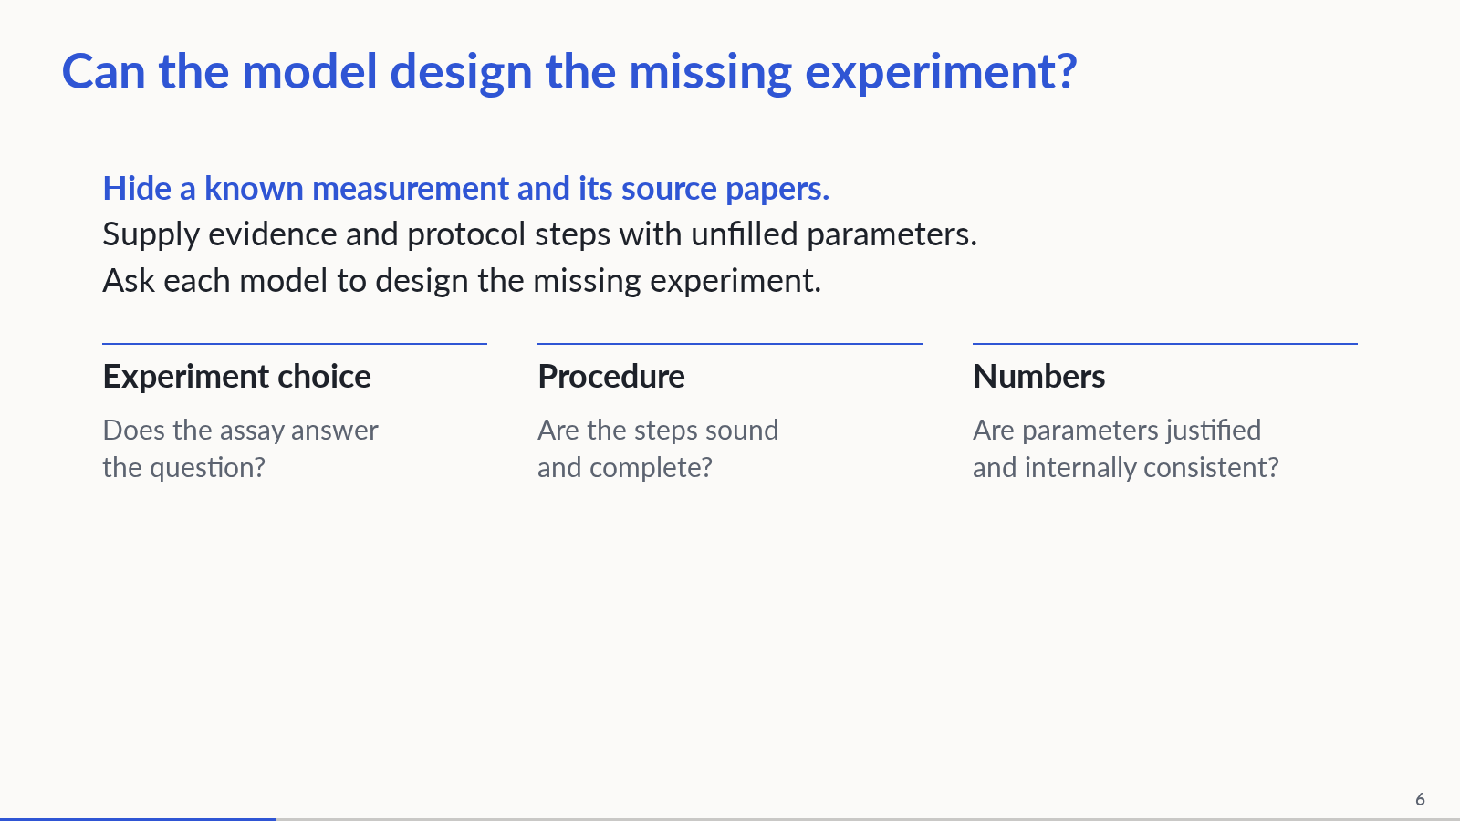
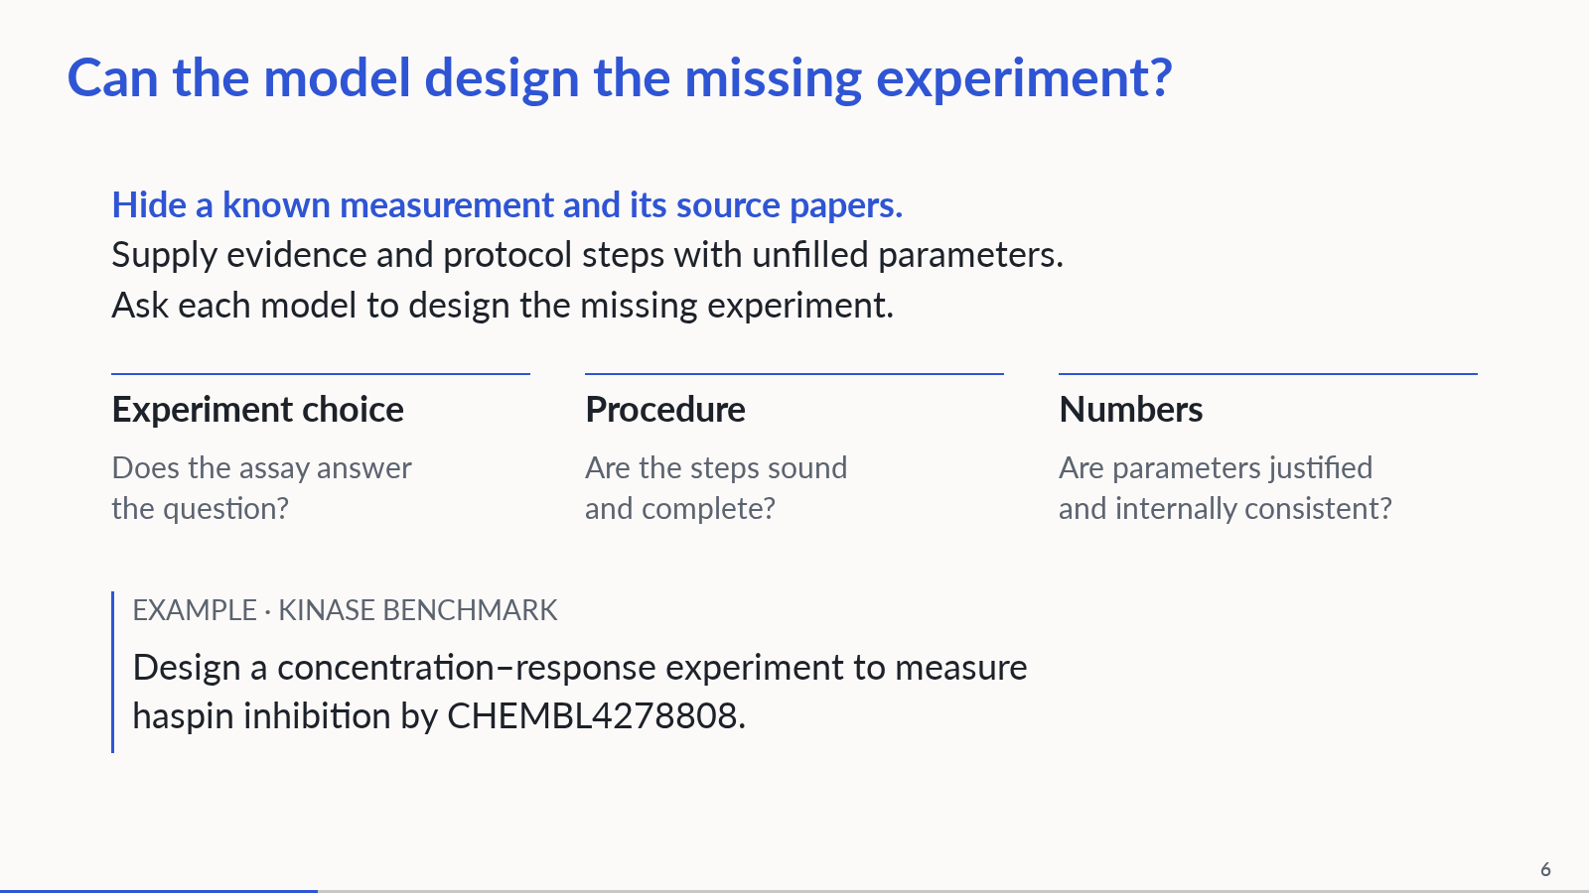
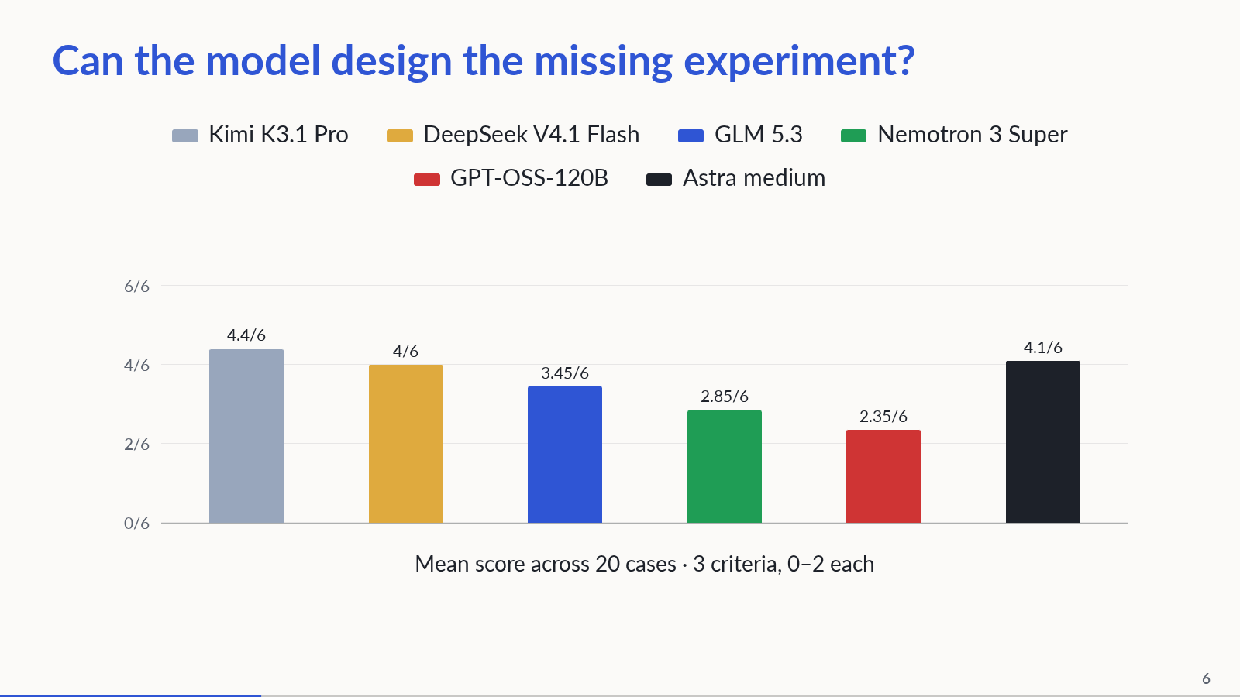
Notes:
4:00–5:15. Four beats: test setup; three assessment criteria; a shortened version of the actual case-1 question; then the results figure. The original case-1 prompt additionally asks for an ordered procedure and justified parameters and forbids remembered potency. In a benchmark simulation, known query-pair evidence and its source documents are excluded from fixed input packets. Six models each produce one response on 20 manually selected, correlated kinase/cell cases (120 responses). Generation uses those fixed packets, with no live graph retrieval. Grade experiment suitability, procedural soundness and numerical soundness, 0–2 each per case. The chart shows mean total scores out of 6 across 20 cases. The original 100 responses were regraded with a frozen rubric by blinded Astra-medium judges; scores are provisional, not expert validation or pass rates. One judge sample per response; no inter-rater agreement estimate. Critical-failure case counts, separate from mean scores: Kimi 0/20, DeepSeek 1/20, GLM 8/20, Nemotron 17/20, GPT-OSS 19/20; Astra medium 0/20. Astra adds 20 proposals scored 4.10/6; it also serves as judge in separate fresh contexts, so same-model preference is possible. Astra generation uses medium reasoning and a different serving interface; prior candidates used low reasoning. Source: benchmark/runs/astra-medium-20/RESULTS.md at aff33ef. No statistical ranking, deterministic baseline, measured KG lift or MIC end-to-end result is established. Models: Kimi K3.1 Pro, GLM 5.3 (not Flash), DeepSeek V4.1 Flash 1017, Nemotron 3 Super, GPT-OSS-120B. Concrete finding, in plain language: one DeepSeek response told the researcher to prepare 11 different concentrations, but the same response listed 10 in its experiment settings. A person would need to resolve that disagreement before using the proposal. Protocol steps here are seven manually generalized benchmark cards with parameter slots and prerequisites, not raw graph nodes or automatically extracted paper protocols. Sources: biohack/data/pilot_results.json and benchmark/judge/RESULTS.md at source commit c1a0e32, plus committed benchmark/runs outputs. Keep detailed axis scores and limitations for Q/A.
PowerPoint: click to reveal successive captured states; smooth HTML motion is represented by discrete reveals. Demo: https://zhang-etal-biohack.pages.dev/talks/biohack/graph/

Slide 7
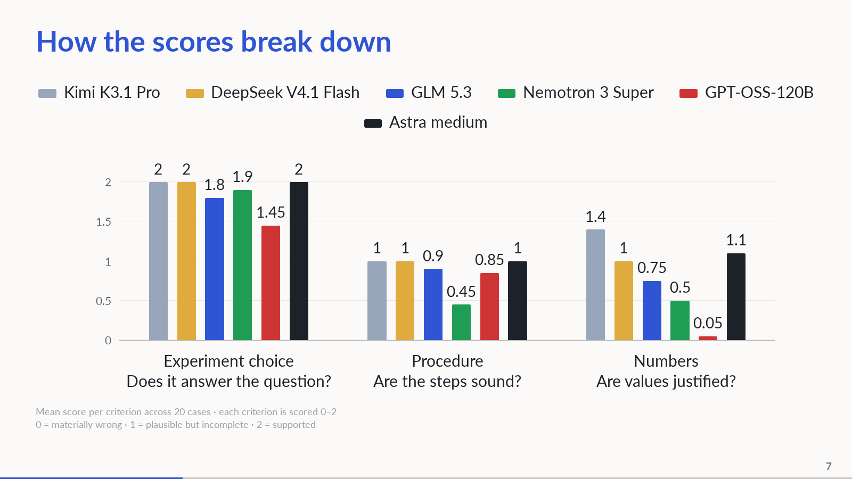
Notes:
Each bar is the mean of 20 case scores on one criterion, from 0 to 2. These three means sum to the preceding total out of 6. Zero means materially wrong; one is plausible but incomplete; two is supported for that criterion. Scores are provisional Astra-medium judgments, not pass rates or wet-lab validation. Astra generated its own candidate responses at medium reasoning using a different serving interface and was judged by fresh Astra contexts; same-model preference is possible. Source: biohack/data/pilot_results.json and the linked benchmark reports. A procedure score of 1 can reflect an honest outline with unresolved lab settings.
PowerPoint: click to reveal successive captured states; smooth HTML motion is represented by discrete reveals. Demo: https://zhang-etal-biohack.pages.dev/talks/biohack/graph/

Slide 8
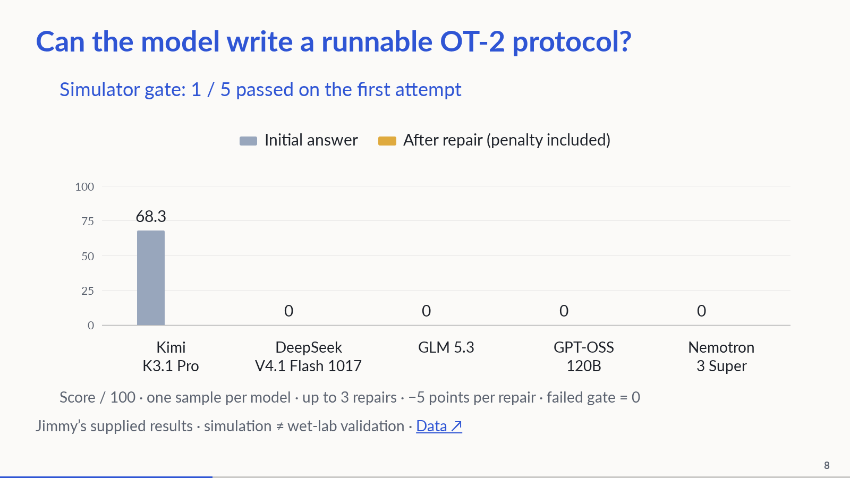
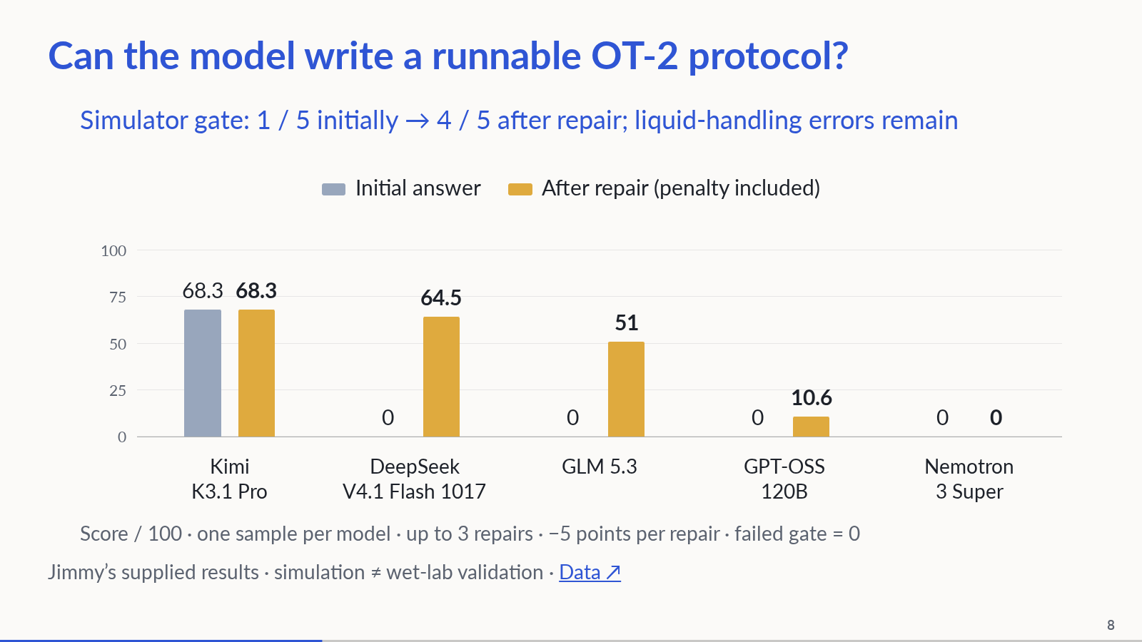
Notes:
Separate OT-2 MIC protocol benchmark supplied by Jimmy on 2026-11-08; not an end-to-end execution of the preceding kinase/cell proposals. Five models, one initial sample each, high reasoning effort. Same MIC prompt; 16 weighted rubric rows normalized to 100. A failed simulator/hardware gate scores zero. Up to three repairs using simulator feedback, with five points deducted per repair. Gate pass count rises from one to four, but correct liquid handling is not guaranteed: GPT-OSS passes after three repairs while its dilution/control logic is wrong. Nemotron still fails after three repairs. Repair counts in chart order: 0, 1, 2, 3, 3. Reference scores 100. Model labels and scores are as supplied; independent reproduction is pending. Source: benchmark/step3_MIC_benchmark/candidates_step3/benchmark_before_after.md and leaderboard.csv. Source documents simulator API-level adjustments. This small benchmark does not establish statistical superiority or wet-lab success.
PowerPoint: click to reveal successive captured states; smooth HTML motion is represented by discrete reveals. Demo: https://zhang-etal-biohack.pages.dev/talks/biohack/graph/

Slide 9
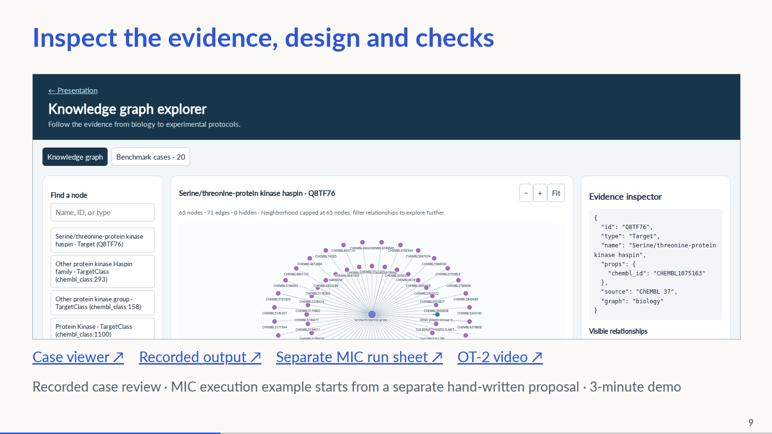
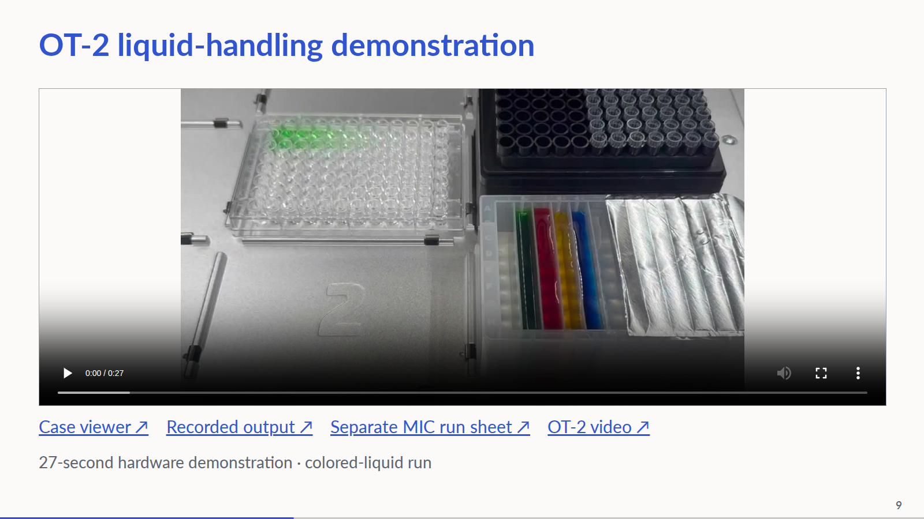
Notes:
5:15–8:15, strict three-minute evidence walkthrough. 0:00–0:30 establish the question and show the supplied case input. 0:30–1:30 inspect retained evidence and step cards in the benchmark-case tab; the withheld answer is reviewer-only. 1:30–2:15 reveal the held-out record and discuss experiment/steps/numbers; open the recorded model output via the link if useful. 2:15–3:00 advance to the second reveal and play the 27-second OT-2 hardware demonstration. The clip shows the team’s colored-liquid run; it is not established as the execution of the model proposal or the separate generated MIC protocol. The MIC run sheet remains linked for inspection. This last artifact begins from a hand-written four-species proposal; it is NOT the execution of the model output just shown. Say so explicitly. This is a recorded-artifact walkthrough, not a live agent run. If the UI is slow, use the pre-opened pages; do not run paid model calls during the pitch. No wet-lab outcomes claimed.
PowerPoint: click to reveal successive captured states; smooth HTML motion is represented by discrete reveals. Demo: https://zhang-etal-biohack.pages.dev/talks/biohack/graph/

Slide 10
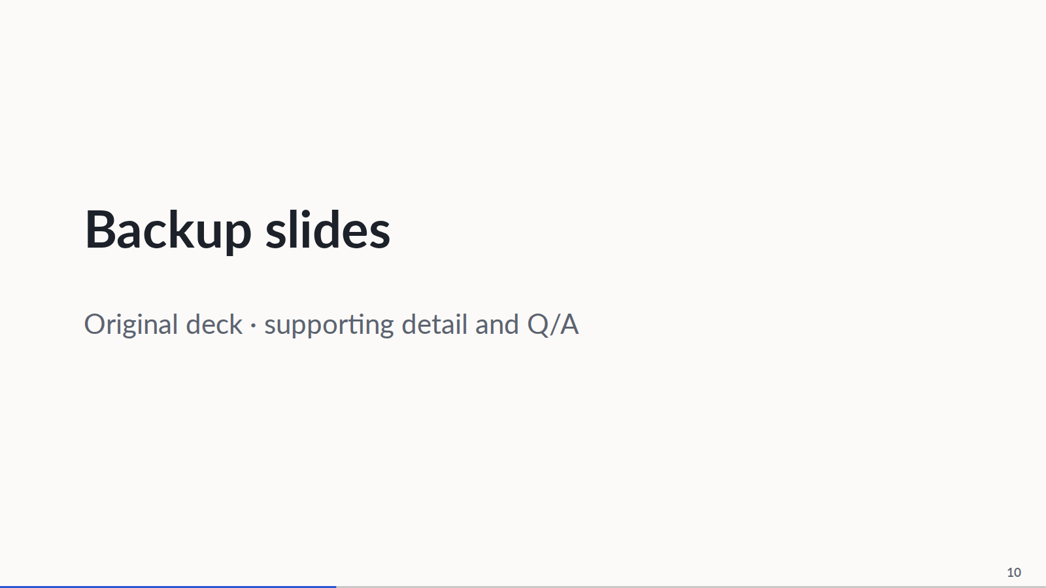
Notes:
The timed pitch ends after the preceding demo slide. The remaining nineteen slides from the original deck follow for questions and reference.
PowerPoint: click to reveal successive captured states; smooth HTML motion is represented by discrete reveals. Demo: https://zhang-etal-biohack.pages.dev/talks/biohack/graph/

Slide 11
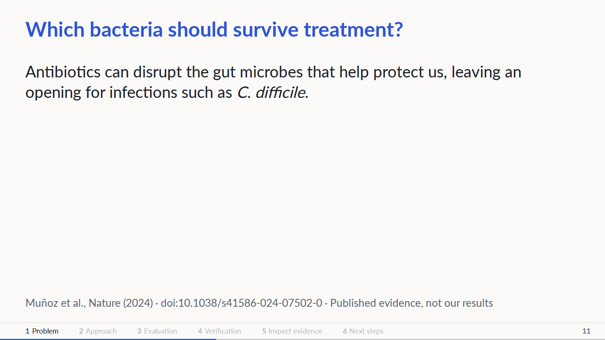
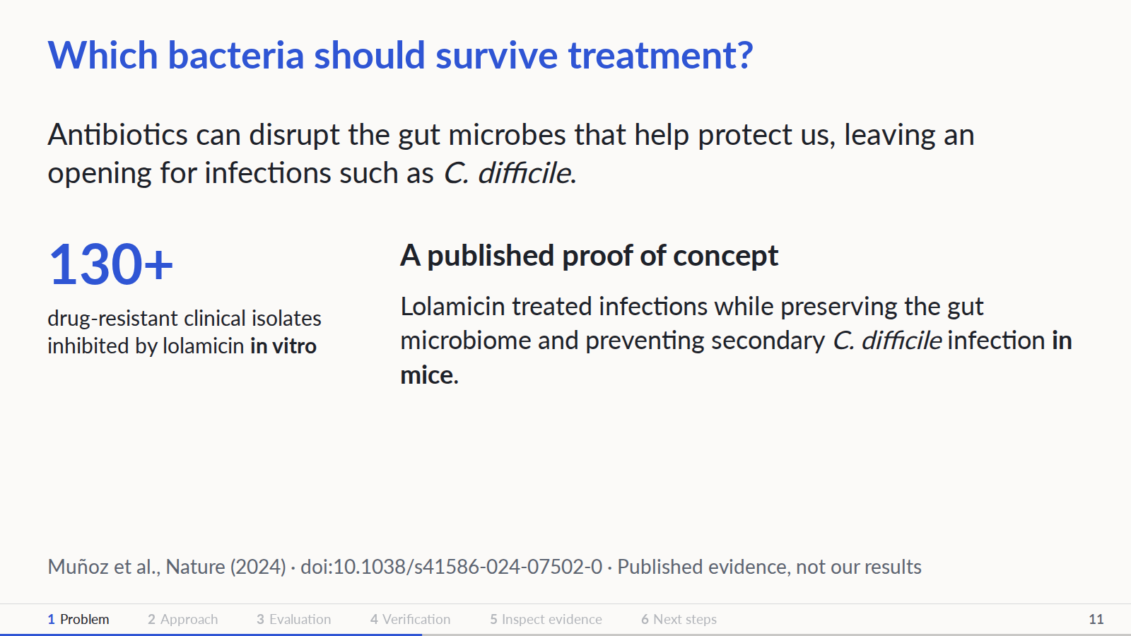
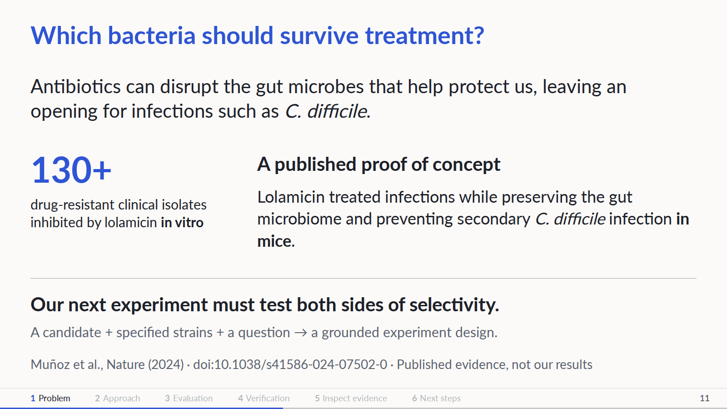
Notes:
Open with the consequence: an antibiotic can inhibit a pathogen while also disrupting gut bacteria that help resist colonization by opportunistic pathogens. Pathogen potency alone does not establish microbiome preservation. This motivates measuring both sides early in discovery. Published proof of concept: Muñoz et al., A Gram-negative-selective antibiotic that spares the gut microbiome, Nature 630, 429–436 (2024), doi:10.1038/s41586-024-07502-0. https://www.nature.com/articles/s41586-024-07502-0 ; https://pubmed.ncbi.nlm.nih.gov/38811738/ . The authors report activity against more than 130 multidrug-resistant clinical isolates and efficacy in mouse infection models, with microbiome preservation and prevention of secondary C. difficile infection in mice. These are separate in-vitro and animal findings, not human efficacy or results from our system. Our researcher supplies a candidate and specified bacterial strains; selecting either is upstream. The proposed workflow connects available biological evidence to an appropriate concentration series, culture requirements and a lab-feasible MIC plan. A panel MIC assay is an early selectivity screen; it cannot establish whole-microbiome safety, human exposure, clinical benefit or efficacy. The immediate output is a reviewable experiment, and the longer-term motivation is finding candidates with less collateral microbiome damage.
PowerPoint: click to reveal successive captured states; smooth HTML motion is represented by discrete reveals. Demo: https://zhang-etal-biohack.pages.dev/talks/biohack/graph/

Slide 12
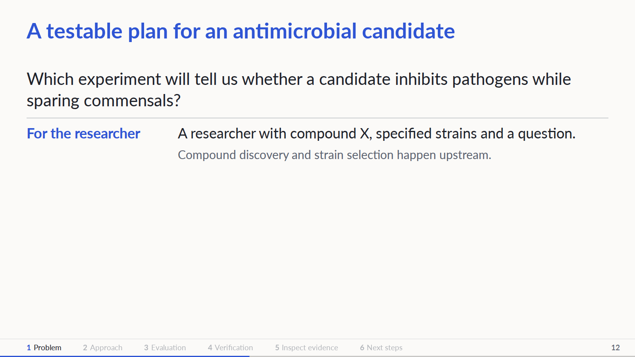
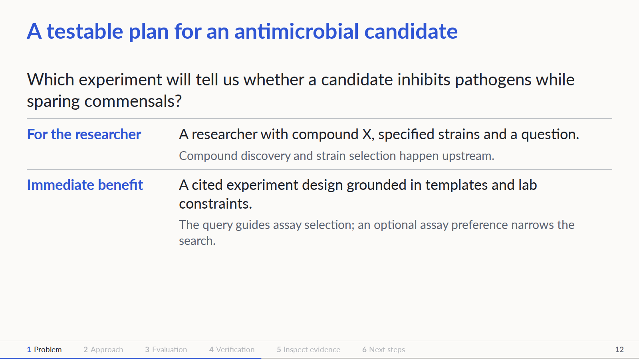
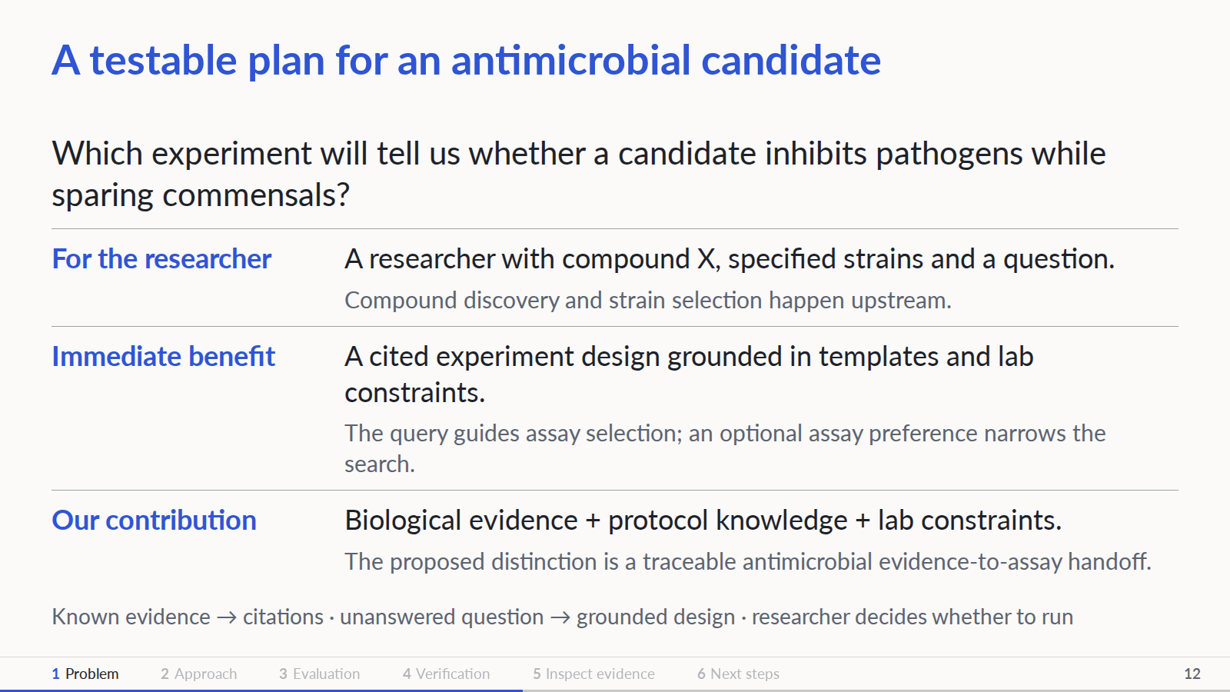
Notes:
Grounding agreement: assume the KB is up to date. Known evidence is returned with citations; the researcher decides whether to run another experiment. The demo follows a genuinely unanswered question, not incomplete-literature meta-analysis. An incompatible proposal must stop before compilation or hardware execution, even if its limitations are displayed. This is the required workflow, not proof that current runtime gates implement it. Whether LLM step assembly improves on template selection and parameter filling remains open. Evaluate appropriate experiment, sound steps and reasonable numerical parameters. Hiding known evidence simulates the missing-information case only in evaluation. Our immediate end-user is an antimicrobial discovery researcher moving a candidate from a virtual screen into experimental testing. Given specified bacterial strains, the question is how to measure pathogen inhibition and effects on commensals with an appropriate MIC experiment. The intended immediate benefit is less manual translation from evidence to a reviewable assay plan; time savings and biological selectivity have not been measured. Strain selection is upstream of this workflow, alongside compound discovery. MIC means minimum inhibitory concentration. Our contribution is the combination of biological evidence, protocol knowledge and explicit lab constraints in one traceable workflow. We do not claim a new foundation model or a demonstrated first-in-industry algorithm. Industry context: Benchling offers AI experimental design and instrument-connected automation; Opentrons Protocol Designer creates executable robot protocols. Our proposed distinction is the focused antimicrobial evidence-to-assay handoff, to be evaluated rather than asserted as superior. Sources: https://www.benchling.com/ai/experimental-design ; https://www.benchling.com/automation ; https://docs.opentrons.com/protocol-designer/ . Commensal-sparing is an illustrative goal, not a validated result. Sparse commensal measurements and species-specific culture and oxygen requirements limit what can be inferred or executed. Patient benefit is a longer-term motivation; this prototype supports research decisions.
PowerPoint: click to reveal successive captured states; smooth HTML motion is represented by discrete reveals. Demo: https://zhang-etal-biohack.pages.dev/talks/biohack/graph/

Slide 13
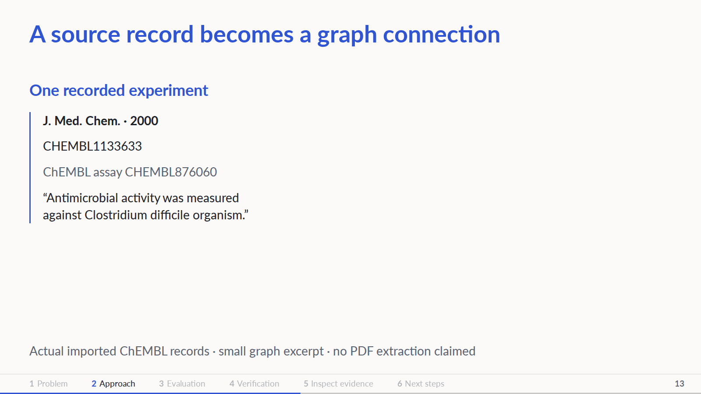
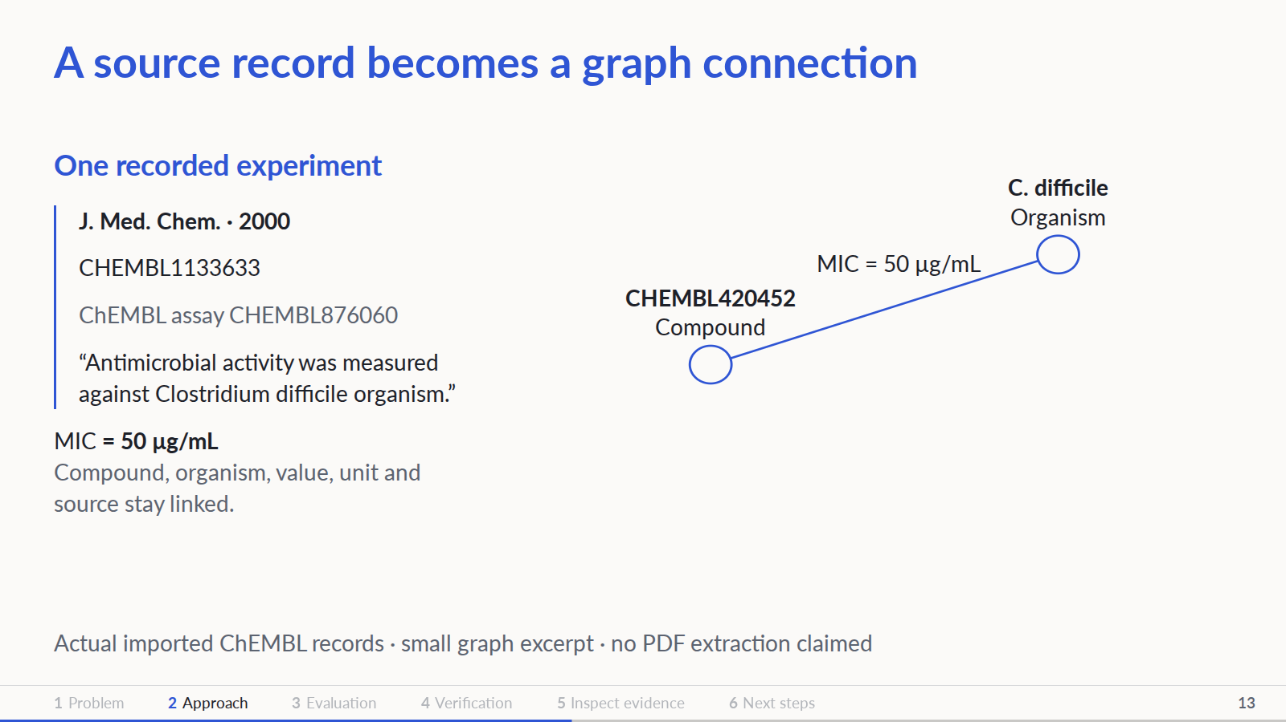
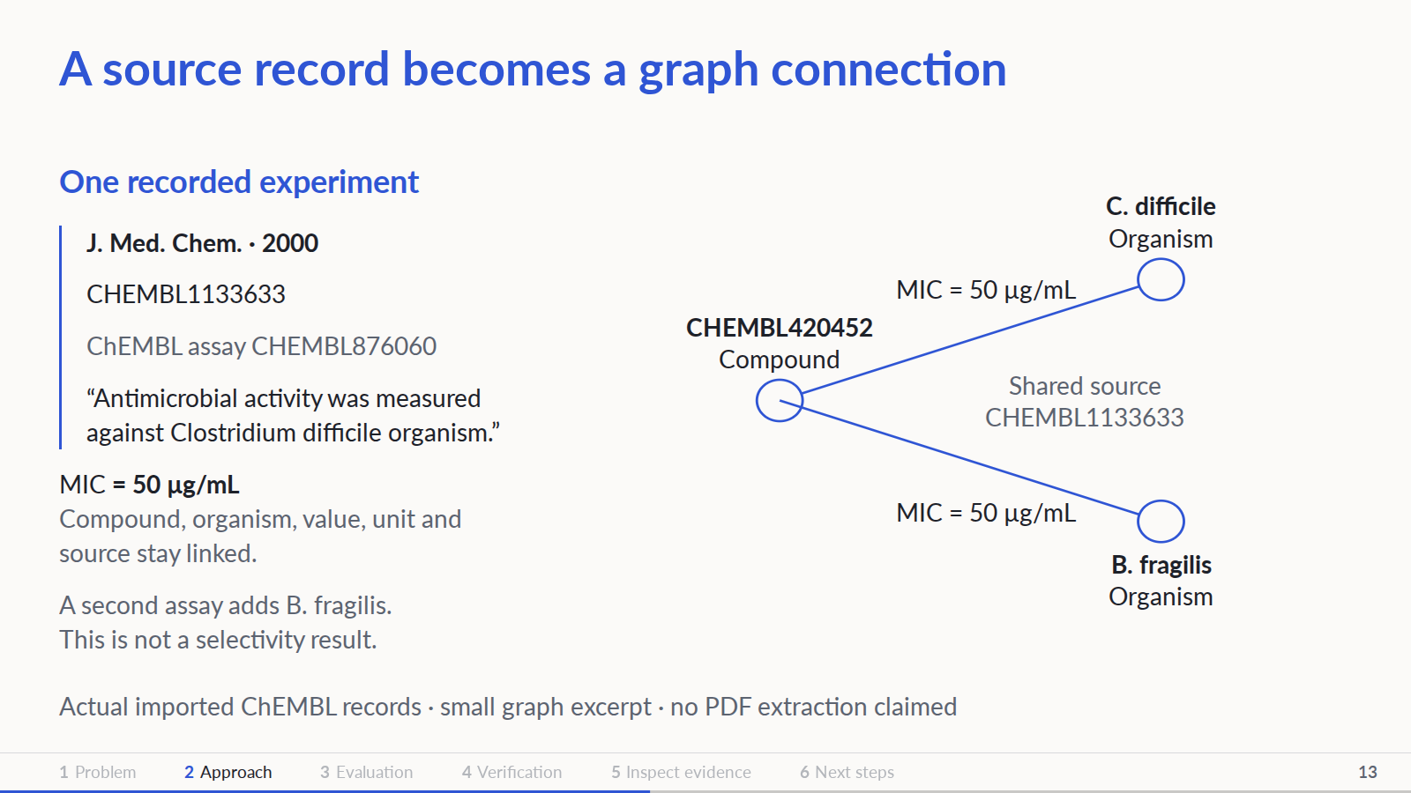
Notes:
Literal ChEMBL 37 graph_bacteria records for CHEMBL420452. Assay CHEMBL876060 reports MIC = 50 ug.mL-1 against C. difficile, linked to document CHEMBL1133633, J Med Chem (2000). Second assay CHEMBL875007 reports 50 ug.mL-1 against B. fragilis from the same document. Measurement links are real; diagram positions and source connectors are a presentation of edge metadata, not a complete graph neighborhood. ChEMBL import, not demonstrated PDF extraction. Neither comparison establishes selectivity.
PowerPoint: click to reveal successive captured states; smooth HTML motion is represented by discrete reveals. Demo: https://zhang-etal-biohack.pages.dev/talks/biohack/graph/

Slide 14
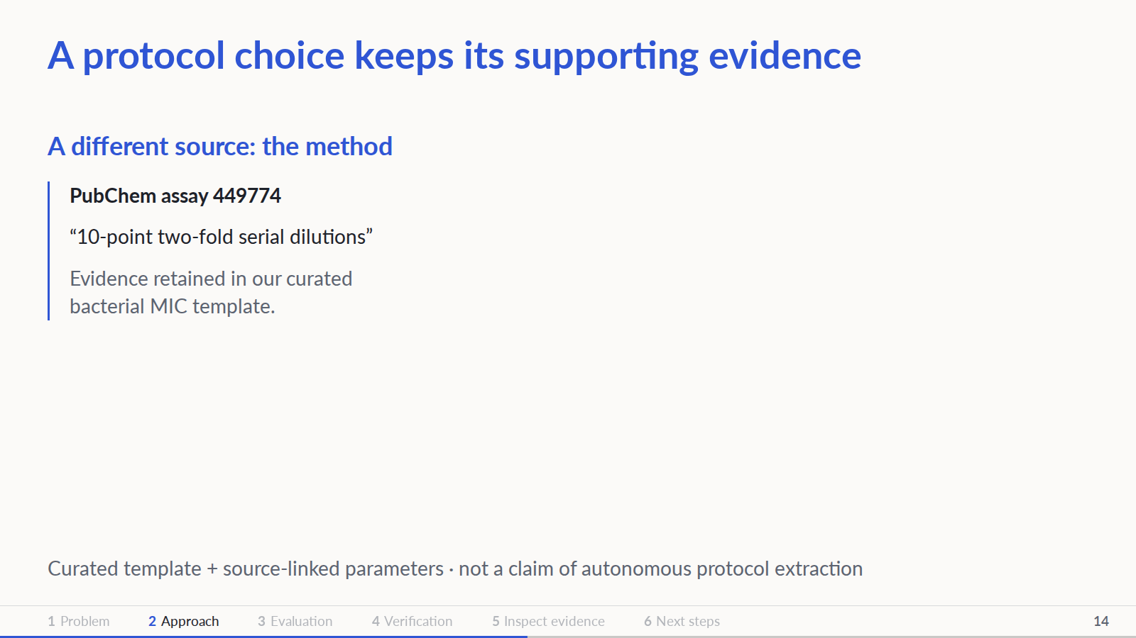
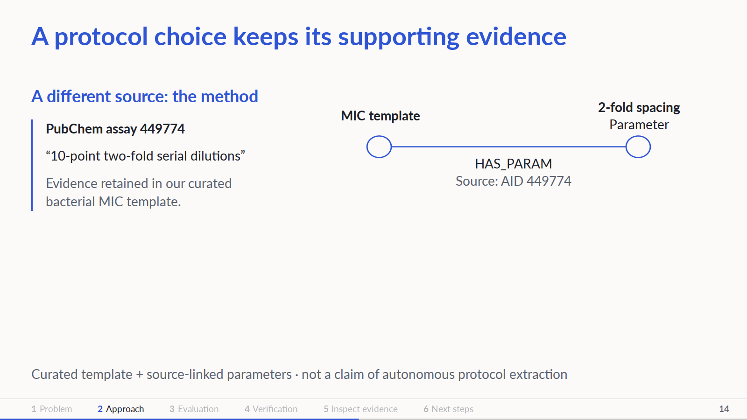
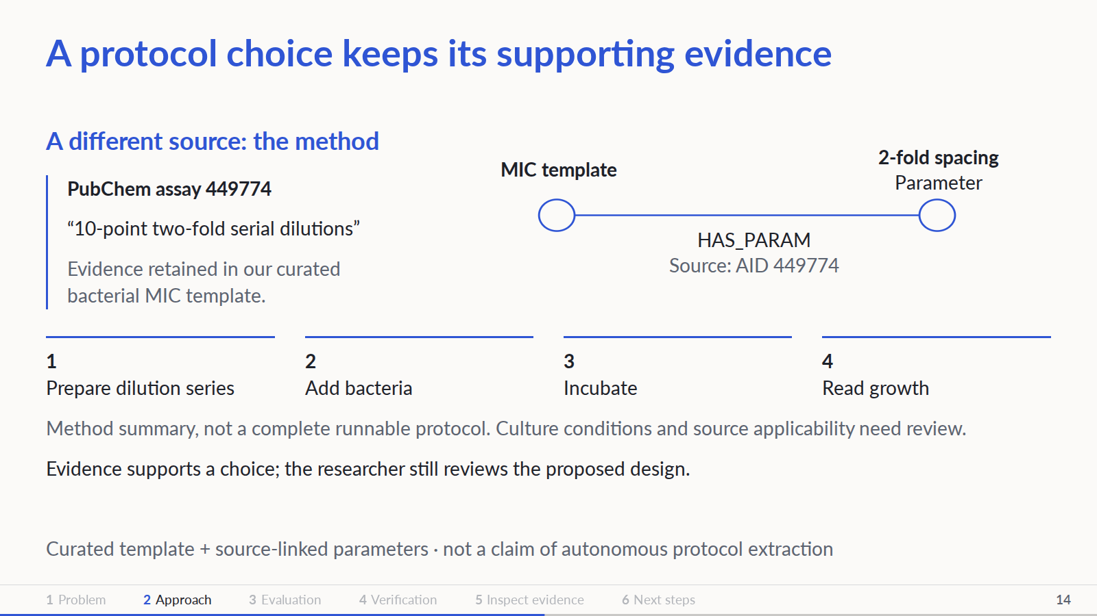
Notes:
Source quote and observed dilution factor are from kg/protocols/templates/bacterial_mic_broth.json, parameters.dilution_factor.observed[0], PubChem AID 449774. The template is agent-curated; its source applicability requires domain review. The prepare/inoculate/incubate/read chain summarizes the method, not an exact rendering of all CSV step nodes. Do not imply these conditions were extracted from the ChEMBL document on slide 4. The next plate is a separate hand-written execution example.
PowerPoint: click to reveal successive captured states; smooth HTML motion is represented by discrete reveals. Demo: https://zhang-etal-biohack.pages.dev/talks/biohack/graph/

Slide 15
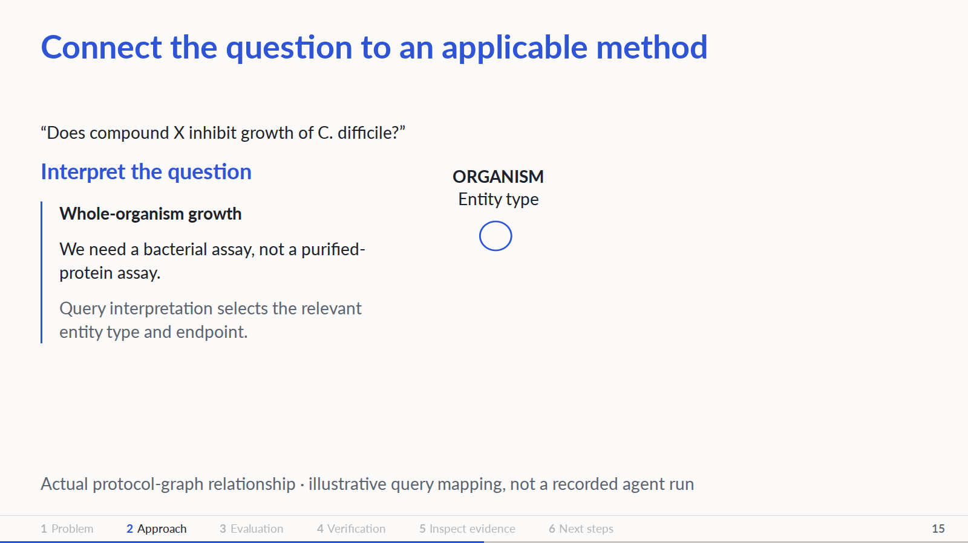
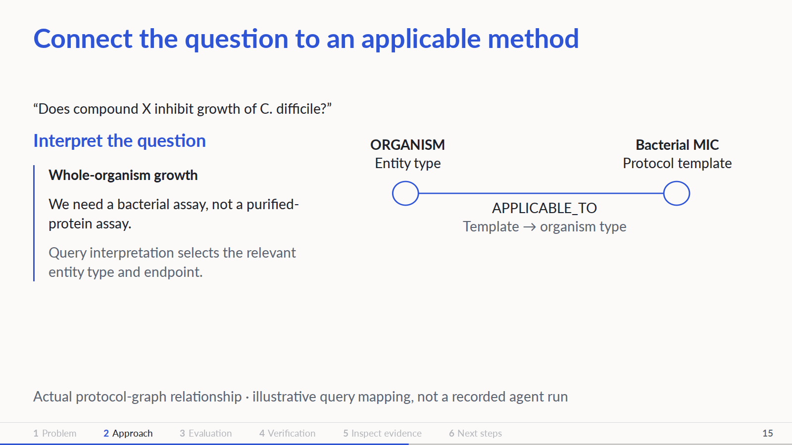
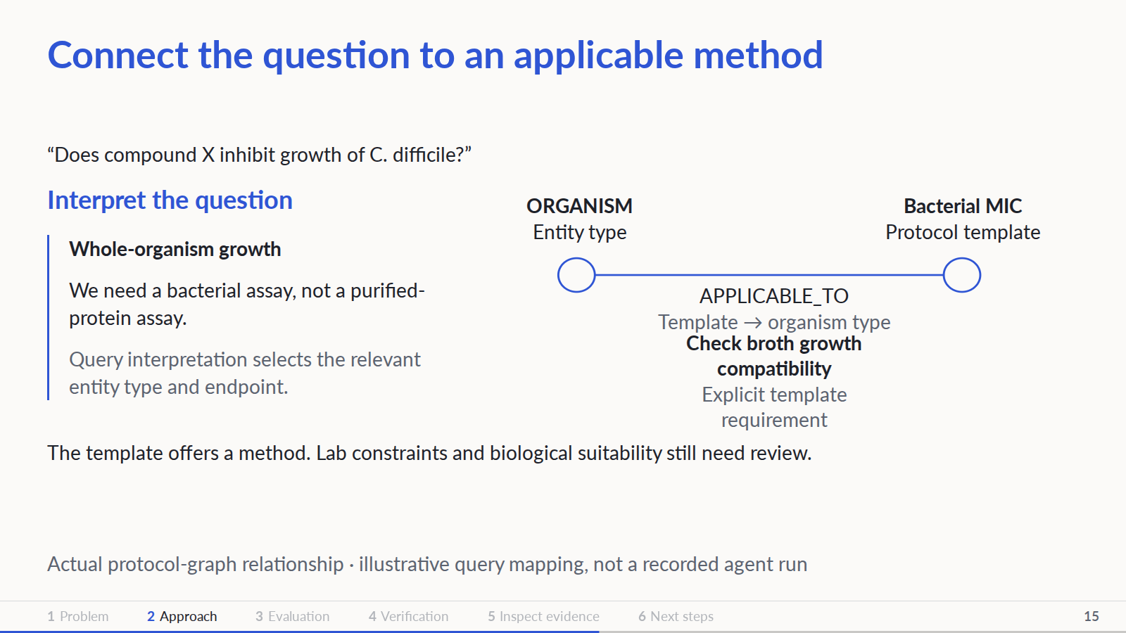
Notes:
Graph relations: kg/protocols/graph/edges.csv includes proto:bacterial_mic_broth APPLICABLE_TO chembl_target_type:ORGANISM and REQUIRES cond:target_is_whole_organism / cond:strain_growth_readable_in_broth. The C. difficile query is an illustrative routing example, not an executed agent trace. Organism type is query interpretation, not a claimed direct CSV edge from that species to the protocol. The current helper described in agent/tools.py defaults to kinase retrieval; this shows MIC compatibility evidence, not proof of an integrated runtime path.
PowerPoint: click to reveal successive captured states; smooth HTML motion is represented by discrete reveals. Demo: https://zhang-etal-biohack.pages.dev/talks/biohack/graph/

Slide 16
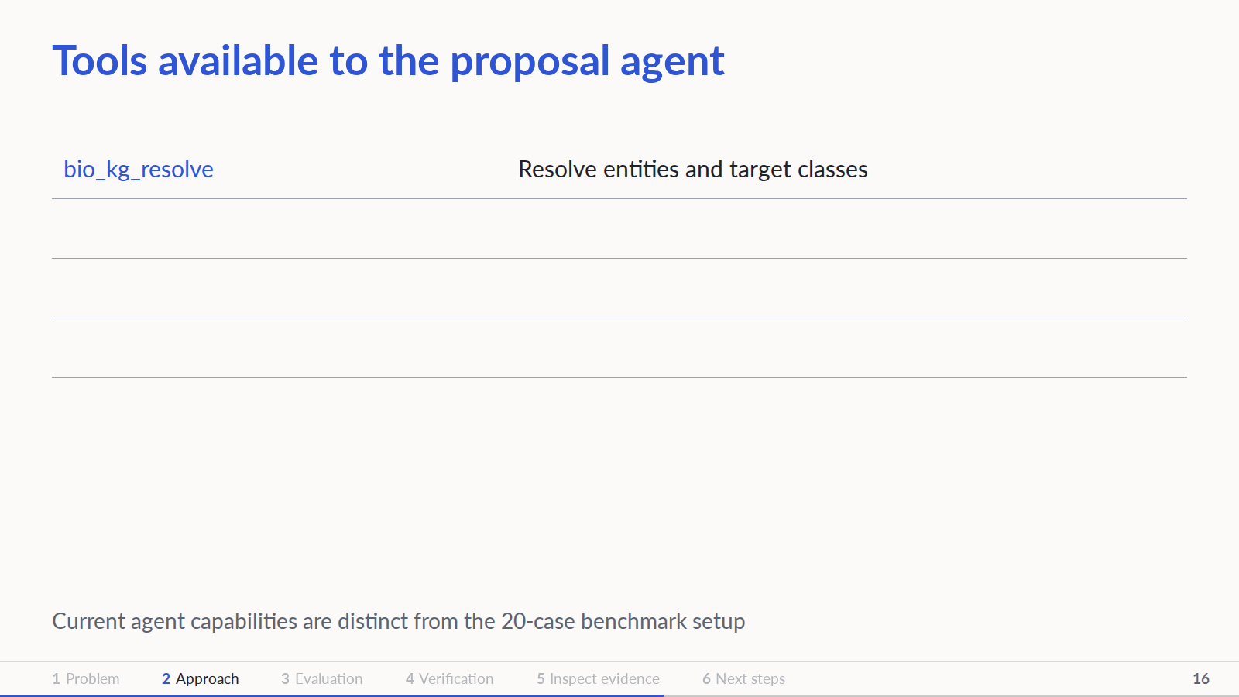
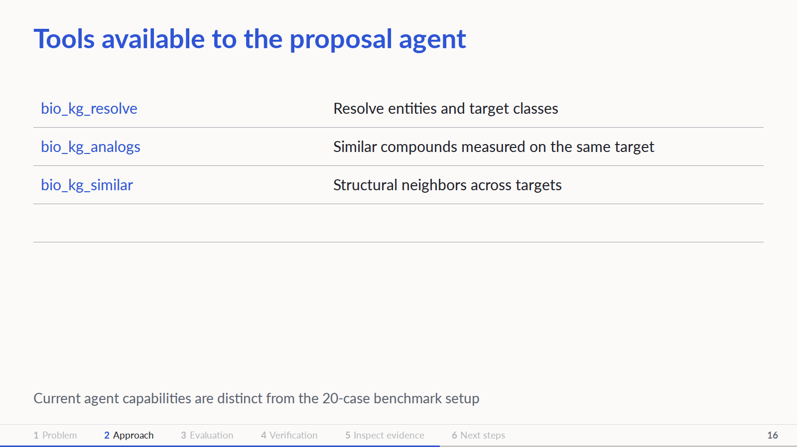
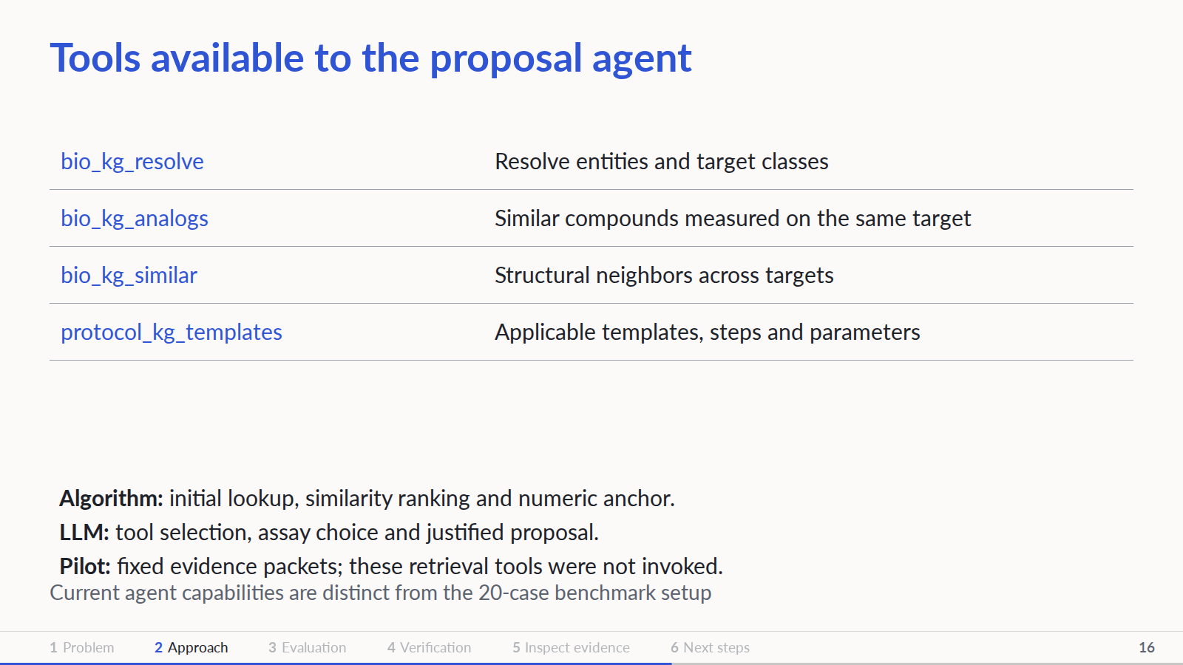
Notes:
Source: agent/tools.py TOOL_SPECS, agent/anchor.py and proposal flow. Four retrieval tools are exposed to the LLM. Initial lookup and numeric anchor are deterministic. The five-model pilot used fixed input packets and no retrieval tool loop.
PowerPoint: click to reveal successive captured states; smooth HTML motion is represented by discrete reveals. Demo: https://zhang-etal-biohack.pages.dev/talks/biohack/graph/

Slide 17
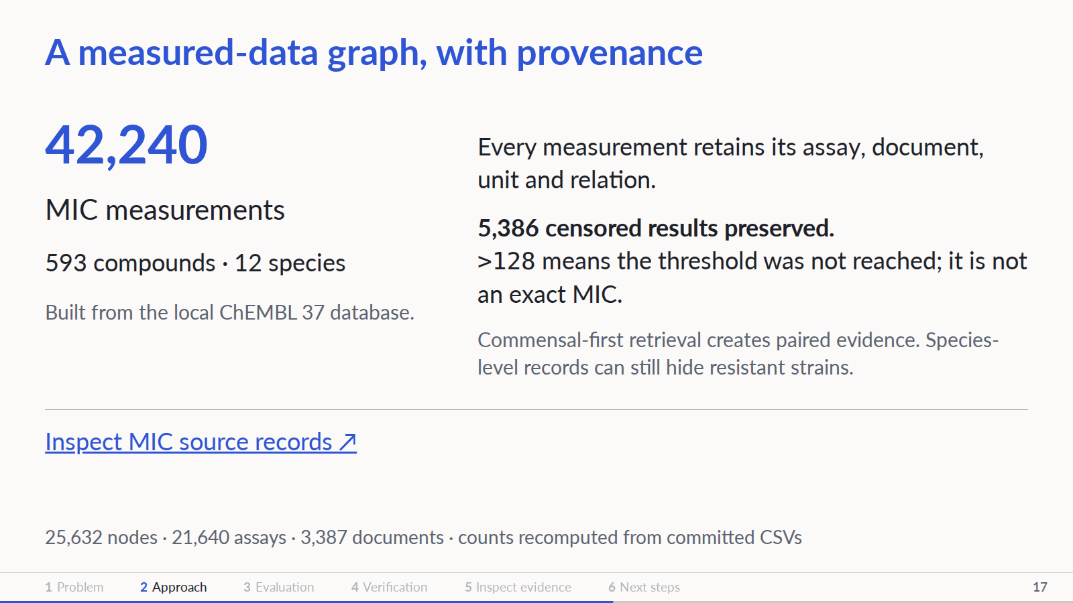
Notes:
Repository audit: main 30886d3 (2026-11-08). Sources: kg/biology/build_bacteria.py, chembl_bacteria_db.py, graph_bacteria/{nodes,edges}.csv. No benchmark hold-out applied to this MIC graph. Traits are hand-curated. A high MIC in one resistant isolate does not prove commensal sparing. The separate explorer contains kinase/protocol data, not the bacterial MIC graph.
PowerPoint: click to reveal successive captured states; smooth HTML motion is represented by discrete reveals. Demo: https://zhang-etal-biohack.pages.dev/talks/biohack/graph/

Slide 18
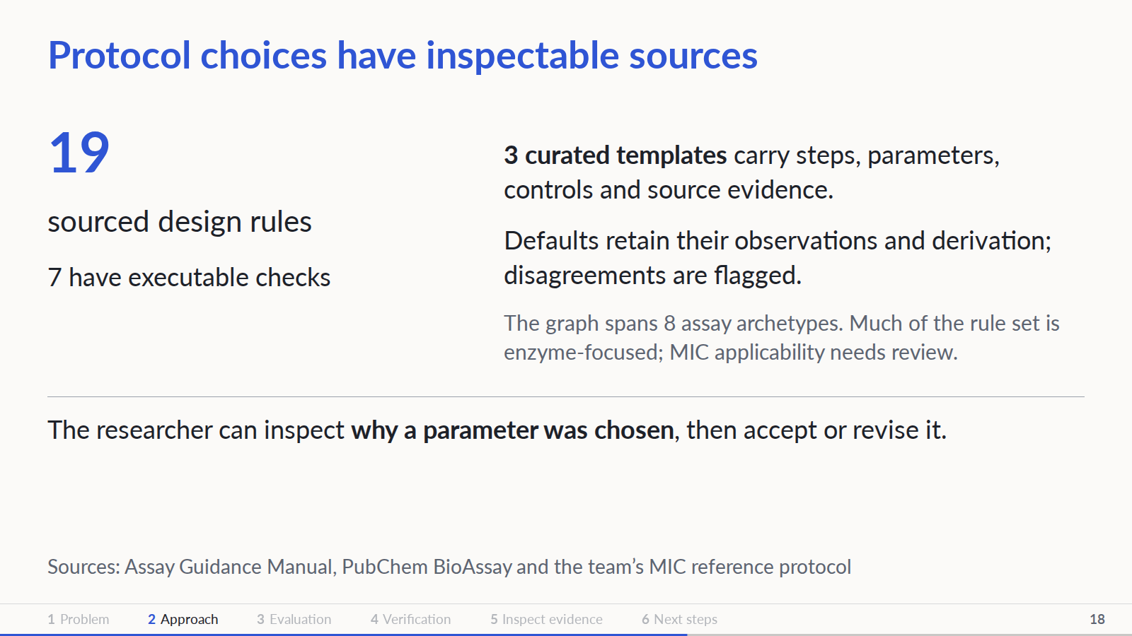
Notes:
Repository audit: main 30886d3 (2026-11-08). kg/protocols/rules.yaml, templates/*.json, defaults.py and build_db.py. Curated content has not received full human review. extract.py is tested with a stubbed client, not evidence of completed bulk LLM extraction. Keep routing mechanics high-level; show source-linked values when challenged.
PowerPoint: click to reveal successive captured states; smooth HTML motion is represented by discrete reveals. Demo: https://zhang-etal-biohack.pages.dev/talks/biohack/graph/

Slide 19
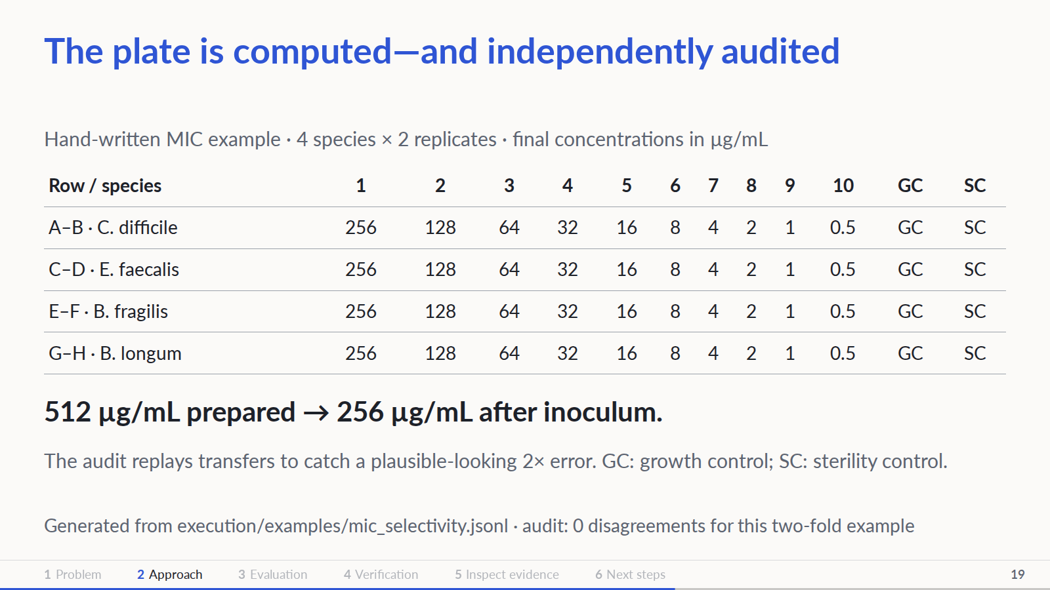
Notes:
Repository audit: main 30886d3 (2026-11-08). execution/plate.py: plate_design and audit use separate arithmetic. The example is hand-written, not agent-generated. Internal historical field names say uM, but design.unit supplies ug/mL. Non-two-fold transfers are not implemented correctly; an audit warning is not yet a hard stop. Species/media compatibility still needs expert review.
PowerPoint: click to reveal successive captured states; smooth HTML motion is represented by discrete reveals. Demo: https://zhang-etal-biohack.pages.dev/talks/biohack/graph/

Slide 20
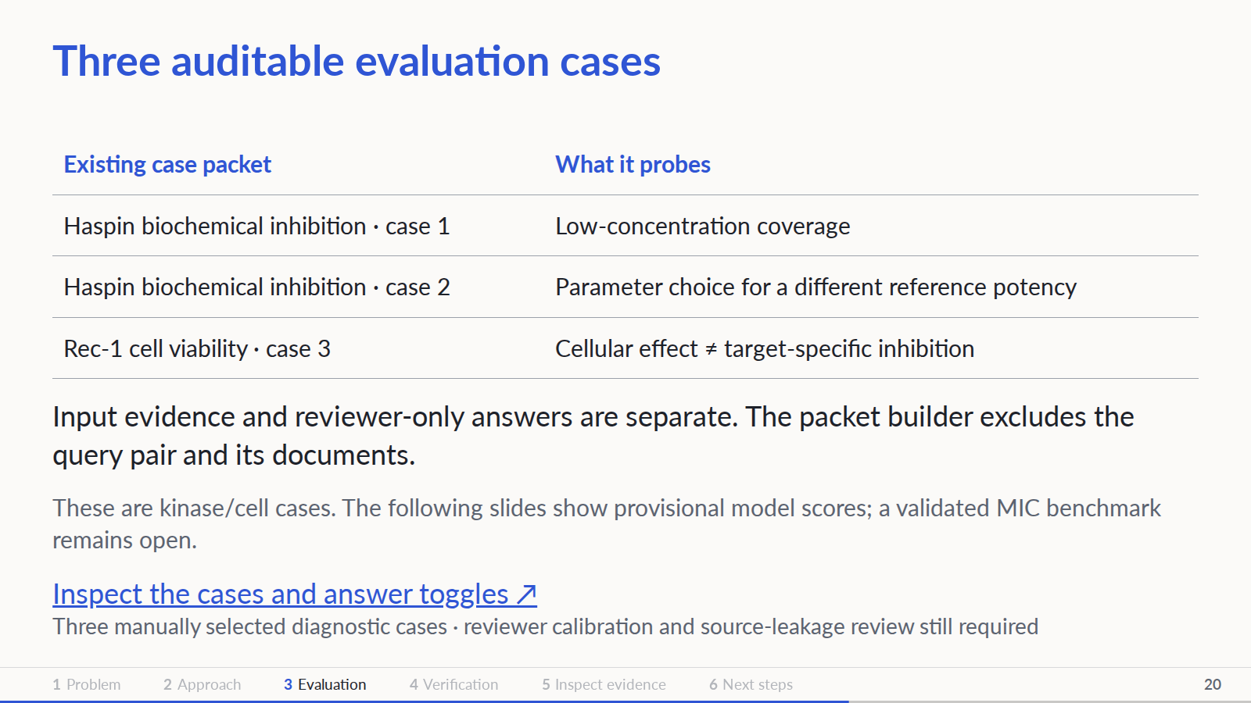
Notes:
Repository audit: main 30886d3 (2026-11-08). slides/talks/biohack/graph/BENCHMARK.md and slides/tools/prep_benchmark_cases.py. Cases are not independent samples for a generalization claim. Runtime graph masking is not wired into the agent. Structured step output extends the current agent contract. Completed fixed-packet pilot: DeepSeek V4.1 Flash 1017, Kimi K3.1 Pro, GLM 5.3 (not Flash), Nemotron 3 Super, and GPT-OSS-120B. The following slides show provisional Astra-medium grades; this is not an agent retrieval comparison.
PowerPoint: click to reveal successive captured states; smooth HTML motion is represented by discrete reveals. Demo: https://zhang-etal-biohack.pages.dev/talks/biohack/graph/

Slide 21
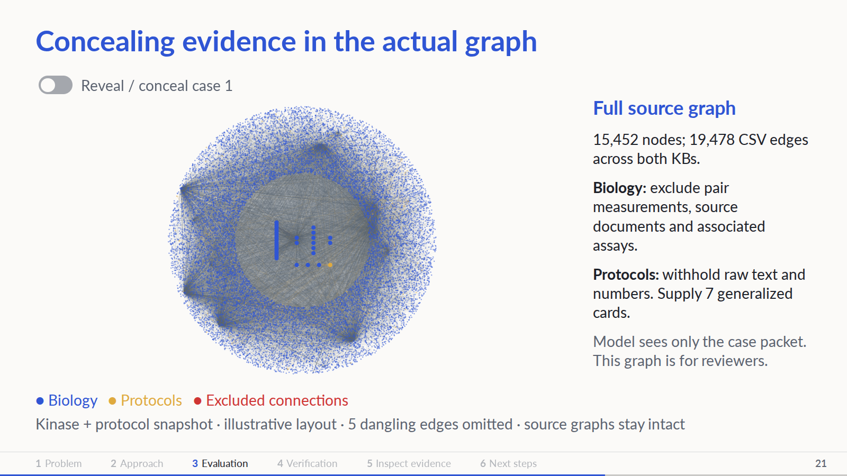



Notes:
Actual combined kinase biology and protocol CSV snapshot, not the bacterial MIC graph. Coordinates are an illustrative layout with case-1 endpoints grouped centrally. All 15452 nodes and 19473 edges with existing endpoints are drawn; five dangling CSV edges are counted but cannot be drawn. Case-1 source hashes match the case audit. Highlighted 24 edges are precisely the packet builder exclusion predicate. Two documents and six assays are omitted from context, not deleted from the shared KG. The model only receives its isolated JSON packet. Raw protocol nodes remain in the source graph; raw text, exact defaults and quotes are withheld and replaced by seven manually generalized cards. Cross-source leakage review remains incomplete. Source and exclusions downloadable in data/kb_story.json.
PowerPoint: click to reveal successive captured states; smooth HTML motion is represented by discrete reveals. Demo: https://zhang-etal-biohack.pages.dev/talks/biohack/graph/

Slide 22



Notes:
The evaluated model sees only the input packet and returns assay/system/readout, ordered step-card instructions, numeric parameters or null, controls, rationale, citations and limitations. Isolated Astra-medium agents review final outputs against the frozen rubric after generation; answers are not included in model requests. Each axis is 0–2 per case. Twenty cases × three axes × two points = 120 possible points/model; plots show means out of 6. Scores are provisional and blinded to model identity. Four synthetic rubric anchors passed; expert validation remains pending. Hidden IC50 values are excluded from judge packets. Numerical coverage against held-out IC50 is an offline diagnostic, conditional on assay comparability, not proof of protocol validity. Missing values and unsupported claims remain explicit; no post-generation repair was scored.
PowerPoint: click to reveal successive captured states; smooth HTML motion is represented by discrete reveals. Demo: https://zhang-etal-biohack.pages.dev/talks/biohack/graph/

Slide 23

Notes:
20 purposively selected cases: 15 biochemical, 5 cellular; six models, one response per case. 85 new completions plus 15 reused outputs with identical inputs/settings. Original 100 freshly reviewed by isolated Astra-medium judges blinded to model identity under a frozen rubric. Four synthetic anchor checks do not establish expert calibration. Each axis 0–2, mean total 0–6. No measured retrieval lift, statistical superiority, MIC or wet-lab validation. Critical failures are reported separately. Source: benchmark/judge/RESULTS.md at c1a0e32. Generation used temperature 0 and low reasoning; judging used medium reasoning. Astra adds 20 proposals and 20 fresh blinded reviews, scoring 4.10/6 with zero critical-failure flags. Its medium generation reasoning and Codex transport differ from prior candidates. Same-model judge preference is possible. Source: benchmark/runs/astra-medium-20/RESULTS.md at aff33ef.
PowerPoint: click to reveal successive captured states; smooth HTML motion is represented by discrete reveals. Demo: https://zhang-etal-biohack.pages.dev/talks/biohack/graph/

Slide 24

Notes:
20 purposively selected cases: 15 biochemical, 5 cellular; six models, one response per case. 85 new completions plus 15 reused outputs with identical inputs/settings. Original 100 freshly reviewed by isolated Astra-medium judges blinded to model identity under a frozen rubric. Four synthetic anchor checks do not establish expert calibration. Each axis 0–2, mean total 0–6. No measured retrieval lift, statistical superiority, MIC or wet-lab validation. Critical failures are reported separately. Source: benchmark/judge/RESULTS.md at c1a0e32. Generation used temperature 0 and low reasoning; judging used medium reasoning. Astra adds 20 proposals and 20 fresh blinded reviews, scoring 4.10/6 with zero critical-failure flags. Its medium generation reasoning and Codex transport differ from prior candidates. Same-model judge preference is possible. Source: benchmark/runs/astra-medium-20/RESULTS.md at aff33ef.
PowerPoint: click to reveal successive captured states; smooth HTML motion is represented by discrete reveals. Demo: https://zhang-etal-biohack.pages.dev/talks/biohack/graph/

Slide 25

Notes:
20 purposively selected cases: 15 biochemical, 5 cellular; six models, one response per case. 85 new completions plus 15 reused outputs with identical inputs/settings. Original 100 freshly reviewed by isolated Astra-medium judges blinded to model identity under a frozen rubric. Four synthetic anchor checks do not establish expert calibration. Each axis 0–2, mean total 0–6. No measured retrieval lift, statistical superiority, MIC or wet-lab validation. Critical failures are reported separately. Source: benchmark/judge/RESULTS.md at c1a0e32. Generation used temperature 0 and low reasoning; judging used medium reasoning. Astra adds 20 proposals and 20 fresh blinded reviews, scoring 4.10/6 with zero critical-failure flags. Its medium generation reasoning and Codex transport differ from prior candidates. Same-model judge preference is possible. Source: benchmark/runs/astra-medium-20/RESULTS.md at aff33ef. New generation: 310831 receipted tokens, estimated $0.674688 plus $0.305636 allowance for three uncertain attempts. Astra token and billing receipts unavailable. Critical failure counts are cases with at least one judge flag, not validated failure rates.
PowerPoint: click to reveal successive captured states; smooth HTML motion is represented by discrete reveals. Demo: https://zhang-etal-biohack.pages.dev/talks/biohack/graph/

Slide 26

Notes:
Repository audit: main 30886d3 (2026-11-08). Reproduced 2026-11-08. pytest: 340 passed, 3 skipped, with no LLM calls. Separate execution.generate --simulate run used the committed hand-written example, opentrons==8.8.2 and numpy<2. Simulation validates executable robot operations, not biological efficacy. Exact input and warnings are downloadable under evidence/.
PowerPoint: click to reveal successive captured states; smooth HTML motion is represented by discrete reveals. Demo: https://zhang-etal-biohack.pages.dev/talks/biohack/graph/

Slide 27

Notes:
Repository audit: main 30886d3 (2026-11-08). Audit of agent/README.md, kg/biology/README.md, execution/README.md, benchmark/README.md and graph/BENCHMARK.md at main 30886d3. Unknown oxygen tolerance currently passes optimistically. The earlier animated trace includes mock execution/validation and is deliberately not the central proof in this deck.
PowerPoint: click to reveal successive captured states; smooth HTML motion is represented by discrete reveals. Demo: https://zhang-etal-biohack.pages.dev/talks/biohack/graph/

Slide 28

Notes:
Open the graph viewer and inspect a measurement, its source and the case input/review split. This is a view of committed data and diagnostic cases, not a live agent or a benchmark result. The viewer has its own dataset controls.
PowerPoint: click to reveal successive captured states; smooth HTML motion is represented by discrete reveals. Demo: https://zhang-etal-biohack.pages.dev/talks/biohack/graph/

Slide 29

Notes:
Repository audit: main 30886d3 (2026-11-08). Proposed next experiments, not completed results. Keep architecture high-level; foreground the auditable artifacts and measured checks. Industry alternatives already provide experimental design and automation; superiority of this combination remains to be tested.
PowerPoint: click to reveal successive captured states; smooth HTML motion is represented by discrete reveals. Demo: https://zhang-etal-biohack.pages.dev/talks/biohack/graph/

